Slide 1


Winning Space Race
with Data Science
Falcon 9 booster landing analysis | IBM Data Science Capstone

Slide 2

Outline
Executive summary and research question
Methods: collection, wrangling, SQL, EDA, mapping and dashboards
Results from exploratory analysis and classification
Conclusions, limitations and project files
IBM Data Science Capstone | Falcon 9 historical course data | 2026
2

Slide 3
Executive Summary
I analyzed 90 historical Falcon 9 launches using IBM course data (2010–2020).
The overall recorded booster landing success rate is 66.7% (60/90).
I cleaned the records, explored locations, payloads and orbits, and used four classification models.
Logistic regression, SVM and KNN each reached 83.3% accuracy on the same test set.
IBM Data Science Capstone | Falcon 9 historical course data | 2026
3

Slide 4
Introduction
SpaceX develops reusable rocket boosters. This project looks at the first-stage landing outcome rather than mission success.
Question: Can historical launch information help explain and predict whether a booster lands successfully?
I compare flight order, payload mass, launch site, orbit and booster features.
IBM Data Science Capstone | Falcon 9 historical course data | 2026
4

Slide 5

Methodology
Section 1

Slide 6
Methodology at a Glance
Data: IBM SpaceX API snapshot and Wikipedia scraping exercise.
Cleaning: missing values, outcome labels and one-hot categorical encoding.
Analysis: pandas, SQL, seaborn/matplotlib, Folium and Plotly Dash.
Prediction: train/test split, scaling, grid search with 10-fold CV, test accuracy.
IBM Data Science Capstone | Falcon 9 historical course data | 2026
6

Slide 7
Data Collection
SpaceX API archive → JSON records → pandas DataFrame.
Wikipedia HTML → BeautifulSoup → launch tables.
The API server returned HTTP 525 during execution; the archived IBM JSON/CSV was used to continue.
I kept the data-source distinction in the report.
IBM Data Science Capstone | Falcon 9 historical course data | 2026
7

Slide 8
SpaceX API Data Collection
1. Load historical launch JSON from IBM course mirror.
2. Normalize the nested JSON into a DataFrame.
3. Identify Falcon 9 launches and launch attributes.
4. Keep 90 launches for the later exercises.
Notebook and executed outputs: see the linked GitHub project.
https://github.com/DanielEspinosaLuengo/IBM-Data-Science-Professional-Certificate/tree/main/10-Applied-Data-Science-Capstone
Notebook/source: jupyter-labs-spacex-data-collection-api-v2.ipynb
IBM Data Science Capstone | Falcon 9 historical course data | 2026
8

Slide 9
Wikipedia Web Scraping
1. Download the Falcon 9 launch-history HTML.
2. Parse launch tables with BeautifulSoup.
3. Extract dates, booster versions, payloads, launch sites and outcomes.
4. Handle missing hyperlinks by extracting cell text.
The scraping exercise uses a separate historical table from the API snapshot.
https://github.com/DanielEspinosaLuengo/IBM-Data-Science-Professional-Certificate/tree/main/10-Applied-Data-Science-Capstone
Notebook/source: jupyter-labs-webscraping.ipynb
IBM Data Science Capstone | Falcon 9 historical course data | 2026
9

Slide 10
Data Wrangling
The final modeling table contains 90 observations.
Map landing outcomes to binary Class: 1 = successful landing; 0 = other outcome.
Fill missing payload mass where required; inspect missing landing-pad values.
One-hot encode orbit, launch site, landing pad and booster serial.
The resulting feature table has 80 columns.
https://github.com/DanielEspinosaLuengo/IBM-Data-Science-Professional-Certificate/tree/main/10-Applied-Data-Science-Capstone
Notebook/source: labs-jupyter-spacex-Data wrangling-v2.ipynb
IBM Data Science Capstone | Falcon 9 historical course data | 2026
10

Slide 11
EDA with Visualization
Scatterplots compare flight number and payload mass across launch sites and orbits.
A bar chart summarizes success rate by orbit.
A line chart shows the yearly landing-success pattern.
I use color to distinguish successful and unsuccessful booster landings.
https://github.com/DanielEspinosaLuengo/IBM-Data-Science-Professional-Certificate/tree/main/10-Applied-Data-Science-Capstone
Notebook/source: jupyter-labs-eda-dataviz-v2.ipynb
IBM Data Science Capstone | Falcon 9 historical course data | 2026
11

Slide 12
EDA with SQL
Queries used SELECT DISTINCT, WHERE, LIKE, GROUP BY, COUNT, SUM, AVG, MIN/MAX and date conditions.
Questions included unique launch sites, NASA payload mass, early landing dates and outcome counts.
The exercise database is a separate launch-history table and is not identical to the 90-row API sample.
https://github.com/DanielEspinosaLuengo/IBM-Data-Science-Professional-Certificate/tree/main/10-Applied-Data-Science-Capstone
Notebook/source: jupyter-labs-eda-sql-coursera_sqllite.ipynb
IBM Data Science Capstone | Falcon 9 historical course data | 2026
12

Slide 13
Interactive Map with Folium
Site markers show launch-site positions and landing outcomes.
Color-coded markers make success and failure easier to compare.
Circles, lines and proximity checks help explore geographic context.
The HTML map is saved as a separate project artifact.
https://github.com/DanielEspinosaLuengo/IBM-Data-Science-Professional-Certificate/tree/main/10-Applied-Data-Science-Capstone
Notebook/source: lab-jupyter-launch-site-location-v2.ipynb
IBM Data Science Capstone | Falcon 9 historical course data | 2026
13

Slide 14
Plotly Dash Dashboard
Dropdown: All Sites or a selected launch site.
Pie chart: share of successful landings by site or outcome split at one site.
Payload slider filters the mass range shown in the scatterplot.
Point colors show booster version categories.
The screenshots included later were captured from the running app.
https://github.com/DanielEspinosaLuengo/IBM-Data-Science-Professional-Certificate/tree/main/10-Applied-Data-Science-Capstone
Notebook/source: spacex_dash_app.py
IBM Data Science Capstone | Falcon 9 historical course data | 2026
14

Slide 15
Predictive Analysis
80 input features and binary outcome target.
Standardize predictors, split into train and test sets.
Tune logistic regression, SVM, KNN and decision tree using GridSearchCV.
Compare all models on the same held-out test records.
Accuracy reflects this historical course sample, not future rocket performance.
https://github.com/DanielEspinosaLuengo/IBM-Data-Science-Professional-Certificate/tree/main/10-Applied-Data-Science-Capstone
Notebook/source: SpaceX-Machine-Learning-Prediction-Part-5-v1.ipynb
IBM Data Science Capstone | Falcon 9 historical course data | 2026
15

Slide 16
Results — Overview
90 Falcon 9 launches, 60 recorded successful booster landings.
Success varies across launch sites and orbit categories.
Yearly success becomes more frequent in later years, with fluctuations.
Three classification models tied at 83.3% test accuracy.
IBM Data Science Capstone | Falcon 9 historical course data | 2026
16

Slide 17

Exploratory Analysis
Section 2

Slide 18
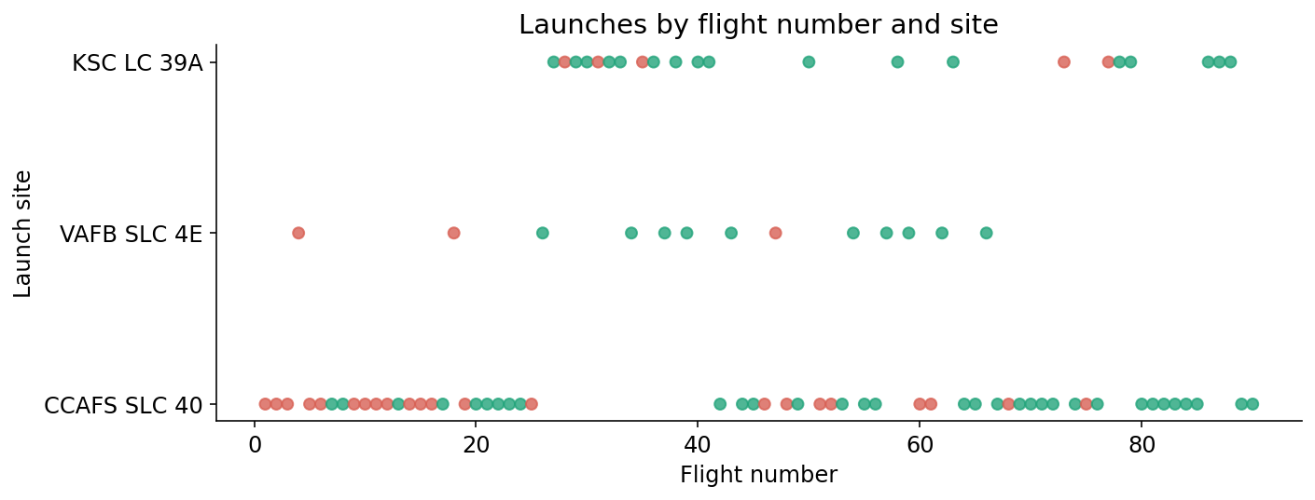
Flight Number vs. Launch Site
Green = successful landing; red = other outcomes.
IBM Data Science Capstone | Falcon 9 historical course data | 2026
18

Slide 19
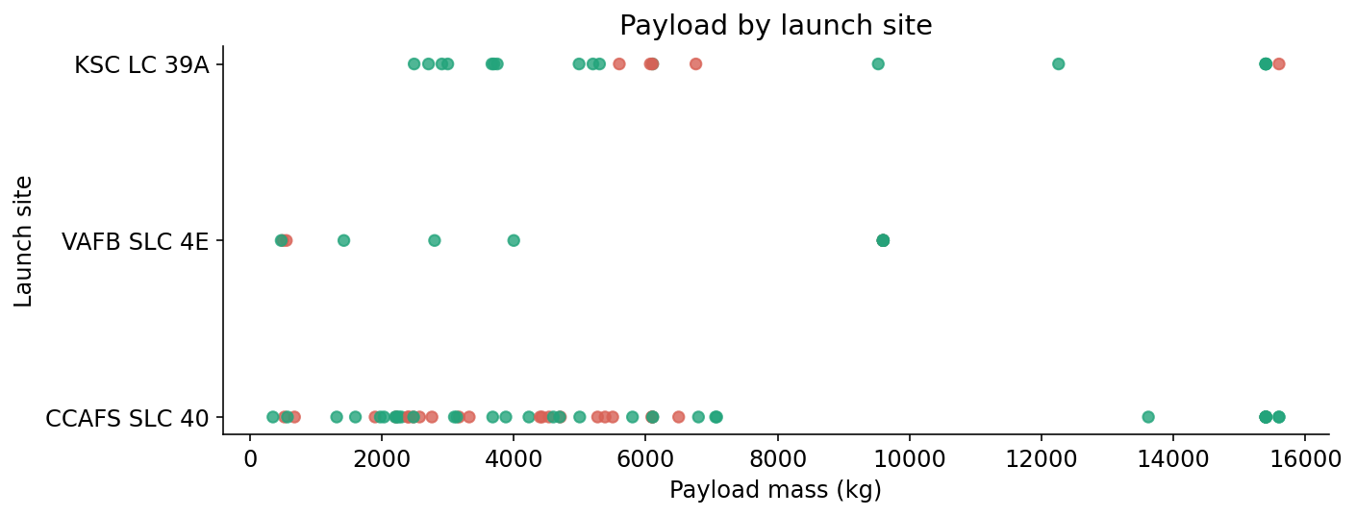
Payload vs. Launch Site
Payload distributions vary across the three sites.
IBM Data Science Capstone | Falcon 9 historical course data | 2026
19

Slide 20
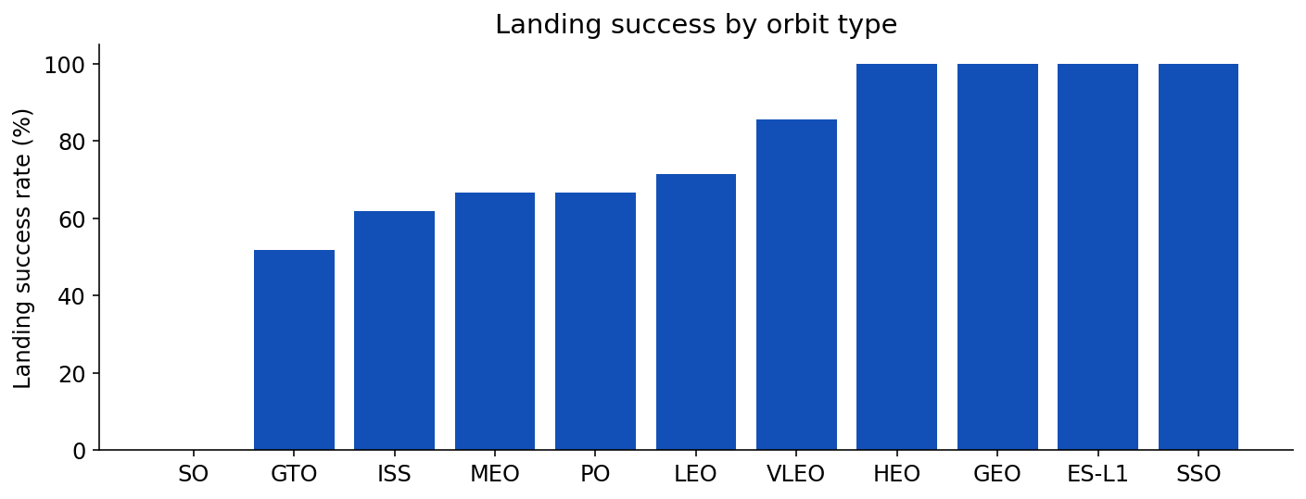
Landing Success by Orbit
Small orbit categories should be interpreted carefully.
IBM Data Science Capstone | Falcon 9 historical course data | 2026
20

Slide 21
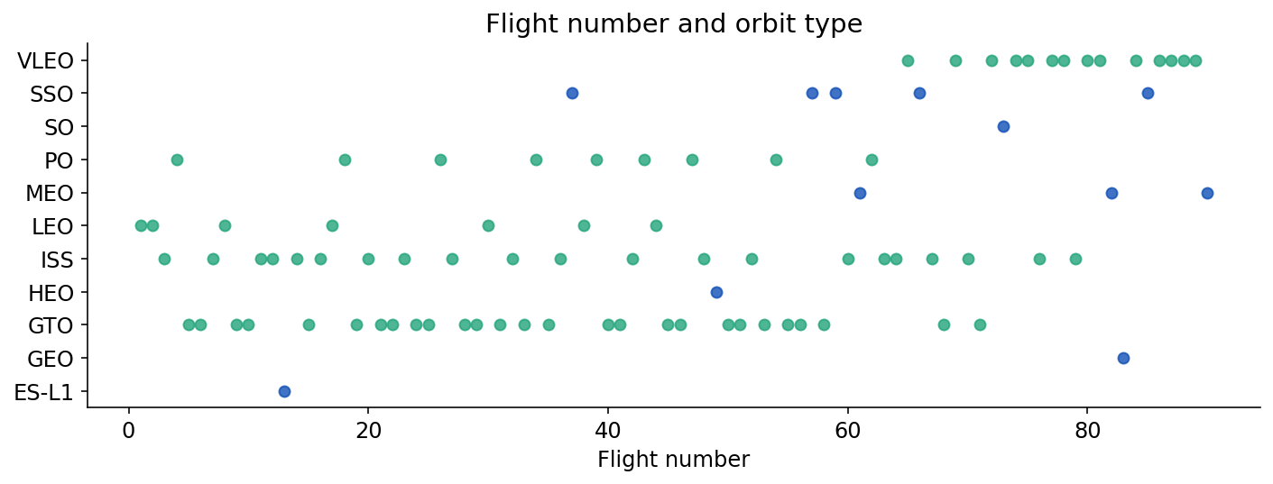
Flight Number vs. Orbit
Launches are grouped by orbit type and flight order.
IBM Data Science Capstone | Falcon 9 historical course data | 2026
21

Slide 22
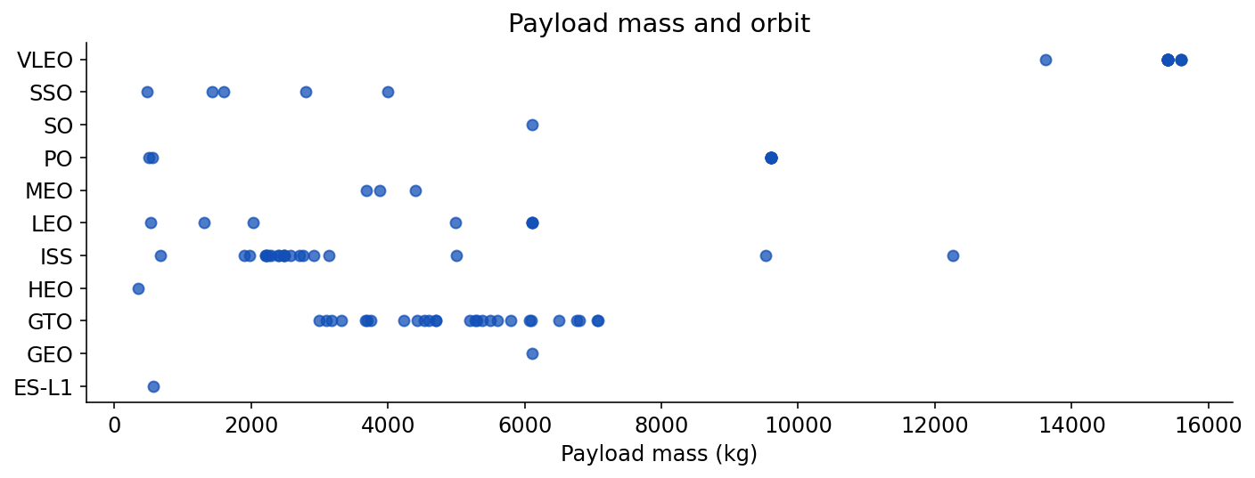
Payload vs. Orbit
Payload masses differ by orbit category.
IBM Data Science Capstone | Falcon 9 historical course data | 2026
22

Slide 23
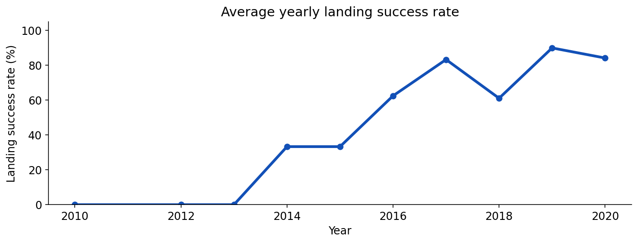
Yearly Success Trend
Rates tend to improve but are not monotonic.
IBM Data Science Capstone | Falcon 9 historical course data | 2026
23

Slide 24
Unique Launch Sites
SQL: SELECT DISTINCT Launch_Site FROM SPACEXTBL;
The historical SQL table contains CCAFS LC-40, CCAFS SLC-40, KSC LC-39A and VAFB SLC-4E naming variants.
The cleaned API sample consolidates the main launch sites into three groups.
Query result — distinct launch sites
CCAFS LC-40 · CCAFS SLC-40 · KSC LC-39A · VAFB SLC-4E
The two CCAFS names are kept separate because they are distinct strings in this historical table.
IBM Data Science Capstone | Falcon 9 historical course data | 2026
24

Slide 25
Launch Sites Beginning with CCA
SQL: SELECT * FROM SPACEXTBL WHERE Launch_Site LIKE "CCA%" LIMIT 5;
This filters launches from Cape Canaveral using a prefix match.
The LIMIT clause displays five example records rather than the full set.
Query result — first five matching rows
2010-06-04 | CCAFS LC-40 | F9 v1.0 B0003
2010-12-08 | CCAFS LC-40 | F9 v1.0 B0004
2012-05-22 | CCAFS LC-40 | F9 v1.0 B0005
2012-10-08 | CCAFS LC-40 | F9 v1.0 B0006
2013-03-01 | CCAFS LC-40 | F9 v1.0 B0007
IBM Data Science Capstone | Falcon 9 historical course data | 2026
25

Slide 26
NASA Payload Mass
SQL: SELECT SUM(PAYLOAD_MASS__KG_) FROM SPACEXTBL WHERE Customer LIKE "%NASA%";
The sum answers how much payload mass NASA-associated missions carried in the SQL table.
Note: the database includes rows not identical to the 90-row modeling sample.
Query result — SUM(payload mass)
107,010 kg of payload mass across rows whose Customer field contains “NASA”.
Source: saved SQLite table SPACEXTBL (historical IBM course dataset).
IBM Data Science Capstone | Falcon 9 historical course data | 2026
26

Slide 27
Average Mass — F9 v1.1
SQL: SELECT AVG(PAYLOAD_MASS__KG_) FROM SPACEXTBL WHERE Booster_Version LIKE "F9 v1.1%";
This estimates typical payload mass for the early Falcon 9 v1.1 booster version.
Query result — AVG(payload mass)
2,534.67 kg average payload for booster descriptions beginning with “F9 v1.1”.
IBM Data Science Capstone | Falcon 9 historical course data | 2026
27

Slide 28
First Successful Ground Landing
SQL filters Landing_Outcome = "Success (ground pad)" and returns MIN(Date).
First successful Falcon 9 booster landing on solid ground: 2015-12-22 (UTC date in this course table).
Query result — MIN(Date)
2015-12-22 — earliest “Success (ground pad)” recorded in the SQL table.
IBM Data Science Capstone | Falcon 9 historical course data | 2026
28

Slide 29
Successful Drone-Ship Landings
SQL filters Landing_Outcome = "Success (drone ship)" and payload mass BETWEEN 4000 AND 6000 kg.
This demonstrates filtering by both numeric payload interval and landing outcome.
Query result — four qualifying launches
JCSAT-14 (4,696 kg) · JCSAT-16 (4,600 kg)
SES-10 (5,300 kg) · SES-11 / EchoStar 105 (5,200 kg)
IBM Data Science Capstone | Falcon 9 historical course data | 2026
29

Slide 30
Mission Success and Failure Counts
SQL uses TRIM(Mission_Outcome), GROUP BY and COUNT(*).
Mission outcome refers to carrying out the flight mission; it is not the same variable as first-stage booster landing success.
The course SQL data contains extra outcome variants.
Query result — normalized mission outcomes
Success: 99 · Failure (in flight): 1 · Success (payload status unclear): 1
A trailing space in one “Success ” entry was removed for grouping.
IBM Data Science Capstone | Falcon 9 historical course data | 2026
30

Slide 31
Maximum Payload Mass
SQL selects MAX(PAYLOAD_MASS__KG_) and the booster versions with this value.
This highlights a record payload launch in the SQL dataset.
Maximum payload in the cleaned 90-launch API dataset: 15,600 kg.
Query result — maximum payload
15,600 kg (MAX(PAYLOAD_MASS__KG_)). This is the highest recorded payload in the SQL exercise table.
IBM Data Science Capstone | Falcon 9 historical course data | 2026
31

Slide 32
2015 Drone-Ship Landing Failures
SQL combines year filtering on Date with Landing_Outcome = "Failure (drone ship)".
The output provides booster version and launch site for the selected unsuccessful landing attempts.
Query result — 2015 drone-ship failures
F9 v1.1 B1012 — CCAFS LC-40
F9 v1.1 B1015 — CCAFS LC-40
IBM Data Science Capstone | Falcon 9 historical course data | 2026
32

Slide 33
Landing Outcomes over Time
SQL groups outcomes between 2010-06-04 and 2017-03-20 and orders counts from most to least frequent.
The output distinguishes ocean-controlled, ground-pad and drone-ship outcomes.
Query result — outcomes in selected date range
No attempt 10 · Success (drone ship) 5 · Failure (drone ship) 5
Success (ground pad) 3 · Controlled (ocean) 3 · Uncontrolled (ocean) 2
Failure (parachute) 2 · Precluded (drone ship) 1
IBM Data Science Capstone | Falcon 9 historical course data | 2026
33

Slide 34

Interactive Folium Maps
Section 3

Slide 35
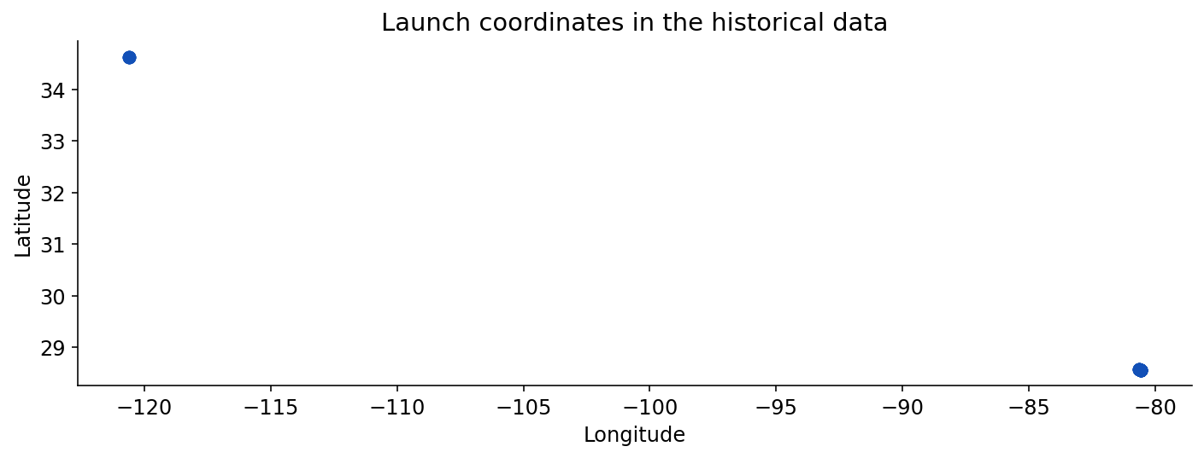
Launch Site Map
Historical coordinates; site markers overlap where many flights share one site.
IBM Data Science Capstone | Falcon 9 historical course data | 2026
35

Slide 36
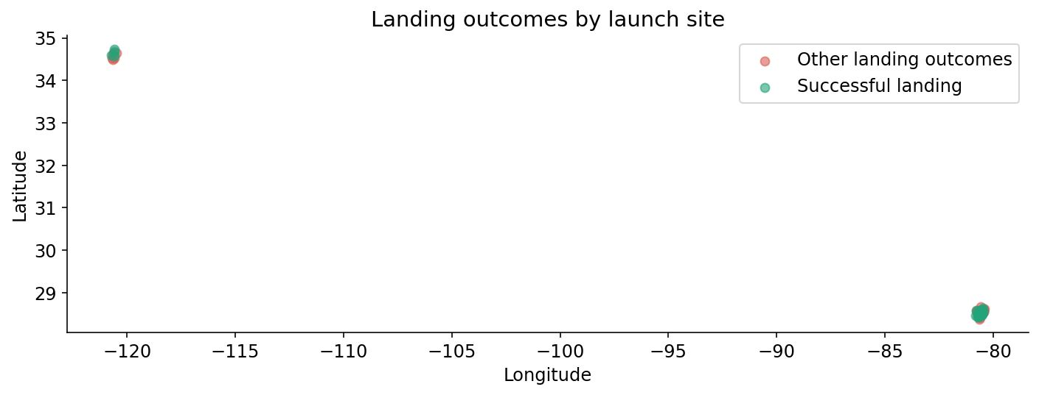
Launch Site Outcomes
Colors indicate landing class, with slight jitter to separate identical coordinates.
IBM Data Science Capstone | Falcon 9 historical course data | 2026
36

Slide 37
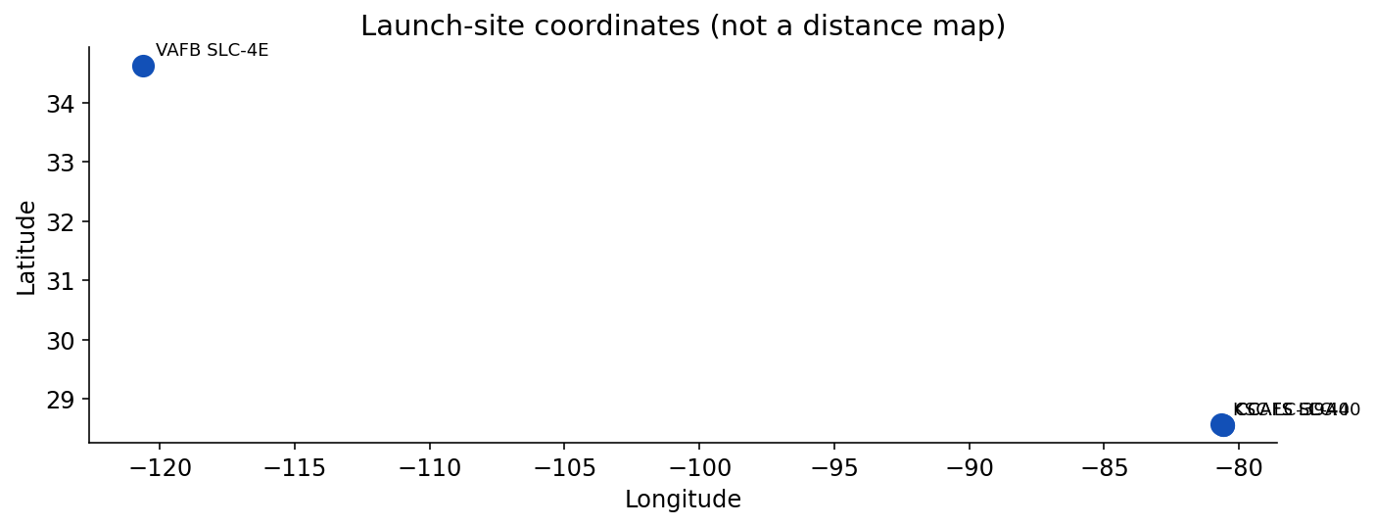
Launch-Site Geography
Proximity measurements to road, railway and coastline are not independently verified by the saved geospatial dataset. The map illustrates site locations only; no fabricated distance is reported.
IBM Data Science Capstone | Falcon 9 historical course data | 2026
37

Slide 38

Plotly Dash Dashboard
Section 4

Slide 39
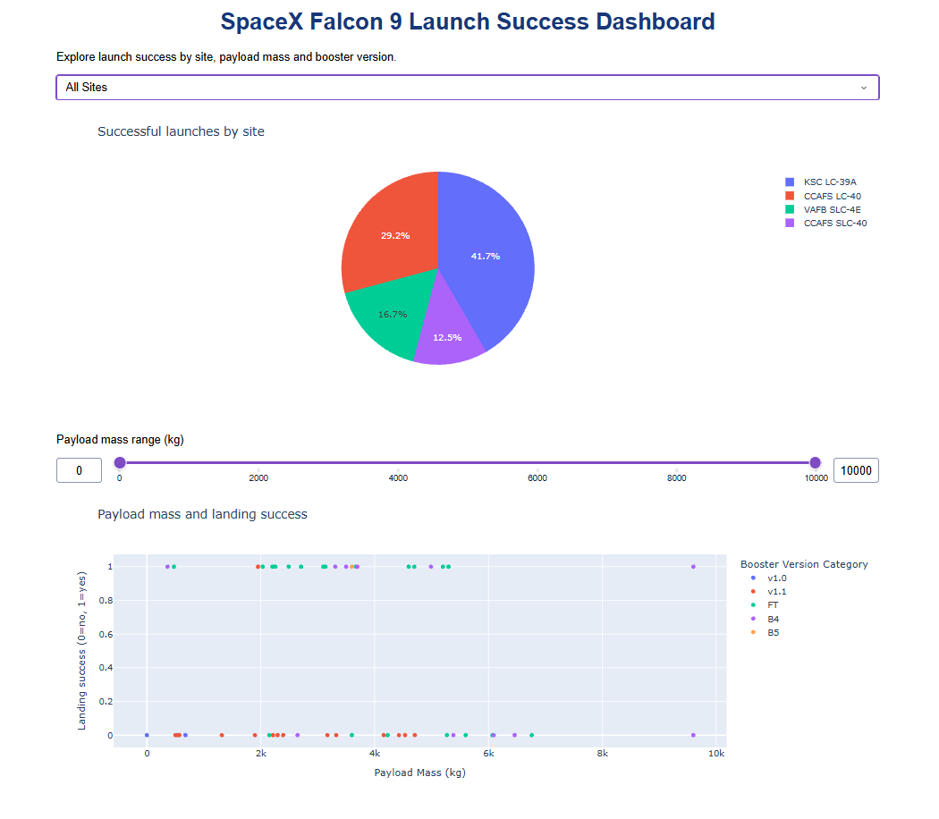
Dashboard — All Launch Sites
IBM Data Science Capstone | Falcon 9 historical course data | 2026
39

Slide 40
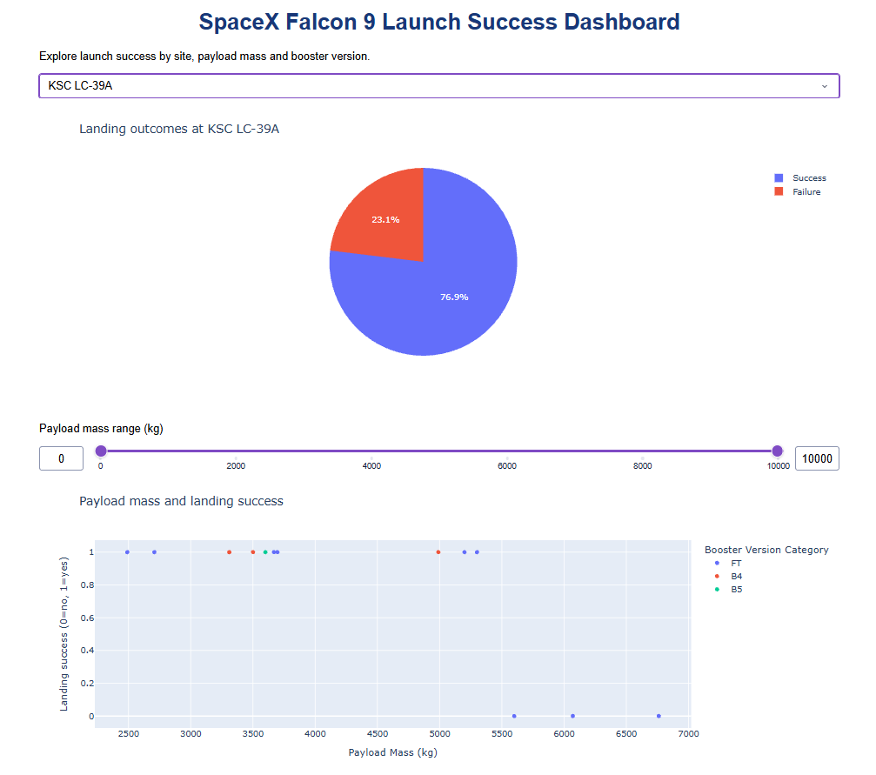
Dashboard — KSC LC-39A
IBM Data Science Capstone | Falcon 9 historical course data | 2026
40

Slide 41
Dashboard Interactions
Changing the launch-site dropdown updates the pie chart and scatterplot.
The payload slider filters the points shown by mass.
The two screenshots compare a general view with one selected site.
IBM Data Science Capstone | Falcon 9 historical course data | 2026
41

Slide 42

Predictive Analysis
Section 5

Slide 43

Classification Model Comparison
Three models tie on the same test split; decision tree performs worse.
IBM Data Science Capstone | Falcon 9 historical course data | 2026
43

Slide 44
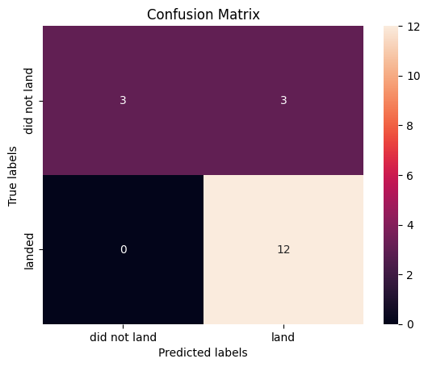
Confusion Matrix — Interpretation
Logistic regression confusion matrix from the executed notebook. 12 true positives; 3 false positives. Test accuracy: 83.3%.
IBM Data Science Capstone | Falcon 9 historical course data | 2026
44

Slide 45
Conclusions
Landing success became more common in the later years of this historical dataset.
The landing rate differs by orbit and site; smaller categories can give unstable percentages.
Logistic regression, SVM and KNN tied at 83.3% accuracy on the test split.
These patterns are associations, not proof that payload or launch site causes success.
More recent launches and external validation would improve confidence.
IBM Data Science Capstone | Falcon 9 historical course data | 2026
45

Slide 46
Appendix — Reproducibility
Source notebooks: API, web scraping, data wrangling, SQL, visual EDA, Folium and ML.
Saved files: dataset_part_1.csv, dataset_part_2.csv, dataset_part_3.csv, SQLite database and Folium HTML.
Plotly Dash Python application and two saved browser screenshots.
All course artifacts are linked from the GitHub folder.
Dataset note: SQL exercise table contains 101 rows; modeling dataset contains 90 rows. These are different course snapshots and should not be directly equated.
IBM Data Science Capstone | Falcon 9 historical course data | 2026
46

Slide 47
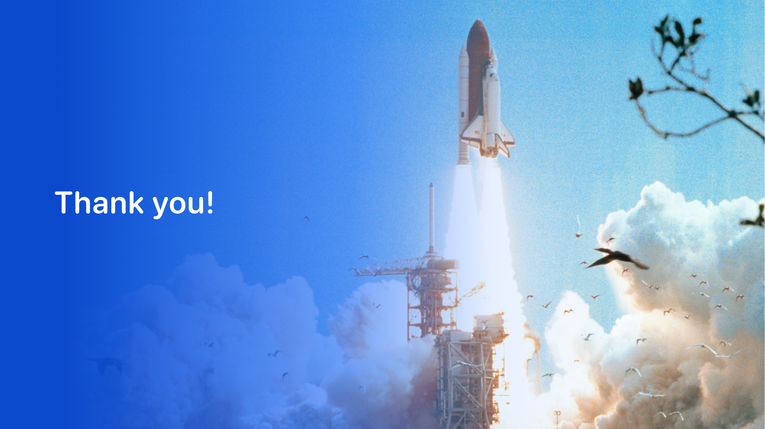
References and Limitations
GitHub: github.com/DanielEspinosaLuengo/IBM-Data-Science-Professional-Certificate/tree/main/10-Applied-Data-Science-Capstone
This is a historical IBM course dataset, not a live SpaceX flight database.
The API endpoint was unavailable (HTTP 525); the IBM archived snapshot was used.
Differences in site naming and source populations were not silently merged.
Model comparisons are descriptive for a small held-out sample.
IBM Data Science Capstone | Falcon 9 historical course data | 2026
47

