Slide 1
Combient Challenge
Daniel F. Perez Ramirez
Stuttgart, April 5th 2019

Slide 2
Problem Description
Santander Customer Satisfaction: predict if a customer is satisfied with the bank or not
Imbalanced Data
Binary Classification
76020 data samples
0
Satisfied customer
1
Unsatisfied customer
369 features

Slide 3
Approach
Describe Problem
Analyze Dataset
Research further strategies on imbalanced data
Decide model for hyperparam search
- Remarks on imbalanced data
- Formulate and try out hypothesis with different models
“00_Explore_data.ipynb”
“01_test_pipeline.ipynb”
Insights on the features of the dataset
“00_Explore_data.ipynb”
Settle on model, preprocessing- and training strategies
“01_test_pipeline.ipynb”
Phase
Next Slide
“main_model.ipynb”
Build/train/evaluate model
Phase Deliverables
To Phase Description
Process flow
Notes:
Analyze Dataset:
34 single-valued features
Several 0-valued features per sample
Classify features according to their respective value_counts
Several features with values-outliers
Research further strategies on imbalanced data
From experience, normalization and an ensemble method best suitable, perhaps PCA
PCA
Best normalization for PCA and imbalanced datasets
MinMax/Mean-normalization
Decide model for hyperparam search
Ensemble method chosen, also tried out SVM
Decide between
Random forest
Xgboostclassifier
Adaboost
RF chosen as it delivered good empirical performance and

Slide 4
Model
Load &
pre-process data
Stratified
Load and pre-clean data
Choose specific features
Normalization
PCA
Train-Test-Split
Remove 0-val features
Replace unrealistic values
filter_case
norm_case
pca_dim
Oversampling
SMOTE
List of strings of cases for extracting specific columns grouped by their value_counts
List of strings of cases for normalization: mean-normalization and Min-Max-normalization
Number of principal components applied
Train & Evaluate
AUC ROC
Evaluate on Test
Cross-Validation on Train
Save best RF on AUC test set
Random Forest Classifier
n_estimators
Step/submodule
Update best model
Variance element
max_depth
High-level subprocess
Process flow
Stratified

Slide 5
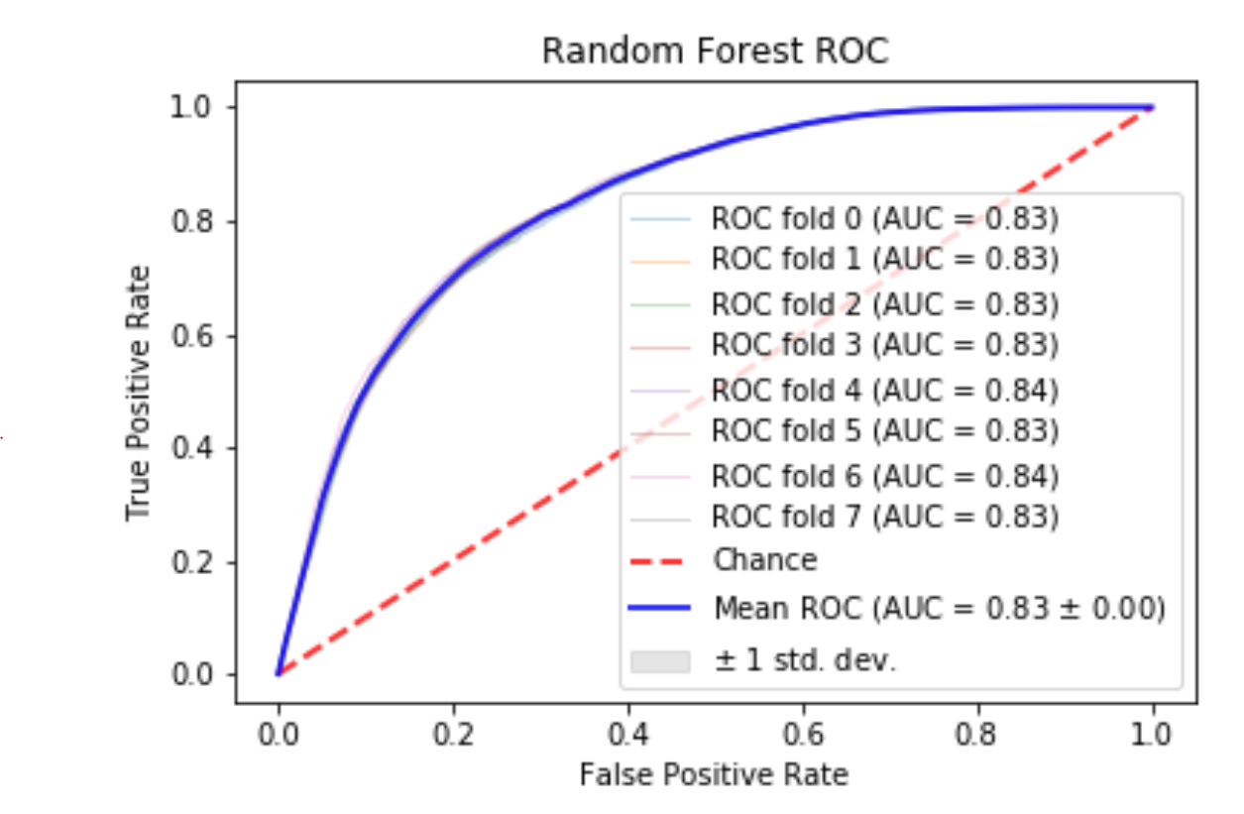
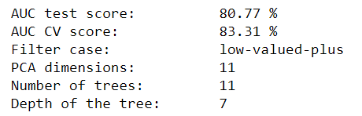
Results
Cross-Validation Results Best Performing model
108 cases evaluated
3 filter cases
2 norm cases
3 different PCA dimensions
2 n_estimators alternatives
3 max_depth alternatives
Best performing RF model

Slide 6
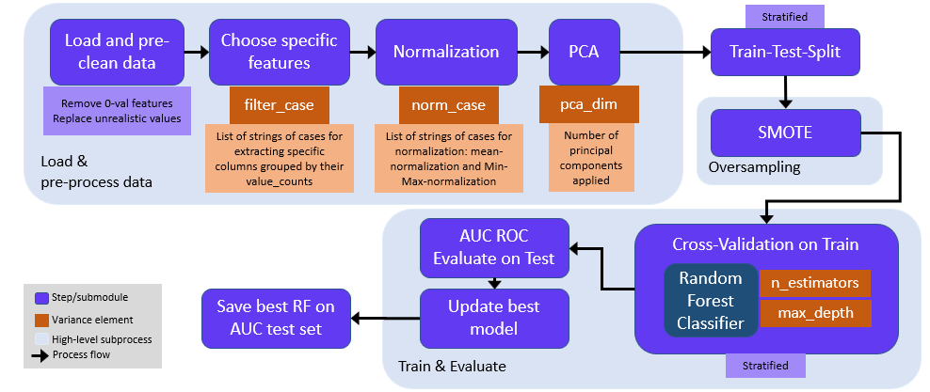
Further Steps
Deeper feature engineering
Try different ensemble methods or classifiers
Replace the classifier
Try other oversampling methods, possible combined with under-sampling of majority class
Perform wider parameter search in PCA and model parameters

Slide 7
Q&A
Daniel F. Perez-Ramirez
daniel.perez@tum.de
+4917657832515

