Slide 1

Answering consumer health questions with non-expert language
SPRINT 2
PREPARAÇÃO PARA DISSERTAÇÃO/ESTÁGIO
2024/2025
Daniel Ferreira, 102885

Slide 2
Overview
The following outlines the key participants involved in this project.
Student | Daniel Jorge Bernardo Ferreira
Supervisor | Sérgio Matos
Co-supervisor | Tiago Almeida
Summary | With the appearance of chatbot applications, searches and conversations regarding health issues can be expected to increase, which raises the challenges on how to reply with verified and reliable information. The objective of this work is to develop and evaluate a method for retrieval and summarization of scientific articles that contain answers to consumer health questions.
For more info: Portfolio
Notes:
O meu projeto está a ser desenvolvido sob a orientação do professor Sérgio Matos e coorientação do doutorando Tiago Almeida.
Nos dias de hoje, com o aumento do uso de assistentes virtuais e chatbots, mais pessoas procuram respostas rápidas para as suas questões de saúde na internet. No entanto, muitos enfrentam dificuldades ao tentar interpretar a linguagem técnica dos artigos científicos.
O desafio que surge é fornecer respostas que, além de corretas e baseadas em evidências científicas, sejam compreensíveis por qualquer pessoa, independentemente do seu conhecimento prévio.
Este é o contexto em que o meu trabalho se insere: como fornecer informação acessível e ao mesmo tempo fiável para perguntas de saúde do público geral.

Slide 3
Conceptual Architecture
Input
Core model
Output processing
User query
Style control
Answer generation
Expertise level
Language model
Knowledge base
Response adaptation
Final response

Slide 4
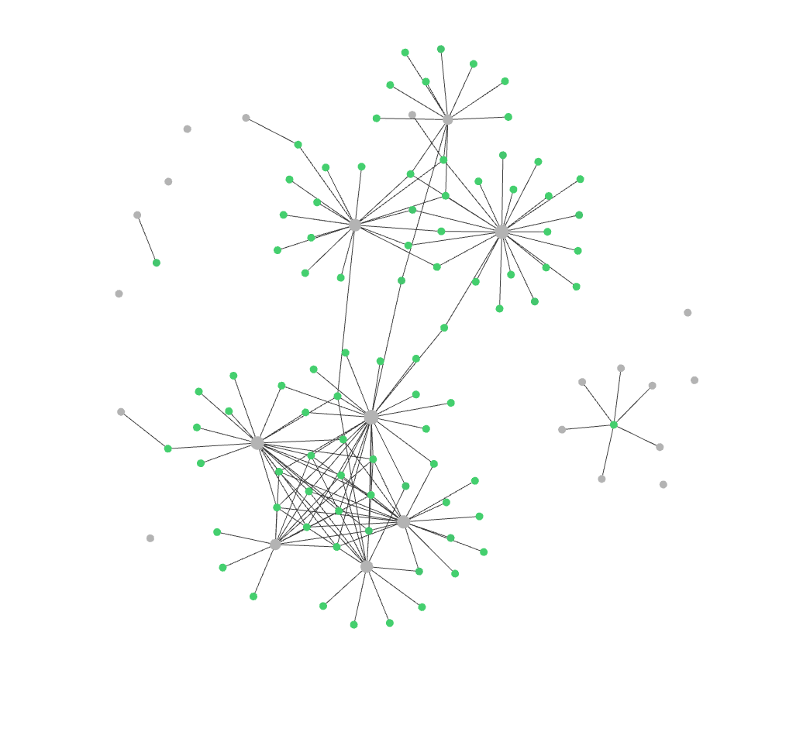
Literature review
Medical LLMs like MedPaLM and Med-Gemini are emerging as powerful tools in healthcare and biomedical research with specialized training for clinical tasks.
Knowledge integration through graphs and UMLS enhances model performance in medical question answering.
Controlled text generation enables precise outputs through various approaches like CTRL and reward-based methods.

Slide 5
Datasets
BQA Approaches
BQA Contents
BQA Formats
Open-domain
Scientific
Yes/no
Knowledge Base
Clinical
Extraction
Information Retrieval
Consumer Health
Generation
Machine Reading Comprehension
Examination
Multichoice
Question Entailment
Retrieval
Visual

Slide 6
Controlled text generation
Control methods
Control types
Training phase
Inference phase
Content control
Attribute control
Retraining
Fine-tuning
Reinforcement learning
Prompt engineering
Latent space manipulation
Decoding-time intervention
Structure
Vocabulary
Length
Format
Sentiment
Style
Topic
Safety
Quality requirements
Fluency
Helpfulness
Diversity
Notes:
Ensuring generated text meets specific requirements while maintaining quality

Slide 7
Pleiades
High Performance Computing (HPC) cluster operated by IEETA. The system features both traditional CPU nodes and GPU-accelerated computing nodes, making it versatile for different types of computational workloads.

Slide 8
Thanks!
Do you have any questions?
djbf@ua.pt
danielferreira011102.pages.dev

