Slide 1

Answering consumer health questions with non-expert language
FINAL PRESENTATION
PREPARAÇÃO PARA DISSERTAÇÃO/ESTÁGIO
2024/2025
Daniel Ferreira, 102885
Notes:
Boa tarde a todos. O meu nome é Daniel Ferreira e hoje vou apresentar o progresso do meu trabalho de dissertação intitulado 'Answering consumer health questions with non-expert language'. Esta é a apresentação do Sprint 2, onde vou partilhar o trabalho desenvolvido desde a nossa última reunião e os próximos passos planeados.

Slide 2
Overview
The following outlines the key participants involved in this project.
Student | Daniel Jorge Bernardo Ferreira
Supervisor | Sérgio Matos
Co-supervisor | Tiago Almeida
Summary | With the appearance of chatbot applications, searches and conversations regarding health issues can be expected to increase, which raises the challenges on how to reply with verified and reliable information. The objective of this work is to develop and evaluate a method for retrieval and summarization of scientific articles that contain answers to consumer health questions.
For more info: Portfolio

Slide 3
Motivation
Medical Information
Technical Version
Simplified Version
Too complex
Accessible
Missing Details
Incomprehensible
Medical Professionals
General Public

Slide 4
Objectives
Quantify Medical Text Complexity
Develop a set metrics for measuring medical text complexity
Create Complexity-Annotated Dataset
Build a high-quality dataset of health QA pairs with complexity levels
Develop Controllable Language Model
Create a model that generates answers with adjustable complexity

Slide 5
Controlled text generation
Control methods
Control types
Training phase
Inference phase
Content control
Attribute control
Retraining
Fine-tuning
Reinforcement learning
Prompt engineering
Latent space manipulation
Decoding-time intervention
Structure
Vocabulary
Length
Format
Sentiment
Style
Topic
Safety
Quality requirements
Fluency
Helpfulness
Diversity

Slide 6
Controlled text generation
Control methods
Control types
Training phase
Inference phase
Content control
Attribute control
Retraining
Fine-tuning
Reinforcement learning
Prompt engineering
Latent space manipulation
Decoding-time intervention
Structure
Vocabulary
Length
Format
Sentiment
Style
Topic
Safety
Quality requirements
Fluency
Helpfulness
Diversity

Slide 7
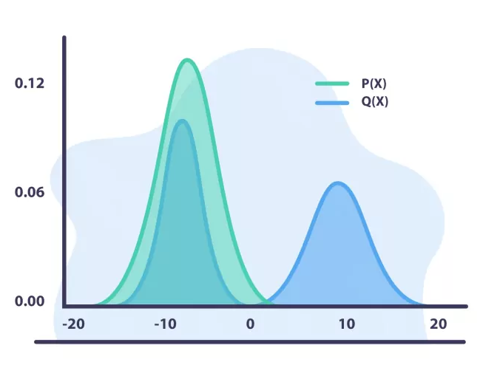
Methodology (RQ1)
Traditional Readability Metrics
Reference-Based Metrics
Literature
Review
Metric Selection
Reference-Free Metrics
LLM-Based Metrics
KL-Divergence
Implementation
Evaluation
Clustering
Classification

Slide 8
Methodology (RQ2)
Pre-trained LLM
Apply RQ1 metrics
Data Collection
Prompt Engineering
Dataset Creation
Quality Control
Generate Alternative Answers
Question
Answer 1
Answer 2
Answer N
. . .

Slide 9
Datasets
BQA Approaches
BQA Contents
BQA Formats
Open-domain
Scientific
Yes/no
Knowledge Base
Clinical
Extraction
Information Retrieval
Consumer Health
Generation
Machine Reading Comprehension
Examination
Multichoice
Question Entailment
Retrieval
Visual

Slide 10
Methodology (RQ3)
LSM
Baseline Model
RL
Pre-trained LLM
Fine-tune on RQ2 Dataset
Guided Decoding
Advanced Techniques
Readability
Evaluation
Factuality
Relevance

Slide 11
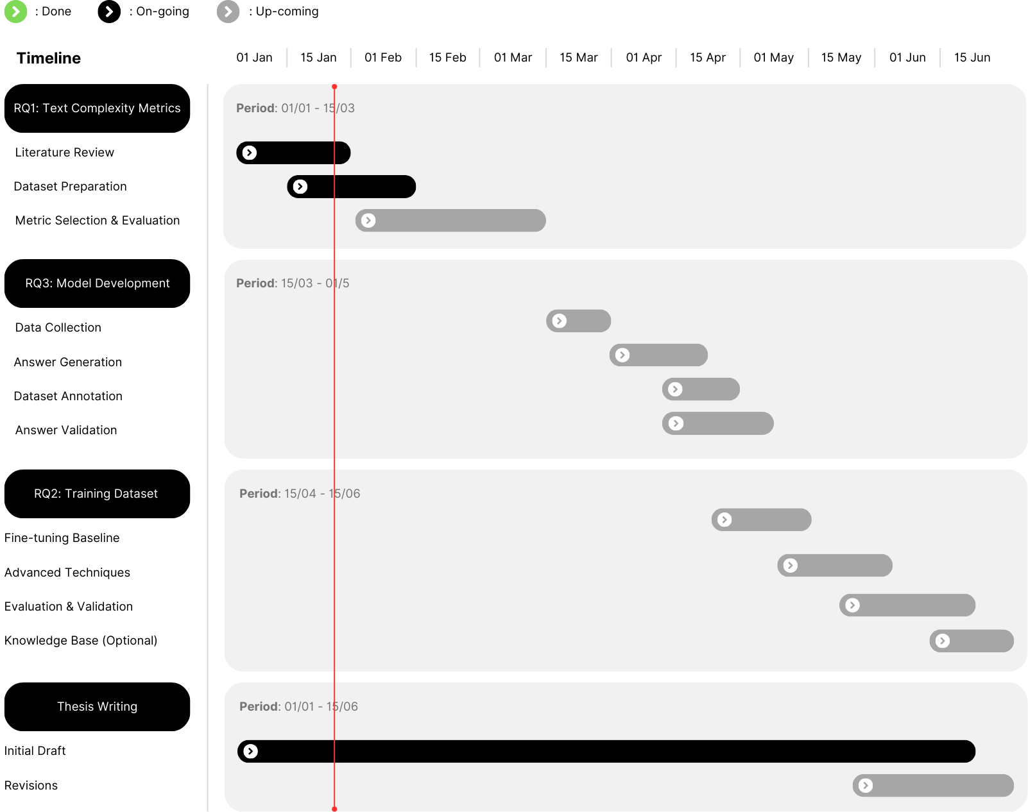
Timeline
The Gantt chart provides a visual representation of the proposed work plan, outlining the tasks and milestones described before.

Slide 12
Pleiades
High Performance Computing (HPC) cluster operated by IEETA. The system features both traditional CPU nodes and GPU-accelerated computing nodes, making it versatile for different types of computational workloads.

Slide 13
Thanks!
Do you have any questions?
djbf@ua.pt
danielferreira011102.pages.dev

