Slide 1

DEPARTAMENTO DE ELETRÓNICA, TELECOMUNICAÇÕES E INFORMÁTICA
UNIVERSIDADE DE AVEIRO
APRESENTAÇÃO DE TÓPICOS DE APRENDIZAGEM AUTOMÁTICA
BANK MARKETING DATASET
2022-2023
ALEXANDRE LIMA GAZUR | 102751
DANIEL JORGE BERNARDO FERREIRA | 102885

Slide 2
STATE OF THE ART
S. Moro, P. Cortez, and P. Rita, “A data-driven approach to predict the success of bank telemarketing”
J. Asare-Frempong and M. Jayabalan, “Predicting customer response to bank direct telemarketing campaign‘’
H. Elsalamony, “Bank Direct Marketing Analysis of Data Mining Techniques”
M. Arifuzzaman and M. S. Islam, “SMOTE Approach for Predicting the Success of Bank Telemarketing”
2

Slide 3
DATASET
Feature | Description
deposit | has the client subscribed to a term deposit? (yes, no)
age | age of the client, numeric
job | type of job, twelve categories
marital | marital status, three categories
education | level of education, four categories
default | has credit in default? (yes, no)
balance | yearly balance of the client, numeric
housing | has a housing loan? (yes, no)
loan | has a personal loan? (yes, no)
contact | communication type (cellular, telephone, unknown)
day | last contact day of the month, numeric
month | last contact month of the year (twelve levels, months)
duration | last contact duration in seconds, numeric
campaign | contacts received during this campaign, numeric
pdays | days since the last contact in a previous campaign, numeric
previous | contacts received before this campaign, numeric
poutcome | previous marketing campaign result, four categories
1,162 observations and 17 features
Dataset is complete (no missing values)
7 numeric features
4 binary categorical features
6 nominal categorical features
There are varying levels of granularity for each feature
3
Notes:
7 features numéricas
4 features categóricas binárias
6 features categóricas nominais
“duration” é um exemplo de “data leakage”, porque é um dado que não estará disponível num cenário real para fazer as previsões.

Slide 4
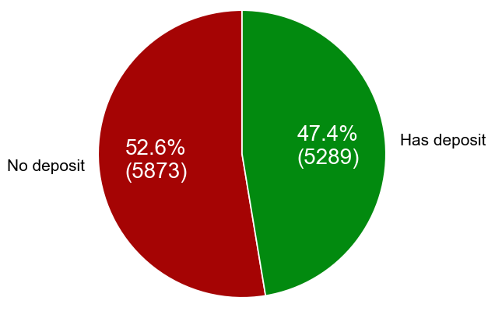
DATA EXPLORATION
CLASS DISTRIBUTION
The prevalence of the positive class is approximately 0.474
Dataset is considered balanced
Preprocessing techniques used to address class imbalance (i.e., SMOTE) are not needed
4

Slide 5
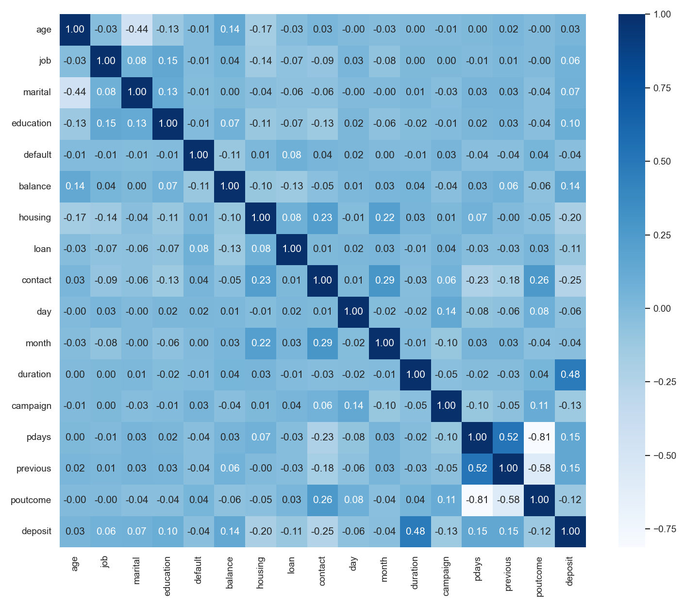
DATA EXPLORATION
FEATURE POINT-BISERIAL CORRELATION
The feature ‘duration’ has the highest correlation coefficient with the target variable
The feature ‘poutcome’ has a strong correlation with both the ‘pdays’ and ‘previous’ features
Most pairs of features have a weak correlation
5

Slide 6
DATA EXPLORATION
OTHER DETAILS
6

