Slide 1


OpenLENS
Visualizing scholarly knowledge for University Students
SPRINT 2
INFORMATION VISUALIZATION
2024/2025
Daniel Ferreira, 102885
Rafael Matos, 118390

Slide 2
First Iteration of the Project
Target Audience
Students, Researchers and Professors
The Dataset
OpenAlex is a fully open catalog of the global research system.
The Methodology
Requirement Analysis
Low Fidelity Prototype
Functional Prototype
Notes:
Fazer aqui um recap rápido do que previamente tinhamos planeado

Slide 3
Purpose Statement
What is the main objective of the project?
Develop a web application to explore research trends, supporting informed decisions on study destinations, collaborations, and academic interests.
Why is this project relevant?
It addresses the need for accessible, research-focused information, helping users find universities aligned with their academic goals.
How will the project be conducted?
Leverage OpenAlex API to collect data, process research trends, and present insights in an interactive, user-friendly web interface.

Slide 4
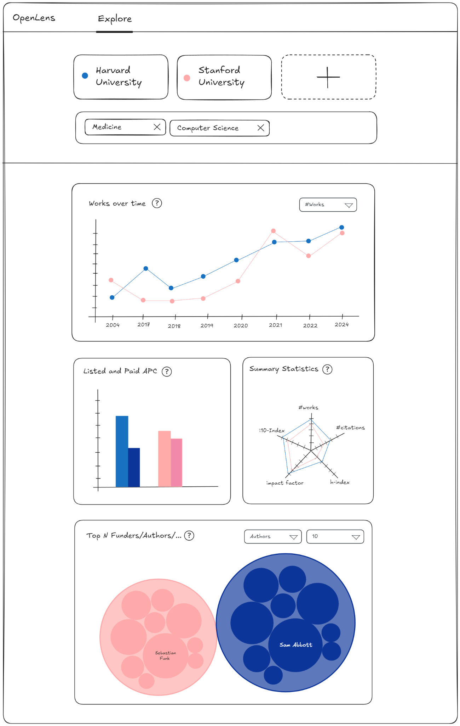
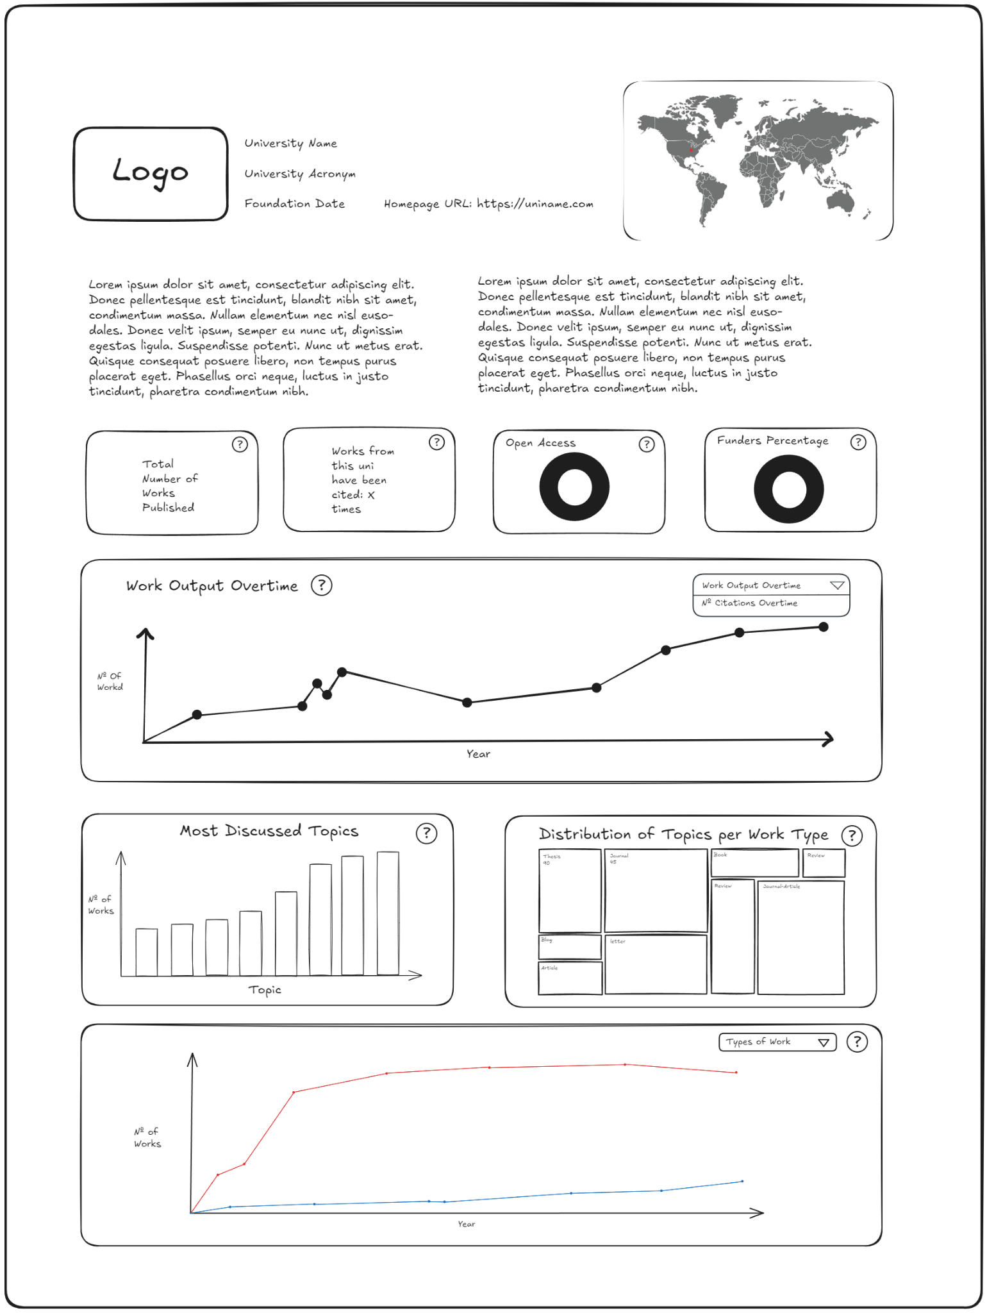
Low Fidelity Prototype
The low-fidelity prototype will provide an outline of where things will go and how it will function for users.

Slide 5
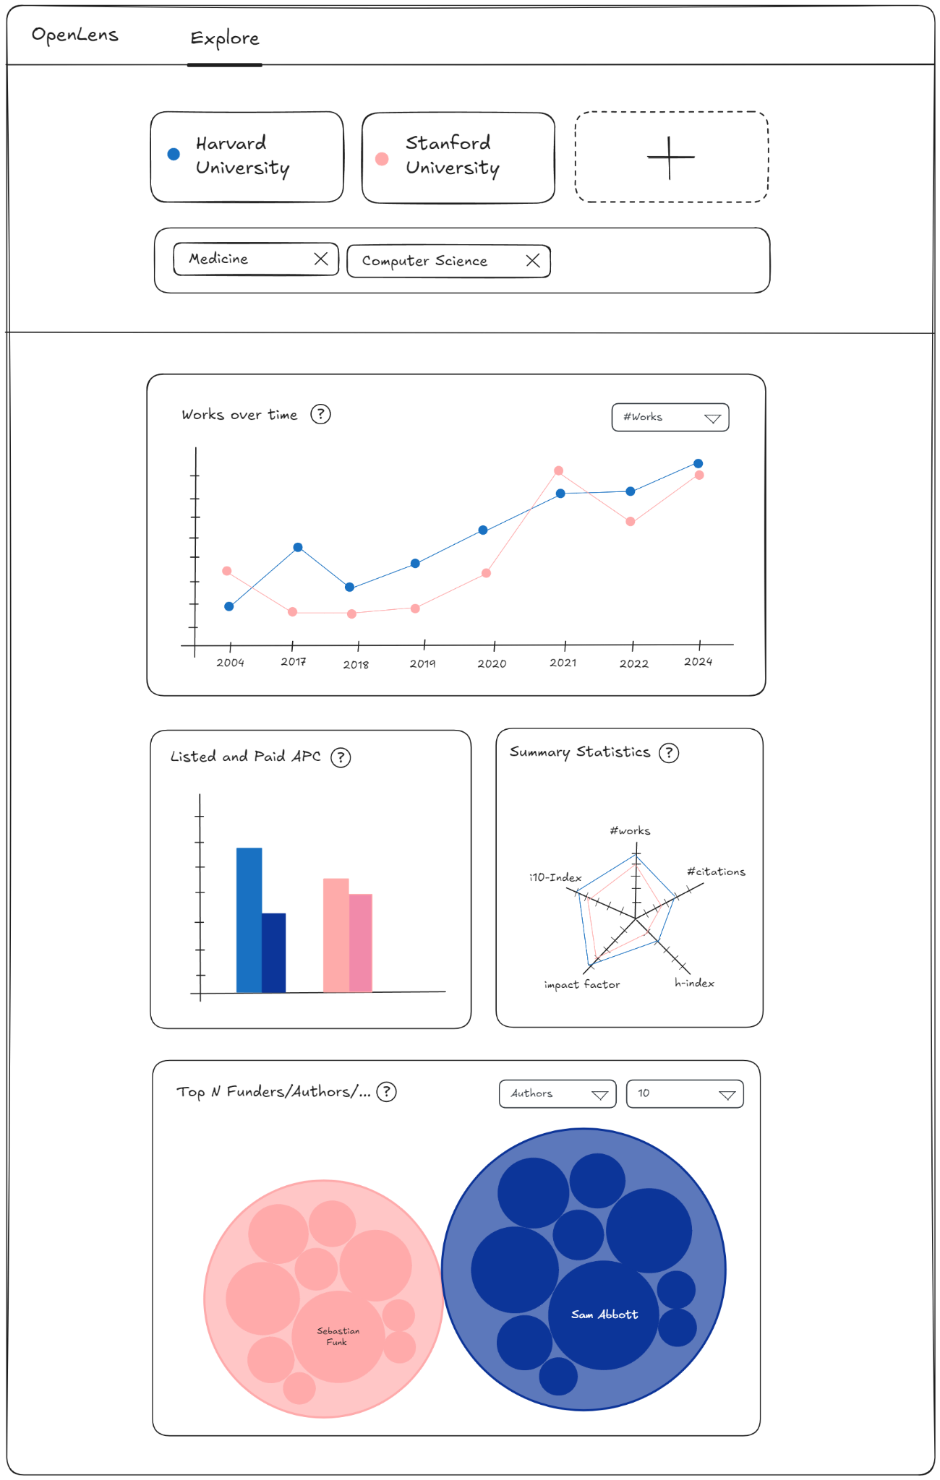
Explore Page
The explorer page normalizes search data to make comparisons between universities easier.

Slide 6
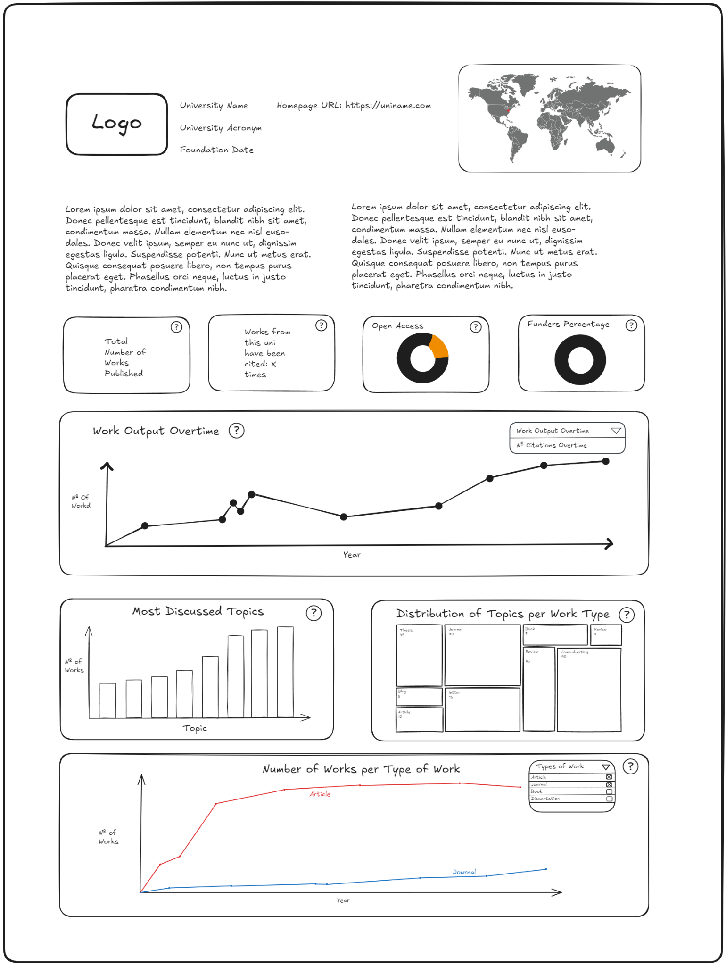
University
Dashboard
The university dashboard is a quick way to find all around information about a university. This page depends heavily on t

Slide 7
LFP User Evaluation
Task 1: In which year did Stanford publish the highest number of works, and received the most citations?
Task 2: Which university, MIT or Stanford, has a higher cumulative h-index for faculty members in Software Engineering?
Task 3: Which university, Harvard or UCLA, has incurred higher Article Processing Charges (APCs)?
Task 4: Who are the primary funding sources for Stanford's research publications?
Task 5: What is the most common type of non-article work published by Stanford?
Notes:
Task1: 1 1
Task2: 4 1
como é prototipo é mais dificil
Task3: 1 1
Task4: 2 1
Task5: 4 1
Por a legenda
esqueceu-se de meter titulo
muita info especificar melhor as cenas

Slide 8
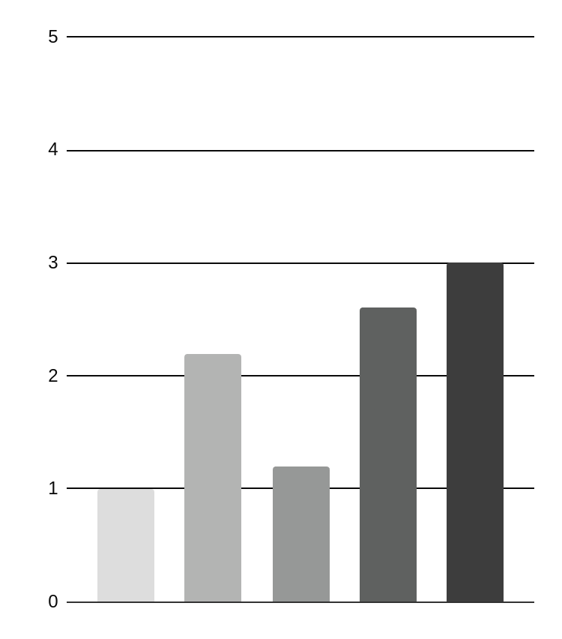
User Evaluation Results
Task 1: Peak publication year and citations (1)
Task 4: Identifying Stanford's research funders (2.6)
Task 2: MIT likely leads h-index (2.2)
Task 5: Stanford's top non-article publications (3)
Task 3: Comparing APCs across universities (1.2)
This table shows the average difficulty score for each task in the user evaluation of the low-fidelity prototype

Slide 9
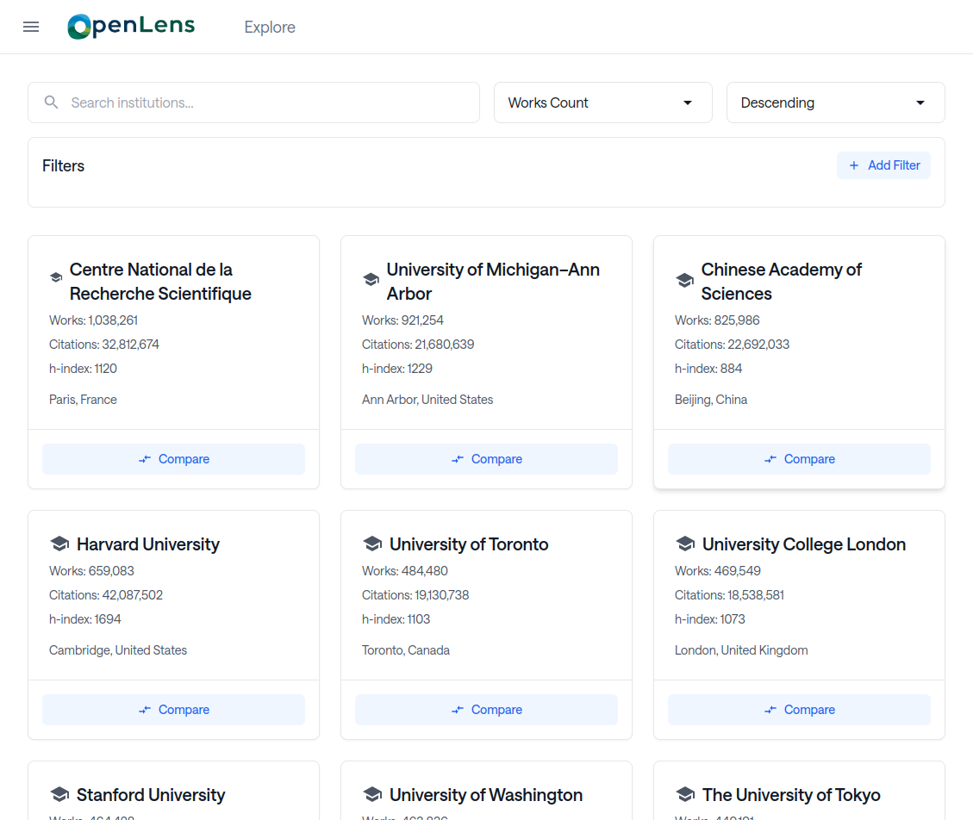
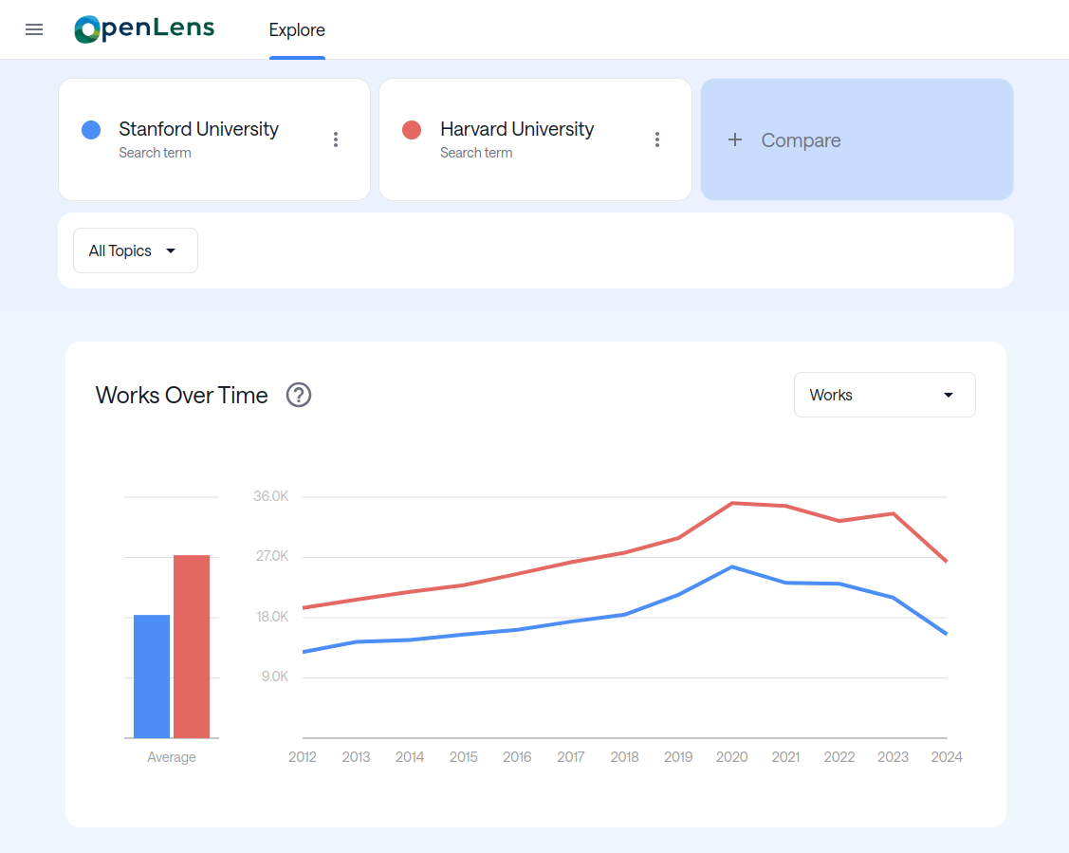
Functional
Prototype
The functional prototype will demonstrate the core features and interactivity of the application, allowing users to test the primary functionality.

Slide 10
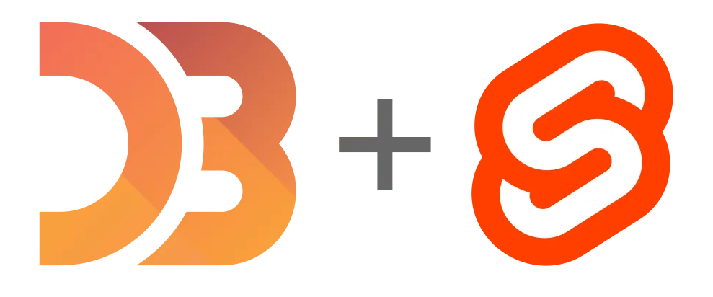
Technologies
D3.js
Svelte

Slide 11
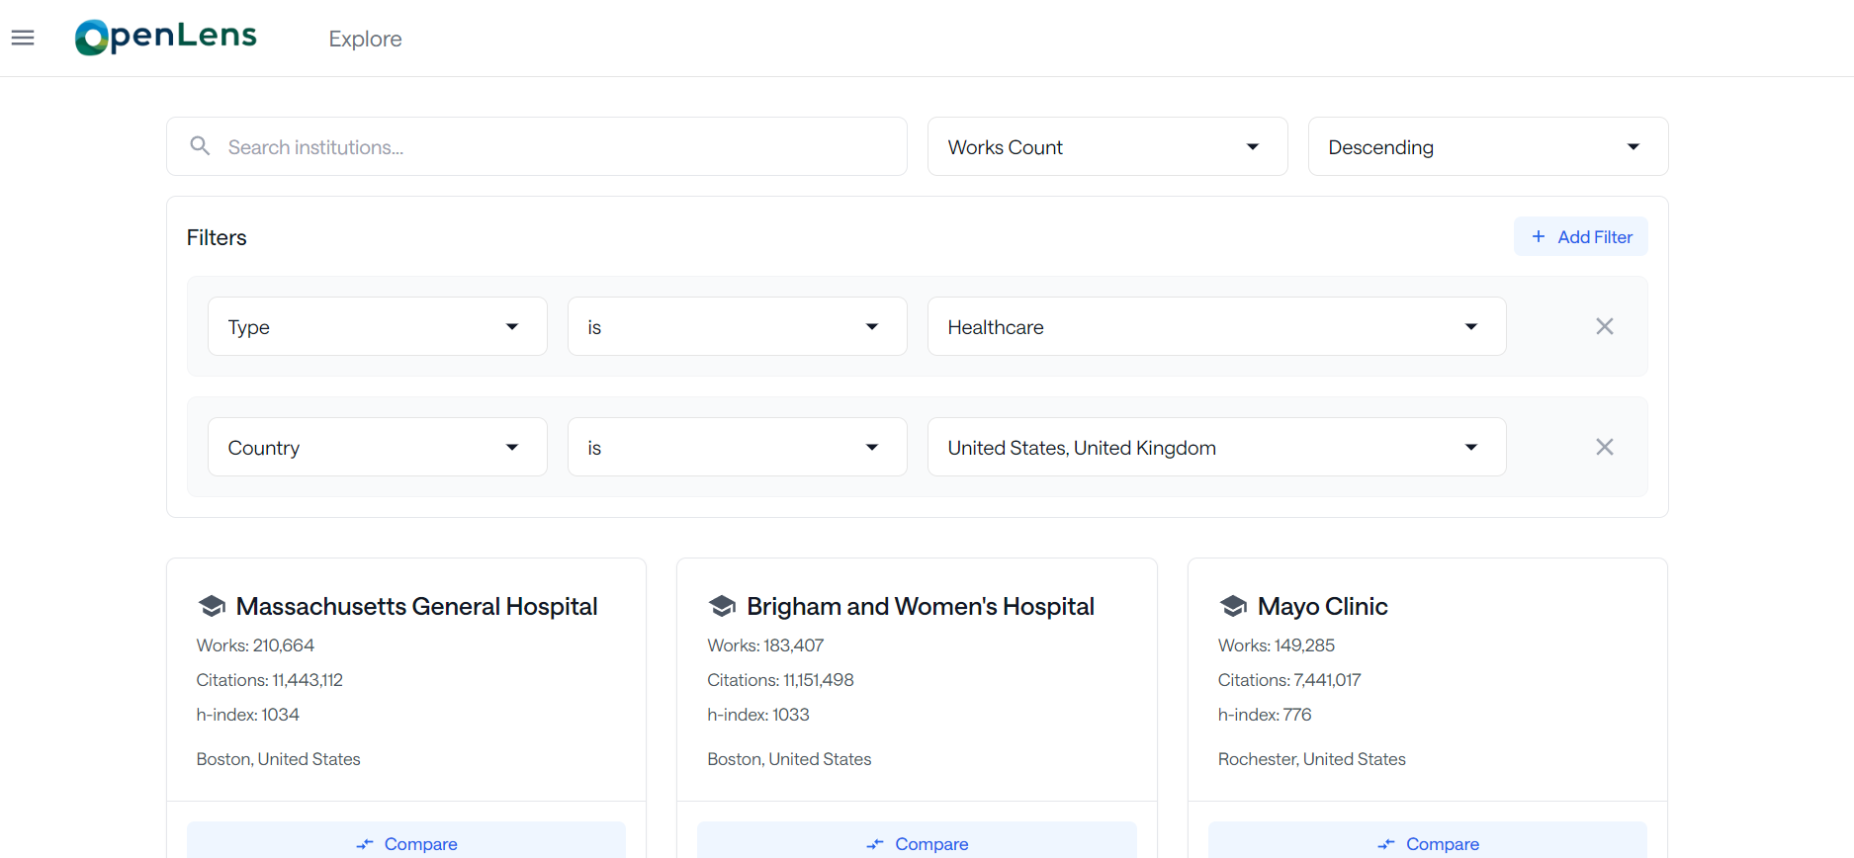
Discover Universities
The university discovery page let’s users search for the desired universities.

Slide 12
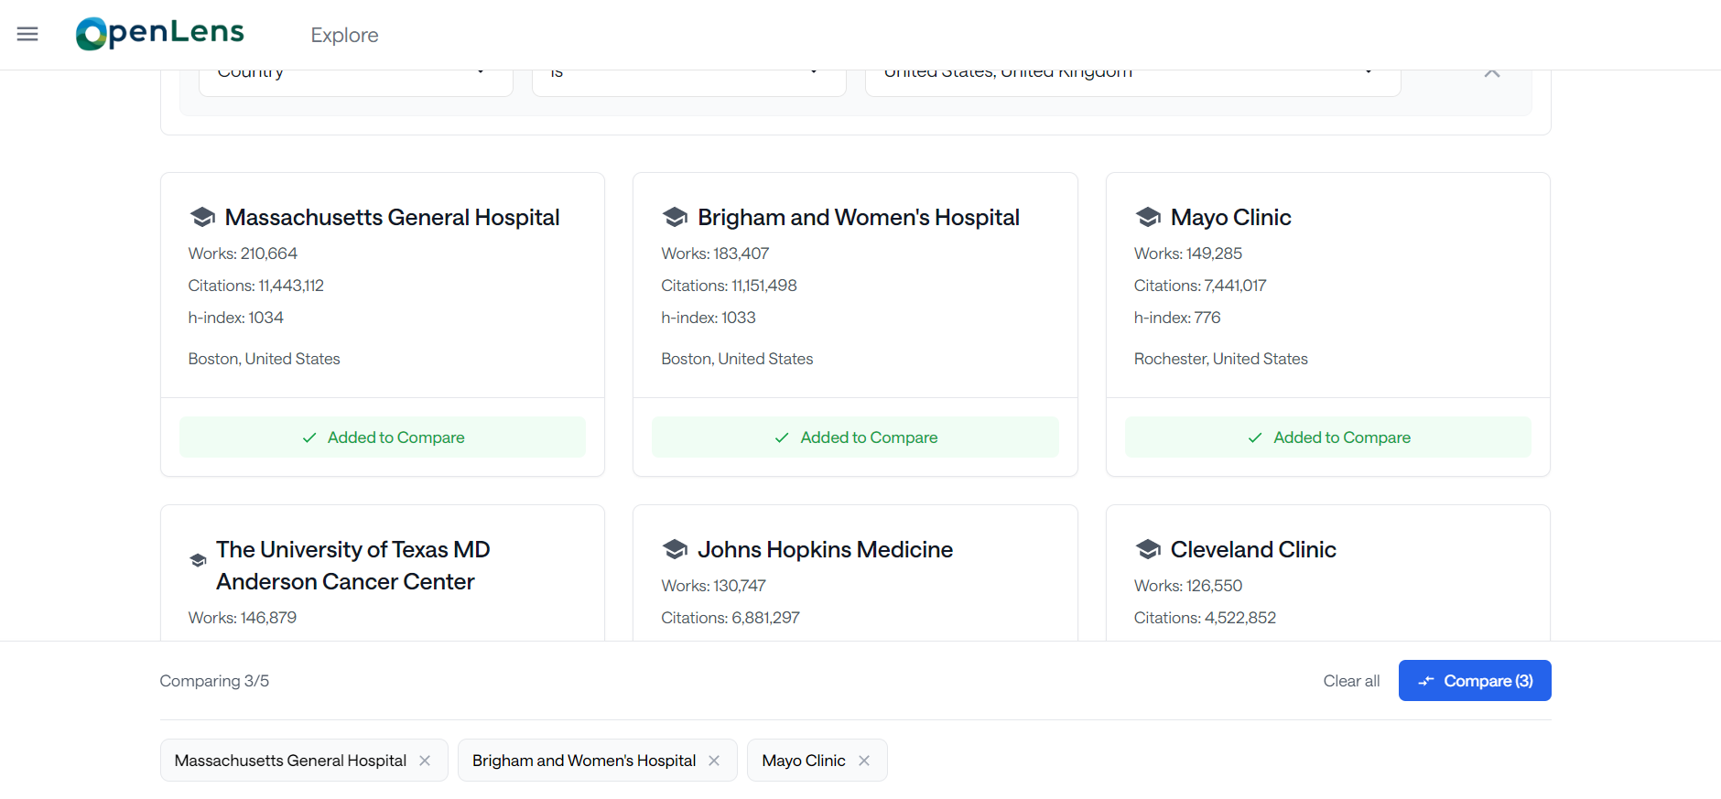
It’s Easy to Compare!

Slide 13
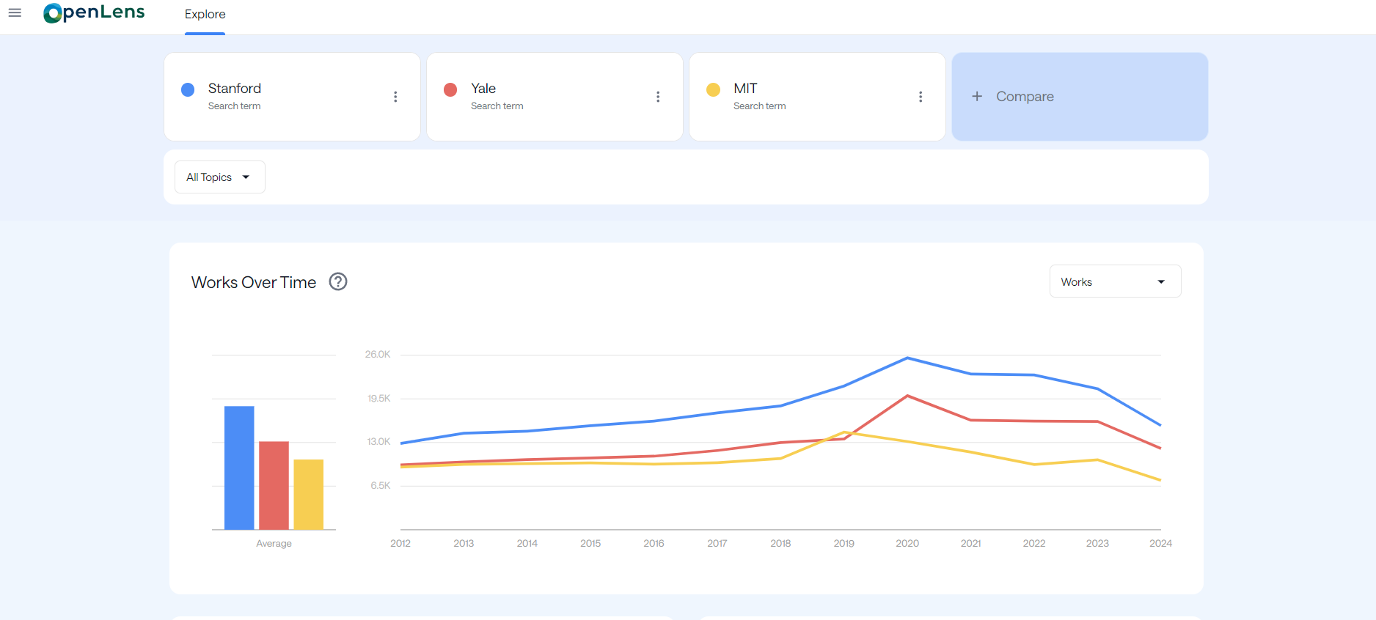
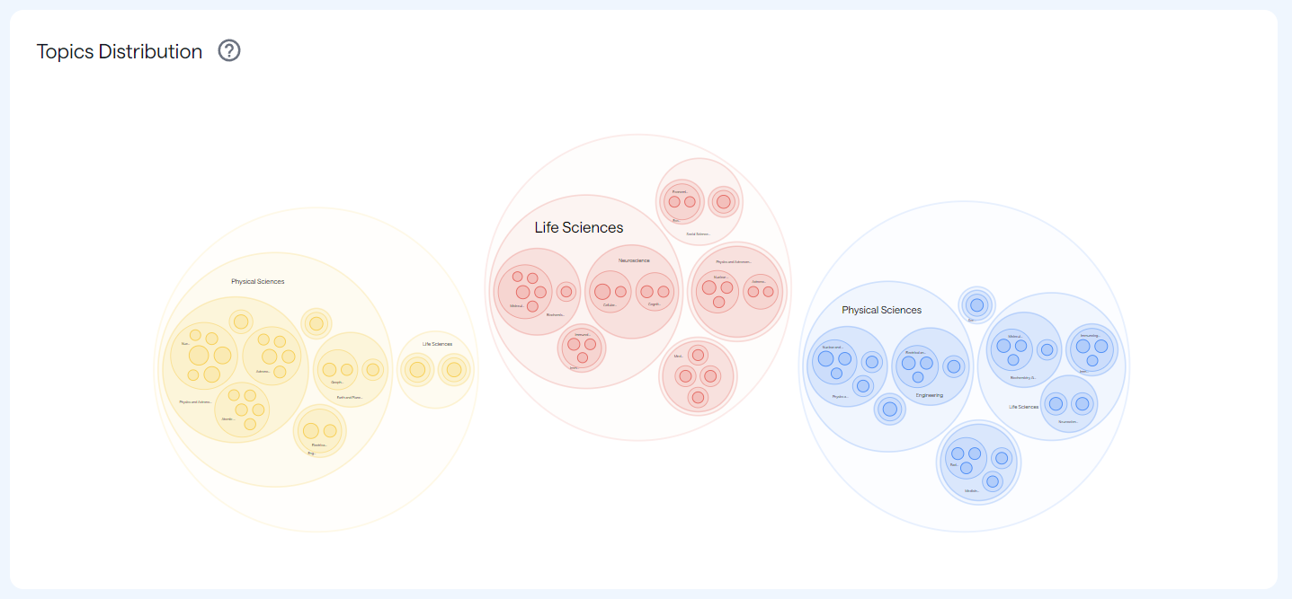
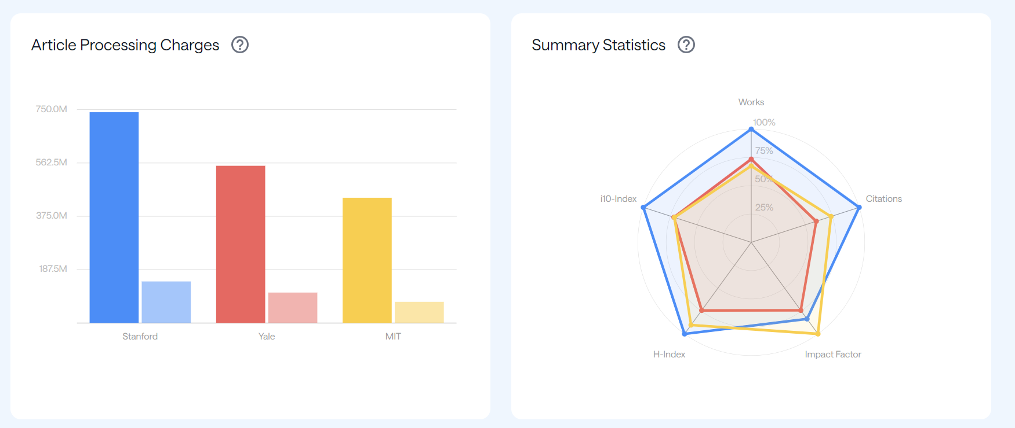
Explore Page
The explorer page normalizes search data to make comparisons between universities easier.

Slide 14
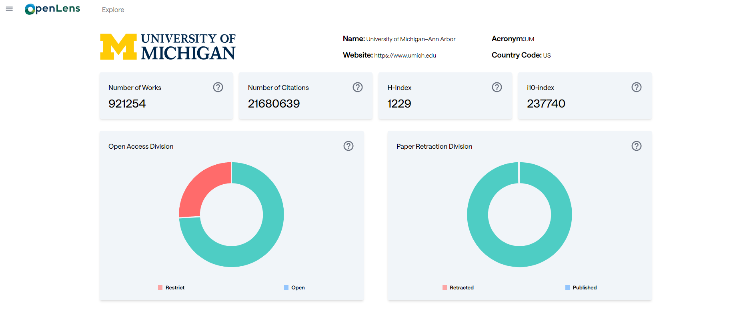
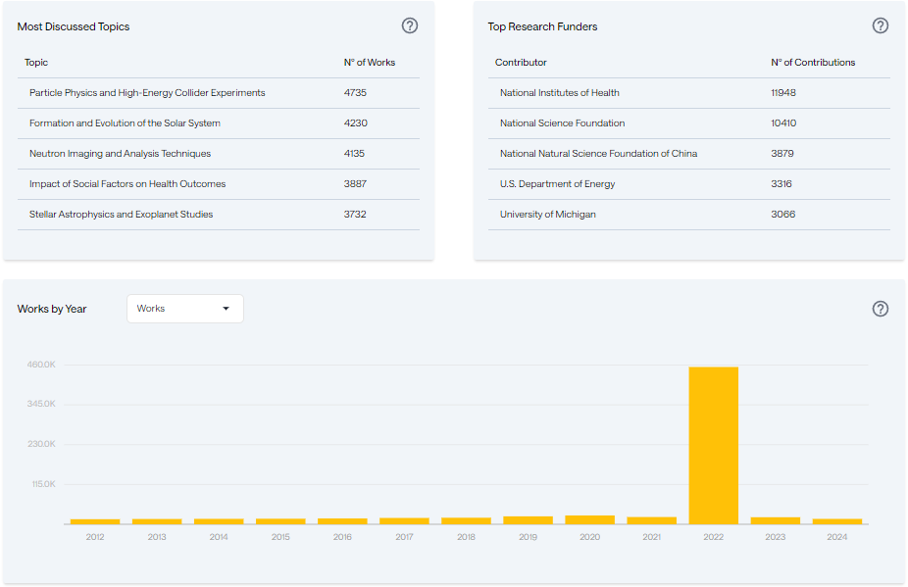
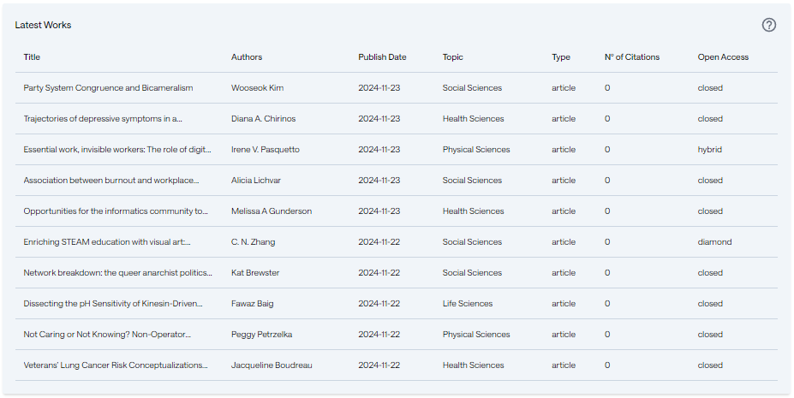
University
Dashboard
The university dashboard is a quick way to find all around information about a university.

Slide 15
Nielsen Heursistics
Jakob Nielsen's 10 Usability Heuristics for UI Design, using the severity rating scale proposed by Nielsen:
0
I don’t agree that this is a usability problem at all
1
Cosmetic problem only: does not to be fixed unless extra time is available
2
Minor usability problem: fixing this should be given low priority
3
Major usability problem: important to fix, so should be given high priority
4
Usability catastrophe: imperative to fix this before product can be released

Slide 16
Heuristic Evaluation (Part 1)
Visibility of System Status
No issues found
Match Between System and the Real World
Issue: OpenAlex’s autocomplete endpoint does not work as expected
Severity rating: 4
User Control and Freedom
No issues found
Consistency and Standards
No issues found
Error Prevention
No issues found
Recognition Rather Than Recall
Issue: The path to get to the help page is not clear.
Severity rating: 3

Slide 17
Heuristic Evaluation (Part 2)
Flexibility and Efficiency of Use
No issues found
Aesthetic and Minimalist Design
Issue: The circular bar chart may be too complex and not very intuitive
Severity rating: 3
Help Users Recognize, Diagnose, and Recover from Errors
Issue: Insufficient information about error resolution (just refresh)
Severity rating: 2
Help and Documentation
Issue: No documentation regarding the filter options in the main page
Severity rating: 1

Slide 18
Did We Achieve Our Goals?
The Website
Evaluation
Develop a web application to explore research trends and academic interests.
Evaluation of the project through different metrics.
The Need
Development
It addresses the need for accessible, research-focused information.
Full project completed following the proposed methodology.

Slide 19
Future Work
Compare Institutions by Topic
Circle Packing Chart Improvement
Overall Responsiveness

Slide 20
Demo!
Notes:
https://youtu.be/VLOrIUK-pnU

Slide 21
The End
If you have any questions
please let us know!

