Slide 1
Smile to Vector
SMILEs
Diffusion Model
Model, Maybe CNN, Transformer?
VAE
Skeleton
Skeleton
Smiles
Info To Vector
Info
X_train = Smiles_to_vector + info_to_vector
X_train = Skeleton to vector
Y_train = RDKit Skeleton (Preprocessed)
Y_train = SMILEs input to Variational Auto Encoder
Preprocessing
Training
Input Synthesis
Molecule Generation
Docking/Simulation
Ranking

Slide 2
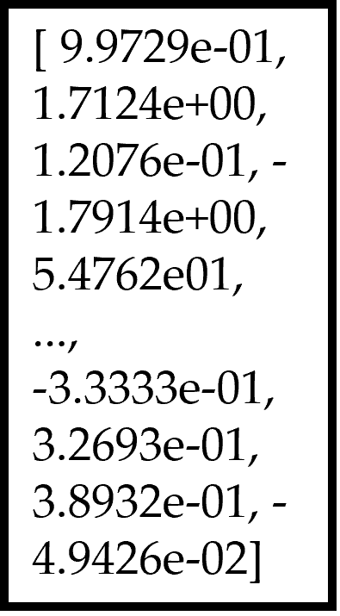
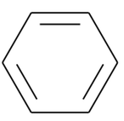
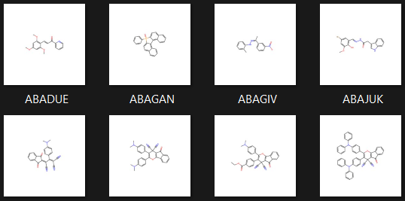
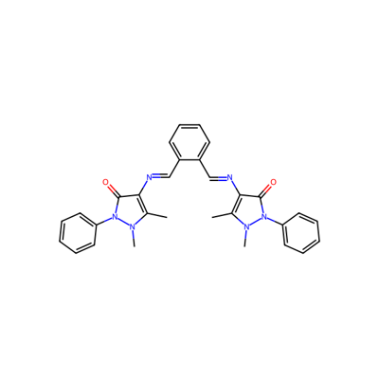
Vector Representation of Benzene
Chosen Molecule
SMILEs Representation of Benzene
c1ccccc1
ChemBERTa Model
ChemBERTa Model
Dataset Structure Standardisation
Skeleton Image Generated
Chosen Molecule
RDKit Smiles -> Mol -> Skeleton
CN1N(c2ccccc2)C(=O).......N(C)N(c2ccccc2)C1=O
400x400 pixels

Slide 3

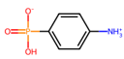
Concatenate Latent Space with condition for decoder
Vector Form of SMILES
Molecule
SMILES Representation
Latent Space
Encoder
Latent Space
Decoder
c1ccccc1
Condition Vector
Preprocessing
Variational Auto Encoder
Post Processing

Slide 4
Mean
Latent Vector
Vector Form of SMILES
…
Dense Layer
Batch Normalisation
Dense Layer
Dense Layer
Batch Normalisation
Latent Vector
Generated Image
Dense Layer
Reshape
Flatten
Transpose Convolutional Layer
Transpose Convolutional Layer
Variance
User Specified conditions
latent_inputs = tf.keras.Input(shape=(latent_dim,), name='latent_inputs')
# Reshape the latent vector to match the input shape for the convolutional layers
x = layers.Dense(units=output_dim[0]*output_dim[1]*output_dim[2], activation='relu')(latent_inputs)
x = layers.Reshape(target_shape=(output_dim[0], output_dim[1], output_dim[2]))(x)
x = layers.Conv2DTranspose(128, kernel_size=(4, 4), padding='same',activation="relu")(x)
x = layers.Conv2DTranspose(64, kernel_size=(4, 4), padding='same',activation="relu")(x)
x = layers.Conv2DTranspose(32, kernel_size=(4, 4), padding='same',activation="relu")(x)
x = layers.Conv2DTranspose(16, kernel_size=(3, 3), padding='same',activation="relu")(x)
# Output layer with tanh activation instead of relu
outputs = layers.Conv2DTranspose(filters=1, kernel_size=(3, 3), padding='same',activation="relu")(x)
outputs = layers.Flatten()(outputs)
outputs = layers.Dense(units=output_dim[0] * output_dim[1] * output_dim[2],activation="sigmoid")(latent_inputs)

