Slide 1
Smile to Vector
SMILEs
Diffusion Model
Model, Maybe CNN, Transformer?
VAE
Skeleton
Skeleton
Smiles
Info To Vector
Info
X_train = Smiles_to_vector + info_to_vector
X_train = Skeleton to vector
Y_train = RDKit Skeleton (Preprocessed)
Y_train = SMILEs input to Variational Auto Encoder
Preprocessing
Training
Input Synthesis
Molecule Generation
Docking/Simulation
Ranking

Slide 2
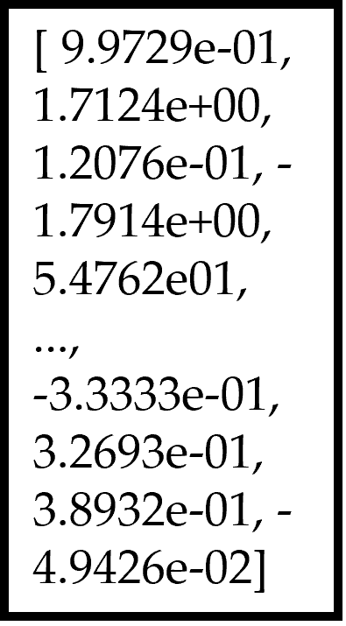
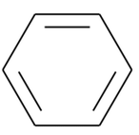
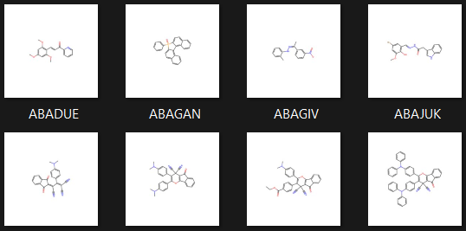
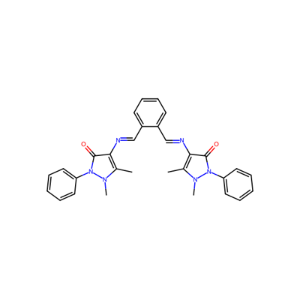
Vector Representation of Benzene
Chosen Molecule
SMILEs Representation of Benzene
c1ccccc1
ChemBERTa Model
ChemBERTa Model
Dataset Structure Standardisation
Skeleton Image Generated
Chosen Molecule
RDKit Smiles -> Mol -> Skeleton
CN1N(c2ccccc2)C(=O).......N(C)N(c2ccccc2)C1=O
400x400 pixels

Slide 3

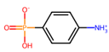
Concatenate Latent Space with condition for decoder
Vector Form of SMILES
Molecule
SMILES Representation
Latent Space
Encoder
Latent Space
Decoder
c1ccccc1
Condition Vector
Preprocessing
Variational Auto Encoder
Post Processing

Slide 4
Mean
Latent Vector
Vector Form of SMILES
…
Dense Layer
Batch Normalisation
Dense Layer
Dense Layer
Batch Normalisation
Latent Vector
Generated Image
Dense Layer
Reshape
Flatten
Transpose Convolutional Layer
Transpose Convolutional Layer
Variance
User Specified conditions
latent_inputs = tf.keras.Input(shape=(latent_dim,), name='latent_inputs')
# Reshape the latent vector to match the input shape for the convolutional layers
x = layers.Dense(units=output_dim[0]*output_dim[1]*output_dim[2], activation='relu')(latent_inputs)
x = layers.Reshape(target_shape=(output_dim[0], output_dim[1], output_dim[2]))(x)
x = layers.Conv2DTranspose(128, kernel_size=(4, 4), padding='same',activation="relu")(x)
x = layers.Conv2DTranspose(64, kernel_size=(4, 4), padding='same',activation="relu")(x)
x = layers.Conv2DTranspose(32, kernel_size=(4, 4), padding='same',activation="relu")(x)
x = layers.Conv2DTranspose(16, kernel_size=(3, 3), padding='same',activation="relu")(x)
# Output layer with tanh activation instead of relu
outputs = layers.Conv2DTranspose(filters=1, kernel_size=(3, 3), padding='same',activation="relu")(x)
outputs = layers.Flatten()(outputs)
outputs = layers.Dense(units=output_dim[0] * output_dim[1] * output_dim[2],activation="sigmoid")(latent_inputs)

Slide 5

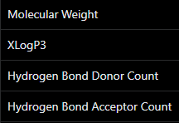

Data
Molecule SMILEs
With Conditions
Chosen Dataset of SMILES
Search for Molecule by SMILES
Get Conditions
Conditions
Normalise Conditions
SMILEs Representation
Vector Form of Skeleton
Vectors
Chosen Molecule
CN1N(c2ccccc2)C(=O)...N(C)N(c2ccccc2)C1=O
ChemBERTa Model
Pre-processed Data
Chosen Molecule
RDKit Smiles -> Mol -> Skeleton
Standardisation
Skeleton Image Generated
Targets
CN1N....N(C)N(c2ccccc2)C1=O

Slide 6
Generation Encoder
Generation Encoder
Latent Vector
Vector Representation of Genetic Information
Dense Layer
Vector Representation of Genetic Information
Batch Normalisation
Dense Layer
Batch Normalisation
Batch Normalisation
Dense Layer
Batch Normalisation
Dense Layer
Latent Vector
User Specified conditions

Slide 7
Input Synthesis
Generation
Analysis
Genetic Information
Genetic Information
Decoder
Encoder
Latent Vector
Current Treatment Molecules
Target Diseases
Simulation
Latent Vector
Best Starting Molecules
Potential Target Molecules
Profile Generation
Decoder
Ranking
Encoder
Encoder – Image to Molecule
Ranking Model
Synthesis Route Generation
Conditions
Other Analysis
Genetic Information
Genetics Latent Space
Encoder

