Slide 1
Smile to Vector
SMILEs
Diffusion Model
Model, Maybe CNN, Transformer?
VAE
Skeleton
Skeleton
Smiles
Info To Vector
Info
X_train = Smiles_to_vector + info_to_vector
X_train = Skeleton to vector
Y_train = RDKit Skeleton (Preprocessed)
Y_train = SMILEs input to Variational Auto Encoder
Preprocessing
Training
Input Synthesis
Molecule Generation
Docking/Simulation
Ranking

Slide 2
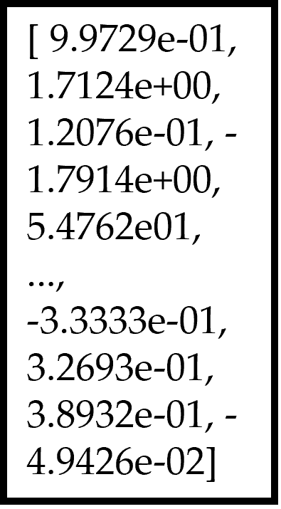
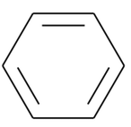
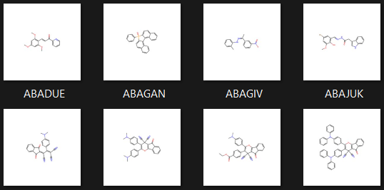
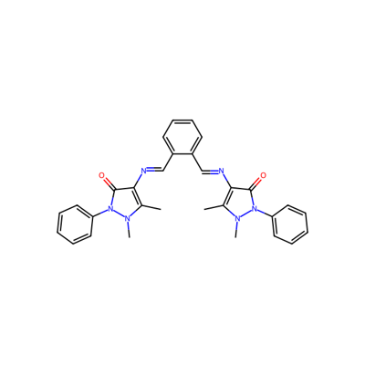
Vector Representation of Benzene
Chosen Molecule
SMILEs Representation of Benzene
c1ccccc1
ChemBERTa Model
ChemBERTa Model
Dataset Structure Standardisation
Skeleton Image Generated
Chosen Molecule
RDKit Smiles -> Mol -> Skeleton
CN1N(c2ccccc2)C(=O).......N(C)N(c2ccccc2)C1=O
400x400 pixels

Slide 3
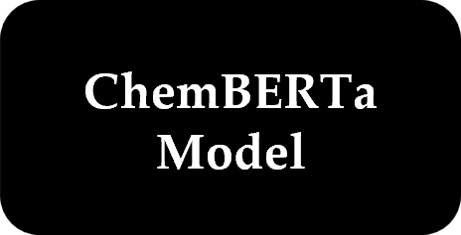
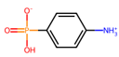
Concatenate Latent Space with condition for decoder
Vector Form of SMILES
Molecule
SMILES Representation
Latent Space
Encoder
Latent Space
Decoder
c1ccccc1
Condition Vector
Preprocessing
Variational Auto Encoder
Post Processing

