Slide 1
One Compiler to Rule Them All:
Extending the Storm Programming Language Platform with a Java Frontend

Slide 2
Research Questions
To what extent is the Storm Platform appropriate for implementing an object-oriented language?
What is a suitable method for implementing a new language in Storm?

Slide 3
Background
Formal Languages and automata theory
Regular Languages
Context Free Languages
Pushdown Automata
Automata and Computability – Dextor Kozen

Slide 4
Background
Compiler Theory
Lexical Analysis
Syntax Analysis
Semantic Analysis
Intermediate Code Generation
Machine-Independent Code Optimization
Code Generation
Machine-Dependent Code optimization
Compilers: Principles, Techniques, and Tools – Aho, Lam, Sethi & Ullman

Slide 5
Storm
An interactive compiler platform for creating extensible languages
Exposes an extensible type system, a parser and code generation to all languages
A standard interface called the name tree enables seamless interaction between languages

Slide 6
Storm
Named Entities & Name tree
A named entity is an object that has a name and zero or more parameters
The parameters can be functions, types or name sets
A name set is an entity which stores a set of named entities as its children
The name tree is the base level of this recursive structure

Slide 7
Storm basic storm
General purpose programming language
Syntax resembles C or Java
Most things are treated as expressions
Blocks evaluate to the value of the last expressions and thus the language has implicit returns
Implemented using the name tree and the built-in syntax language like any language a developer would extend Storm with

Slide 8
Storm syntax language
Specifies the context free grammar of a language
Used by the built-in parser to perform analysis in the correct manner
Produces either a rule(nonterminal) or a production(production rule)
Entities are stored in the name tree
Syntax transforms used to turn the parse tree into a n abstract syntax tree is also specified in the syntax language

Slide 9
Action Research
An explanation
Not a case study
Learning Cycles
Evaluation Stage
Considerations for next cycle

Slide 10
Action Research
IN our project
Agile Connection
Reconnaissance Cycle
Initial Implementation
Bottom Up
Structured Framework

Slide 11
Result
To what extent is the Storm Platform appropriate for implementing an object-oriented language?
Pros:
Storm provides many pre-implemented features for creating new languages
Many basic storm features can be extended in new languages to simplify the implementation
Languages are fully customizable in terms of syntax, transforms and three address code instructions

Slide 12
Result
To what extent is the Storm Platform appropriate for implementing an object-oriented language?
cons:
No 16-bit registers
Lazy compilation strategy makes testing harder
Lack of documentation due to novelty of Storm

Slide 13
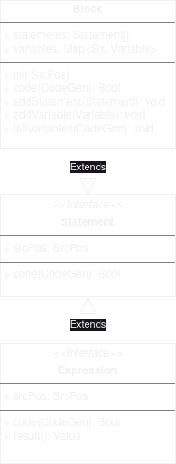
Result
What is a suitable method for implementing a new language in Storm?

Slide 14
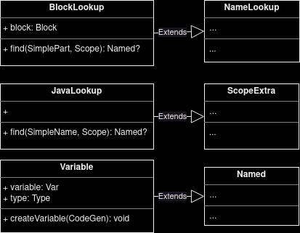
Result
What is a suitable method for implementing a new language in Storm?

Slide 15
Thank you!

