Slide 1

M5. Visual Recognition
Team 3
Keyao Li
Marc Orós
Daniel Fuentes

Slide 2
Outline
Architecture
Install setup
Implementation
Loss
Accuracy
Conclusions

Slide 3
Neural Network Architecture

Slide 4
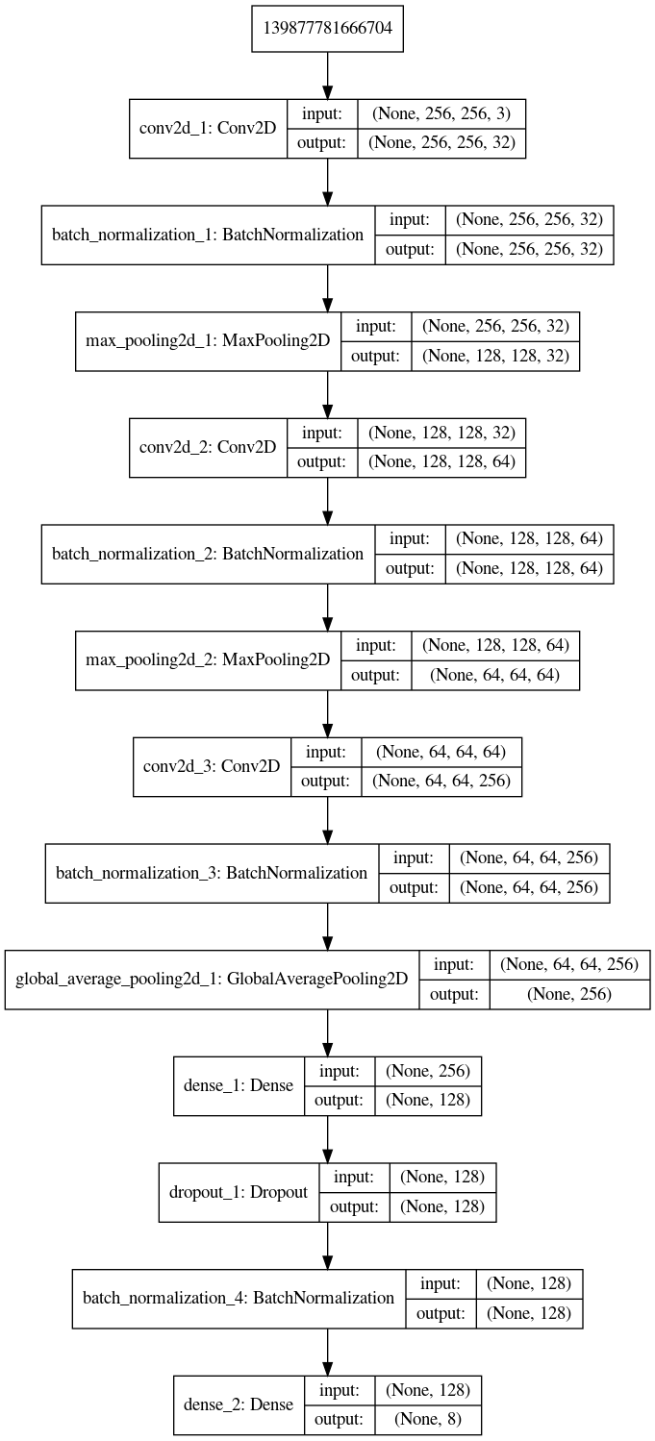
CNN Architecture
3 conv layers
Maxpooling
BatchNorm
Dropout (0.2)
Global Average Pooling and Dense layers (If using Global Avg pooling we don’t need to use dense layers, but we used them in M3, so we kept them to make an even comparison)
Learning rate = 0.01 with no momentum
Batch size = 32

Slide 5
Sessions
Which we have done.

Slide 6
Install and setup the development framework

Slide 7
Install and setup the development framework
In order to have available the environment and the usage of GPUs in the server we follow the following steps:
We executed the command → bash ~/mcv/Anaconda3-2019.10-Linux-x86_64.sh
The previous command was set up in the path of our group → /home/grupo03
In order to use an interface to Graphviz we installed Pydot with the command → conda install -c anaconda pydot
One of the most important steps is allow the use of Cuda and the GPUs for this reason is necessary to add in the file .bashrc the following lines:
export LD_LIBRARY_PATH=/usr/local/cuda/lib64:$LD_LIBRARY_PATH
export CUDA_HOME=/usr/local/cuda
As is necessary the framework Pytorch for this lab we executed the command → conda install pytorch torchvision -c pytorch

Slide 8
Implement Image Classification network from M3 in Pytorch

Slide 9
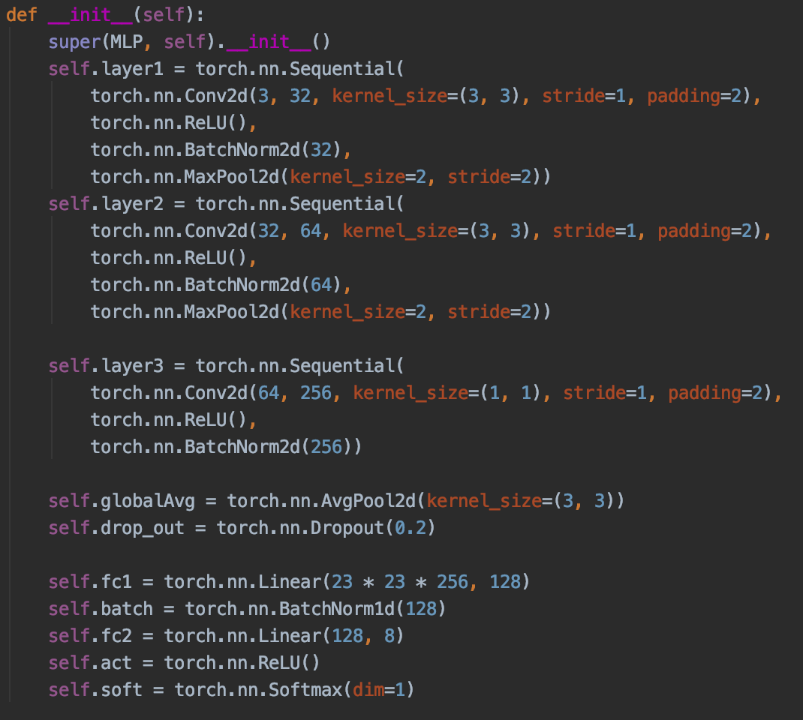
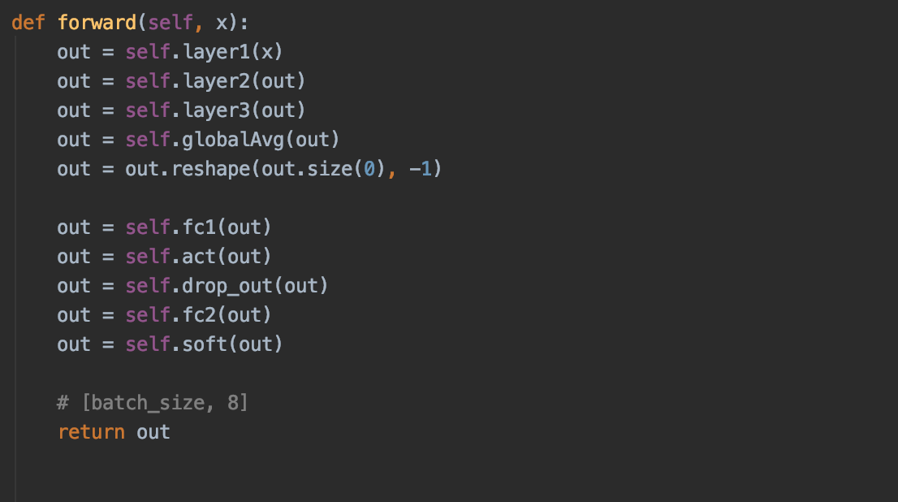
Implement Image Classification network from M3 in Pytorch
In this slide we can see the implementation in Pytorch of the model that we used for the project in M3.
We went through the architecture in keras in order to translate each layer to Pycharm syntax.
In the --init-- method we defined all the layers to be used in our architecture.
In the method forward we build the architecture connecting the differents layers in order to conform the architecture detailed in Keras.

Slide 10
Compute losses graphs and compare them with yours from Keras

Slide 11
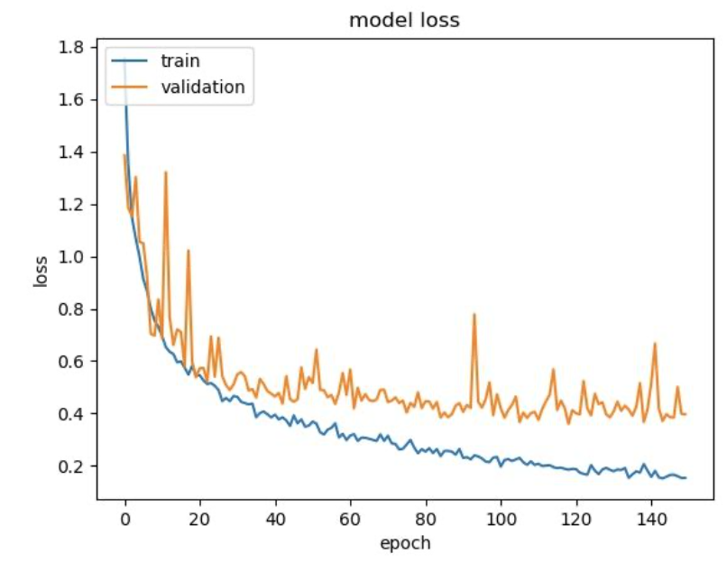
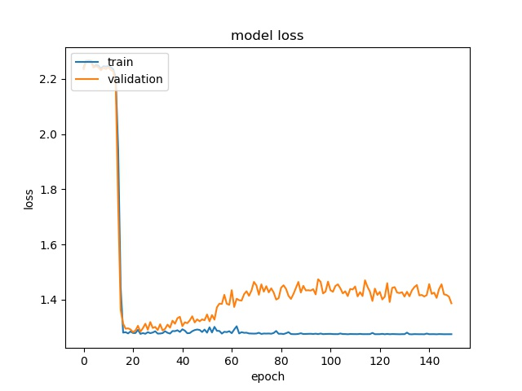
Compute losses graphs and compare them with yours from Keras
Keras
Pytorch
We can see that the result of loss in Keras is better than in Pytorch.
Pytorch: The loss curve on the training set and the test set drop first, then on the train set it stayed but on test set it increased and trend to balance.

Slide 12
Compute accuracy graphs and compare them with yours from Keras

Slide 13
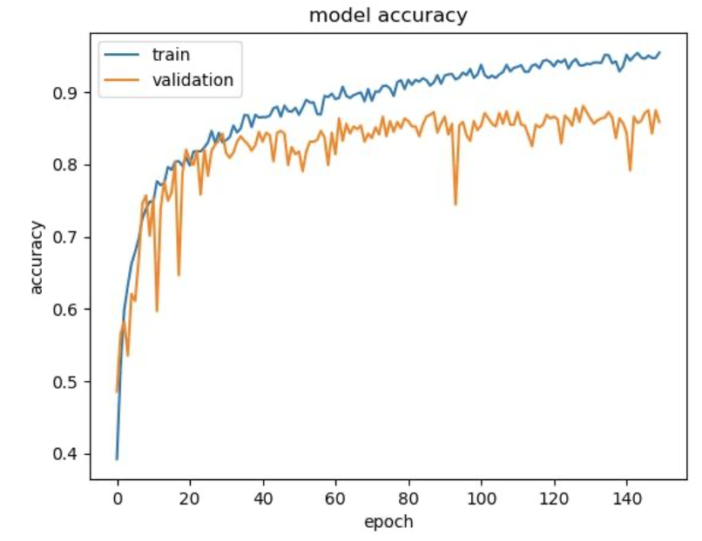
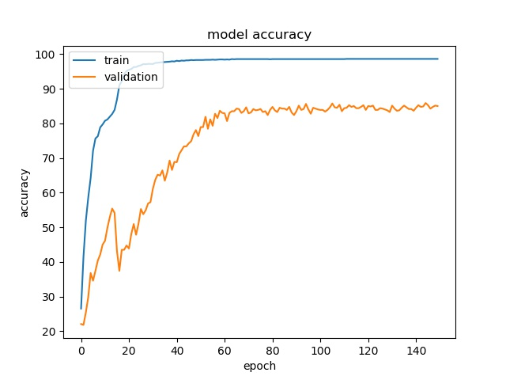
Compute accuracy graphs and compare them with yours from Keras
Keras
Pytorch
As we can see, while pytorch takes a little longer to get good accuracy for the test set, the training is more stable. The final accuracy is 87.2% for Keras and 85.0% for Pytorch.
This result is owin to the lack of data generation, since we have less data is necessary more iterations.

Slide 14
Conclusions

Slide 15
Conclusions
We have been able to implement the model that we used in the project for M3
The model trains in a more stable way than the one using Keras, but the accuracy is slightly worse, which might be because we used data augmentation in Keras, but not in Pytorch
The definition of layers is totally different in pytorch, then we had to learn how use this new framework
We can say that pytorch is a framework that allow to developer more flexibility and customization
The use of GPU is straightforward allowing complex architectures and big datasets
The results are very similar but different in the behaviour

Slide 16
Thanks

