Slide 1

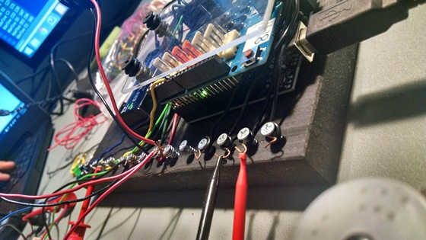
Construction System
Creative Technology Laboratory

Slide 2
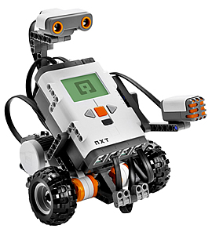
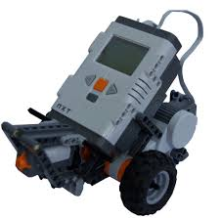
Construction System
Why are we doing it?
Lego kits are expensive and their configuration changes every 5 years, approximately.
Build-It-Yourself.com

Slide 3
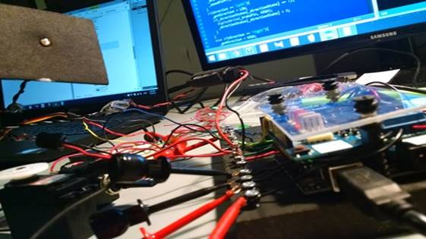
Our vision
Construction Machines
Build a system which can receive orders from different platforms, open source programming. Cheaper than Lego and with the same effectiveness.
Build-It-Yourself.com

Slide 4


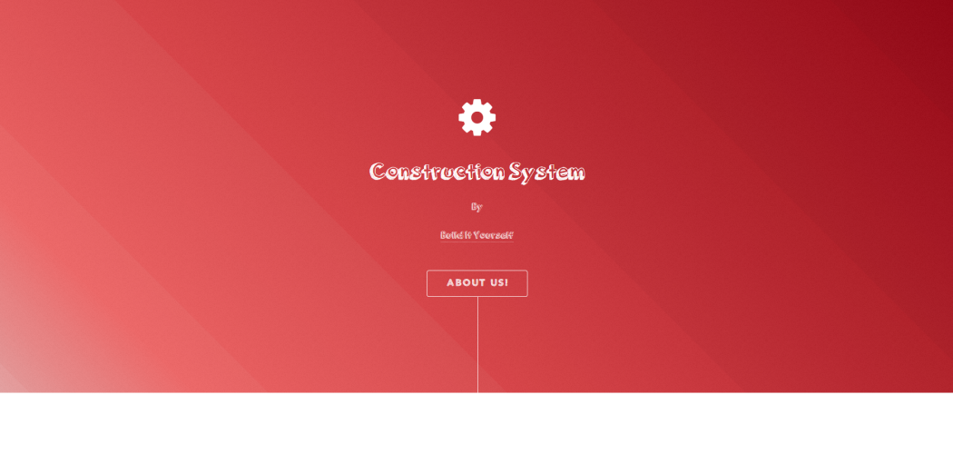
Uploading a program
Construction System
You can use one of our different platforms. You can select between a website, a Scratch program, or an executable for Windows.
Build-It-Yourself.com

