Slide 1

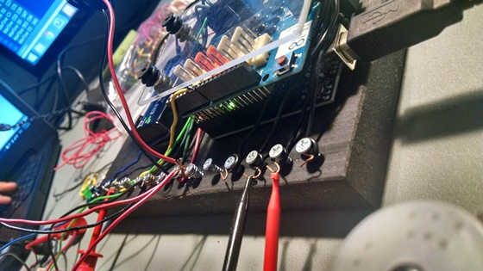
Construction System
Creative Technology Laboratory

Slide 2
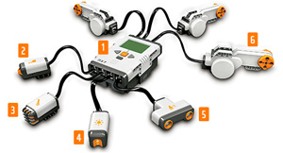
Construction System
Why are we doing it?
Lego kits are expensive and their configuration changes every 5 years, approximately.
Build-It-Yourself.com

Slide 3
Our vision
Construction Machines
Build a controller system which…
Is less than one third the price
Can be programmed by any program that controls a screen display
Does not change every 5-6 years
Costs less than $100
Build-It-Yourself.com

Slide 4


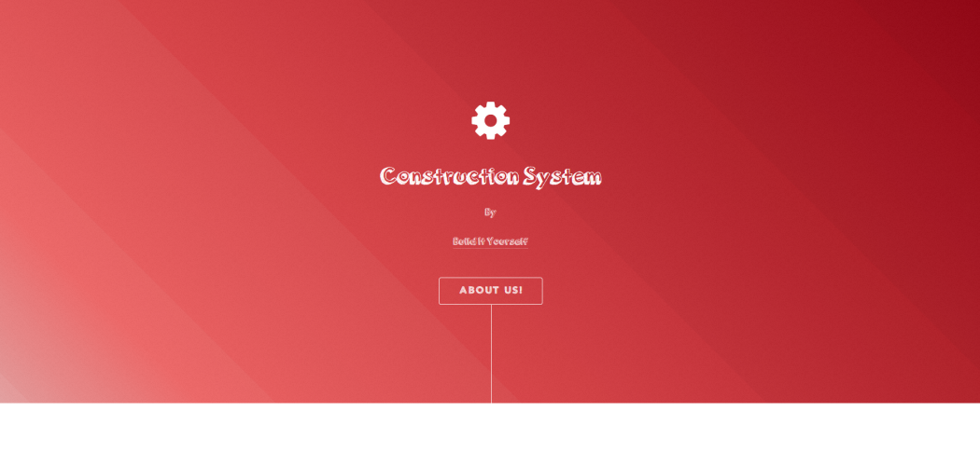
Uploading a program
Construction System
You can use one of our different platforms. You can select between a website, a Scratch program, or an executable for Windows.
Build-It-Yourself.com

Slide 5
Chart
Pros and no-pros
Test sensors

