Slide 1

Song lyrics generation by genre
Using LSTM Approach
Daniel David Glazman
Yuval Fisher

Slide 2
Introduction
Our goal in this project was to generate song yrics by a given genre – Pop or Rap.
The network receives as input the genre type and a starting sequence for the song. Upon processing these inputs through a trained model, it generates a complete song tailored to the provided genre and starting sequence.
To achieve this, we employed the Long Short-Term Memory (LSTM) approach, known for its effectiveness in modeling sequential data and capturing long-term dependencies.

Slide 3
The Dataset
We used a kaggle data set of 5 million song lyrics – Link.
We trained a model for both genres Pop and Rap.
We divided the dataset to batches and randomly sampled 5000 songs for each genre for the training process – overall we used 10000 songs.
Because the dataset has songs in several languages, we made sure that the sampled songs are in English only.

Slide 4
Data Preprocessing
Removing any unnecessary symbols, such as punctuation and parentheses.
Removing unnecessary song instruction words, such as “verse”, “intro”, ”outro”, etc.
Removing unnecessary numbers.
Refining Corpus Content: Remove any line with 2 words or less to make the songs more coherent and make sure to remove the artist’s name from the lyrics.
Tokenizing the lyrics.
Creating a lyrics corpus for each genre and unifying them.

Slide 5
Embedding
Instead of using the wasteful approach of One-Hot Encoding (Sparse vectors with one '1' and many '0’s), we encode each word with a unique integer and store it in a dictionary.
We enhance our model by incorporating genre information through genre embedding, representing genre as dense vectors. These vectors, combined with indexed words, create target word and sentence windows.
By integrating genre context with word sequences, our model learns genre-specific patterns, resulting in more contextually relevant predictions.

Slide 6
The Generation Model Architecture
Embedding Layer: - Converts input word indices and genre information into dense vector representations.
LSTM Layer: - Utilizes a LSTM architecture. - Incorporates dropout regularization to prevent overfitting. - Consists of two layers for capturing complex temporal dependencies.
Linear Output Layer: - Produces output predictions based on the final LSTM hidden state. - Outputs a vector the length of the vocabulary. - Applies softmax activation to generate a probability distribution over the vocabulary.
Training Process: - Learns genre-specific patterns through genre embedding. - Regularizes LSTM training with dropout to enhance generalization. - Employs softmax activation to convert raw output into probability distribution.

Slide 7
Generation Training Parameters
Data Handling: Input and output data are organized into batches with batch size of 2048, using TensorDataset and DataLoader.
Optimization: Uses Adam optimizer with a learning rate of 2e-4 to optimize model parameters.
Loss Calculation: Utilizes Cross-Entropy Loss for training the model.
Epochs: We trained the model for 20 epochs.

Slide 8
Validation Set
Data Preparation: Utilizing the train_test_split, we divided the dataset into training and validation sets, allocating 70% for training and 30% for validation. This ensures an adequate sample for model evaluation while preventing overfitting.
Crucial Evaluation: The validation set embodies the model's ability to generalize beyond the training data. Its role transcends mere evaluation, serving as a litmus test for the model's adaptability to unseen samples.
Validation Process: Validation was conducted alongside training using the validation set. The model, operating in evaluation mode, made predictions on the validation data.
Mitigating Overfitting: We tackle overfitting by closely monitoring the model's performance on unseen data using the validation set. This ensures that the model learns to generalize well without simply memorizing the training data.

Slide 9
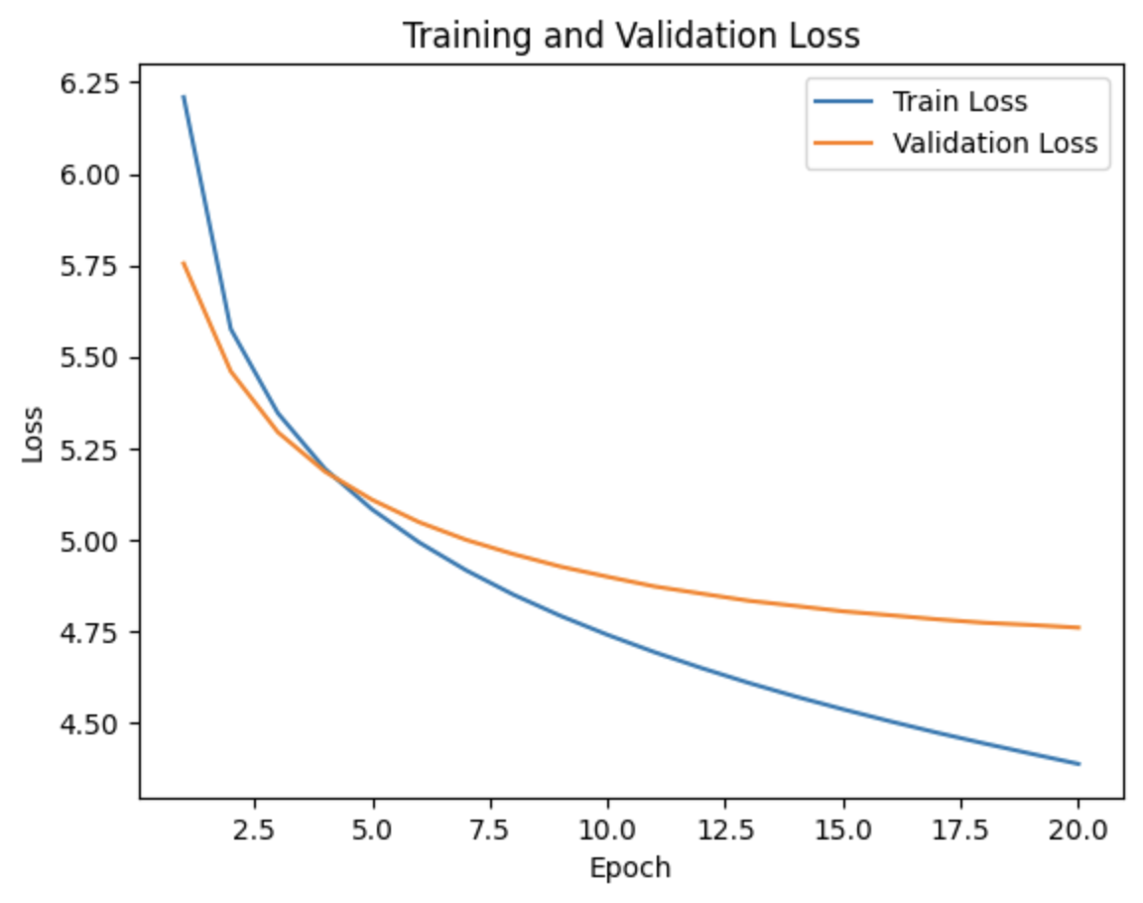
Generation Training and Validation Results
Training loss and Validation loss functions:

Slide 10
Generation Results
We loaded the trained model.
Based on user’s input we defined the seeding sentence of the song, namely the first phrase of the song lyrics.
Seeding provides a starting point and context for text generation, in our case song lyrics, guiding the model to produce coherent and thematically relevant output aligned with the desired style or mood.
We got as a result a full song that has a context to the first given phrase, and in addition we can notice that the generated lyrics have the structure of the given genre.

Slide 11
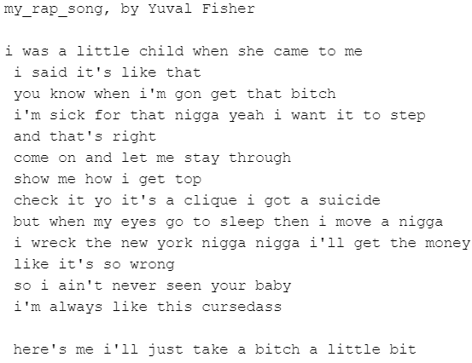

Generated Lyrics Example
Rap Song Lyrics
Pop Song Lyrics

Slide 12
Conclusion
Based on the results of the project, we conclude that LSTM networks are quite good at generating new text, song lyrics in our case.
Inspecting the generation results, we got songs that corresponded with the input parameter, namley the genre and the contexrt of the seeding sentence.
On the other hand, the songs weren’t perfect in terms of musical structure and in terms of ryming.

