Slide 1
096415 – Topics in Regression Final Project – Introducing DropLasso
Daniel Goman
Maximilian Matyash

Slide 2
Overview
Introduction
Definition
Property 1
Property 2
Solving DropLasso
Implementation
Results

Slide 3

Introduction
DropLasso was introduced in “DropLasso: A robust variant of Lasso for single cell RNA-seq data” by Khalfaoui and Vert, PSL Research University, Paris, France.
The motivation comes from the field of molecular analysis, in particular the paper focuses on using single cell RNA sequence data in order to classify cells into predefined classes.
Such data is prone to errors called dropouts referring to genes (features) that fail to be detected even though they are present. This is caused by the fact that the amount of RNA in a single cell is minuscule and therefore a large fraction can be lost during the preparation process.

Slide 4

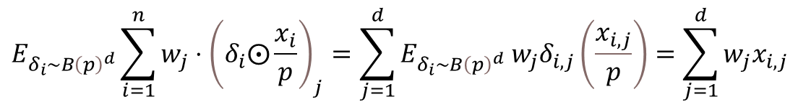
DropLasso
$$Definition:$$
$$\min_{w∈R^{d}}\left(\frac{1}{n}\sum_{i=1}^{n}{E_{δ_{i}\sim B{\left(p\right)}^{d}}L\left(w, δ_{i}⨀\frac{x_{i}}{p},y_{i}\right) }+λ{\left|\left|w\right|\right|}_{1}\right)$$
$$\text{Diving} \text{by} p \text{to} \text{ensure} \text{that} \text{on} \text{average} \text{the} \text{inner} \text{product} \text{between} \text{w} \text{and} δ_{i}⨀\frac{x_{i}}{p} \text{is} \text{independent} \text{of} \text{p}\text{:}$$
$$E_{δ_{i}\sim B{\left(p\right)}^{d}}\sum_{i=1}^{n}{w_{j}⋅{\left(δ_{i}⨀\frac{x_{i}}{p}\right)}_{j}=\sum_{j=1}^{d}{E_{δ_{i}\sim B{\left(p\right)}^{d}} w_{j}δ_{i,j}\left(\frac{x_{i,j}}{p}\right)=\sum_{j=1}^{d}{w_{j}x_{i,j}}}}$$
$$Remarks:$$
$p=1, λ>0 reduces to standard Lasso regularization$
$p<1, λ=0 reduces to standard dropout regularization$

Slide 5

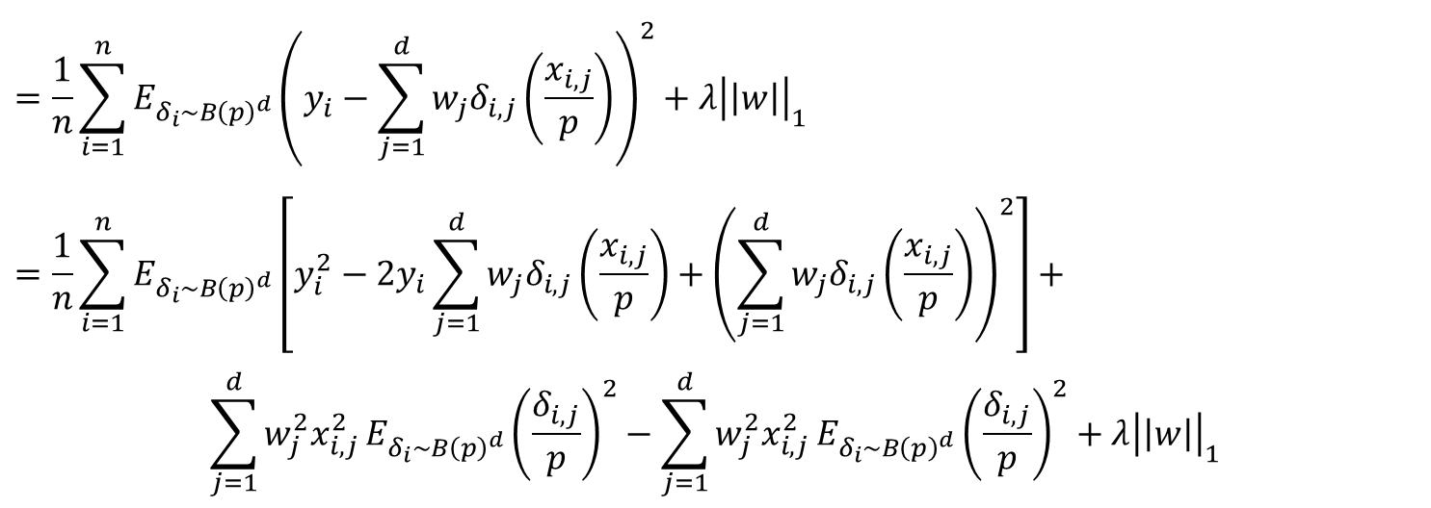
Property 1
For square loss:
Data is normalized $→$ DropLasso is equivalent to elastic net
Data isn’t normalized $→$ DropLasso is equivalent to elastic net with weighted ridge penalty
$$Proof:$$
$$\frac{1}{n}\sum_{i=1}^{n}{E_{δ_{i}\sim B{\left(p\right)}^{d}}L\left(w, δ_{i}⨀\frac{x_{i}}{p},y_{i}\right) }+λ{\left|\left|w\right|\right|}_{1}$$
$$=\frac{1}{n}\sum_{i=1}^{n}{E_{δ_{i}\sim B{\left(p\right)}^{d}}{\left(y_{i}−\sum_{j=1}^{d}{w_{j}δ_{i,j}\left(\frac{x_{i,j}}{p}\right)}\right)}^{2}}+λ{\left|\left|w\right|\right|}_{1}$$
$$=\frac{1}{n}\sum_{i=1}^{n}{E_{δ_{i}\sim B{\left(p\right)}^{d}}\left[y_{i}^{2}−2y_{i}\sum_{j=1}^{d}{w_{j}δ_{i,j}\left(\frac{x_{i,j}}{p}\right)}+{\left(\sum_{j=1}^{d}{w_{j}δ_{i,j}\left(\frac{x_{i,j}}{p}\right)}\right)}^{2}\right]+}$$
$$\sum_{j=1}^{d}{w_{j}^{2}x_{i,j }^{2}E_{δ_{i}\sim B{\left(p\right)}^{d}}{\left(\frac{δ_{i,j}}{p}\right)}^{2}−\sum_{j=1}^{d}{w_{j}^{2}x_{i,j }^{2}E_{δ_{i}\sim B{\left(p\right)}^{d}}{\left(\frac{δ_{i,j}}{p}\right)}^{2}}}+λ{\left|\left|w\right|\right|}_{1}$$

Slide 6

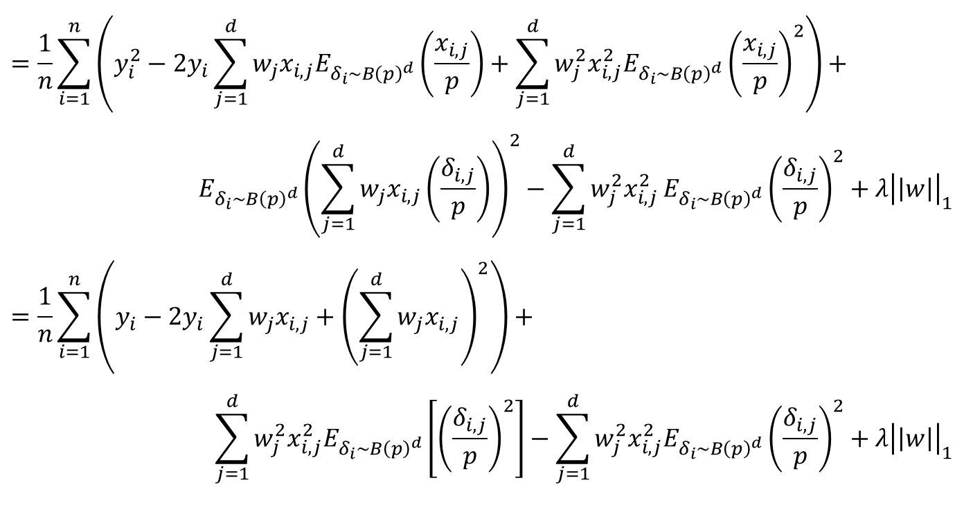
Property 1 proof – Cont.
$$=\frac{1}{n}\sum_{i=1}^{n}{\left(y_{i}^{2}−2y_{i}\sum_{j=1}^{d}{w_{j}x_{i,j}E_{δ_{i}\sim B{\left(p\right)}^{d}}\left(\frac{x_{i,j}}{p}\right)+\sum_{j=1}^{d}{w_{j}^{2}x_{i,j}^{2}E_{δ_{i}\sim B{\left(p\right)}^{d}}{\left(\frac{x_{i,j}}{p}\right)}^{2}}}\right)+}$$
$${E_{δ_{i}\sim B{\left(p\right)}^{d}}\left(\sum_{j=1}^{d}{w_{j}x_{i,j}\left(\frac{δ_{i,j}}{p}\right)}\right)}^{2}−\sum_{j=1}^{d}{w_{j}^{2}x_{i,j }^{2}E_{δ_{i}\sim B{\left(p\right)}^{d}}{\left(\frac{δ_{i,j}}{p}\right)}^{2}}+λ{\left|\left|w\right|\right|}_{1}$$
$$=\frac{1}{n}\sum_{i=1}^{n}{\left(y_{i}−2y_{i}\sum_{j=1}^{d}{w_{j}x_{i,j}}+{\left(\sum_{j=1}^{d}{w_{j}x_{i,j}}\right)}^{2}\right)+}$$
$$\sum_{j=1}^{d}{w_{j}^{2}x_{i,j}^{2}E_{δ_{i}\sim B{\left(p\right)}^{d}}\left[{\left(\frac{δ_{i,j}}{p}\right)}^{2}\right]}−\sum_{j=1}^{d}{w_{j}^{2}x_{i,j}^{2}E_{δ_{i}\sim B{\left(p\right)}^{d}}{\left(\frac{δ_{i,j}}{p}\right)}^{2}}+λ{\left|\left|w\right|\right|}_{1}$$
$$swap between 3^{rd}$$
$$and 4^{th} terms$$

Slide 7
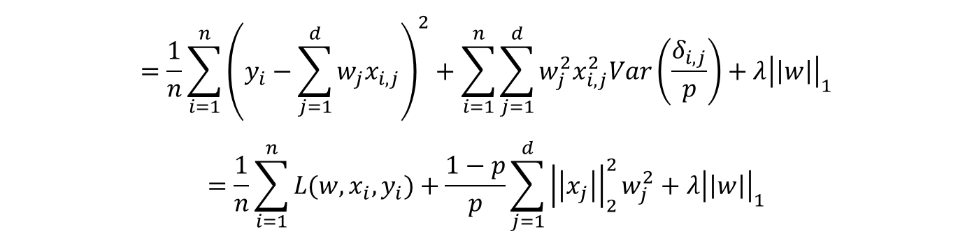
Property 1 proof – Cont.
$$=\frac{1}{n}\sum_{i=1}^{n}{{\left(y_{i}−\sum_{j=1}^{d}{w_{j}x_{i,j}}\right)}^{2}+\sum_{i=1}^{n}{\sum_{j=1}^{d}{w_{j}^{2}x_{i,j}^{2}Var\left(\frac{δ_{i,j}}{p}\right)}}}+λ{\left|\left|w\right|\right|}_{1}$$
$$=\frac{1}{n}\sum_{i=1}^{n}{L(w, x_{i},y_{i})}+\frac{1−p}{p}\sum_{j=1}^{d}{{\left|\left|x_{j}\right|\right|}_{2}^{2}w_{j}^{2}}+λ{\left|\left|w\right|\right|}_{1}$$
For square loss:
$Data is normalized→ DropLasso is equivalent to elastic net$
$Data isn’t normalized → DropLasso is equivalent to elastic net with weighted ridge penalty$

Slide 8
Property 2
DropLasso can be approximated by an adaptive version of elastic net that encourages more confident predictions.
Preparation for proof:
$$L_{logistic}\left(w, x_{i}, y_{i}\right)=\log{(1+\exp{(−y_{i}\sum_{j=1}^{d}{w_{j}x_{i,j}})})}=\log\left(1+\exp\left(−y_{i}w^{T}x_{i}\right)\right)$$
$$\frac{∂^{2}L\left(w,x_{i},y_{i}\right)}{∂x_{i,j}^{2}}=\frac{∂}{∂x_{i,j}}\frac{−y_{i}w_{j}}{1+e^{y_{i}w^{T}x_{i}}}=y_{i}w_{j}{\left(1+e^{y_{i}w^{T}x_{i}}\right)}^{−2}e^{y_{i}w^{T}x_{i}}y_{i}w_{j}=y_{i}^{2}w_{j}^{2}\frac{e^{y_{i}w^{T}x_{i}}}{{\left(1+e^{y_{i}w^{T}x_{i}}\right)}^{2}}$$
Important Note:
$$y_{i}^{2}w_{j}^{2}\frac{e^{y_{i}w^{T}x_{i}}}{{\left(1+e^{y_{i}w^{T}x_{i}}\right)}^{2}}=y_{i}^{2}w_{j}^{2}\frac{e^{y_{i}w^{T}x_{i}}}{1+2e^{y_{i}w^{T}x_{i}}+e^{2y_{i}w^{T}x_{i}}}=y_{i}^{2}w_{j}^{2}\frac{1}{2+e^{−y_{i}w^{T}x_{i}}+e^{y_{i}w^{T}x_{i}}}$$
Note that this term is invariant to the sign of $y_{i}$ and given $y_{i}∈\left\{−1, 1\right\}$ we can ignore it.

Slide 9
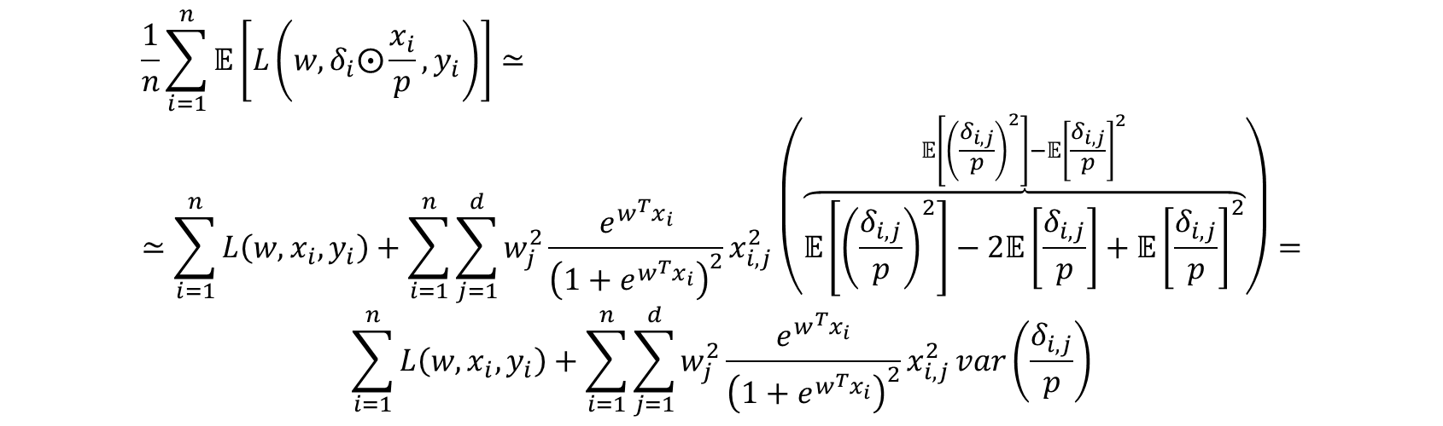
Property 2 proof
Second order Taylor expansion:
$$L\left(w, δ_{i}⨀\frac{x_{i}}{p}, y_{i}\right)≈L\left(w, x_{i}, y_{i}\right)+\sum_{j=1}^{d}{\frac{∂L\left(w, x_{i},y_{i}\right)}{∂x_{i,j}}}\left(\frac{δ_{i,j}}{p}−1\right)x_{i,j}+\frac{1}{2}\sum_{i=1}^{d}{\frac{∂L\left(w, x_{i},y_{i}\right)}{∂x_{i,j}^{2}}}{\left(\frac{δ_{i,j}}{p}−1\right)}^{2}x_{i,j}^{2}$$
If we take expectation w.r.t $δ_{i}$, the first order term cancels out since $𝔼\left[δ_{i}⨀\frac{x_{i}}{p}\right]=x_{i}$
$$\frac{1}{n}\sum_{i=1}^{n}{𝔼\left[L\left(w,δ_{i}⨀\frac{x_{i}}{p},y_{i}\right)\right]≃}≃\sum_{i=1}^{n}{L\left(w, x_{i},y_{i}\right)}+\sum_{i=1}^{n}{\sum_{j=1}^{d}{w_{j}^{2}\frac{e^{w^{T}x_{i}}}{{\left(1+e^{w^{T}x_{i}}\right)}^{2}}x_{i,j}^{2}}}\left(\overset{𝔼\left[{\left(\frac{δ_{i,j}}{p}\right)}^{2}\right]−𝔼{\left[\frac{δ_{i,j}}{p}\right]}^{2}}{\overbrace{𝔼\left[{\left(\frac{δ_{i,j}}{p}\right)}^{2}\right]−2𝔼\left[\frac{δ_{i,j}}{p}\right]+𝔼{\left[\frac{δ_{i,j}}{p}\right]}^{2}}}\right)=$$
$$\sum_{i=1}^{n}{L\left(w, x_{i},y_{i}\right)}+\sum_{i=1}^{n}{\sum_{j=1}^{d}{w_{j}^{2}\frac{e^{w^{T}x_{i}}}{{\left(1+e^{w^{T}x_{i}}\right)}^{2}}x_{i,j}^{2}}}var\left(\frac{δ_{i,j}}{p}\right)$$

Slide 10
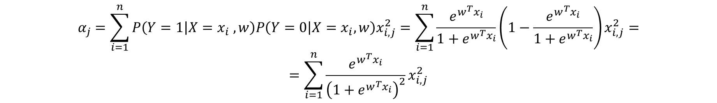
Define:
$$α_{j}=\sum_{i=1}^{n}{P\left(Y=1 | X=x_{i} , w\right)P\left(Y=0 | X=x_{i}, w\right)x_{i,j}^{2}}=\sum_{i=1}^{n}{\frac{e^{w^{T}x_{i}}}{1+e^{w^{T}x_{i}}}\left(1−\frac{e^{w^{T}x_{i}}}{1+e^{w^{T}x_{i}}}\right)x_{i,j}^{2}}=$$
$$=\sum_{i=1}^{n}{\frac{e^{w^{T}x_{i}}}{{\left(1+e^{w^{T}x_{i}}\right)}^{2}}x_{i,j}^{2}}$$
Finally, we get:
$$\frac{1}{n}\sum_{i=1}^{n}{𝔼\left[L\left(w,δ_{i}⨀\frac{x_{i}}{p},y_{i}\right)\right]}+λ{\left\|w\right\|}_{1}≃\sum_{i=1}^{n}{L\left(w, x_{i},y_{i}\right)}+\frac{1−p}{p}\sum_{j=1}^{d}{α_{j}w_{j}^{2}}+λ{\left\|w\right\|}_{1}$$

Slide 11
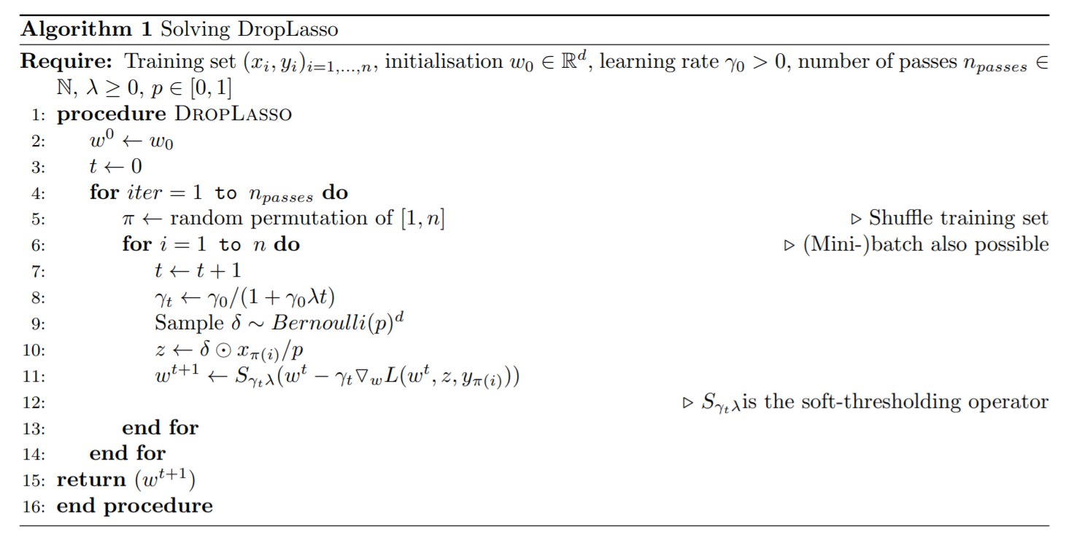
Pseudo Code

Slide 12
Implementation
We implemented the pseudo code in python
We simulated data
We ran DropLasso along with Dropout and Elastic Net on it

Slide 13
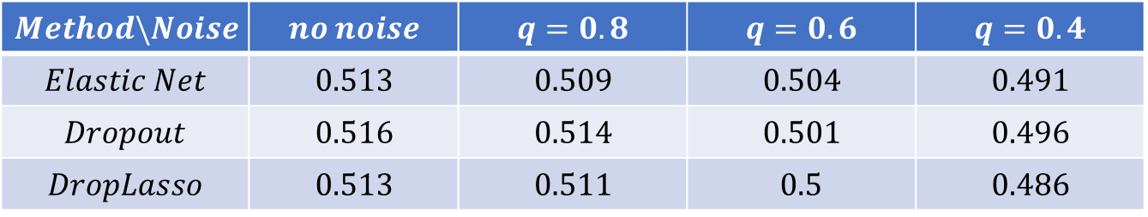
Results
$$q=0.4$$ | $$q=0.6$$ | $$q=0.8$$ | $$no noise$$ | $$Method\backslash Noise$$
$$0.491$$ | $$0.504$$ | $$0.509$$ | $$0.513$$ | $$Elastic Net$$
$$0.496$$ | $$0.501$$ | $$0.514$$ | $$0.516$$ | $$Dropout$$
$$0.486$$ | $$0.5$$ | $$0.511$$ | $$0.513$$ | $$DropLasso$$

Slide 14

Thanks for listening!

