Slide 1

Python & SQL
SQL
Bryan Cafferky

Slide 2


Python & SQL
SQL

Slide 3

Python SQL
SQL
Bryan Cafferky
https://github.com/bcafferky/shared

Slide 4

Python SQL
SQL
Bryan Cafferky

Slide 5
About Me...
Author
Microsoft TSP
Azure Data Science Training Developer
Data and AI Consultant
https://github.com/bcafferky/shared

Slide 6

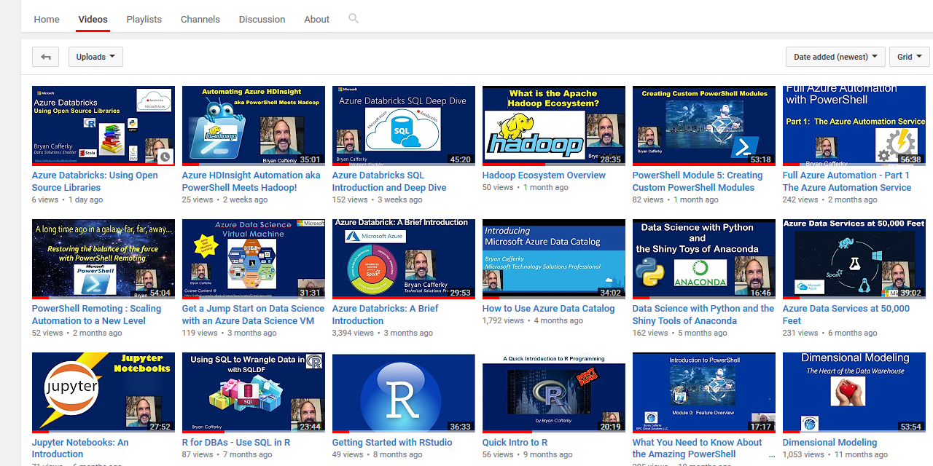
Subscribe to my YouTube Channel
https://www.youtube.com/c/BryanCafferky

Slide 7
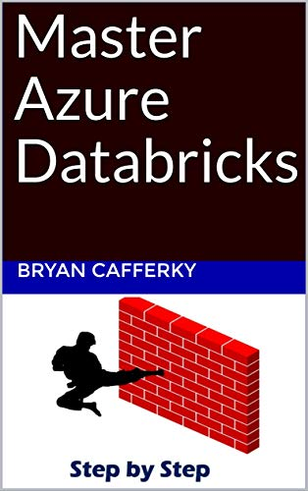
Apache Spark Based Service
Comprehensive Resource
From Beginner to Expert
Expert Resource
Step by Step Use Case

Slide 8

Important Information Follows

Slide 9


Presentation Goals
Lightning Intro to Python
Why SQL in Python?
The Easiest Way to SQL
More Robust SQL
Accessing SQL Databases
Wrapping Up
SQL
https://www.clipartmax.com/download/m2i8K9H7G6b1i8H7_cute-cartoon-panda-cute-panda/

Slide 10
Python review
Python is a scripting language like many other languages.
Two modes of running Python.
A command prompt REPL (Read, Eval, Print and Loop)
Programs can be developed in a Text editor (IDE) and run
Multiple Paradigms:
Functional
Object Orientated
Procedural

Slide 11

Getting Python
Best Method: Install the Anaconda Distribution of Python
https://www.anaconda.com/download/
Install with Miniconda
https://conda.io/miniconda.html
Just Python
https://www.python.org/downloads/

Slide 12
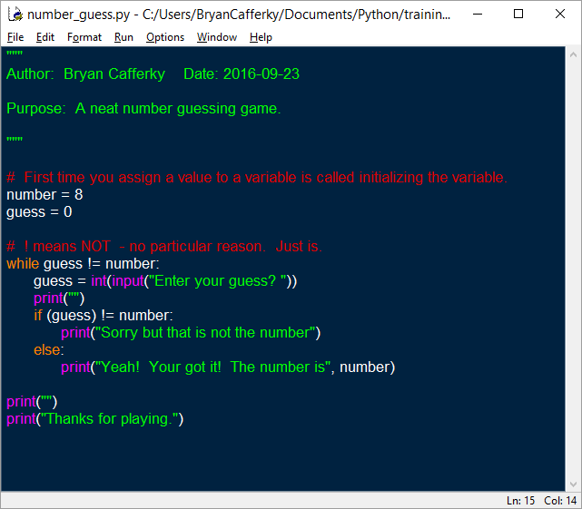
Lightning Introduction
!!! Indentation is Critical !!!
Comment block.
Inline comment.
Declare and initialize variables. Dynamic typing.
Case sensitive!
While loop with code
block.
Readability is Paramount!!!!

Slide 13

What is Pandas?
Open Source Python Package
Rich Features for Data Manipulation Like R Data Frames
Read Data from Many Formats
Fast and Memory Efficient
“The” Standard Python Data Wrangling Library
Built-In SQL Support
https://pandas.pydata.org/pandas-docs/stable/overview.html

Slide 14

Importing Pandas
Standard Module Prefixes
Numpy is for fast array handling
Visualizations Support
https://pandas.pydata.org/pandas-docs/stable/10min.html

Slide 15

Why SQL?
Jump Start Your Data Query and Wrangling Capability
SQL Just Makes Sense
Scalability and Performance
Why Not?

Slide 16
The Easiest Way to Use SQL - pysqldf
Uses SQLite under the covers
Can treat Pandas data frames as if they were tables
Good for small workloads
SQL is somewhat limited
Jump start data wrangling with Python

Slide 17
Installing pysqldf
> pip install –U pandasql
> pip install –U pysqldf
Demo

Slide 18

A More Robust Approach -
Automatically Installed with Python. Batteries Included.
Built-in Fully Functional Database.
Good SQL Support.
Great for local application or analysis work.
Demo

Slide 19
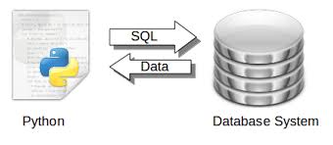
Querying a Full-Scale DBMS with ODBC
Using ODBC to Connect to Popular Databases
Python Favors PostgreSQL
A Production Grade Solution
Maximum Flexibility
https://pythonspot.com/tag/sql/
Demo

Slide 20
Demo Time!

Slide 21

The Name That Shall Not Be Spoken
Used by developers for the ORM
Supports three modes (ORM, function API, SQL pass through)
Production scale performance (be wary) ?
Very Popular but too much to cover here

Slide 22

Wrapping Up
Lightning Intro to Python
Why SQL in Python?
The Easiest Way to SQL
More Robust SQL
Accessing SQL Databases
Wrapping Up

