Slide 1





Python + SQL + SQLite
DW

Slide 2
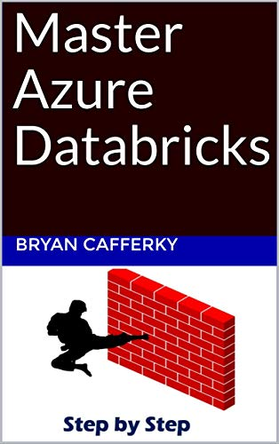
Apache Spark Based Service
Comprehensive Resource
From Beginner to Expert
Step by Step Use Case
Available on Amazon!

Slide 3
Where Are We Going?
The Proposal: Use SQLite as a local DW
Power & Features of SQLite
The Local Data Warehouse Architecture
Free Python Class to Read any SQL Database
Riveting End to End DW Load and EDA

Slide 4
The Proposal
Data Analysis Requires Many Transformations
These Are Often Applied in a Layered Approach
Create New Columns for Analysis and Model Features
Stratify and Prepare Data for Model Training
Use SQLite to Save the Transformed Data
Like your own Local Data Warehouse
Step By Step Notebook with Code Included

Slide 5
SQLite Power
Maximum Database Size: 281 terabytes
Maximum # Tables in a Database: 2 billion
Maximum Number of Joins in a Query: 64
Maximum Size of Query: 107,374,1824

Slide 6
SQLite Features
Zero Configuration / Built into Python
Less Than 600 KB memory footprint
Support for Views, Triggers, Window Functions
Indexes (Clustered, Partial, Index Expressions)
Full ACID Support (Commit/Rollback)
In-Memory Database Support
Public Domain (No License Req.)

Slide 7




Instant Data Warehouse
Python
Pandas
SQLite
PyODBC
Adventure Works
Adventure Works
CSV Files
JSON Files
AW EDA

Slide 8
Demo
Demo

Slide 9
Wrapping Up
The Proposal: Use SQLite as a local DW
Features of SQLite
The Local Data Warehouse Architecture
Free Python Class to Read any SQL Database
Riveting End to End DW Load and EDA

Slide 10
Wrapping Up
Thank You!

