Slide 1




Use SQLite Upsert in Python
Upsert

Slide 2


Maintaining Data in SQLite
with Python
Part 1
Insert
Update
Delete
Bryan Cafferky
Data and AI Enabler

Slide 3
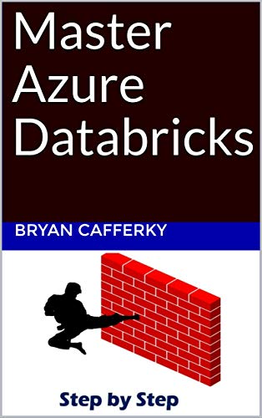
Apache Spark Based Service
Comprehensive Resource
From Beginner to Expert
Step by Step Use Case
Available on Amazon!

Slide 4
Where Are We Going?
What is Data Maintenance?
Why Maintain the Data?
The Traditional DML Statements
The tools of the trade
Riveting demo

Slide 5



Problem: Database Table Maintenance
Enterprise
Database
(Data Source)
Transactions
Target
Table
Flat File
Transactions
Add
Change
Delete
Local Database

Slide 6
Why Maintain the Data
Data is constantly changing!
Volume is High to Drop and Replace
You Get Current and Reliable Data

Slide 7
Traditional DML Statments
Insert
Use Insert Statement to Perform Adds.
Update Statement to Apply Changes.
Delete Statement to Remove Rows.
Update
Delete

Slide 8
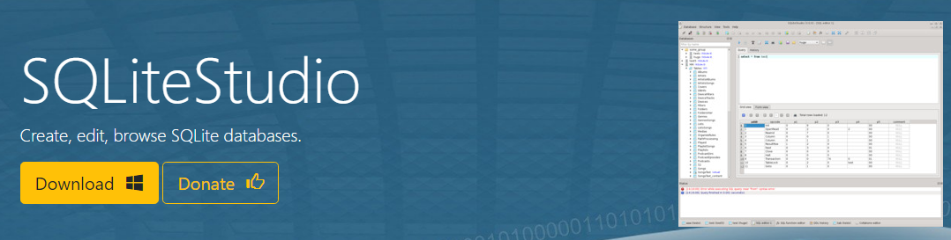
The Tools of the Trade
https://sqlitestudio.pl/

Slide 9
Demo
Demo

Slide 10
Wrapping Up
What is Data Maintenance?
Why Maintain the Data?
The Traditional DML Statements
The tools of the trade
Riveting demo

Slide 11
Wrapping Up
Thank You!

