Slide 1
IWA 19 BOOK-CONNECT
DANIEL GUEZO

Slide 2
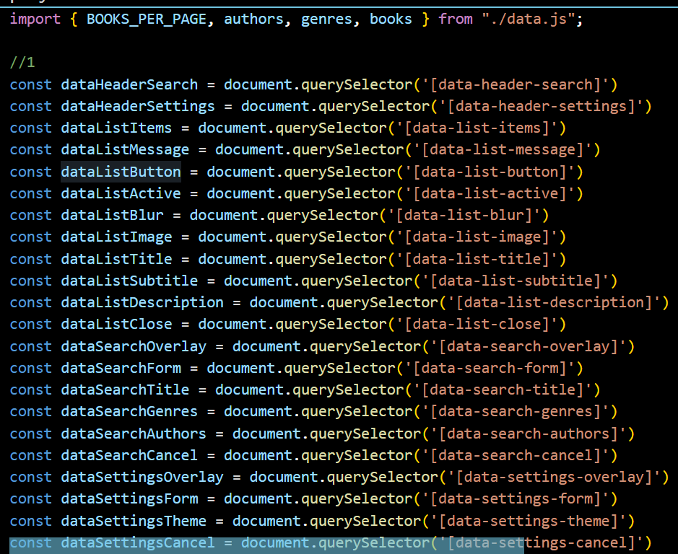
#1) Select elements from the Document Object Model using data attributes

Slide 3
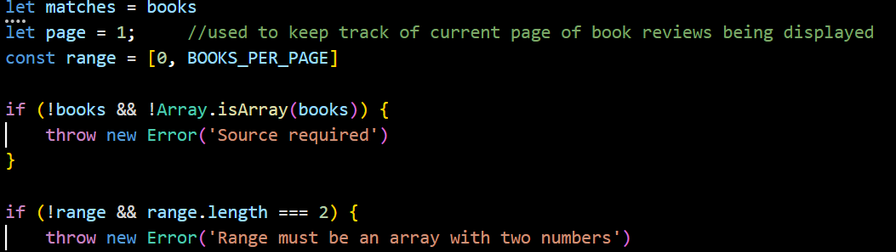
#2) Preview books

Slide 4
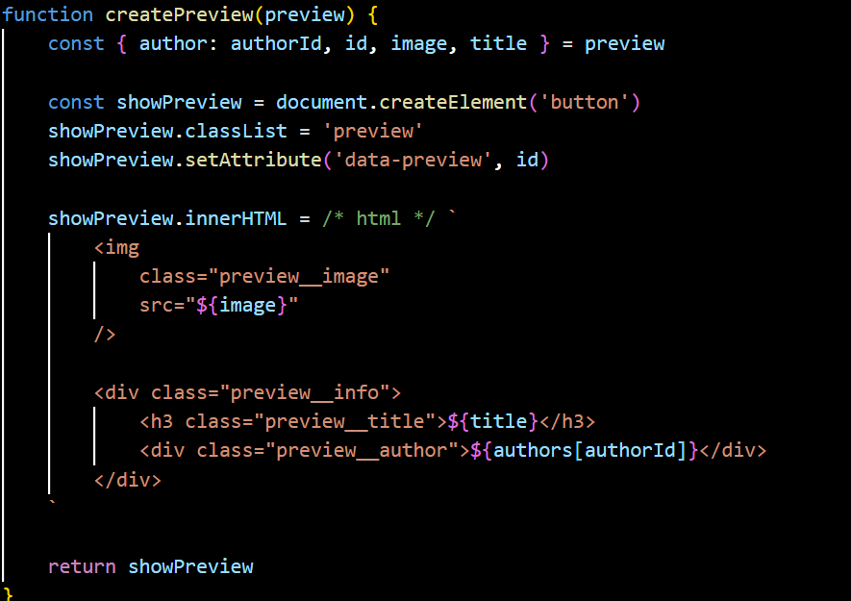
#3) The createPreview() function takes a book preview and returns a button

Slide 5
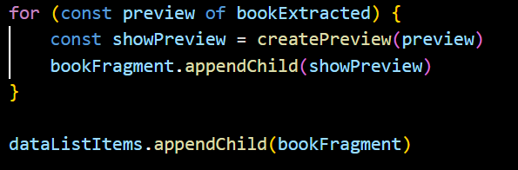
#4) This loop repeats over the book previews to display on the current page

Slide 6
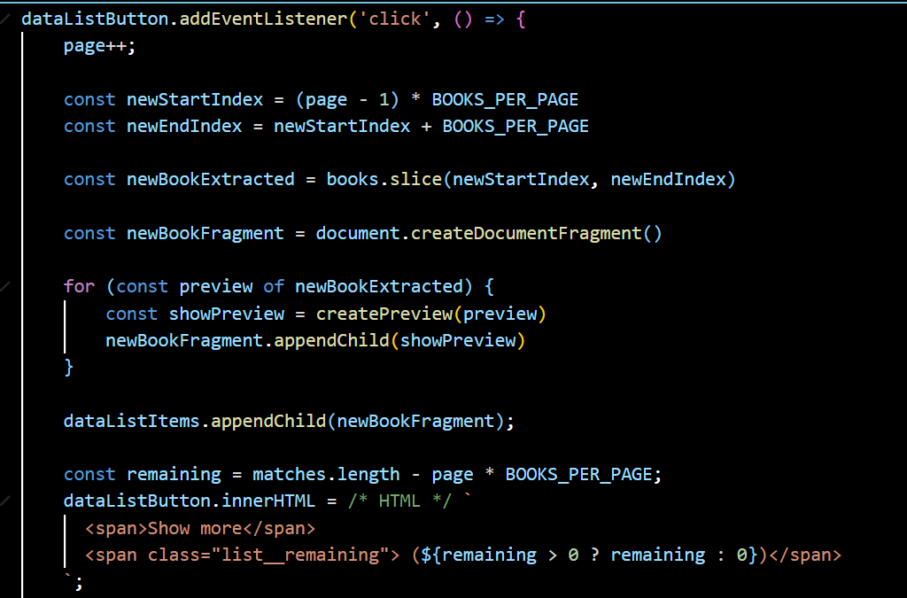
#5)This sets up a click event listener for the "Show More" button

Slide 7
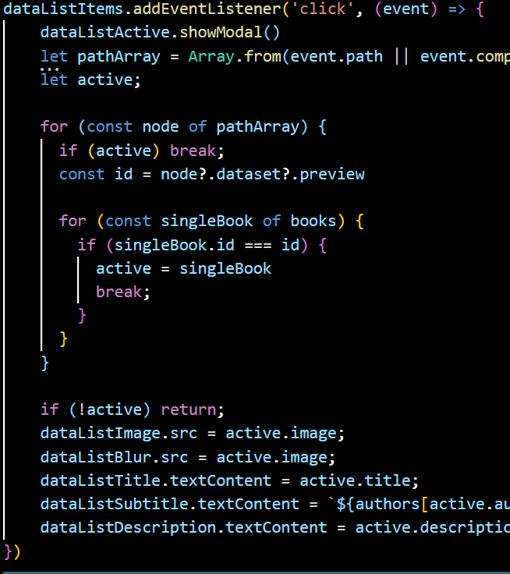
#6) Book Summary

Slide 8
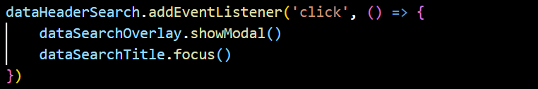
#7) Genres and Authors

Slide 9
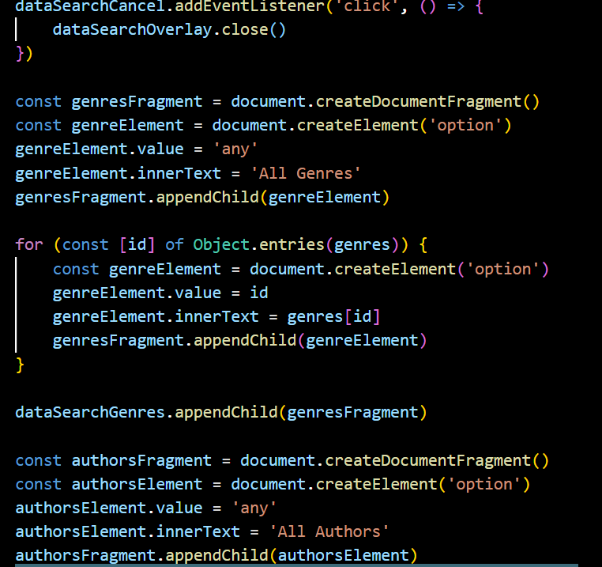
#8) closes modal by invoking close() on dataSearchOverlay

Slide 10
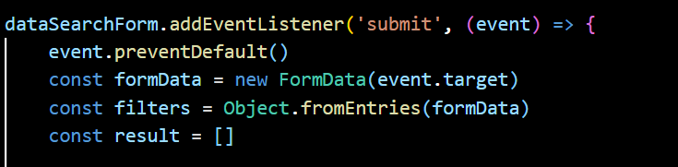
#9) Filter books by Title, Genre and Author

Slide 11
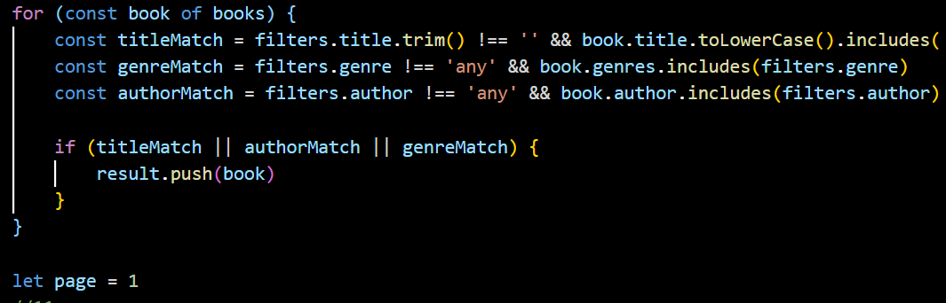
#10) Checks if any of the filters matches with the books

Slide 12
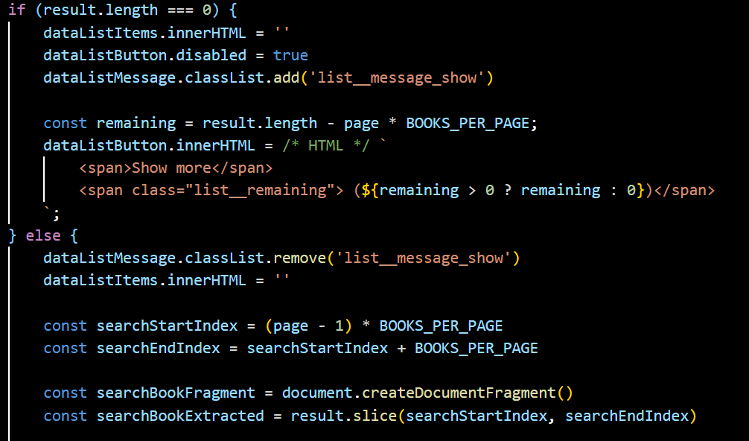
#11) Checks the result array and the result length is equal to 0 none

Slide 13
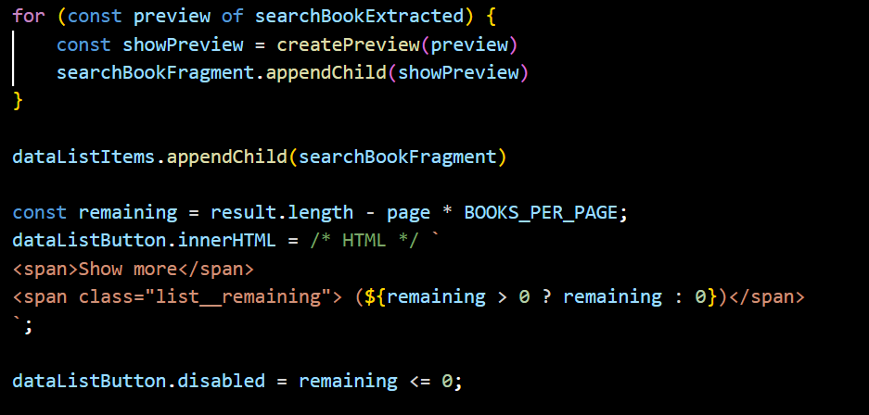
#12) Book previews to display on the current page

Slide 14
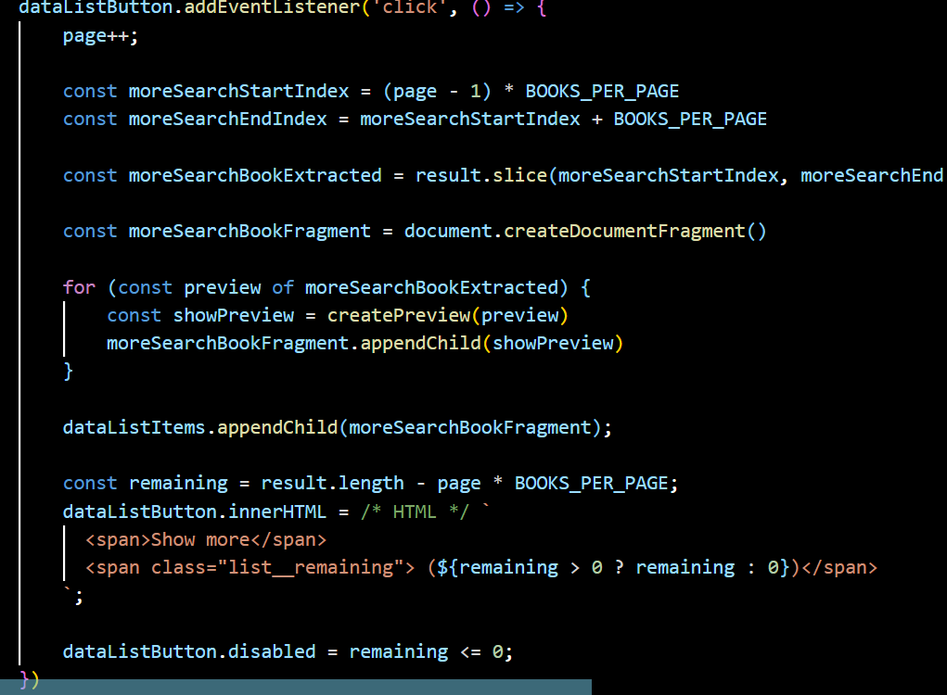
13) Event listener for the "Show More" button

Slide 15
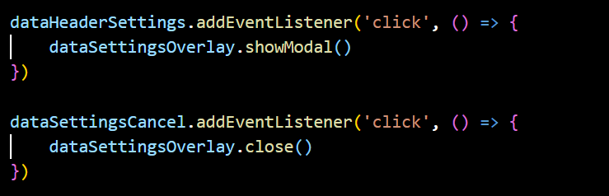
#14) Select Theme

Slide 16
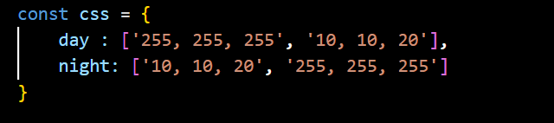
#15) Day and Night Theme

Slide 17
#16) Datasettingstheme

Slide 18
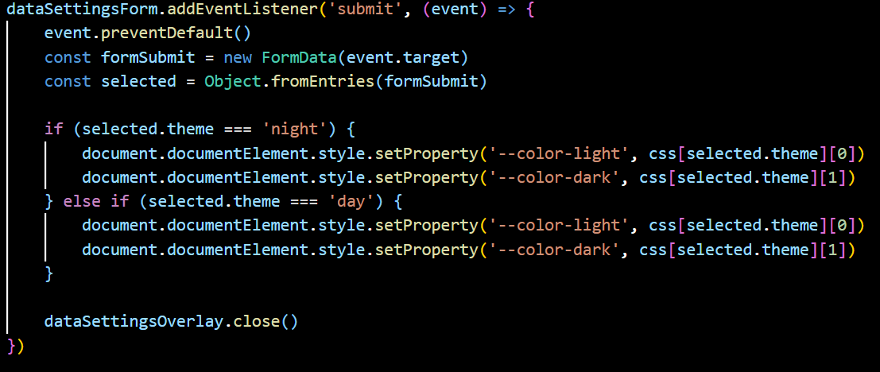
#17) Submit event listener

