Slide 1
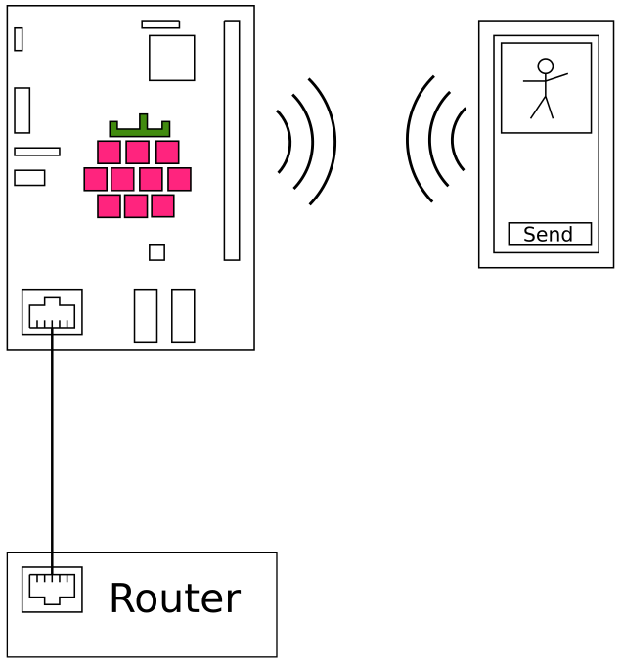
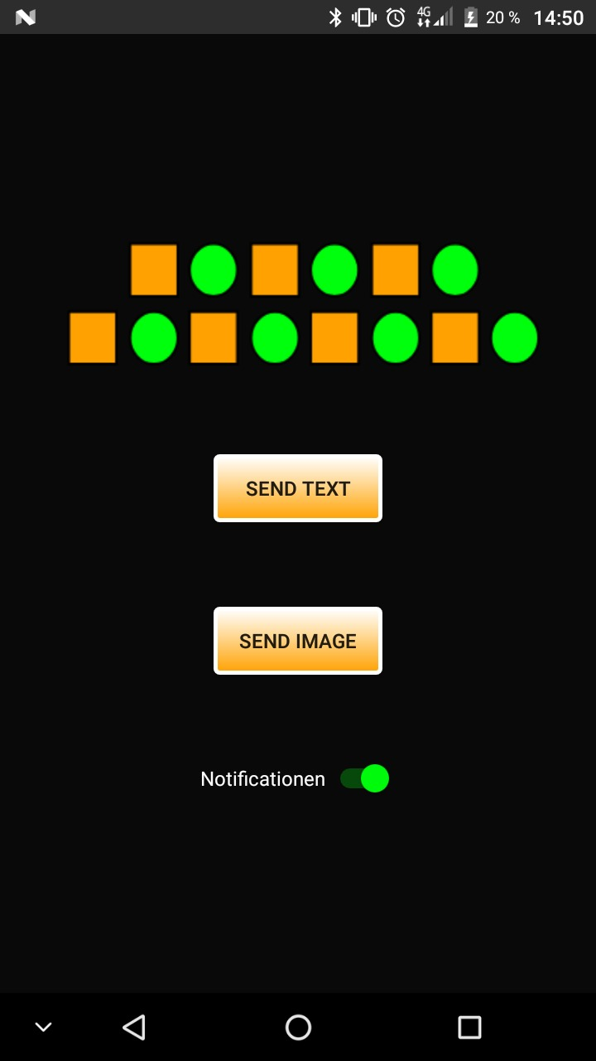
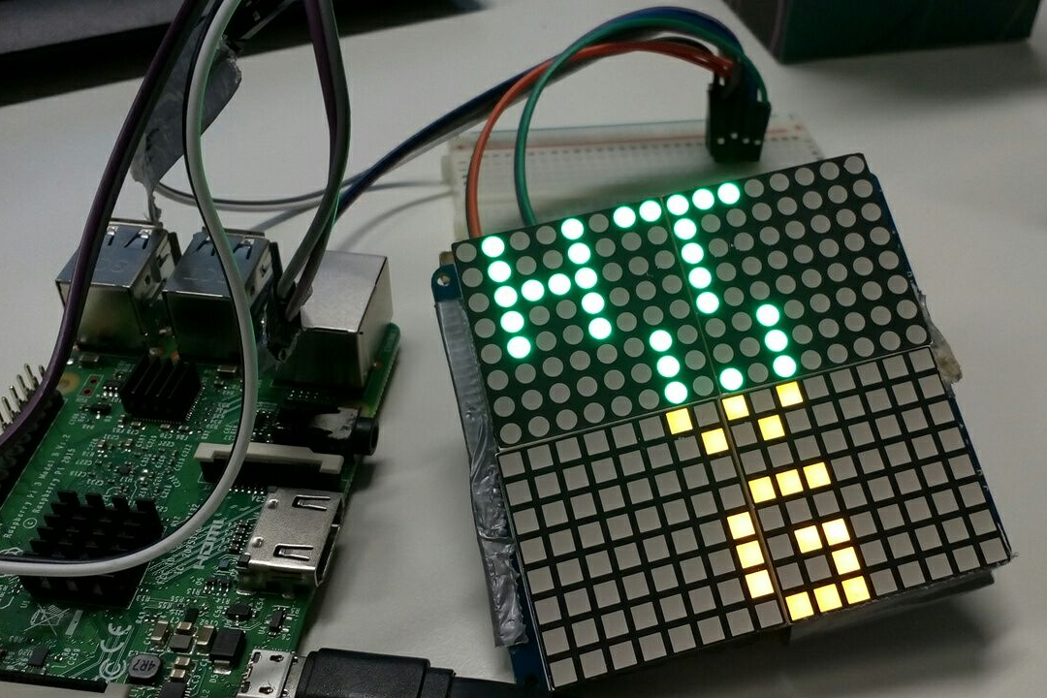


Dot Matrix Notifier
Daniel Hipp, Etienne Gramlich, Thomas Gnädig
{dahipp,etgramli,thgnaedi}
Abstract
The Dot Matrix Notifier can be used to display messages, images or notifications from an Android smartphone to a 16x16 LED-Matrix. A MAX7219 LED Driver is used to handle the 256 individual LEDs.
The communication between the Android smartphone and the matrix is established by a Raspberry Pi 3. The Pi will be connected to a router via LAN for internet access and shares this via WiFi.
The user's smartphone will be connected to this WiFi interface and can use the internet as usual.
Additionally it can send HTTP GET requests, which contains the text or images which should be displayed on the matrix, to the Raspberry Pi. Images will be shown as binary 16x16 images and messages will be shown as scrolling text.
Architecture
Raspberry Pi connects all components
Smartphone conntects over WiFi to the Pi
Matrix over I²C to the Raspberry Pi
HTTP Server on the Pi listening for requests
User sends text/images from smartphone to the Pi

