Slide 1

MRI
HW2-FLASH
Presenter：
M11107309 何柏昇

Slide 2

OUTLINE
EX2.1 Simulate The Timing of M_{xy} and M_{z}
Introduction
Method
Experimental Results
EX2.2 The Maximum MRI Image Brightness
Introduction
Method
Experimental Results
EX2.3 Subcortical Structures
Introduction
Method
Experimental Results

Slide 3
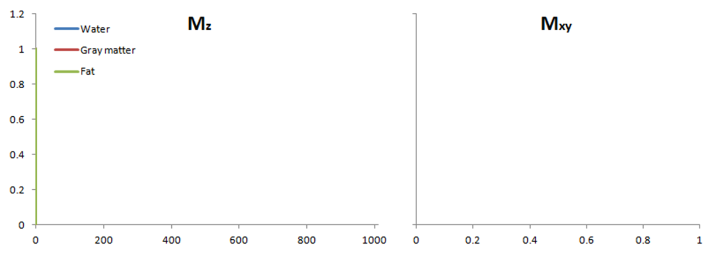
Introduction
M _{z} = M * (1 - e ^{- t /T1})
M _{xy} = M ₀ * e ^{- t /T2}
http://xrayphysics.com/sequences.html

Slide 4
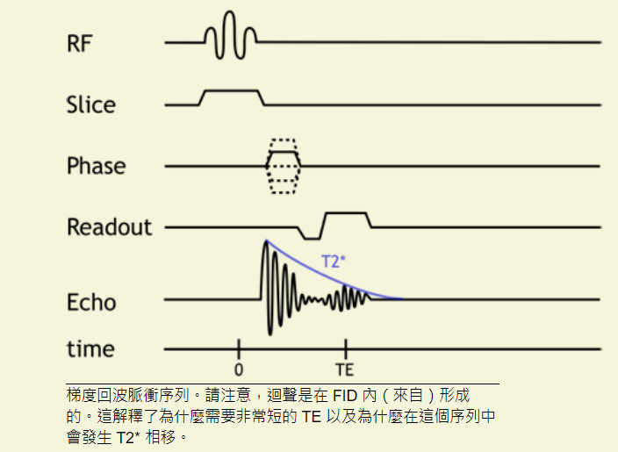
Introduction
Gradient Echo
由於 T2 效應未被抵消，GRE 序列的信號損失更快，因此通常使用更短的 TE。
更短的 TE 允許使用更短的 TR，這增加 了T1 權重
http://xrayphysics.com/sequences.html

Slide 5
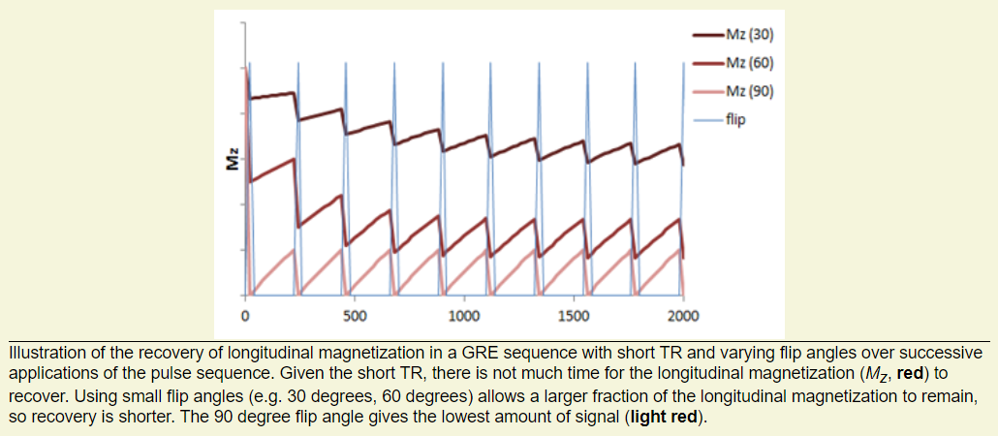
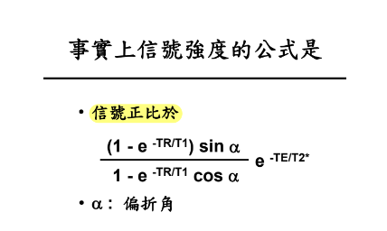
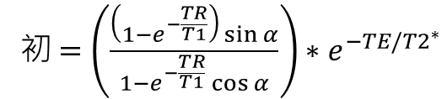

Introduction
$$M_{z}={終+(初−終)e}^{−t/T1}$$
初$=\left(\frac{\left(1−e^{−\frac{TR}{T1}}\right)\sin{α}}{1−e^{−\frac{TR}{T1}}\cos{α}}\right)∗e^{−TE/{T2}^{∗}}$

Slide 6
Method
Initialize
% Initialize values
clear;clc;
TR = 50;
T1 = 1000;
T2_dephasing = 50;
n=6;
Alpha = linspace(pi/12,pi/2,n);
% Iteration: N times of RF
N = 10;
% Mz
M_decade = ones(N,n);
M_recovery=[];
Mz=ones(1,n);
% Mxy
Mxy_decade = [];
Mxy_recovery=zeros(N,n);
Mxy=zeros(1,n);

Slide 7
Method
Iteration
for i=1:N
% Excitation
if i>1
M_decade(i,:) = Mz(end,:).*cos(Alpha);
Mxy_recovery(i,:) = Mz(end,:).*sin(Alpha);
else
M_decade(i,:) = ones(1,n).*cos(Alpha);
Mxy_recovery(i,:) = ones(1,n).*sin(Alpha);
end
Mz = [Mz; M_decade(i,:)];
Mxy = [Mxy; Mxy_recovery(i,:)];
% Relaxation
for j=2:TR
M_recovery = [M_recovery;1+(M_decade(i,:)-1).*exp(-(j)/T1)];
Mz = [Mz; M_recovery(end,:)];
Mxy_decade = [Mxy_decade; Mxy_recovery(i,:).*exp(-(j)/T2_dephasing)];
Mxy = [Mxy; Mxy_decade(end,:)];
end
end

Slide 8
Method
Plot
% Plot Mz
T = 0:TR*N;
figure();
hold on;
for i=1:n
plot(T,Mz(:,i));
end
LineName = ['Mz(15)';'Mz(30)';'Mz(45)'; 'Mz(60)’;'Mz(75)';'Mz(90)'] ;
legend(LineName);
axis([min(T(:)) max(T(:)) 0 1]);
ylabel('Mz'); xlabel('t (ms)')
% Plot Mxy
T = 0:TR*N;
figure();
hold on;
for i=1:n
plot(T,Mxy(:,i));
end
LineName = ['Mxy(15)';'Mxy(30)';'Mxy(45)'; 'Mxy(60)';'Mxy(75)';'Mxy(90)'] ;
legend(LineName);
axis([min(T(:)) max(T(:)) 0 1]);
ylabel('Mxy'); xlabel('t (ms)')

Slide 9
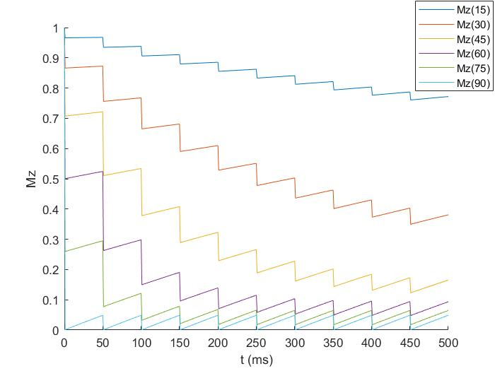
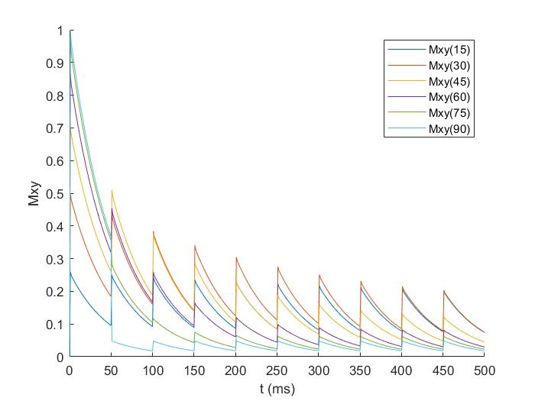
Experimental Results

Slide 10
OUTLINE
EX2.1 Simulate The Timing of M_{xy} and M_{z}
Introduction
Method
Experimental Results
EX2.2 The Maximum MRI Image Brightness
Introduction
Method
Experimental Results
EX2.3 Subcortical Structures
Introduction
Method
Experimental Results

Slide 11
Introduction

Slide 12
Method
Initialize & Calculate
% Initialize values
clear;clc;
TR = 100;
T2_dephasing = 50;
n=901;
Alpha = linspace(0,pi/2,n);
% Calculate Mz
T1 = [1000 1100]
% for T1_1
Mz(1,:) = ((1-exp(-TR/T1(1))).*sin(Alpha))./(1-exp(-TR/T1(1)).*cos(Alpha));
% for T1_2
Mz(2,:) = ((1-exp(-TR/T1(2))).*sin(Alpha))./(1-exp(-TR/T1(2)).*cos(Alpha));

Slide 13
Method
Find the Different between two number
% Find maximum MRI image brightness difference between the two tissues(T1s)
different = abs(Mz(2,:)-Mz(1,:));
index = find(different == max(different));
maxAngle = Alpha(index)*180/pi
% Show the result
figure();
hold on
plot(Alpha*180/pi,Mz(1,:))
plot(Alpha*180/pi,Mz(2,:))
plot([index/10 index/10],Mz(:,index))
txt = ['Maximum difference on ‘, num2str(maxAngle),'\circ'];
xlabel("θ")
ylabel("Mz")
title(txt)
legend([strcat("T1: ",num2str(T1(1))); strcat("T1: ",num2str(T1(2)))])
axis([0 90 min(Mz(:)) max(Mz(:))])

Slide 14
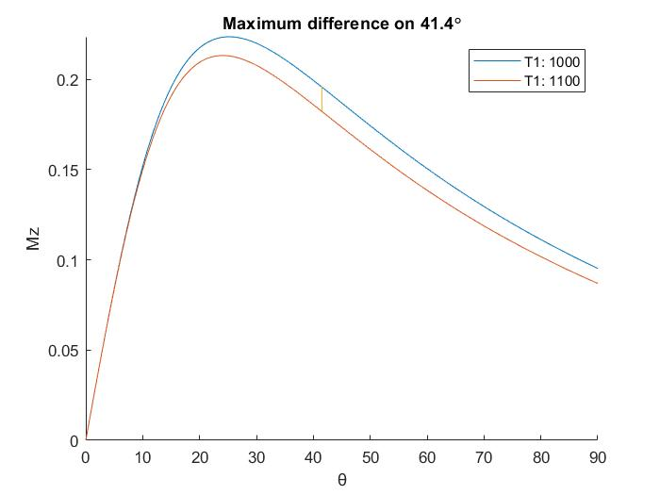
Experimental Results

Slide 15
OUTLINE
EX2.1 Simulate The Timing of M_{xy} and M_{z}
Introduction
Method
Experimental Results
EX2.2 The Maximum MRI Image Brightness
Introduction
Method
Experimental Results
EX2.3 Subcortical Structures
Introduction
Method
Experimental Results

Slide 16
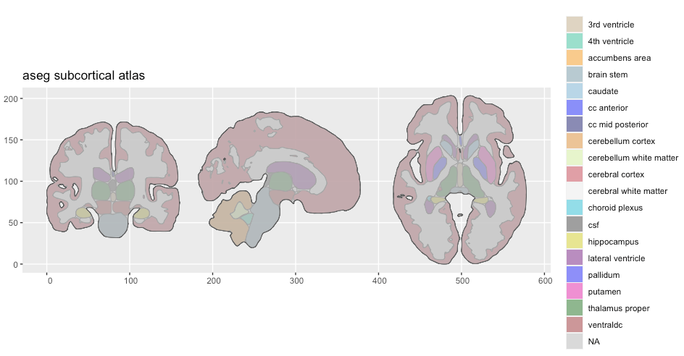
Introduction
The subcortical
1. Read the nii.gz of MRI files.
2. Calculate volumes of each subcortical area.
3. Read the IXI.xls by pandas dataform.
4. Correlation analysis between volume and personal informations.
https://ggseg.github.io/ggsegExtra/articles/createaseg.html

Slide 17
Method
Import
import nibabel as nib
import pandas as pd
import numpy as np
import os
import glob
import seaborn as sns
import matplotlib.pyplot as plt
nibabel: to read nii file
pandas: to data analysis
numpy: for calculate
os: write and read the file
glob: read the path of file
matplotlib and seaborn: plot the result

Slide 18
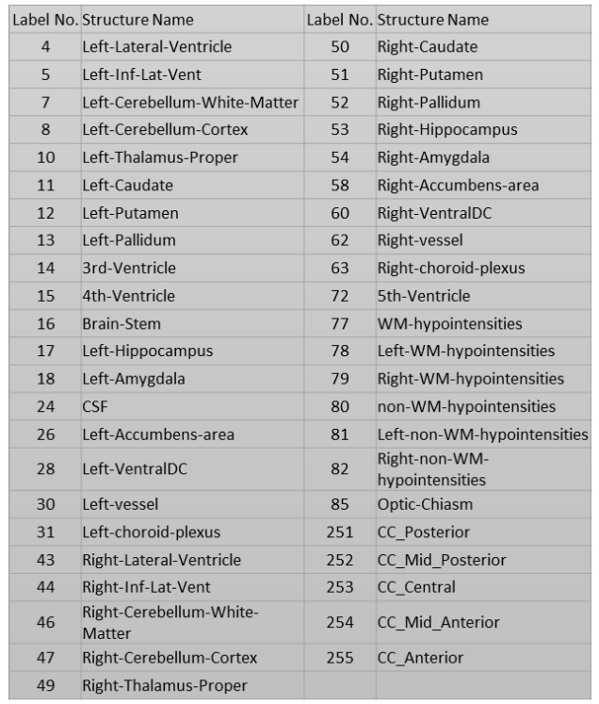
Method
Initialize
# setting the path of files
files = glob.glob('IXI_aseg/*.nii.gz’)
# create list to save labels of each area
labels=[4,5,7,8,10,11,12,13,14,15,16,17,18,
24,26,28,30,31,43,44,46,47,49,50,51,
52,53,54,58,60,62,63,72,77,78,79,80,
81,82,85,251,252,253,254,255]

Slide 19
Method
Calculate
# calculate volumes of each area
if not os.path.exists('vol_all.npy'):
vol_all = []
for file in files:
vol = []
img = nib.load(file)
img_array = img.get_fdata()
factor = np.prod(img.header.get_zooms())
for label in labels:
vol.append(np.sum(img_array==label)*factor)
vol_all.append(vol)
# save result to `*.npy`
np.save('vol_all',vol_all)
# if done, load the `*.npy`
else:
vol_all = np.load('vol_all.npy')

Slide 20
Method
DataFrame
# create list to save the ID of each nii file.
id = [int(os.path.basename(file).split('-')[0][3:6]) for file in files]
# read xls file by pandas
df = pd.read_excel('IXI.xls')
# change index
df.index = df['IXI_ID']
# match ID between nii file and xls
id_new = [i for i in id if i in df['IXI_ID']]
# create new df
df_new = df.loc[id_new]
df_new.drop_duplicates(subset='IXI_ID', keep='first', inplace=True)
# save new df
df_new.to_excel('df_new.xlsx')

Slide 21
Method
DataFrame
# create df of volumes
vol_all = np.array(vol_all)
df_vol = pd.DataFrame(vol_all, columns = labels)
df_vol.insert(loc=0, column="IXI_ID", value=id)
df_vol.index = df_vol['IXI_ID']
# match ID between nii file and xls
df_vol_new = df_vol.loc[id_new]
df_vol_new.drop_duplicates(subset='IXI_ID', keep='first', inplace=True)
df_vol_new.to_excel('df_vol_new.xlsx')

Slide 22
Method
DataFrame
# concat df and df_vol
df_concat = pd.concat([df_new,df_vol_new.drop(['IXI_ID'],axis=1)],axis=1)
df_concat.to_excel('df_concat.xlsx')
# drop some information we don't use: 'IXI_ID','DOB','DATE_AVAILABLE','STUDY_DATE'
df_concat = df_concat.drop(['IXI_ID','DOB','DATE_AVAILABLE','STUDY_DATE'],axis=1)
# Fill 0 to Nan value
df_concat.fillna(0)
# change 0 to mean value
df_concat['HEIGHT'] = df_concat['HEIGHT'].replace(0,df_concat['HEIGHT'].mean())
df_concat['WEIGHT'] = df_concat['WEIGHT'].replace(0,df_concat['WEIGHT'].mean())
df_concat['AGE'] = df_concat['AGE'].replace(0,df_concat['AGE'].mean())
# drop some missing data
df_concat = df_concat[df_concat['ETHNIC_ID'] != 0]
df_concat = df_concat[df_concat['MARITAL_ID'] != 0]
df_concat = df_concat[df_concat['OCCUPATION_ID'] != 0]
df_concat = df_concat[df_concat['QUALIFICATION_ID'] != 0]

Slide 23
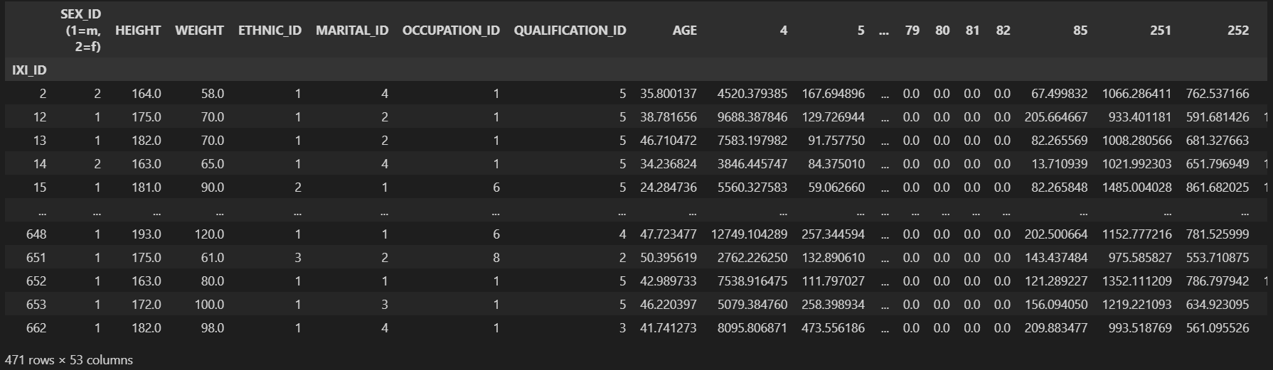
Method
DataFrame

Slide 24
Method
Correlation Analysis
# correlation analysis
for lebel in labels:
df_corr = df_concat.iloc[:,0:8]
corr_label = lebel
df_corr[lebel]=df_concat[lebel]
# compute pairwise correlation of columns by df.corr
corr = df_corr.corr()
corr_result = corr[lebel]

Slide 25
Method
Plot
# plot the result bar
fig = plt.figure(figsize=(6,4))
corr_result.sort_values().plot(kind='bar',figsize=(32, 24), fontsize=24).get_figure()
# save the result of bar
if not os.path.exists('images/result/'):
os.mkdir('images/result')
fig.savefig('images/result/IXI_Volume_'+str(lebel)+'.jpg')
# clear fig
plt.cla()
plt.clf()
# plot the result by heatmap
sns.heatmap(corr, vmin=-1, vmax=1, annot=True, linecolor="white")
# save the result of heatmap
fig.savefig('images/result/IXI_Volume_heatmap_'+str(lebel)+'.jpg') # close fig
plt.close()

Slide 26
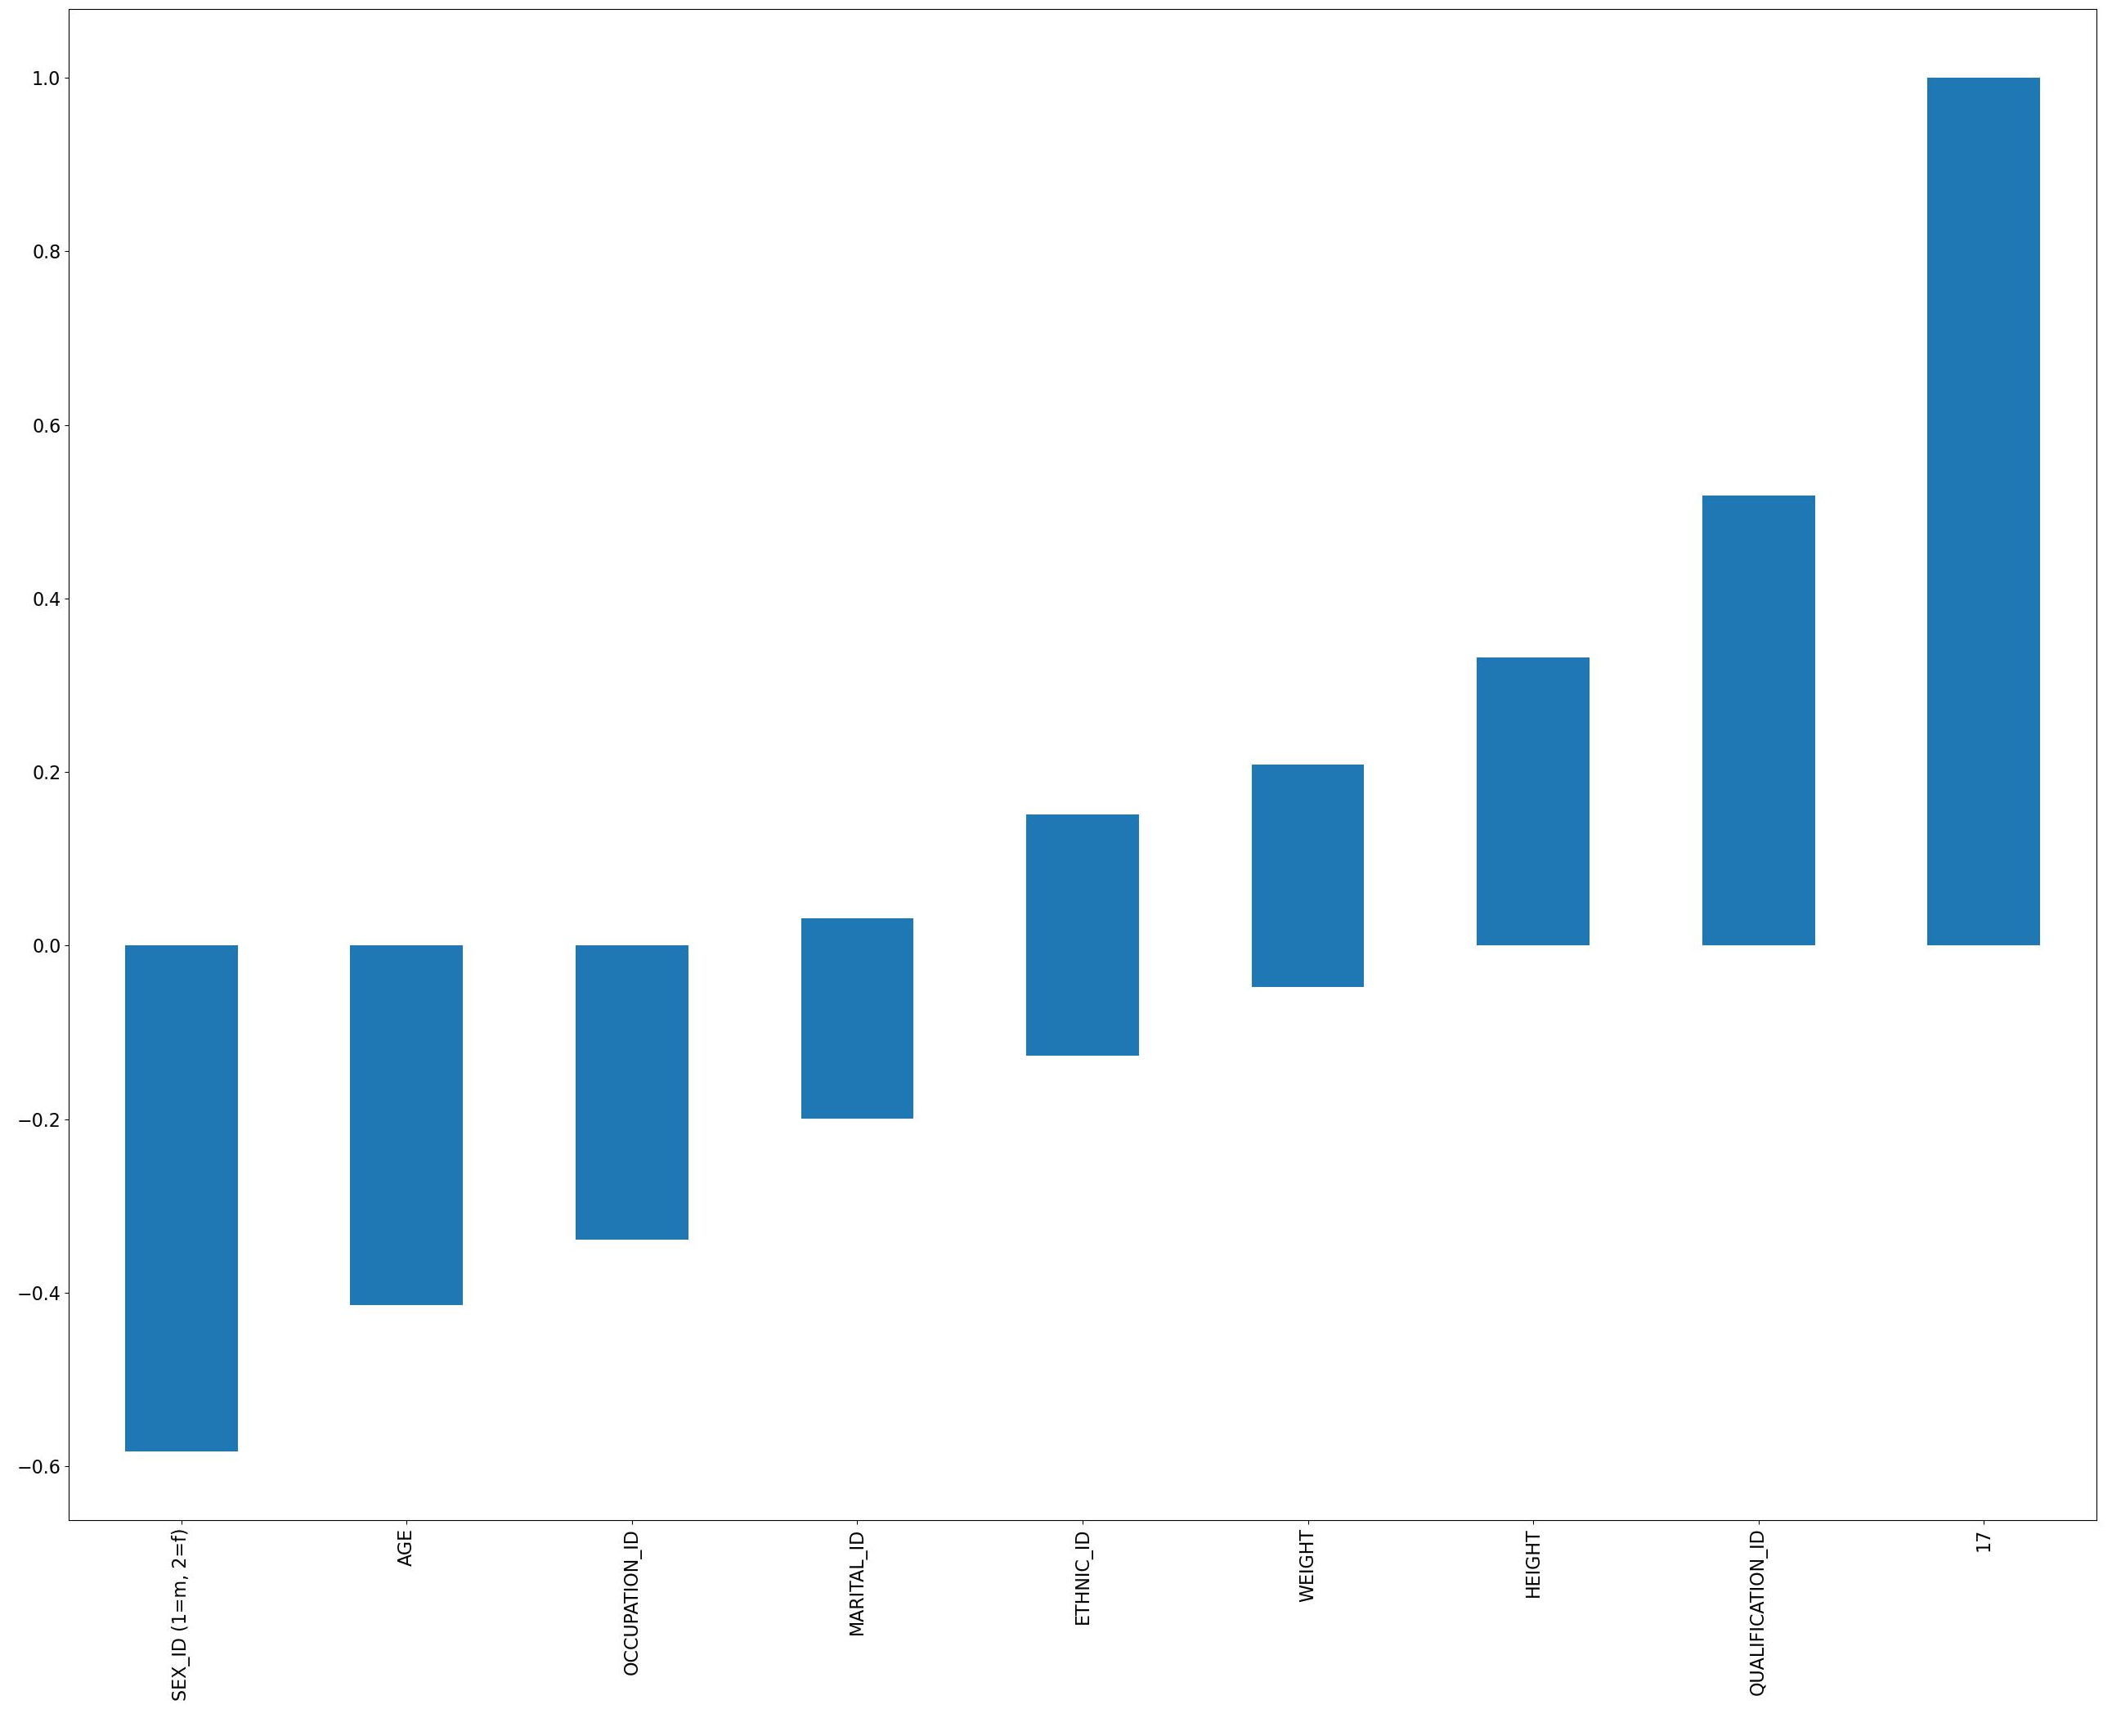

Experimental Results
Left-Hippocampus
Right-Hippocampus

Slide 27
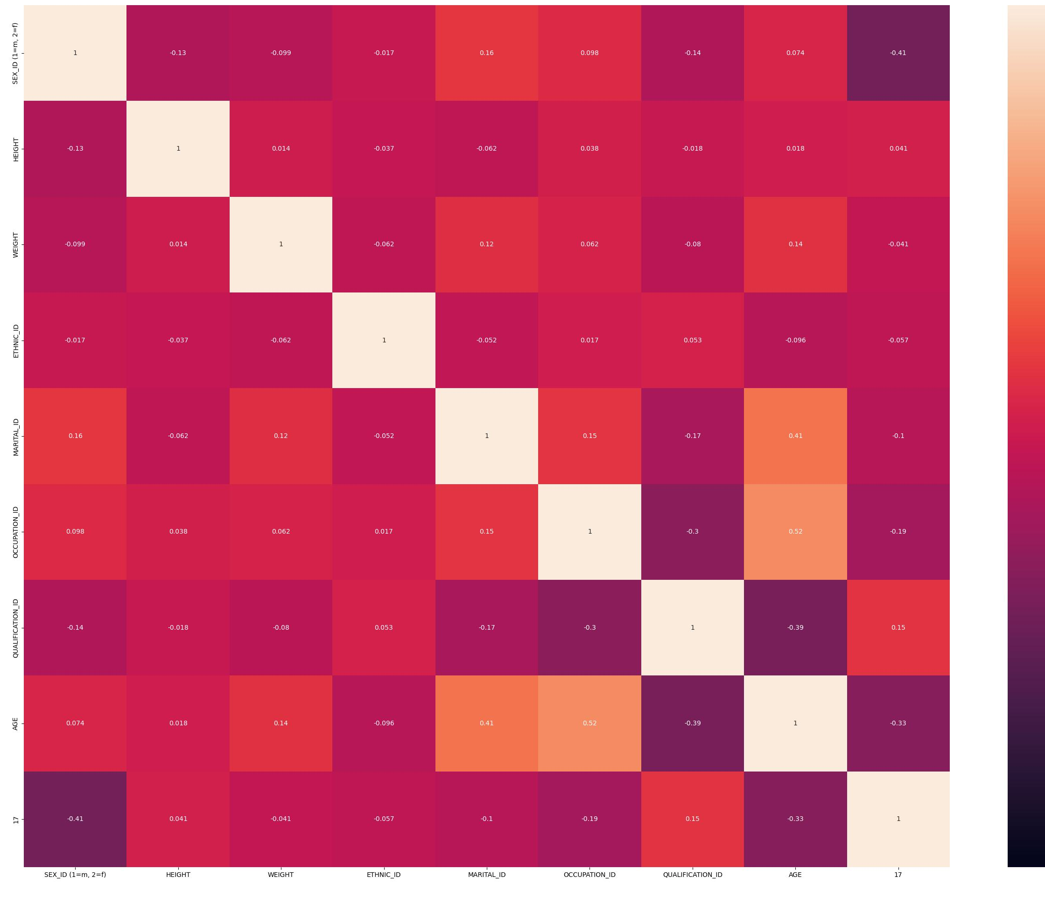

Experimental Results
Left-Hippocampus
Right-Hippocampus

Slide 28
Q&A
Thanks
GitHub

