Slide 1
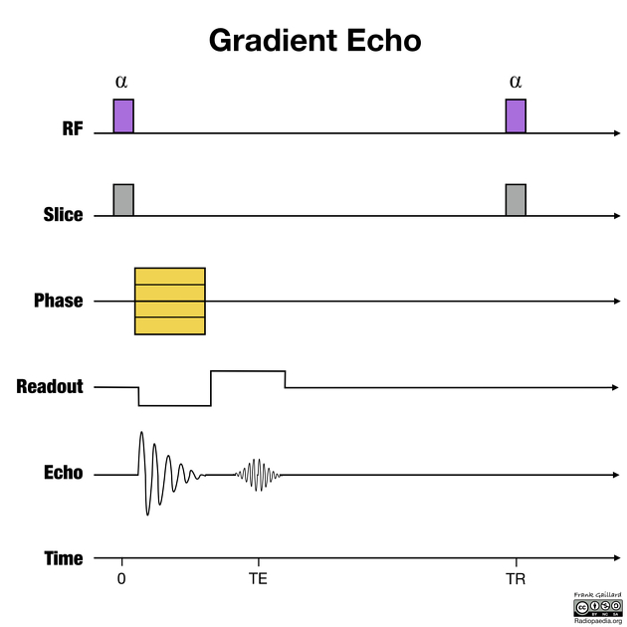
https://radiopaedia.org/articles/gradient-echo-sequences-1
The flip angle is usually at or close to 90 degrees for a spin-echo sequence but is less on gradient-echo sequences, commonly varying over a range of 10 to 80 degrees (usually denoted by α). For the basic GRE sequence FLASH, the larger flip angles give more T1 weighting to the image and the smaller flip angles give more T2, or actually T2* weighting, to the images.

Slide 2
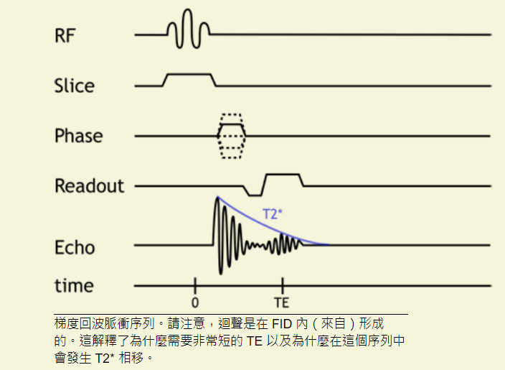
http://xrayphysics.com/sequences.html
M _{z} = M * (1 - e ^{- t /T1})
M _{xy} = M ₀ * e ^{- t /T2}
Gradient Echo
This sequence does not use a 180-degree refocusing pulse and thus retains T2* dephasing.
由於 T2 效應未被抵消，GRE 序列的信號損失更快，因此通常使用更短的 TE。
更短的 TE 允許使用更短的 TR，這增加 了T1 權重
the advantage of GRE is that we can use very short TR (since we do not need to wait for the 180 degree pulse and rephasing).

Slide 3
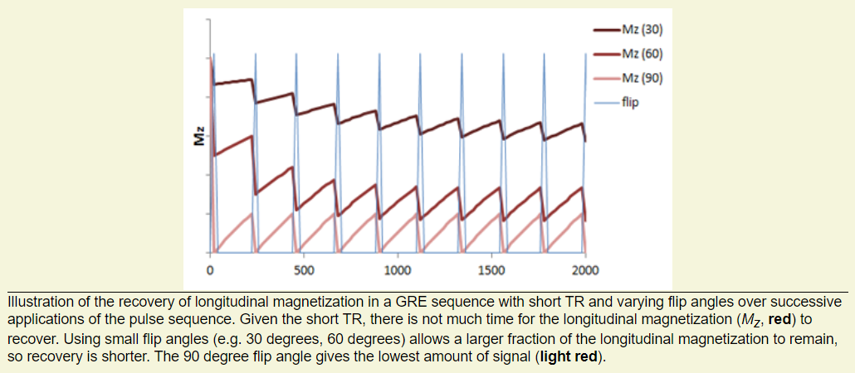
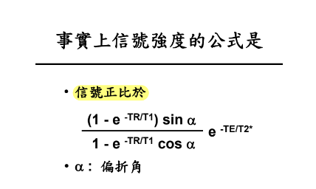
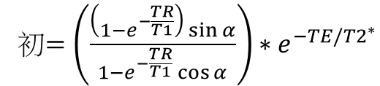

$$M_{z}={終+(初−終)e}^{−t/T1}$$
初$=\left(\frac{\left(1−e^{−\frac{TR}{T1}}\right)\sin{α}}{1−e^{−\frac{TR}{T1}}\cos{α}}\right)∗e^{−TE/{T2}^{∗}}$
TR = 50 ms, T1 = 1000 ms, T2*= 50ms

Slide 4
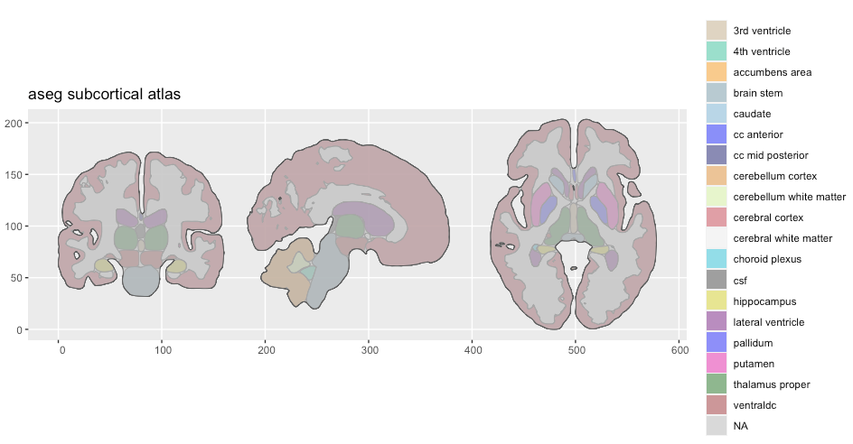
https://carpentries-incubator.github.io/SDC-BIDS-sMRI/aio/index.html
https://github.com/ggseg/python-ggseg/blob/main/doc/ggseg.ipynb
import nibabel as nib
import nilearn
from nilearn import plotting
pip install nibabel nilearn

