Slide 1
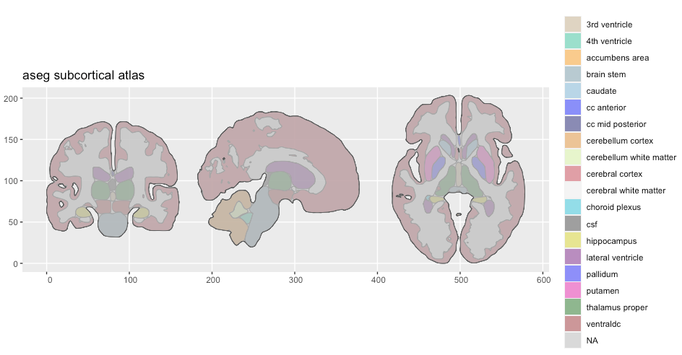
https://carpentries-incubator.github.io/SDC-BIDS-sMRI/aio/index.html
https://github.com/ggseg/python-ggseg/blob/main/doc/ggseg.ipynb
import nibabel as nib
import nilearn
from nilearn import plotting
pip install nibabel nilearn

Slide 2

MRI
HW2-FLASH
Presenter：
M11107309 何柏昇

Slide 3

OUTLINE
EX2.1 Simulate The Timing of Mxy and Mz
Introduction
Method
Experimental Results
EX2.2 The Maximum MRI Image Brightness
Introduction
Method
Experimental Results
EX2.3 Subcortical Structures
Introduction
Method
Experimental Results

Slide 4
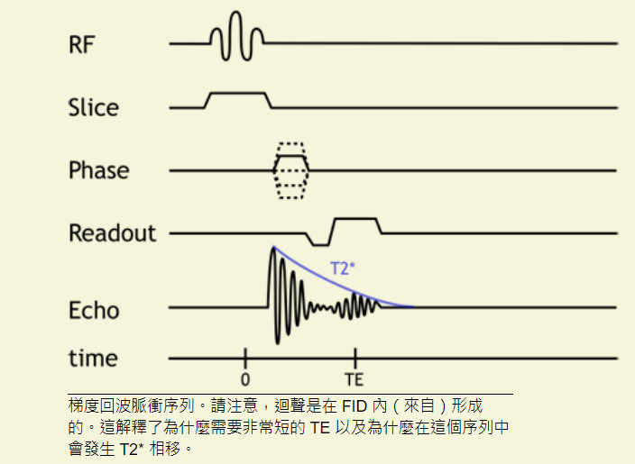
http://xrayphysics.com/sequences.html
M _{z} = M * (1 - e ^{- t /T1})
M _{xy} = M ₀ * e ^{- t /T2}
Gradient Echo
This sequence does not use a 180-degree refocusing pulse and thus retains T2* dephasing.
由於 T2 效應未被抵消，GRE 序列的信號損失更快，因此通常使用更短的 TE。
更短的 TE 允許使用更短的 TR，這增加 了T1 權重
the advantage of GRE is that we can use very short TR (since we do not need to wait for the 180 degree pulse and rephasing).

Slide 5
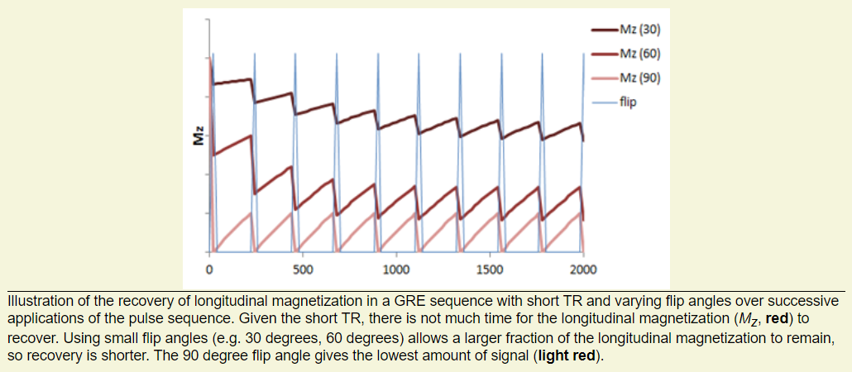
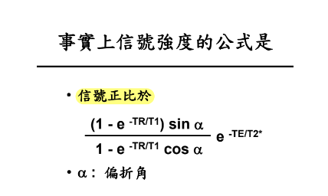
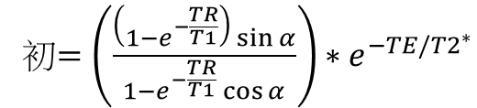

$$M_{z}={終+(初−終)e}^{−t/T1}$$
初$=\left(\frac{\left(1−e^{−\frac{TR}{T1}}\right)\sin{α}}{1−e^{−\frac{TR}{T1}}\cos{α}}\right)∗e^{−TE/{T2}^{∗}}$
TR = 50 ms, T1 = 1000 ms, T2*= 50ms

Slide 6
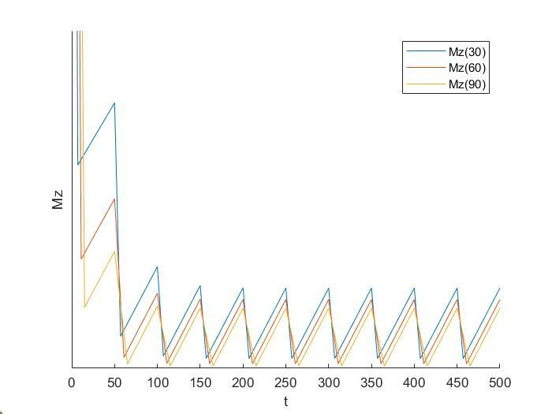
% Setting initial values
clear;clc;
TR = 50;
T1 = 1000;
T2_dephasing = 50;
n=6;
TE = linspace(5,15,n);
Alpha = linspace(pi/12,pi/2,n);
% Iteration: N times of RF
N = 10;
M_initial = ones(N,n);
M = zeros(N,n);
result=ones(2*N+1,n);
for N=1:N
if N>1
M_initial(N,:) = M(N-1,:).*((1-exp(-TR/T1)).*sin(Alpha))./(1-exp(-TR/T1).*cos(Alpha)).*exp(-TE/T2_dephasing);
else
M_initial(N,:) = ones(1,n).*((1-exp(-TR/T1)).*sin(Alpha))./(1-exp(-TR/T1).*cos(Alpha)).*exp(-TE/T2_dephasing);
end
M(N,:) = 1+(M_initial(N,:)-1).*exp(-(TR-TE)/T1);
result(2*N,:) = M_initial(N,:);
result(2*N+1,:) = M(N,:);
end

Slide 7
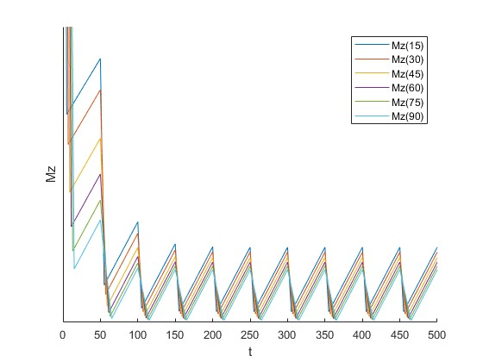
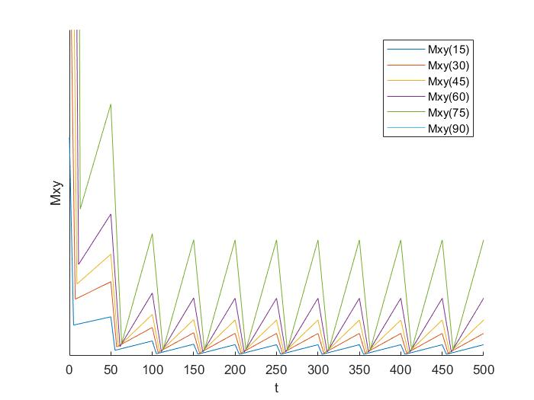

Slide 8
OUTLINE
EX2.1 Simulate The Timing of Mxy and Mz
Introduction
Method
Experimental Results
EX2.2 The Maximum MRI Image Brightness
Introduction
Method
Experimental Results
EX2.3 Subcortical Structures
Introduction
Method
Experimental Results

Slide 9
Exhaustive method
% Setting initial values
clear;clc;
TR = 100;
T2_dephasing = 50;
n=91;
TE = 5;
Alpha = linspace(0,pi/2,n);
% Find maximum MRI image brightness
T1 = 1000;
M_initial = ((1-exp(-TR/T1)).*sin(Alpha))./(1-exp(-TR/T1).*cos(Alpha))*exp(-TE/T2_dephasing);
Mz_angle = Alpha(find(M_initial==max(M_initial(:))))/pi*180;
fprintf('T1: %d', T1)
fprintf('Angle of max(Mz): %d\n', Mz_angle)

Slide 10
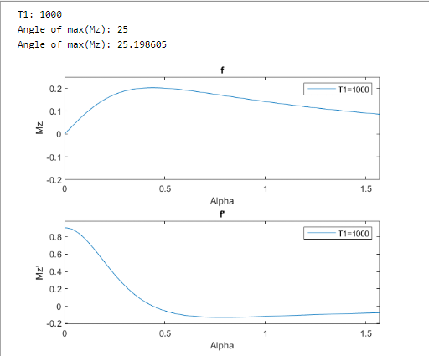
Differences and Approximate Derivatives
% Setting initial values
clear;clc;
TR = 100;
T2_dephasing = 50;
n=91;
TE = 5;
Alpha = linspace(0,pi/2,n);
% Find the curve local maximum or minimum
% By differences and approximate derivatives
T1 = 1000;
syms a
f = ((1-exp(-TR/T1))*sin(a))/(1-exp(-TR/T1)*cos(a))*exp(-TE/T2_dephasing);
% Solve (find the maximum)
g = diff(f);
s = solve(g);
angle = s(2)/pi*180;
fprintf('Angle of max(Mz): %f\n\n',angle)

Slide 11
