Slide 1

MRI
HW1-Spin Echo
Presenter：
M11107309 何柏昇

Slide 2

OUTLINE
Introduction
Method
DCM
Curve Fitting
Experimental Results

Slide 3
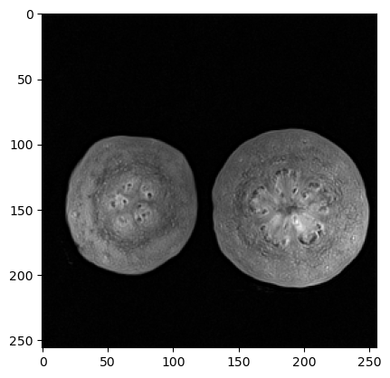
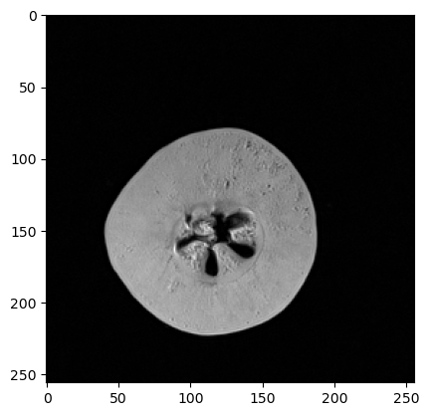
Introduction
T2 image-A
T2 image-B

Slide 4
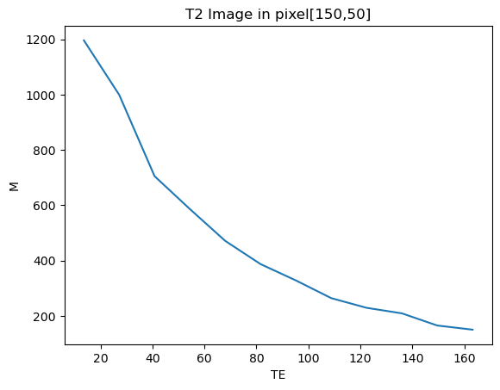


Introduction
T2 equation:
$$M=M_{0}∗e^{−T2/TE}$$
$${⇒M}_{0}\& TE$$

Slide 5
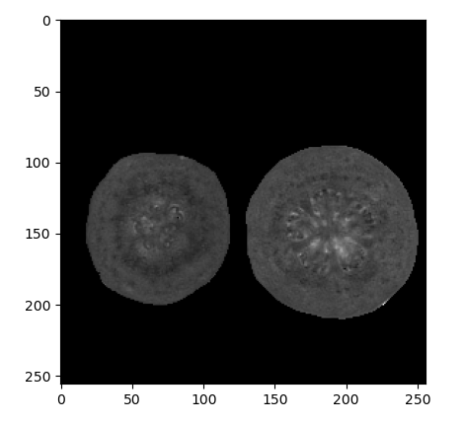
Introduction
T2 image-A
T2 Map
Mapping

Slide 6
OUTLINE
Introduction
Method
DCM
Curve Fitting
Experimental Results

Slide 7
Method
Python
pydicom: To read DCM file
numpy and scipy: To calculate
matplotlib: To plot the image

Slide 8
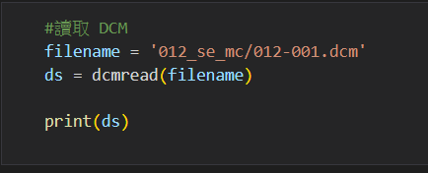

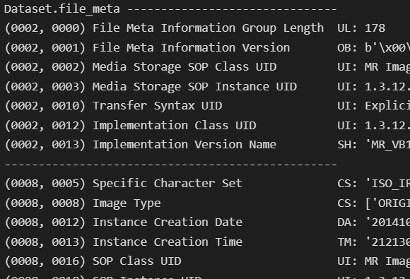
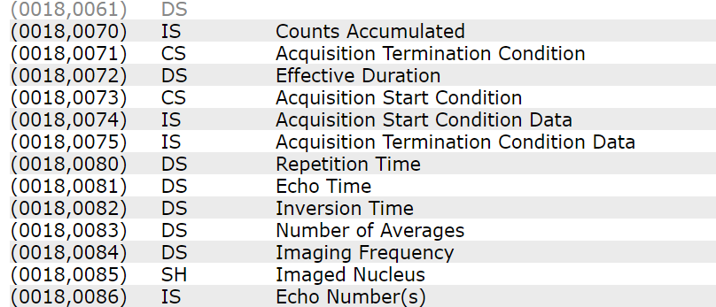
Method - DCM
DCM file Read
DCM Table
- pydicom

Slide 9
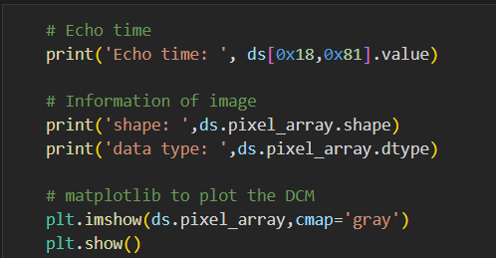
Method - DCM
DCM file Read
- pydicom
Echo time: 13.6
shape: (256, 256)
data type: uint16

Slide 10
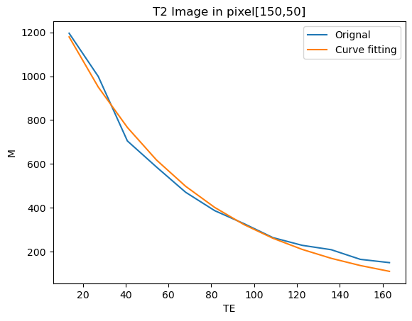



Method - Curve Fitting
$$M=M_{0}∗e^{−T2/TE}$$
$${⇒M}_{0}\& TE$$
$$⇒Curve fitting$$

Slide 11
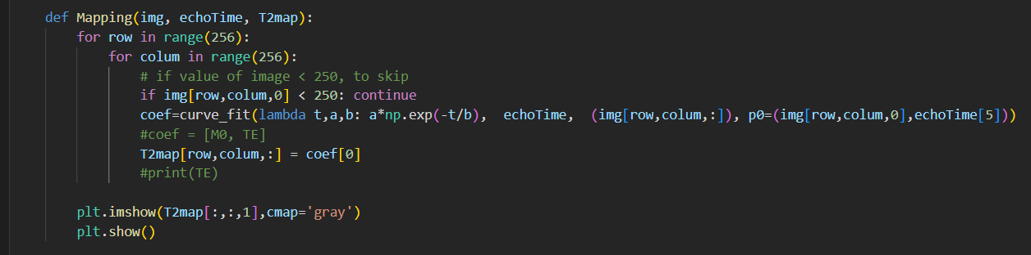
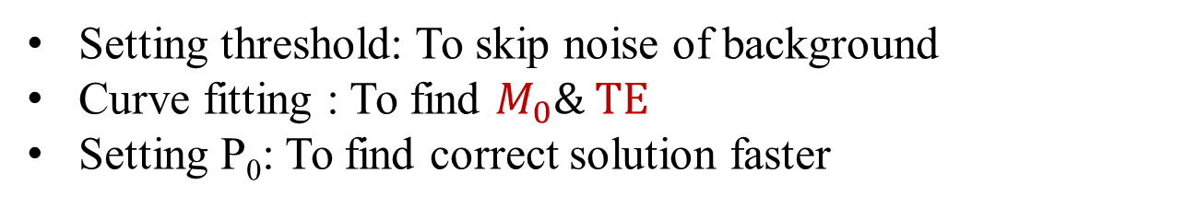
Method - Curve Fitting
Curve fitting
- scipy.optimize.curve_fit
Setting threshold: To skip noise of background
Curve fitting : To find $M_{0}\& TE$
Setting P₀: To find correct solution faster

Slide 12


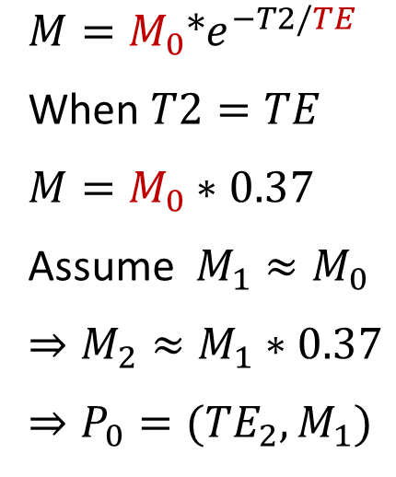
Method - Curve Fitting
Curve fitting
Setting P₀: To find correct solution faster
$$P_{1}({TE}_{1},M_{1})$$
$$M=M_{0}∗e^{−T2/TE}$$
When $T2=TE$
$$M=M_{0}∗0.37$$
Assume $M_{1}≈M_{0}$
$$⇒M_{2}≈M_{1}∗0.37$$
$$⇒P_{0}=({TE}_{2},M_{1})$$
$$P_{2}({TE}_{2},M_{2})$$

Slide 13
OUTLINE
Introduction
Method
DCM
Curve Fitting
Experimental Results

Slide 14
Experimental Results - Curve Fitting

Slide 15
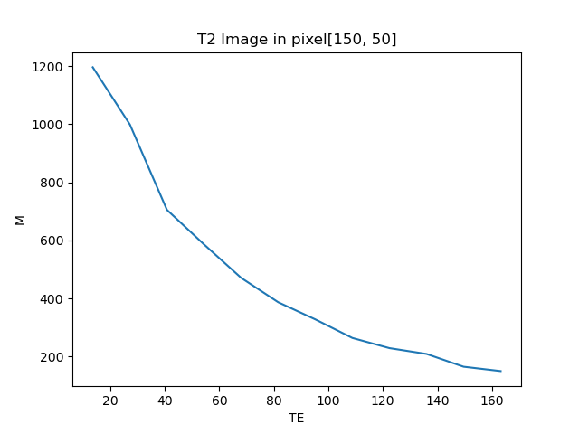
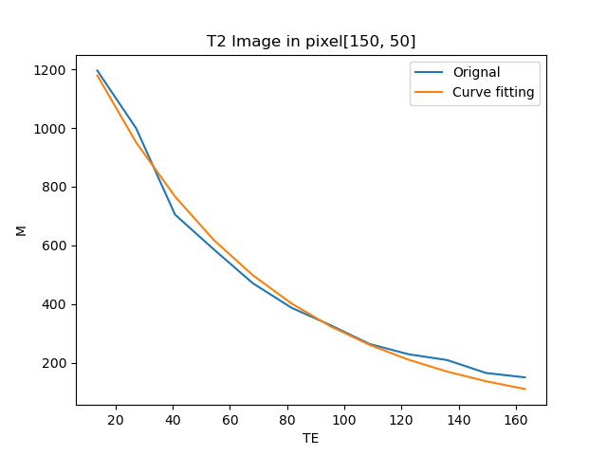
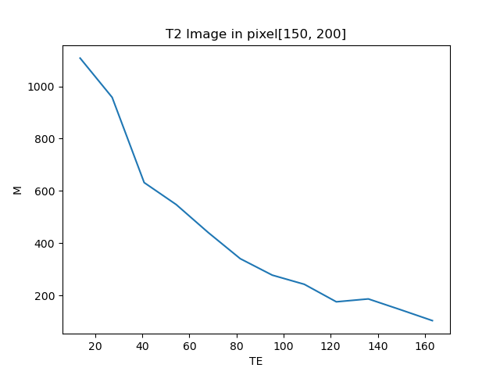

Experimental Results - Curve Fitting - Image A

Slide 16
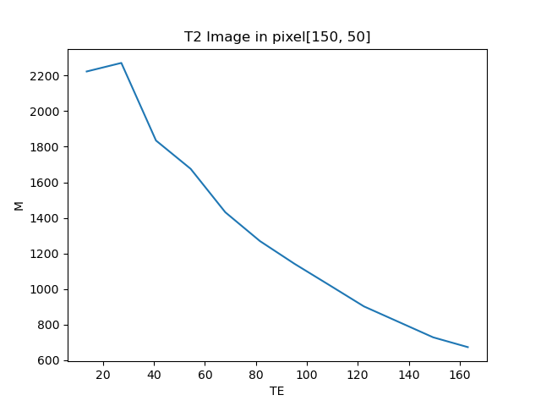
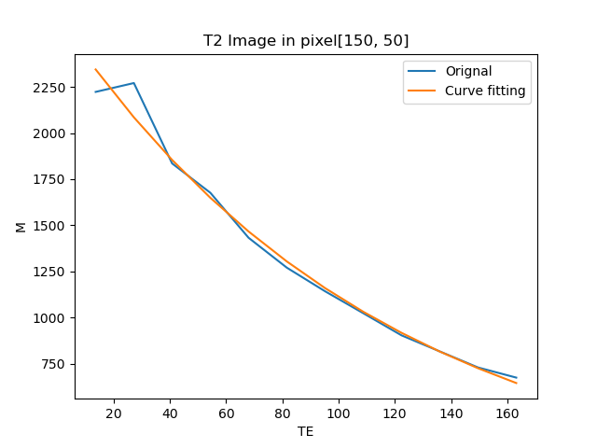
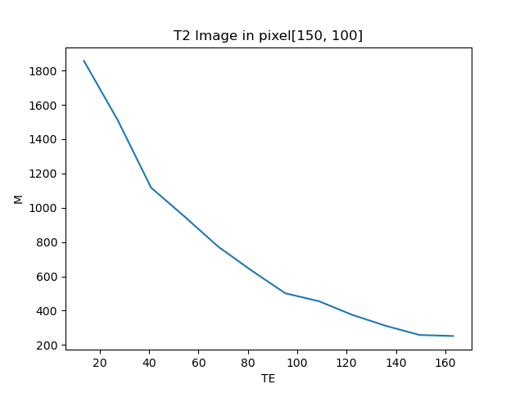
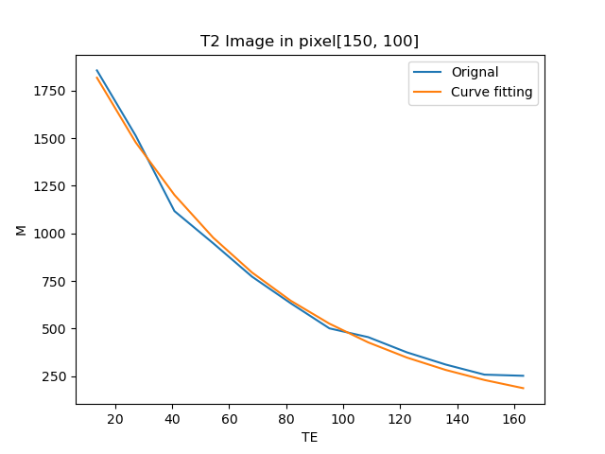
Experimental Results - Curve Fitting - Image B

Slide 17
Experimental Results - Mapping
T2 image-A
T2 Map
Mapping

Slide 18
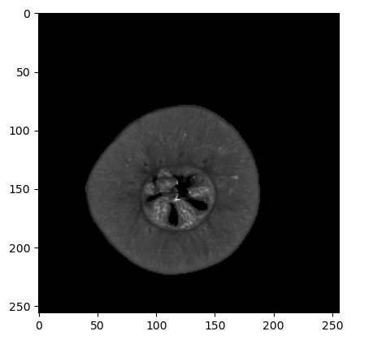
Experimental Results - Mapping
T2 image-B
T2 Map
Mapping

Slide 19
Q&A
Thanks
GitHub

