Slide 1

Examples on Functional Testing
Winter 2006
Presented by Nikos Giannopoulos
nikos@swen.uwaterloo.ca
ECE 453, Prof. Kontogiannis
University of Waterloo

Slide 2
Agenda
Telephone Billing Example
Flowchart → Decision Table Example
ECE 453, Prof. Kontogiannis
University of Waterloo

Slide 3
Agenda
Telephone Billing Example
Flowchart → Decision Table Example
ECE 453, Prof. Kontogiannis
University of Waterloo

Slide 4
Telephone Billing Example
The Spring and Fall changes between Standard and Daylight Savings time create an interesting problem for telephone bills. Develop equivalence classes for a long distance telephone service that bills calls at a flat rate of $0.05 per minute. Assume that the chargeable time of a call begins when the called party answers, and ends when the calling party disconnects
ECE 453, Prof. Kontogiannis
University of Waterloo

Slide 5
Telephone Billing Example
For simplicity we consider a fixed Daylight Saving Time beginning date (March 13), and a fixed Standard Time beginning date (November 7)
For simplicity we consider that time switches at midnight (March 13 and November 7)
ECE 453, Prof. Kontogiannis
University of Waterloo

Slide 6
Telephone Billing Example
Inputs:
  Start Date
  Start Time
  End Date
  End Time
Outputs:
  Charge
Start Date & Time < End Date & Time
ECE 453, Prof. Kontogiannis
University of Waterloo

Slide 7
Telephone Billing Example
Proposed equivalence relation: which are the crucial start/end dates to consider and which are the crucial start/end times that affect the billing procedure?
ECE 453, Prof. Kontogiannis
University of Waterloo

Slide 8
Telephone Billing Example
Start Date
  SD₁ = { startDate : January 1 ≤ startDate < March 13 }
  SD₂ = { startDate : startDate = March 13 }
  SD₃ = { startDate : March 13 < startDate < November 7 }
  SD₄ = { startDate : startDate = November 7 }
  SD₅ = { startDate : November 7 < startDate ≤ December 31 }
Start Time
  ST₁ = { startTime : startTime = 24h clock }
End Date
  ED₁ = { endDate : January 1 ≤ endDate < March 13 }
  ED₂ = { endDate : endDate = March 13 }
  ED₃ = { endDate : March 13 < endDate < November 7 }
  ED₄ = { endDate : endDate = November 7 }
  ED₅ = { endDate : November 7 < endDate ≤ December 31 }
End Time
  ET₁ = { endTime : endTime = 24h clock }
ECE 453, Prof. Kontogiannis
University of Waterloo

Slide 9
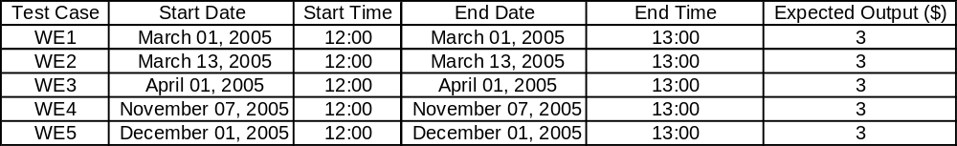
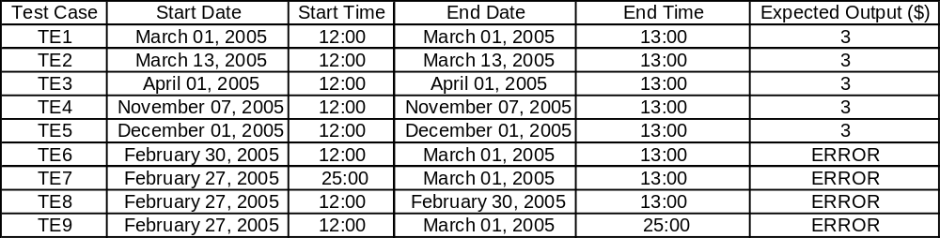
Telephone Billing Example
Weak Equivalence Class Test Cases
SD₆ = { startDate : invalid dates }
ED₆ = { endDate : invalid dates }
ST₂ = { startTime : invalid times }
ET₂ = { endTime : invalid times }
Traditional Equivalence Class Test Cases
ECE 453, Prof. Kontogiannis
University of Waterloo

Slide 10
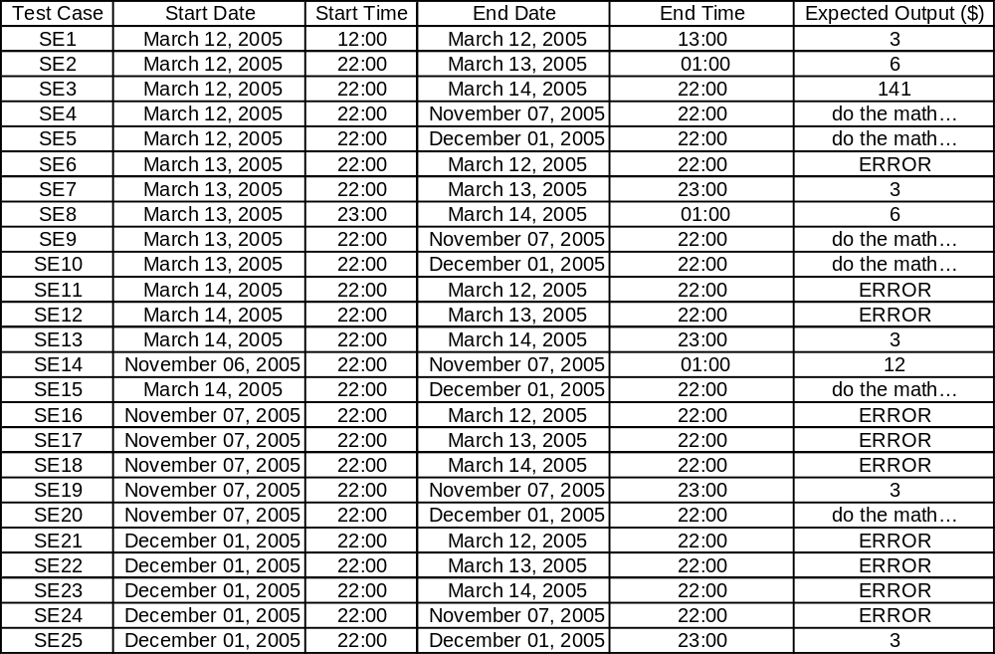
Telephone Billing Example
Strong Equivalence Class Test Cases
ECE 453, Prof. Kontogiannis
University of Waterloo

Slide 11
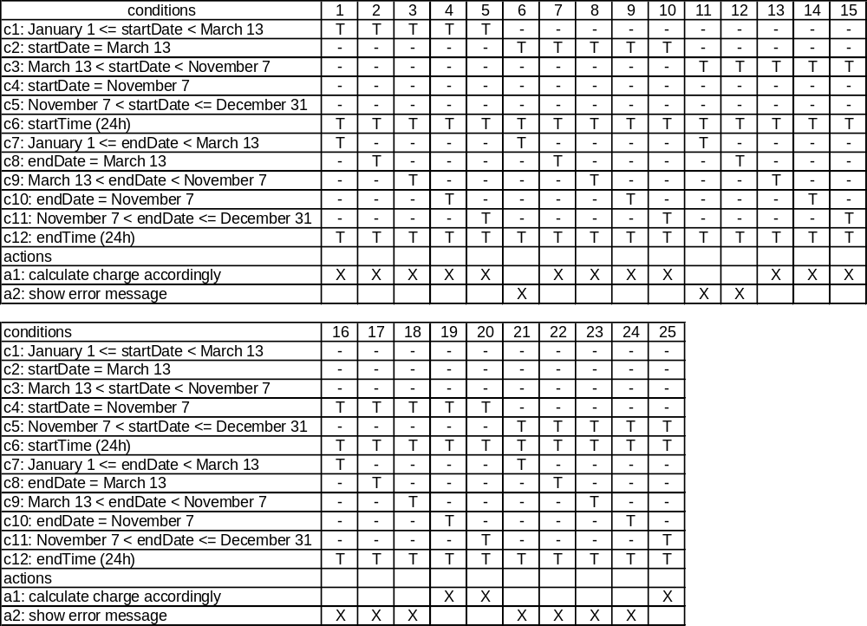
Telephone Billing Example
Decision
Table
ECE 453, Prof. Kontogiannis
University of Waterloo

Slide 12
Agenda
Telephone Billing Example
Flowchart → Decision Table Example
ECE 453, Prof. Kontogiannis
University of Waterloo

Slide 13
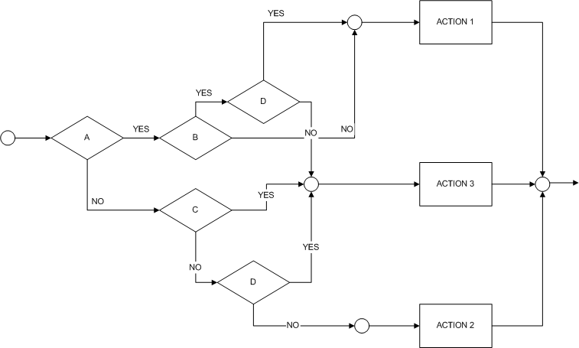
Flowchart → Decision Table Example
ECE 453, Prof. Kontogiannis
University of Waterloo

Slide 14
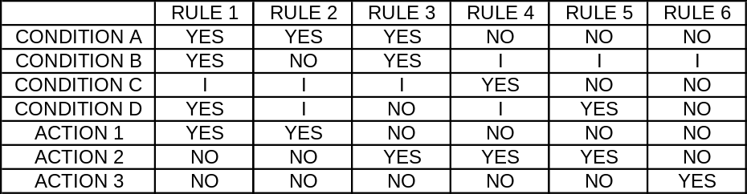
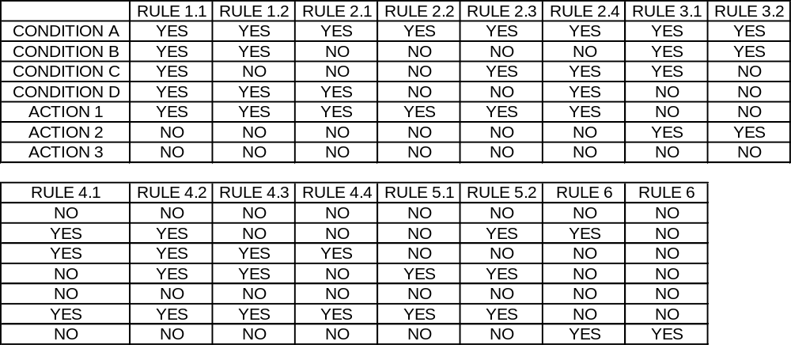
Flowchart → Decision Table Example
ECE 453, Prof. Kontogiannis
University of Waterloo

Slide 15
Agenda
Telephone Billing Example
Flowchart → Decision Table Example
ECE 453, Prof. Kontogiannis
University of Waterloo

Slide 16
References
Software Testing A Craftsman's Approach 2nd edition, Paul C. Jorgensen, CRC Press (Chapters 5, 6, and 7)
Software Testing Techniques, Second Edition, Boris Beizer
ECE 453, Prof. Kontogiannis
University of Waterloo

