Slide 1
Welcome!
Your host today
Daniel Ironhack

Slide 2
Multilingual Youtube Analyzer
Ease up your life
RAG-System

Slide 3
What does it do?
Ask any question about the content —
The agent answers profoundly

Slide 4
Which components do you need?
We provide deep Analysis and Insights for you!

Slide 5
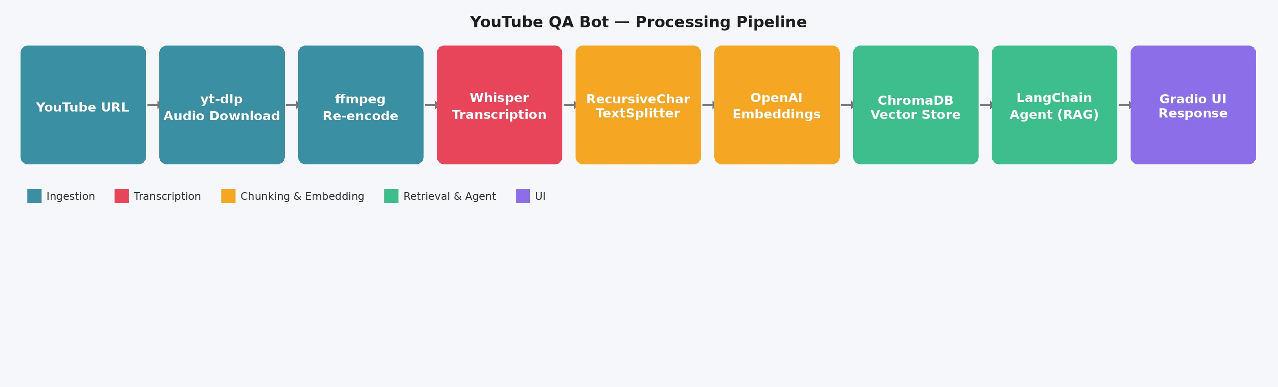
RAG Pipeline

Slide 6
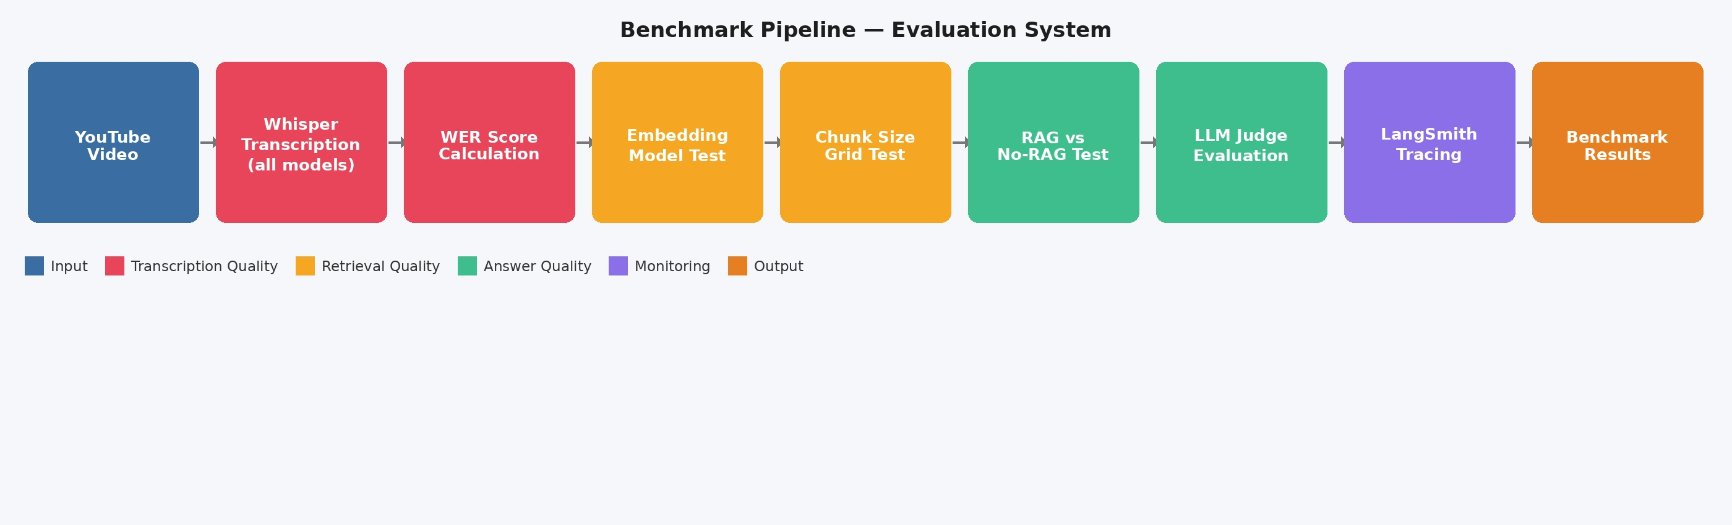
Benchmark Pipeline

Slide 7
Benchmarking
Whisper Models
Audio Bitrate
Embedding Models
Large Language Models Costs and Judge Ability

Slide 8
Benchmarking 2
RAG System vs no RAG
Chunk size Grid Test
Full Matrix Test
Stress Tests Whisper Abilities: Rap God

Slide 9
Whisper Model Sizes
Which model gives the best quality vs. cost trade-off?
Tracing Costs via Langsmith and WER score (Errors)

Slide 10
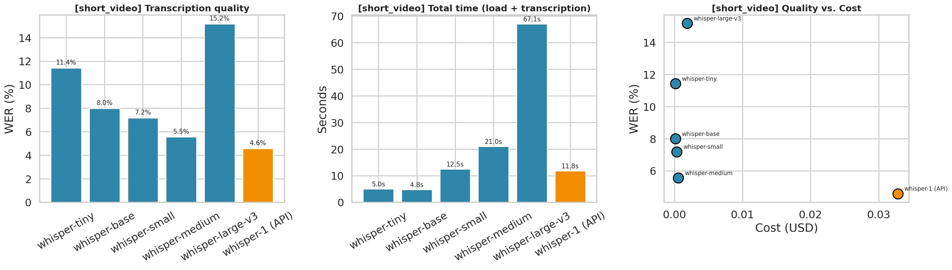
Short Video
Business Choice
Whisper API provides best WER and fastest Transcription causing higher costs
Whisper-small provides best balance of WER and speed for short clips

Slide 11
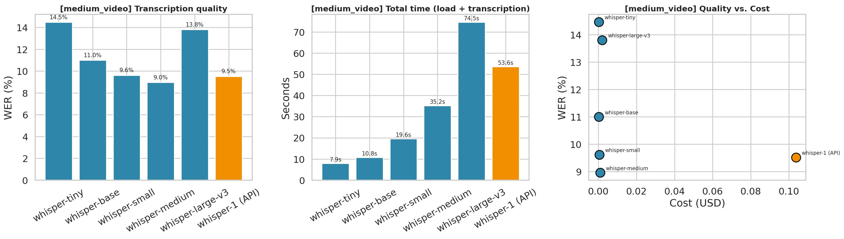
Medium Video
Transcription quality, speed and cost
Business Choice
Whisper-small provides best balance of WER and speed for medium clips
Whisper medium and Whisper API remain good choices with constraints

Slide 12
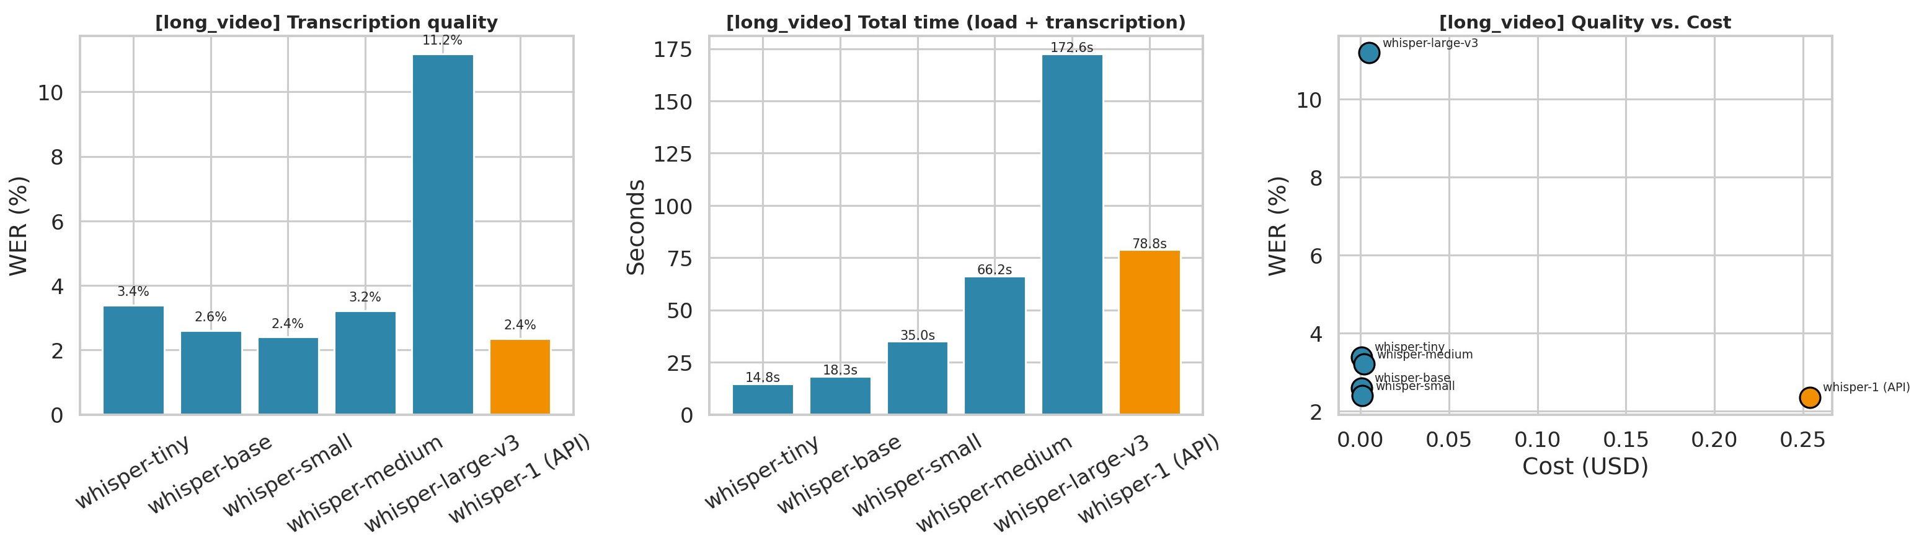
Long Video
Transcription quality, speed and cost
Business Choice
Whisper-small provides best balance of WER and speed even for long clips.
Local, smaller versions tend to perform even better on longer videos .

Slide 13
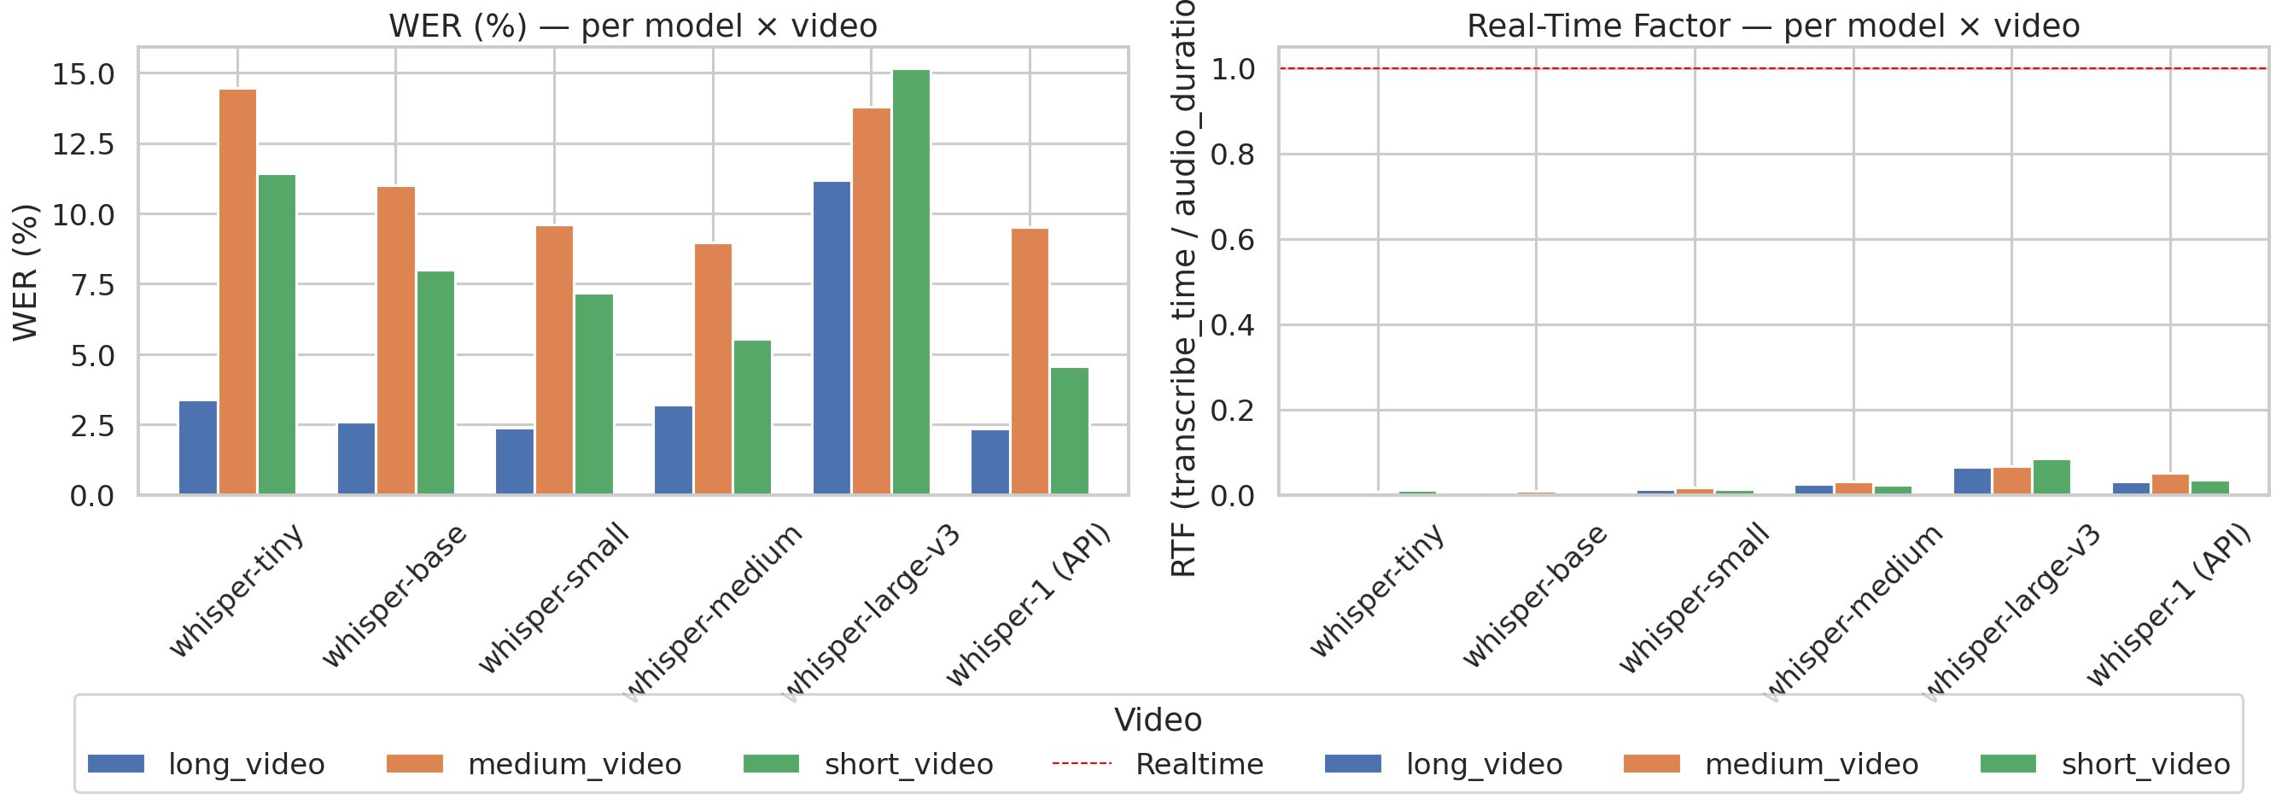
Whisper-small the Allrounder
Business Sweet Spot: Whisper-small — WER 2.40% at $0.00097/run. API for production.

Slide 14
Audio Bitrate
Does compression quality matter for transcription?

Slide 15
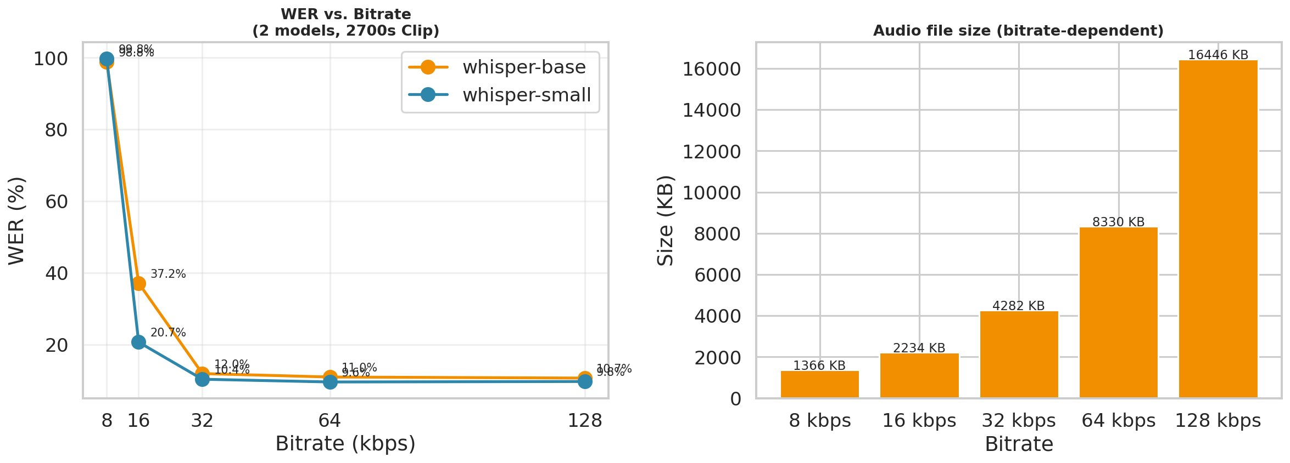
Audio Bitrate vs. WER
64 kbps = sweet spot. Near-identical WER to 128 kbps at half the file size, even 32 kbps delivers.

Slide 16
Embedding Models
Which embedding model retrieves best?

Slide 17
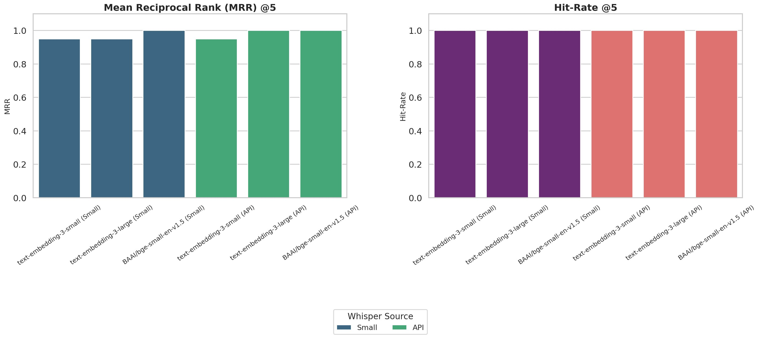
Embedding Model Comparison
MRR @5 and Hit-Rate @5 — OpenAI vs HuggingFace
"MRR is a great way to capture the positive user experience: It rewards systems that deliver exactly what the user is looking for—instantly."

Slide 18
LLM Comparison
Quality, speed and costs — which model wins?

Slide 19
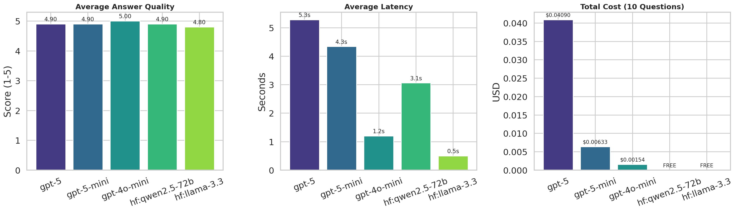
LLM: Quality, Latency & Cost
5 models, 10 eval questions
gpt-4o-mini: score 5.0, latency 1.2s, $0.00154. HF Llama: FREE & 0.5s — great for free tier.

Slide 20
RAG vs. No-RAG
Does retrieval actually matter?

Slide 21
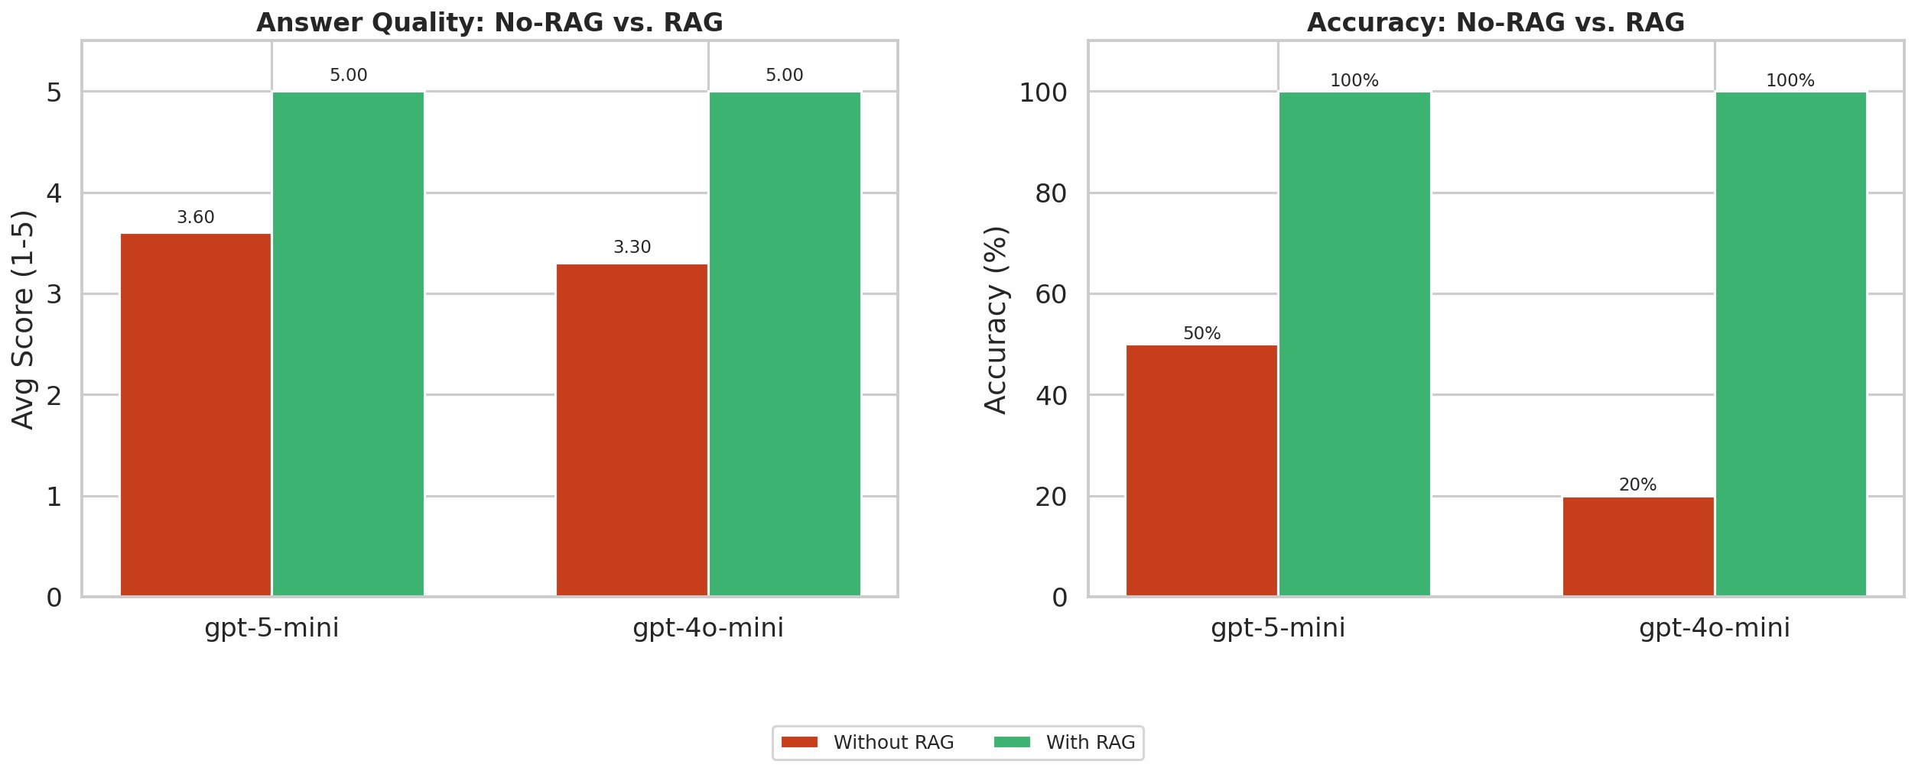
RAG is quality - Lifts Accuracy to 100%
100%
Accuracy
with RAG
20–70%
Accuracy
without RAG
Retrieval is non-negotiable for factual video Q&A. RAG lifts accuracy.

Slide 22
Why RAG?
The time for cost expensive Training, Data Providence or Fine Tuning...
...is up!

Slide 23
Core Value: Uses up-to-date, external, or private data Reduces hallucinations, Provides grounded, source-based answers

Slide 24
Chunk-Size Grid
What's the optimal chunk size for retrieval and precise Answers by the Agent?

Slide 25
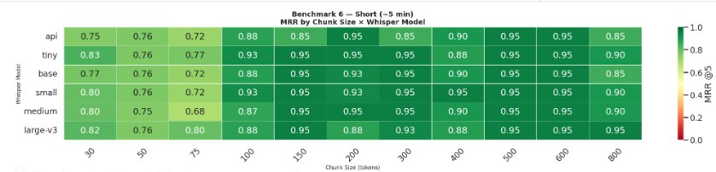
Chunk-Size: Short Videos (~5 min)
MRR@5 by Chunk Size × Whisper Model

Slide 26
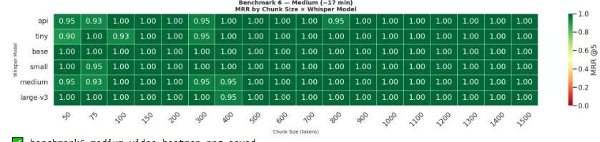
Chunk-Size: Medium Videos (~17 min)
MRR@5 by Chunk Size × Whisper Model

Slide 27
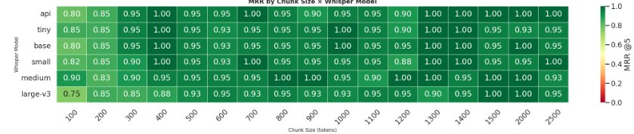
Chunk-Size: Long Videos (~42 min)
MRR@5 by Chunk Size × Whisper Model

Slide 28
Component Selection by Persona
From solo developer to global enterprise

Slide 29
What is your goal?

Slide 30
The Right Stack for Every Budget
Solo Developer
Startup
SME
Enterprise
Budget: almost none
Budget: small
Budget: medium
Budget: unlimited
Llama (free)
+ Whisper small
+ text-emb.-3-small
+ Bitrate 32-64
gpt-4o-mini or Llama
+ Whisper small
+ text-emb.-3-small
+ Bitrate 32-64
gpt-5-mini
+ API Whisper
+ text-emb.-small
+ Bitrate 64
gpt-5 or higher
+ API Whisper
+ text-emb.-small
+ Bitrate 64

Slide 31
Real-World RAG Applications
Where this technology creates the most value?

Slide 32
Real-World RAG Applications
We build products your clients will love — powered by RAG

Video & Podcast Intelligence
Instantly query hours of YouTube, podcast or webinar content. Your customers ask — our RAG answers. Perfect for media companies, e-learning and corporate training.

News & Research Monitor
Continuously ingest news feeds, research papers and reports. Deliver precise, cited answers from thousands of sources in real time.

E-Learning & Corporate Training
Turn any document library, course catalog or compliance handbook into an interactive Q&A assistant. Onboarding in hours, not weeks.

Slide 33
Real-World RAG Applications
From customer service to internal knowledge — RAG scales with your business

Customer Support Automation
Replace static FAQs with a live RAG agent trained on your product docs. 80% fewer support tickets, 24/7 availability, always up to date.
⚖️
Legal & Compliance Advisor
Query contracts, regulations and internal policies in seconds. Lawyers and compliance teams get cited answers — not keyword search results.

Medical & Clinical Knowledge
Clinicians query drug interactions, treatment guidelines and patient records. RAG provides grounded, traceable answers that reduce risk.

Slide 34
Real-World RAG Applications
The next wave of AI products — your competitive advantage

Codebase & Dev Docs Assistant
Developers ask questions about your codebase, API docs or changelogs and get precise code-aware answers instantly.
️
Enterprise Internal Search
Connect SharePoint, Confluence, Slack and emails. One RAG interface for all internal knowledge — no more lost information.

Multilingual Global Deployments
One RAG system, 50+ languages. Serve global customers in their native language using the same knowledge base.

Slide 35
Our RAG-System

Slide 36
Audio Transcription via Whisper
Models tested
whisper-tiny · whisper-base
whisper-small · whisper-medium
whisper-large-v3 · Whisper API
Key Metric: WER (Word Error Rate)
Tracked via LangSmith tracing for every model run and benchmark.

Slide 37
Text Chunking & Embedding
Embedding Models
text-embedding-3-small (OpenAI)
HuggingFace sentence-transformers
Winner: text-embedding-3-small
Highest MRR@5 and Hit-Rate@5 across all video lengths tested.

Slide 38
Store & Retrieval via ChromaDB
ChromaDB Advantages
Local — no external API call needed
Persistent storage between sessions
Scales from laptop to cloud deployment
MRR@5 achieved: 0.95 – 1.00
Retrieval is near-perfect at optimal chunk sizes of 150+ tokens.

Slide 39
LangChain Agent — The RAG Brain
LLMs tested
GPT-4o-mini (best balance)
GPT-4o, GPT-5
Llama 3 via HuggingFace (free tier)
Winner: gpt-4o-mini — score 5.0, 1.2s, $0.00154
Llama 3 is FREE and delivers 0.5s latency — perfect for budget deployments.

Slide 40
Tracing & Tracking via LangSmith
What LangSmith tracks
End-to-end latency per run
Token usage & API costs
WER per Whisper model
LLM judge evaluation scores
Retrieval quality (MRR@5)
100% of benchmark runs fully traced and reproducible.

Slide 41
Multilingual Youtube Analyzer App V 1.0

Slide 42
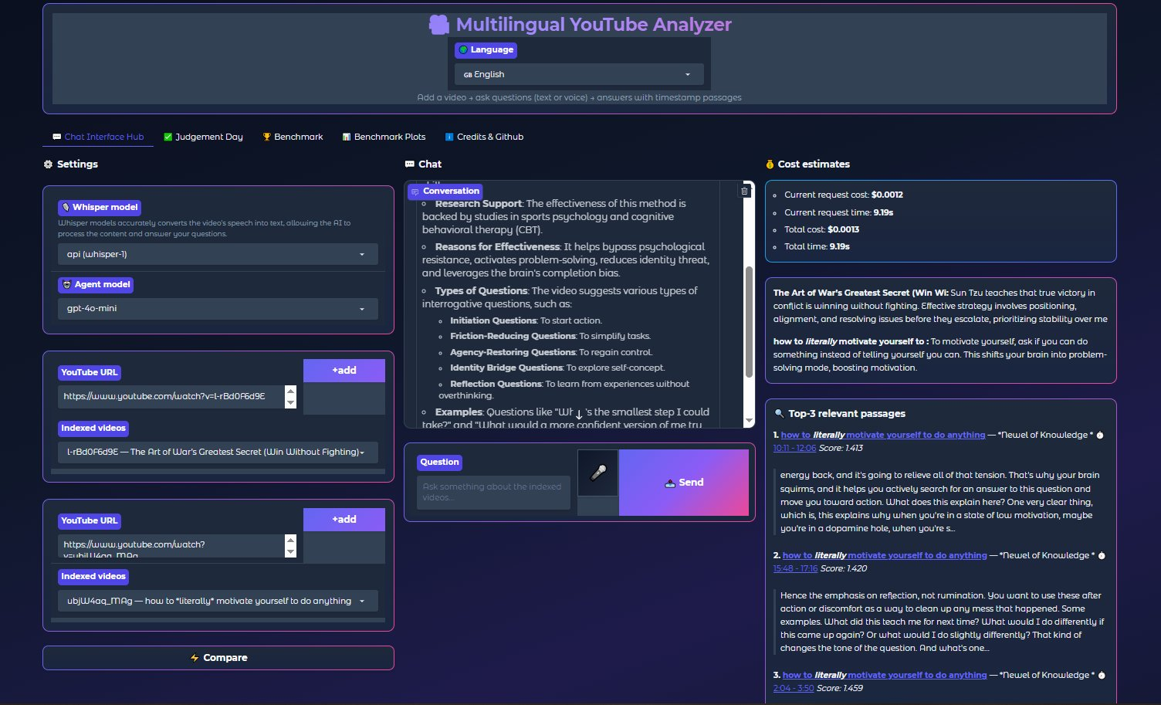

Slide 43
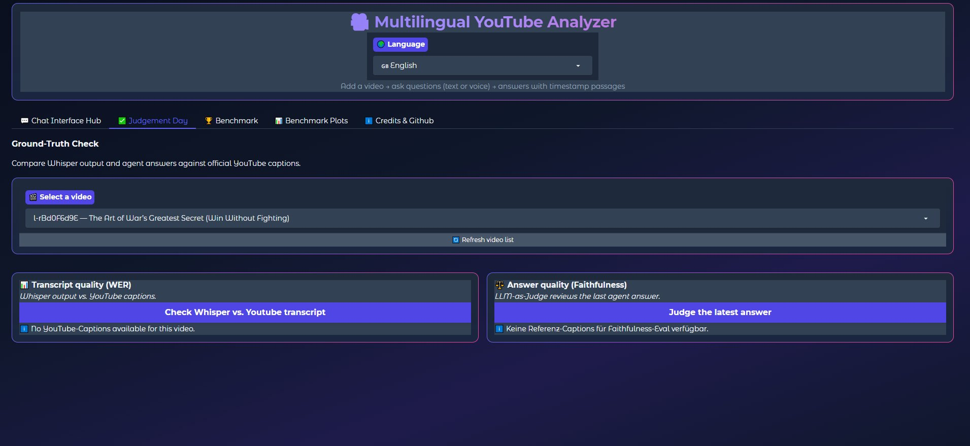

Slide 44
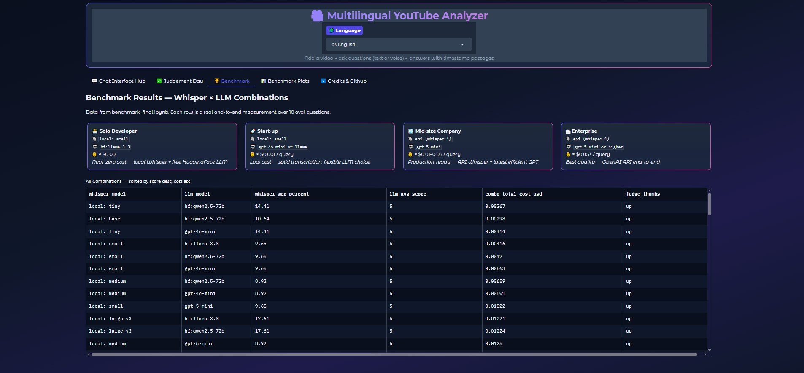

Slide 45
Credits
Creator
Daniel Ironhack
Assistance
Ashish · Jesus · Nurcan
Special Thanks
Al Hussein
AI Intelligence
Claude AI
Atmosphere
Lowkey Ambient working music
Ironhack AI Bootcamp 2026 — Final Project

Slide 46
"We ensure the quality of your customers' experience."

Slide 47
Thanks for
listening!
Do you have any Questions for me?
YouTube Q&A Agent · RAG System · Ironhack AI Bootcamp

