Slide 1
Project 4 Group 5 – Loan Rangers
WHICH ALGORITHM WORKS BEST FOR CLASSIFYING CREDIT CARD APPLICATIONS?
Daniel Hughes
Mohammed Nawaz
Ayomide Olanrewaju
Nana Afranie Ampadu Mensah

Slide 2
Task
This project uses historical credit card data to predict the future behaviour of customers who are applying for credit cards. The behaviours predicted are:
Balance paid off each month
Balance owing or overdue each month
No credit card loan taken out each month

Slide 3
Algorithms tested
To do the predictions we explored different ways of modelling the data.
Recurrent neural networks
Logistics regression
Random forest

Slide 4
dATA
Output

Slide 5
Neural Networks
Baseline Neural Network – Trained over 10 Epochs
Input Layer (48 inputs)
Hidden Layer 1 (50 neurons, ReLU activation)
Hidden Layer 2 (50 neurons, ReLU activation)
Output Layer (3 neurons, Softmax activation)

Slide 6
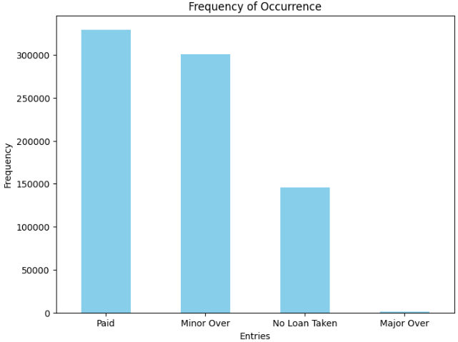
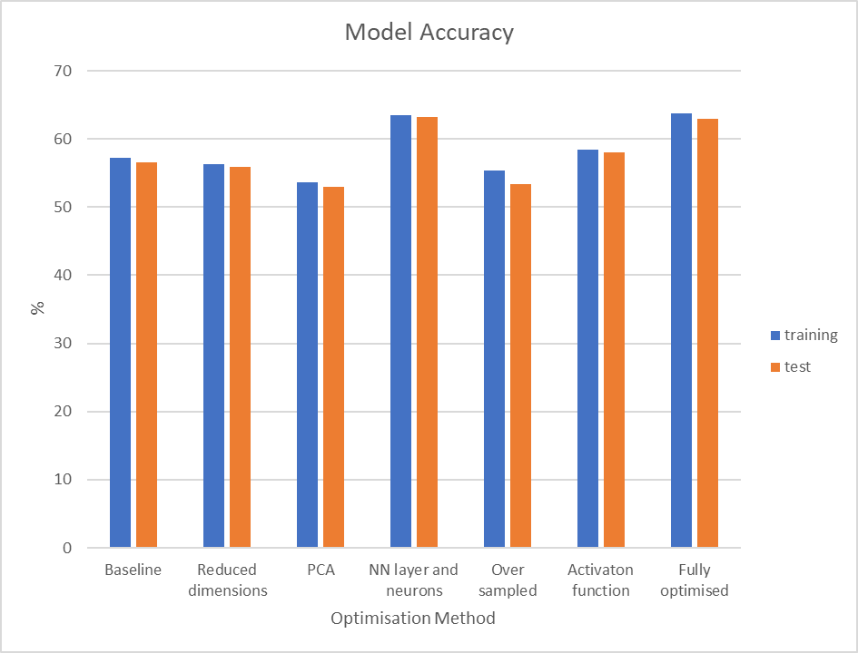
Optimisation Technique | Accuracy (%)
 | Training | Test
Baseline | 57.2 | 56.6
Reduced dimensions | 56.3 | 55.9
PCA | 53.6 | 52.9
NN layers and Neurons | 63.5 | 63.2
Over sampled | 55.3 | 53.3
Activation function | 58.4 | 58
Fully optimised | 63.8 | 62.9

Slide 7
Optimised Neural Network – Trained over 10 Epochs
Input Layer (48 inputs)
Hidden Layer 1 (100 neurons, Tanh activation)
Hidden Layer 2 (100 neurons, Tanh activation)
Hidden Layer 3 (100 neurons, Tanh activation)
Output Layer (3 neurons, Softmax activation)

Slide 8
Test
0.077 | 0.076 | 0.847
0.617 | 0.081 | 0.302
0.231 | 0.012 | 0.757
0.313 | 0.118 | 0.569
0.310 | 0.081 | 0.609
Baseline
Minor | No Loan | Paid
0 | 1 | 0
0 | 0 | 1
0 | 0 | 1
0 | 0 | 1
1 | 0 | 0
0.198 | 0.144 | 0.658
0.436 | 0.033 | 0.531
0.097 | 0.007 | 0.897
0.065 | 0.031 | 0.904
0.442 | 0.190 | 0.368
Optimised

Slide 9


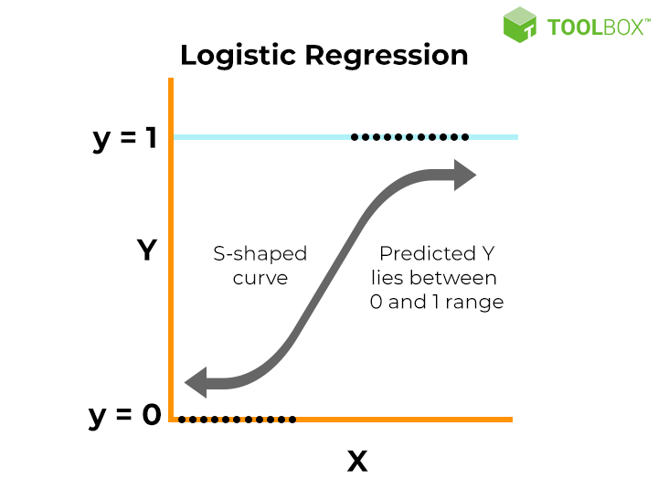
Logistic Regression
LogisticRegression?i
LogisticRegression(max_iter=2000, multi_class='ovr', random_state=42)
Method for modelling relationships between variables. Used to infer or predict a variable based on other variables.
X- other features
Y- target variable( Status: Paid, Minor overdue, No loan Taken)

Slide 10

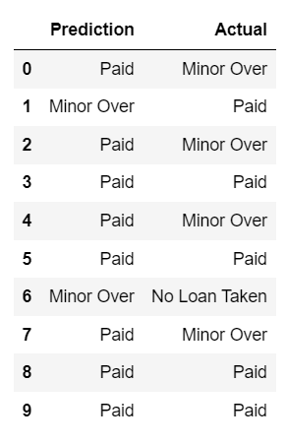
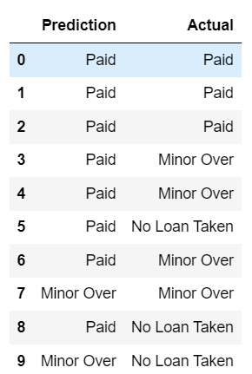
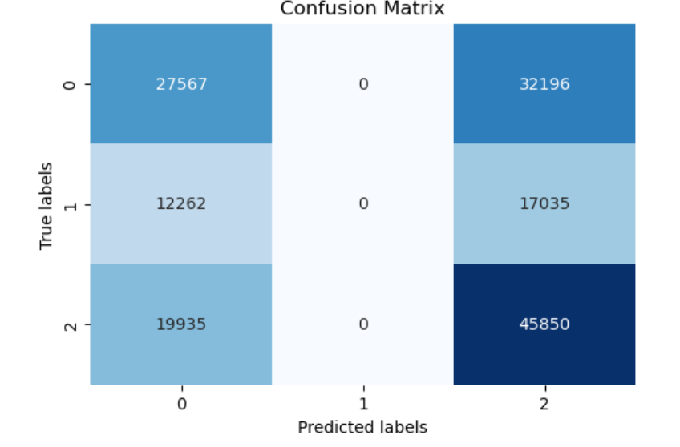
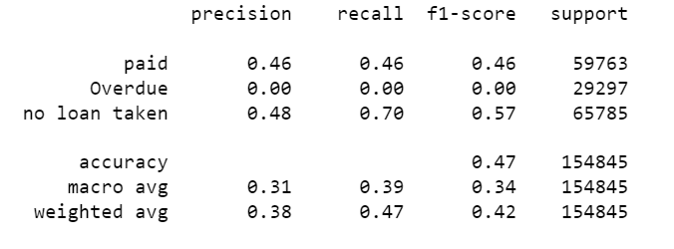
BASELINE MODEL
Prediction
Train
Test
Classification Report

Slide 11
Optimising
Encoding & Scaling
Random Over Sampling
Grid Search Cross-Validation
Regularisation and weight Balancing

Slide 12
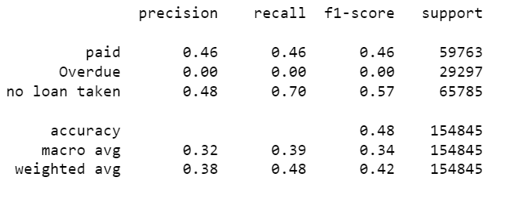


Encoding & Scaling
Classification report

Slide 13
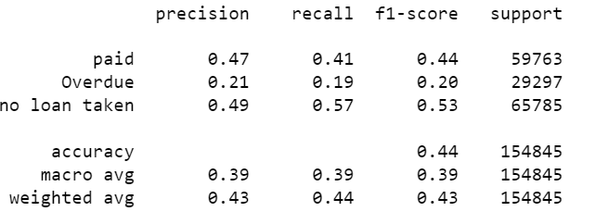


Random Over Sampling
Classification report

Slide 14
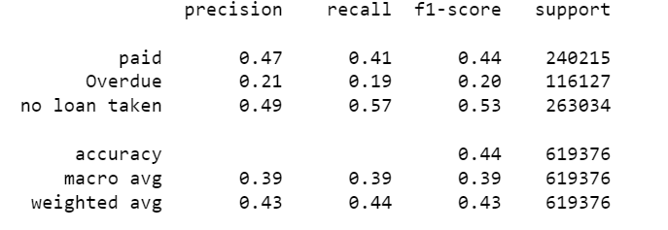


Regularisation and weight Balancing
Classification report

Slide 15
Grid search and cross classification
Classification report

Slide 16
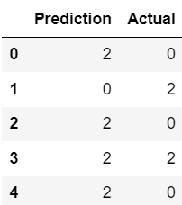
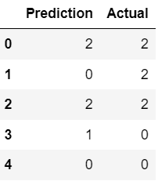
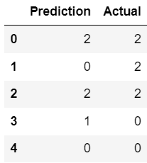
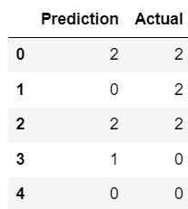
Paid- 0 Minor(overdue)- 1 no loan taken- 2
Encoding and scaling
Random Oversampling
Grid Search
Same result
Regularising, weight balance

Slide 17
PERFORMANCE EVALUATION
Optimisation Techniques | Training Accuracy | Test Accuracy
BaseLine | 0.48 | 0.47
Encoding and Scaling | 0.48 | 0.48
Random Oversampler | 0.44 | 0.44
Grid Search Cross Validation | 0.43 | 0.43
Regularisation and Weight Balancing | 0.44 | 0.44
Encoding & Scaling- most optimizing technique.
Logistics regression- updates model for performing multi-class predictions based on a very large sample data base. Very unreliable.

Slide 18
Random Forest
Baseline accuracy - The baseline accuracy suggests that the initial model, without any optimization, correctly classifies approximately 62% of the credit card applications in the test dataset.
Grid search – A grid search is applied to optimize the accuracy of the data. The test accuracy of 65% represents the performance of the model using the optimal hyperparameters obtained from grid search. Compared to the baseline accuracy or previous model performance, this indicates an improvement achieved through hyperparameter optimization.
Standard Scaler - The test accuracy of 62% indicates the performance of the model when trained and evaluated on data that has been standardized using standard scaling. The results is however same as the baseline accuracy

Slide 19
Model Comparison
Model | Accuracy (%)
Neural Networks | 63.2
Logistic Regression | 48.0
Random Forest | 65.0

