Slide 1
Project 4 Group 5
WHICH ALGORITHM WORKS BEST FOR CLASSIFYING CREDIT CARD APPLICATIONS?

Slide 2
Task
Use credit card data to predict the future behaviour of customers.
Historical data has the following status for each customer:
Paid – Balance paid off each month
Minor Overdue – Balance owing each month
No Loan – Customer did not use credit card that month

Slide 3
Algorithms tested
Logistics Regression
SVM
Neural Networks

Slide 4
dATA
Output

Slide 5
Neural Networks
Baseline Neural Network – Trained over 10 Epochs
Input Layer (48 inputs)
Hidden Layer 1 (50 neurons, ReLU activation)
Hidden Layer 2 (50 neurons, ReLU activation)
Output Layer (3 neurons, Softmax activation)

Slide 6
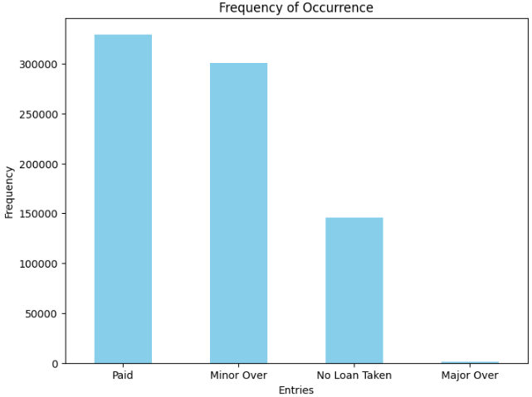
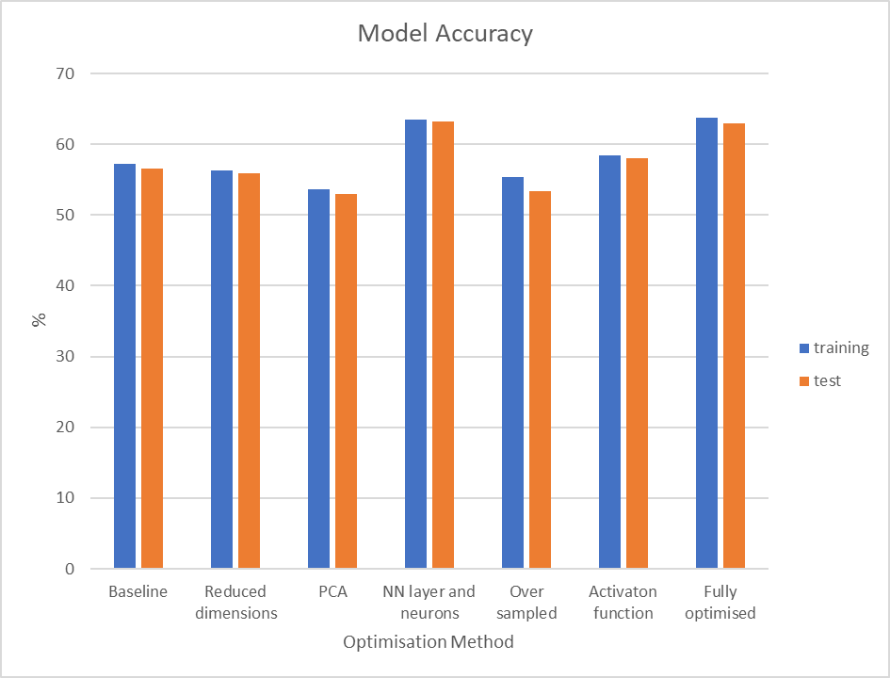
Optimisation Technique | Accuracy (%)
 | Training | Test
Baseline | 57.2 | 56.6
Reduced dimensions | 56.3 | 55.9
PCA | 53.6 | 52.9
NN layers and Neurons | 63.5 | 63.2
Over sampled | 55.3 | 53.3
Activation function | 58.4 | 58
Fully optimised | 63.8 | 62.9

Slide 7
Optimised Neural Network – Trained over 10 Epochs
Input Layer (48 inputs)
Hidden Layer 1 (100 neurons, Tanh activation)
Hidden Layer 2 (100 neurons, Tanh activation)
Hidden Layer 3 (100 neurons, Tanh activation)
Output Layer (3 neurons, Softmax activation)

Slide 8
Test
7.7 | 7.6 | 84.7
61.7 | 8.1 | 30.2
23.1 | 12.3 | 75.7
31.3 | 11.8 | 56.9
31.0 | 8.1 | 60.9
Baseline
Minor | No Loan | Paid
0 | 1 | 0
0 | 0 | 1
0 | 0 | 1
0 | 0 | 1
1 | 0 | 0
19.8 | 14.4 | 65.8
43.6 | 3.3 | 53.1
9.7 | 0.7 | 89.7
6.5 | 3.1 | 90.4
44.2 | 19 | 36.8
Optimised

Slide 9


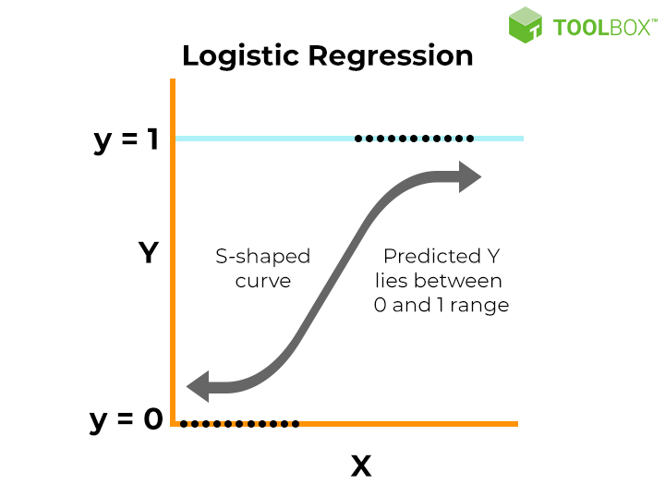
Logistic Regression
LogisticRegression?i
LogisticRegression(max_iter=2000, multi_class='ovr', random_state=42)
Method for modelling relationships between variables. Used to infer or predict a variable based on other variables.
X- other features
Y- target variable( Status: Paid, Minor overdue, No loan Taken)

Slide 10

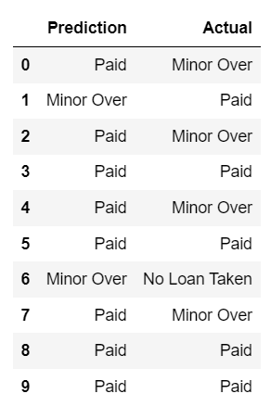
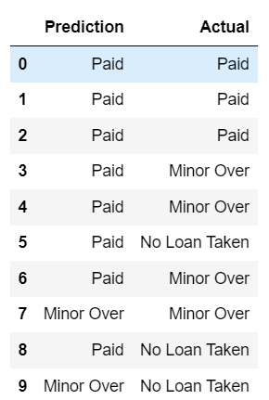
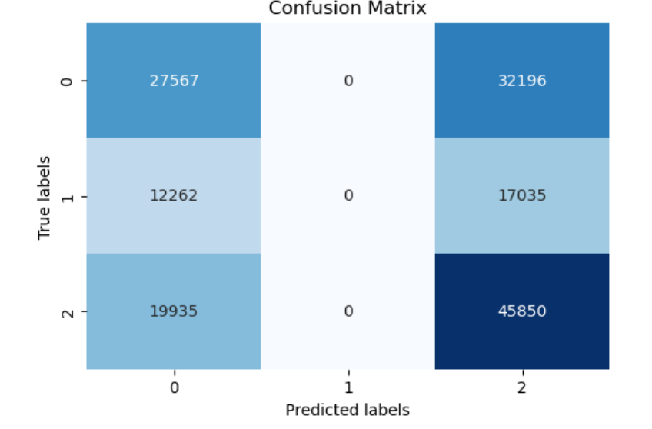
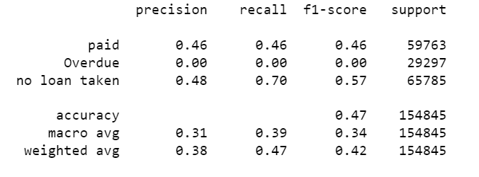
BASELINE MODEL
Prediction
Train
Test
Classification Report

Slide 11
Optimising
Encoding & Scaling
Random Over Sampling
Grid Search Cross-Validation
Regularisation and weight Balancing

Slide 12
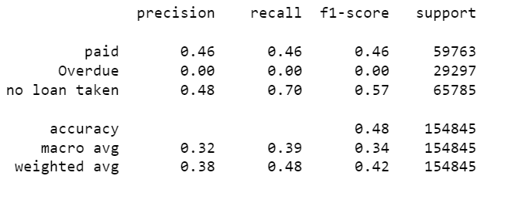


Encoding & Scaling
Classification report

Slide 13
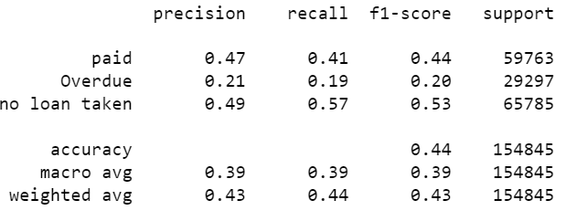


Random Over Sampling
Classification report

Slide 14
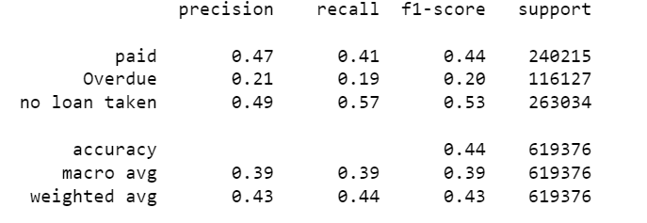


Regularisation and weight Balancing
Classification report

Slide 15
Grid search and cross classification
Classification report

Slide 16
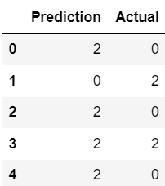
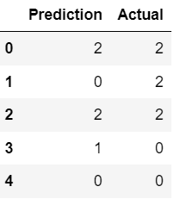
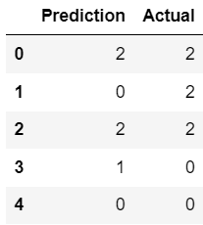
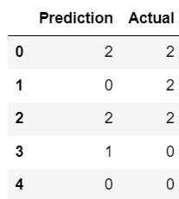
Paid- 0 Minor(overdue)- 1 no loan taken- 2
Encoding and scaling
Random Oversampling
Grid Search
Same result
Regularising, weight balance

Slide 17
PERFORMANCE EVALUATION
Optimisation Techniques | Training Accuracy | Test Accuracy
BaseLine | 0.48 | 0.47
Encoding and Scaling | 0.48 | 0.48
Random Oversampler | 0.44 | 0.44
Grid Search Cross Validation | 0.43 | 0.43
Regularisation and Weight Balancing | 0.44 | 0.44
Encoding & Scaling- most optimizing technique.
Logistics regression- updates model for performing multi-class predictions based on a very large sample data base. Very unreliable.

Slide 18
SVM

