Slide 1
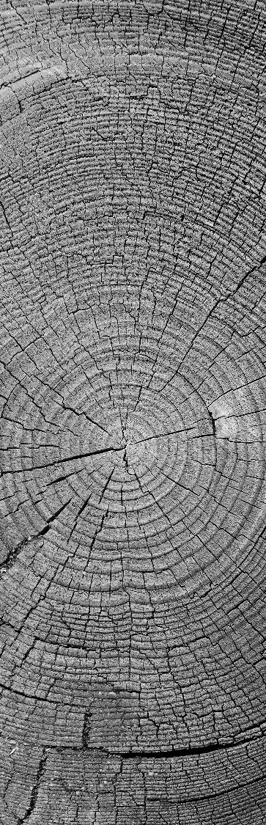
Data Mining and Foundations of AI: Assessment 2
---------

Slide 2
introduction
The field of AI has had significant advancement, especially in healthcare, throughout the past 20 years. In this project, we utilised its availability to train an AI model to analyse images of lungs and determine if they have pneumonia.
This Kaggle dataset was used for the basis of my analysis:
https://www.kaggle.com/datasets/paultimothymooney/chest-xray-pneumonia
This is then combined with explainable AI techniques to provide insight as to why the predicative models chose the decisions they made.

Slide 3
Problem Analysis
Developing an accurate model will be no mean feat. Even the most experienced of radiologists can struggle to detect pneumonia due to its visual similarity with other lung conditions. However, an accurate computer prediction model should be able to rapidly detect the subtleties that humans often miss.
The Kaggle dataset I have chosen has images split into three sections – ‘test’, ‘train’, and ‘val’. Each of these have ‘normal’ and ‘pneumonia’ sections for ease of implementation, with a wide variety of images to work with.
An in depth look at the Kaggle dataset shows that there is a significant imbalance between pneumonia and normal cases – there’s almost 3 times as many pneumonia cases! This should be solved with data augmentation.

Slide 4
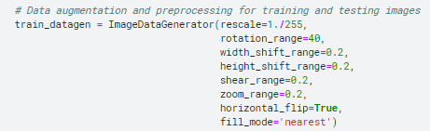
Data preparation
Data preparation includes loading, preprocessing, and augmenting it.
It’s loaded by pointing to the train and test directory
The data then pre-processed by resizing them to a standard 150 x 150 resolution. They are also normalised to a 0-1 scale, as it is faster for models to process.
Data is finally augmented. They are randomly rotated up to 40 degrees, and well as being shifted up or down. They can also randomly be zoomed or sheared. This creates a much more diverse dataset to train from.
This prevents overfitting, which was a problem with some of my earlier models.

Slide 5
Model selection
Selecting the correct model is arguably the single most important step to success. To ensure that I can evaluate multiple solutions, I picked three different models for further analysis.
CNN Model
The CNN (Convolutional Neural Network) was chosen because it is the modern standard for AI image classification, well suited for finding minor discrepancies in images.
SVM Model
The SVM (Support Vector Machine) model was selected due to it being the historical go-to for image analysis. It is great at classification-based tasks.
RF Model
The RF (Random Forest) model was picked as it’s a very robust model with easily interpretable decision rules.

Slide 6
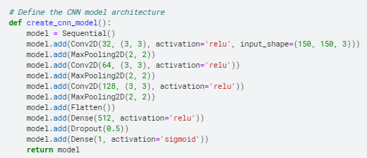
Cnn model development
CNNs are a powerful type of deep learning model, perfect for image classification tasks.
I began witth a simple CNN using two convolutional layers of 32 and 64 filters, and a 2x2 kernel. This was about 70% accurate
This proved ineffective, so I expanded it to a 3x3 filter which saw 5-10%+ accuracy improvements.
I then also added a third convolution layer, this time doubling the filter count again (128). This saw another 5-10%+ improvement.
With a little reading, it seemed the Rectified linear units would be the correct activation choice, as it would allow for non-linearity. This would be incredibly important for achieving accurate results.
I finally experimented with epochs and found that anything above 10 resulted in severely diminishing returns. It capped out around 90% accurate.

Slide 7

SVM model development
SVM models are supervised learning algorithms used for both classification and regression based tasks.
I started with a ‘default’ SVM, which was giving accuracy results of around 50% - 55%.
After a bit of research, I found that RBF was the best kernel to use. It can capture non-linear relationships, which is far more appropriate than the ‘Linear’ kernel.
A simple 1.0 regularisation parameter surprisingly worked very well in this context, providing a good balance between overfitting and generalisation.
The gamma setting was set to scale so it can automatically calculate the best gamma for the training data.
With these improvements, the accuracy capped out around 70%. However, it was highly volatile, and sometimes dropped as low as 43%.

Slide 8
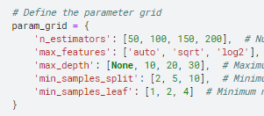
RF model development
RF models are ensemble learning algorithms that combine multiple decision trees to make predictions.
I began with a simple random forest, that gave me an accuracy of right around 50%
I then researched hyperparamter optimisation. A variety of estimator counts were employed to find the best balance between accuracy and computation time. The theory is the same with maximum depth, but this time to prevent overfitting.
The max features parameter also considers 3 options to find if all the extra values actually contributes to the accuracy.
The overall best parameters I found were: 200 Estimators, 2 Min sample split, 1 Min sample leaf, log2 Max features, and no max depth. This raised accuracy to around 60%.

Slide 9
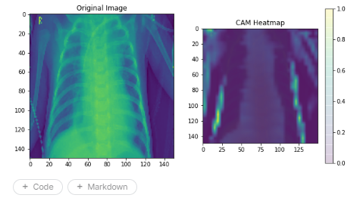
CNN: X-AI
High levels of accuracy are all well and good, but that doesn’t tell us much about how the model came to that decision.
To solve this, I employed a GCAM heatmap to highlight the areas which the CNN model considered most important for determining the result.
From this image, you can see how the model was able to correctly determine that the important parts of the image are the middle shapes, which is where the fluid build-up is located.
The only negative point is how it can sometime highlight an areas of significant difference, such as the letter or arm. This is filtered out over other convolution layers, though.

Slide 10
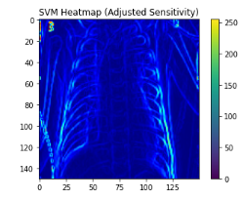
SVM: X-AI
I employed similar analysis methods to my SVM model.
From this image, it is obvious why the SVM model has a lower, and often turbulent, accuracy score.
There is a significant focus on the ribcage as opposed to the telltale signs of pneumonia.
There is also a large focus on irrelevant features such as the letter, which SVM models are unable to filter out as easily as other models.

Slide 11
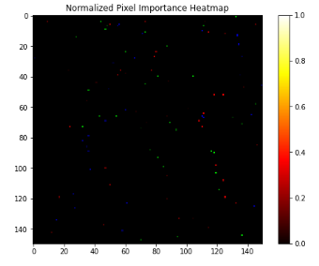
RF: X-AI
I decided on a heatmap for my RF model too. However, as GCAM isn’t compatible with RF models, I utilised a SHAP analysis of pixel importance and then mapped that on to a heatmap.
This image shows little focus on the middle of the image, where the lungs are.
Seemingly random spots on the image showing high importance are likely other symptoms such as wall thickening or mosaic perfusion.
This should reveal why the accuracy is around the 60% mark – it often gets confused.

Slide 12
Comparative Analysis
A comparative analysis of CNN, RF, and SVM models reveals stark reasons that explain the dominance of CNN in the modern day. It excels in capturing complex image features, which allows it to achieve higher accuracy. They are slightly newer than the other two options and have proven to be more versatile in the image recognition space.
Final Accuracy Values:
CNN – 87.6%
SVM – 65.6%
RF – 56.3%
CNNs unique features such as feature hierarchy learning, parameter sharing, spatial invariance, and transfer learning all place them in a league above the offerings of RF and SVM models – they are generally too linear.

Slide 13
conclusion
In conclusion, after testing 3 solutions to pneumonia image detections, I have found that CNN is undoubtably the best option to use. The accuracy rate is significantly higher than the others.
In future, it may be worth considering creating a VGG model for the purpose of pneumonia detection. However, I could only find others precompiled options not appropriate for the task and I considered making my own out of the scope of this project.

Slide 14
Thank you for your attention!
Any Questions?

