Slide 1
Viewing Media in stereo 3D produces a stronger emotional response than in equivalent 2D view
Group 7

Slide 2
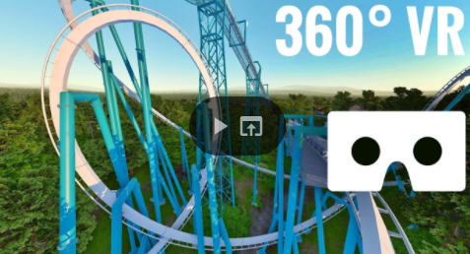
Demonstration

Slide 3
Implementation Design
YouTube roller coaster ride video presented on desktop computer screen
versus
360° YouTube roller coaster ride video on an Oculus Rift S device
H0
In the field of VR there is no clear connection observed between sense of presence and strength of emotional response, so presentation of media in 2D would have a similar impact to the alternative presentation in 3D.
H1
In an experimental setting, stereo 3D content presented in VR is expected to show a significant increase of reported levels of happiness and/or excitement in users as compared to engaging with 2D media through a 2D screen.

Slide 4
1 control group of up to 15 participants
Dependent variable: media presentation’s immersive qualities
Primary questionnaire to ensure participant wellbeing
Self-Assessment Manikin (SAM) Questionnaire - the three dependent variables: happiness, excitement, control
Paired-samples t-test performed on SAM data to measure subjective user feelings.
Switching order of 2D and 3D presentation between users to avoid familiarity with the content affecting the results
Final questionnaire: Information about participants self-assessed sense of presence and opinions on the two types of media

Slide 5
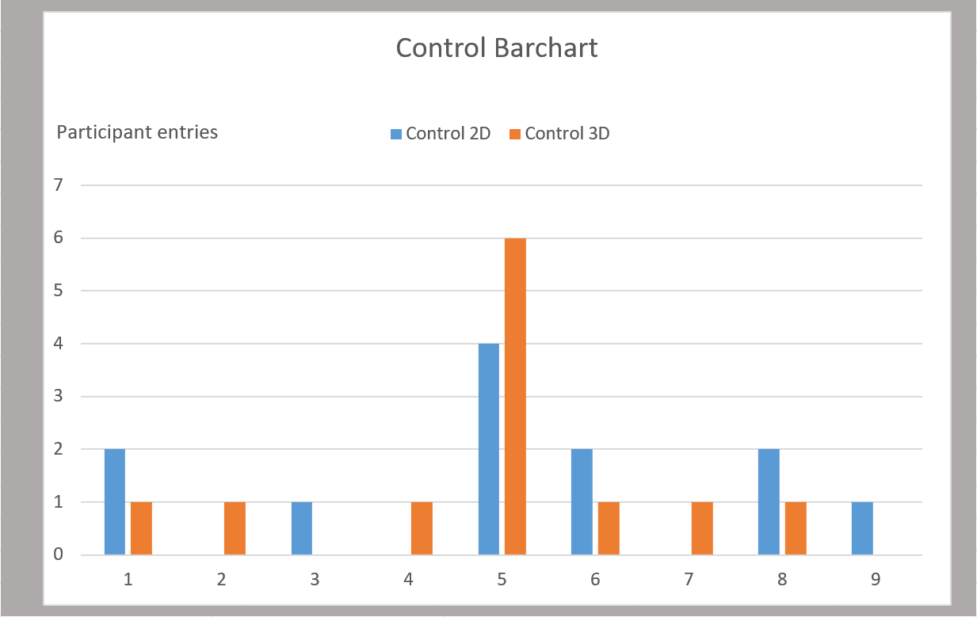
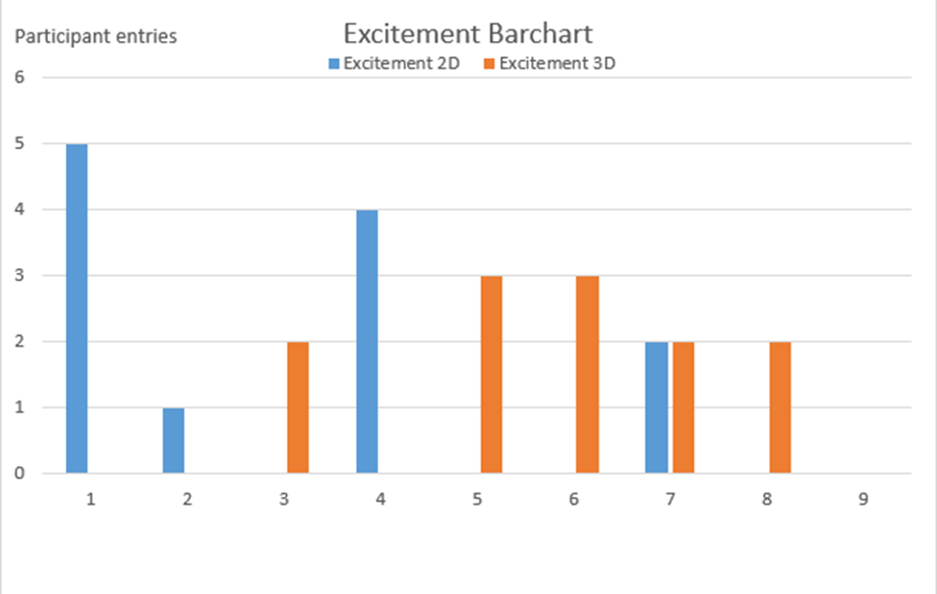
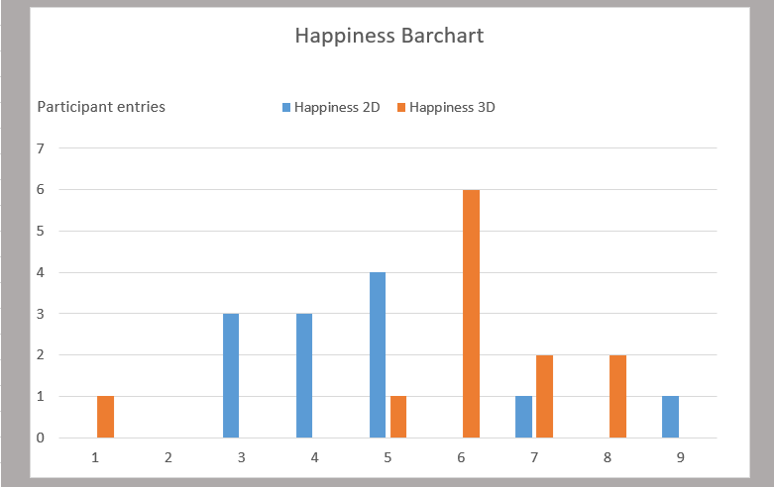
Results

Slide 6
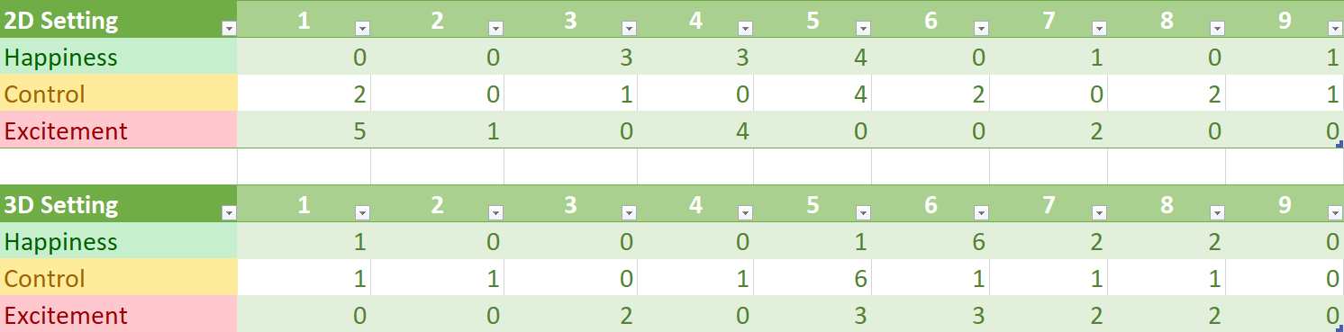
12 entries in total
11 out of 12 agree sense of presence is higher in stereo 3D media than 2D
No statistical difference in happiness measurement for the 2 settings
No statistical difference in control measurement for the 2 settings
Statistically significant difference in the excitement measurements for the two settings

Slide 7
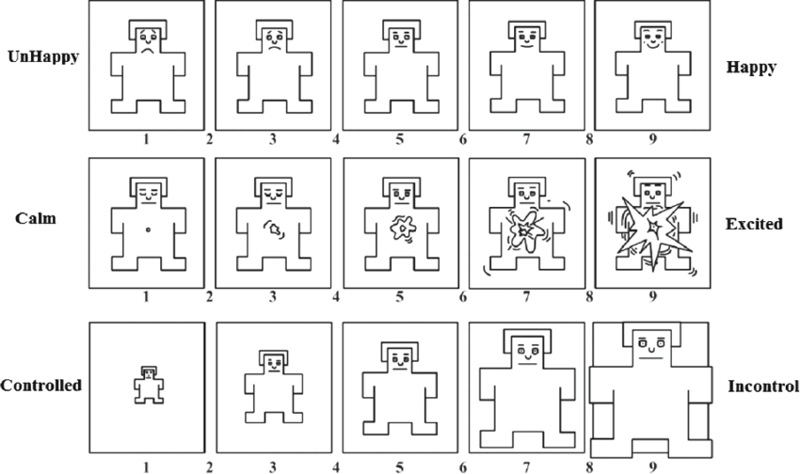
SAM Questionnaire

Slide 8
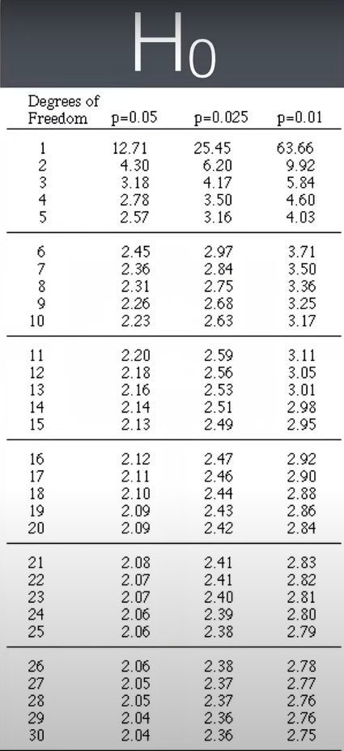
Data Analysis
To observe the impact of each type of media on the reported strength of emotional response, paired-sample t-tests were performed for the happiness, excitement and sense of control measurements. A pre-existing t-table was used to identify the critical value for each test. For a total of 24 measurements, the degrees of freedom were 22, therefore the critical value for p=0.5 was 2.07. This value was used for comparison purposes with the t-values from the next few slides to test the validity of the null hypothesis.
Table derived from: https://www.youtube.com/watch?v=pTmLQvMM-1M

Slide 9
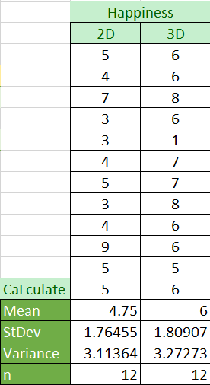
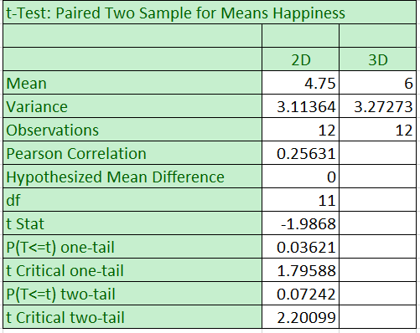
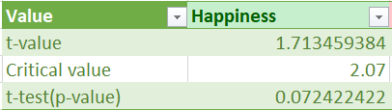
Happiness Measurement
The p-value calculated was 0.07 which shows the probability observed difference occurred by chance was somewhat high.
The calculated t-value was 1.71 and was compared to the critical value of 2.07 as proposed by the t-table used.
No statistically significant difference was observed.

Slide 10
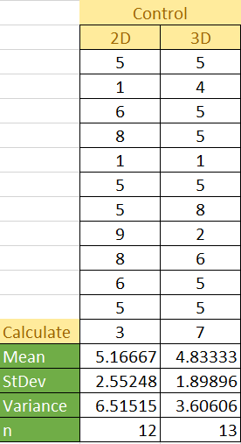
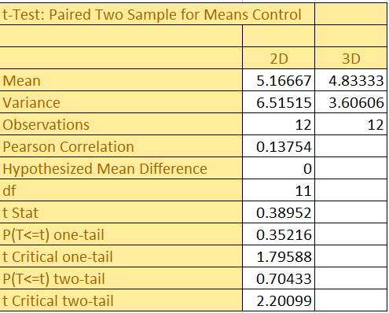
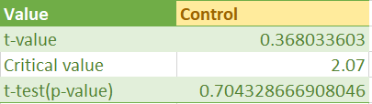
Control Measurement
The p-value calculated was 0.70 which shows the probability observed difference occurred by chance was high.
The calculated t-value was 0.37 and was compared to the critical value of 2.07 as proposed by the t-table used.
No statistically significant difference was observed.

Slide 11
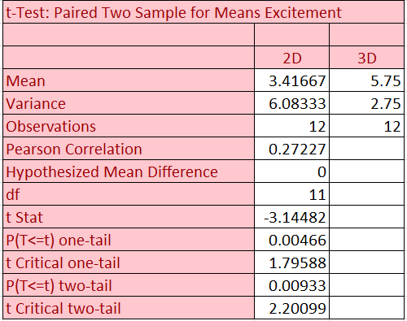
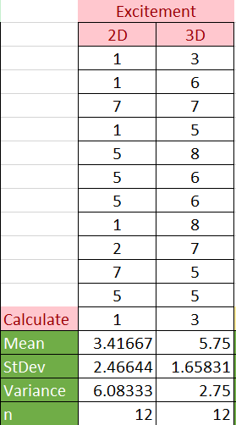
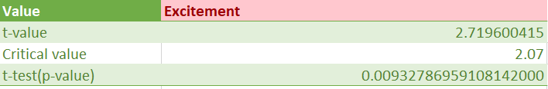
Excitement Measurement
The p-value calculated was 0.00932787 which shows the probability observed difference occurred by chance was low.
The calculated t-value was 2.72 and was compared to the critical value of 2.07 as proposed by the t-table used.
Statistically significant difference was observed in this dimension.

Slide 12
Conclusions
Increase in user engagement and a heightened sense of realism when the viewed media is in a 3D format as opposed to its 2D counterpart
Participants agreed they experienced an increased sense of presence in the 3D media
Due to the significant statistical difference in the excitement dimension for the 2 types of media, H1 was validated
Questions for future research:
What difference does 2D and 3D media presentation make on users’ subjective emotional responses?
How can the combination of immersive technology and 3D media increase the user satisfaction of media consumers in the future?

Slide 13
Thank you for listening!

