Slide 1
BP Influence & Engagement Assessment
Notes:
Welcome to the presentation. This assessment outlines a data-driven approach to strengthening BP's credibility and stakeholder engagement in the energy transition.

Slide 2

Key Objectives of the Assessment
Assess stakeholder perceptions and trust in our initiatives
Evaluate credibility of communications and information sources
Identify preferred channels for stakeholder engagement
Ensure alignment with regulatory compliance and policy standards
Notes:
This slide outlines the primary objectives driving our assessment process. We aim to capture a comprehensive understanding of stakeholder perceptions, evaluate the credibility of our communications, and determine the most effective engagement channels. Additionally, we are prioritizing alignment with regulatory requirements to ensure full compliance. These objectives will guide our data collection and inform actionable recommendations moving forward.

Slide 3
Strategic Methodology for Stakeholder Insights
Establish a robust framework for progress and sentiment tracking
Identify and optimize high-impact communication channels
Benchmark BP’s renewable brand performance against industry peers
Assess media influence on stakeholder perceptions
Map stakeholder objectives and perceptions of BP’s low-carbon initiatives
Notes:
This section introduces our structured approach to gathering actionable insights for BP. We will detail how each phase—from establishing measurement frameworks to benchmarking and stakeholder mapping—will provide a comprehensive understanding of BP’s positioning in the renewables sector. This methodology ensures our recommendations are data-driven, targeted, and aligned with BP’s strategic objectives, setting the stage for effective stakeholder engagement.

Slide 4

Structured Phased Research Approach
Phase 1: Develop and Refine Research Hypotheses
Phase 2: Conduct Comprehensive Media Analysis
Phase 3: Execute In-Depth Elite Qualitative Interviews
Phase 4: Integrate Findings and Synthesize Insights
Notes:
This slide outlines our structured, four-phase research methodology. We begin by developing and refining clear research hypotheses to guide our process. Next, we conduct a thorough analysis of both traditional and social media to capture a broad spectrum of data. In the third phase, we engage with key stakeholders through elite qualitative interviews to gain deeper insights. Finally, we integrate all findings and synthesize actionable insights, ensuring a robust and comprehensive assessment. This phased approach enables us to build a strong evidence base and deliver data-driven recommendations.

Slide 5
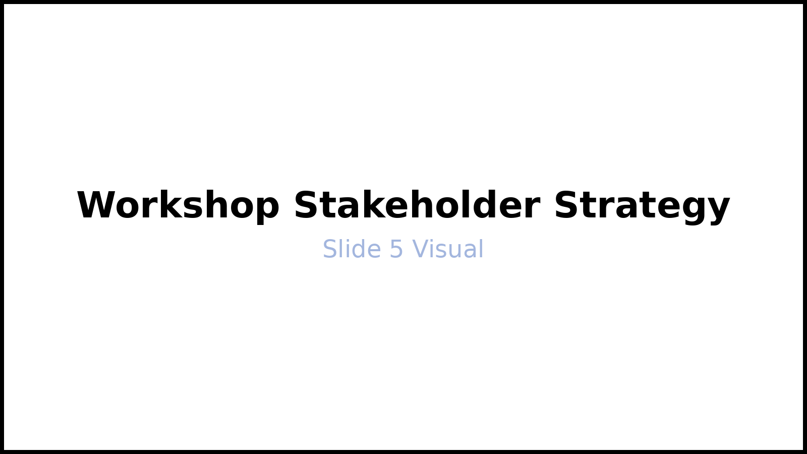
Phase 1: Strategic Hypothesis Development
Analyze BP’s recent strategic initiatives and stakeholder dynamics
Identify and prioritize potential credibility gaps
Formulate data-driven working hypotheses for validation
Establish research priorities and success metrics
Align on project scope, timeline, and key deliverables
Notes:
In Phase 1, we lay the foundation for our research by thoroughly examining BP’s latest strategic moves and stakeholder environment. This enables us to pinpoint credibility gaps and develop focused, data-driven hypotheses. By setting clear research priorities and defining success metrics, we ensure that the project remains aligned with BP’s objectives. This phase concludes with agreement on the project scope, timeline, and deliverables, setting a strong direction for the next stages.

Slide 6

BP’s 2023 Energy Investment Allocation: Key Insights
Allocated $1.3B to low-carbon initiatives
Invested $15B in oil and gas operations
Clean energy receives $1 for every $11 in fossil fuels
Current mix shapes stakeholder trust and ESG ratings
Notes:
This slide presents a clear breakdown of BP’s 2023 energy investment portfolio, emphasizing the significant disparity between low-carbon and fossil fuel allocations. Highlight the $1.3B directed toward low-carbon projects compared to the $15B in oil and gas, underlining the $1 to $11 investment ratio. These figures are critical for understanding BP’s current positioning on sustainability and its impact on stakeholder perception and ESG (Environmental, Social, and Governance) assessments. Transition to discussing how these investment patterns inform BP’s reporting practices and future strategic steps.

Slide 7

Phase 2: Comprehensive Media and Sentiment Analysis
Assess sentiment trends across major media and social platforms
Map key influencers and primary drivers of media coverage
Benchmark BP’s media presence and sentiment against industry peers
Identify emerging topics and reputational risks
Highlight opportunities for strategic engagement and narrative shaping
Notes:
In this phase, we will conduct a thorough analysis of media and social sentiment to establish a clear baseline for BP’s public narrative. By mapping influential voices and coverage drivers, we can better understand the factors shaping BP’s reputation. Benchmarking against industry peers will reveal strengths and areas for improvement, while identifying emerging topics and risks will inform proactive communication strategies. This analysis will guide targeted engagement efforts to enhance BP’s influence and reputation in the marketplace.

Slide 8

Phase 3: Elite Qualitative Research Insights
Conduct 20 in-depth interviews with key stakeholders
Facilitate 2 focus groups with policy influencers (UK/EU, US)
Assess local community impact and identify co-benefits
Analyze stakeholder motivations and expectations
Synthesize qualitative findings to inform strategic recommendations
Notes:
This phase leverages qualitative methods to extract nuanced perspectives from influential stakeholders and policy influencers across key regions. By engaging both individual and group formats, we gain a comprehensive understanding of motivations, expectations, and perceived community impacts. These insights will be synthesized to guide our strategic direction and ensure alignment with stakeholder needs. Transitioning from this research, we will integrate findings into actionable recommendations for the next phase.

Slide 9

Key Stakeholder Groups & Priority Discussion Topics
Institutional Investors: Balancing ESG integration with activist demands
NGOs: Assessing climate strategy credibility and disclosure practices
Regulators: Monitoring compliance with evolving sustainability standards
Employees: Addressing workplace sustainability and engagement
Customers: Evaluating product transparency and ethical sourcing
Notes:
This slide outlines the main stakeholder groups involved in our engagement process and highlights the critical topics to be addressed during interviews and focus groups. Emphasize how each group has distinct priorities, such as investors' focus on ESG versus activism, NGOs' scrutiny of climate action, and regulators' interest in compliance. Also, note the importance of internal and customer perspectives on sustainability. This comprehensive approach ensures our strategy is informed by diverse and relevant stakeholder insights, supporting robust decision-making.

Slide 10

Phase 4: Data-Driven Analysis & Strategic Synthesis
Integrate quantitative and qualitative research insights
Benchmark BP’s clean energy brand performance against industry peers
Identify credibility gaps and reputational risks
Synthesize findings to inform strategic recommendations
Notes:
In this phase, we will systematically combine quantitative data with qualitative insights to provide a comprehensive understanding of BP’s brand position in the clean energy sector. By benchmarking against key competitors, we can pinpoint areas where BP leads or lags. We will also assess potential credibility gaps and reputational risks that could impact stakeholder trust. The synthesis of these findings will directly inform actionable recommendations for BP’s ongoing strategy. This iterative, evidence-based approach ensures our analysis remains focused on delivering measurable value.

Slide 11

BP Brand Perception: Comparative Analysis with Industry P...
BP rated below peers on alignment with 1.5°C climate goals
Only 14% of US voters express trust in oil & gas companies
BP’s credibility in renewables lags behind leading competitors
Peer companies demonstrate stronger public brand associations
Notes:
This chart provides a comparative overview of BP’s brand perception relative to its key industry competitors, focusing on climate alignment and public trust. Note that BP is perceived as less committed to the 1.5°C pathway and faces significant trust challenges among US voters. Additionally, BP’s brand association with renewables is weaker compared to peers, who are outperforming in both credibility and public perception. Use this data to highlight areas for strategic improvement and to set the stage for recommendations on enhancing BP’s brand positioning.

Slide 12

Community Impact: Delivering Local Value
Peacock Solar Farm generated new jobs and increased tax revenue
Launched skills retraining programs in Aberdeen and Teesside
Strengthened local economies through targeted investments
Addressed NGO concerns following recent budget reductions
Notes:
This slide illustrates BP’s tangible contributions to local communities, emphasizing job creation, economic growth, and workforce development. Highlight the success of the Peacock Solar Farm and retraining initiatives, while also acknowledging increased NGO scrutiny after budget cuts. Use this as a transition to discuss BP’s ongoing commitment to a just and inclusive energy transition.

Slide 13

Phase 5: Insightful Reporting & Strategic Recommendations
Present comprehensive research memo and in-depth media analysis
Deliver comparative insights across key stakeholder segments
Provide actionable, data-driven recommendations for engagement
Highlight transparency and mutual community benefits
Support ongoing strategy with clear, evidence-based guidance
Notes:
In this final phase, we consolidate all findings into a comprehensive research memo and detailed media analysis. Our comparative insights will illuminate differences and opportunities across stakeholder groups, ensuring our recommendations are both actionable and tailored. We emphasize transparency and the shared value for the community, reinforcing BP’s commitment to responsible engagement. These deliverables will serve as a foundation for ongoing, evidence-based strategy and communications, positioning BP for sustained success.

Slide 14

Project Timeline & Key Milestones: Phase 1
Initiate project kick-off and align stakeholder objectives
Develop and validate research hypotheses
Conduct comprehensive media landscape analysis
Facilitate interviews and focus group sessions
Synthesize findings and prepare interim report
Notes:
This slide outlines the first phase of our project timeline, highlighting the sequential milestones from project initiation through to interim reporting. Emphasize the importance of stakeholder alignment at kick-off, the rigor in hypothesis development, and the depth of our media analysis. Note that qualitative insights from interviews and focus groups will inform our early findings. This is part one of a two-part timeline overview; the next slide will detail subsequent phases and deliverables.

Slide 15

Project Timeline & Key Milestones: Phase Two
Phase duration: 8–9 weeks with defined deliverables
Conduct bi-weekly progress reviews to ensure alignment
Monitor milestone achievement at each transition point
Address risks and adjust timelines proactively
Document outcomes and lessons learned for future phases
Notes:
This slide outlines the second phase of our project timeline, emphasizing a structured approach to milestone tracking and risk management. Highlight the importance of regular bi-weekly reviews to maintain alignment and transparency. Discuss how proactive risk identification and timely adjustments help us stay on schedule. Finally, stress the value of documenting outcomes and lessons learned to inform subsequent project phases. This ensures continuous improvement and supports successful project delivery.

