Slide 1

Data Scientist Hiring
How should we fill the position and what should we pay them?

Slide 2
What are our main goals?
Hire a full-time Data Scientist.
Hire someone who can drive growth in Data Science department and potentially lead a team in the future as we rapidly grow.
Compare those working in the US vs those working Offshore.

Slide 3
Guidelines to Analysis
Based on data provided, I focused only on full-time Data Scientist employees.
I removed any entry level workers as we are looking to find someone with either Mid-level, Senior-level, or Executive-level experience to potentially lead a team in the future. There was no Executive-level employee data available.
I removed any workers working with a Small-sized company (less than 50 employees) so we could focus on our rapid growth. I only looked at employees from Medium-sized (50 to 250 employees) and Large-sized (over 250 employee) companies.
Compared average salaries between those working in the US and those working Offshore.

Slide 4
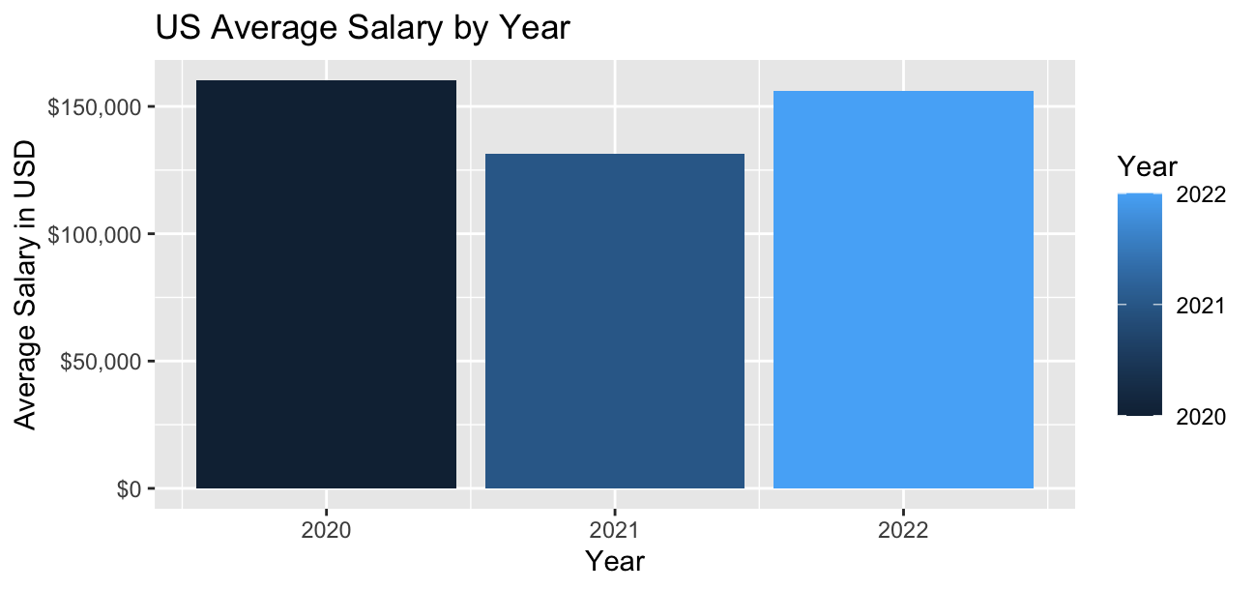
Let’s look at US Data Scientists Salaries
As you can see, the average salary for Data Scientists was much higher in 2020 than 2021 due to the recession. However, we saw those incomes start to climb back up in 2022
$160,295 in 2020
$131,500 in 2021
$156,223 in 2022

Slide 5
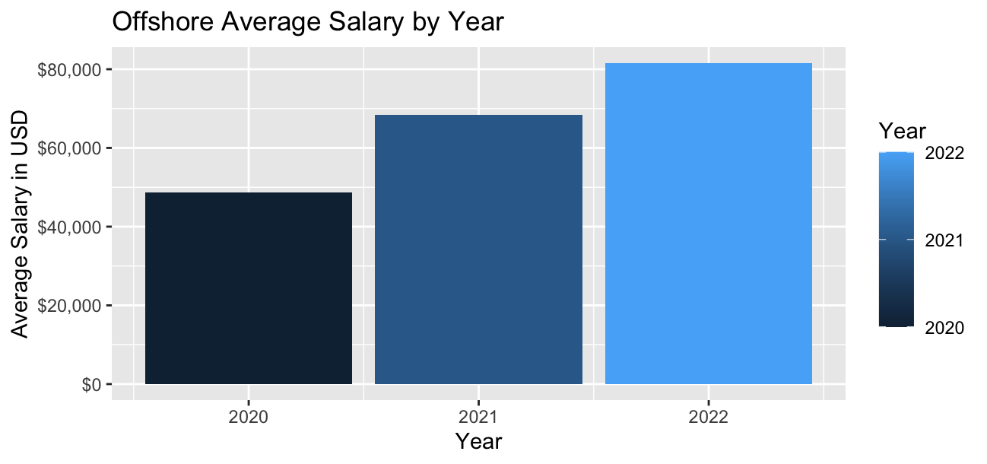
Let’s look at Offshore Data Scientists Salaries
As you can see, the average salary for Offshore Data Scientists was much different than those in the US. Overall, they are much lower and contrary to those in the US the average salary has steadily climbed during the past three years.
$48,706 in 2020
$68,400 in 2021
$81,559 in 2022
Next slide will show you the comparison to see just how much more those in the US are getting paid compared to offshore.

Slide 6
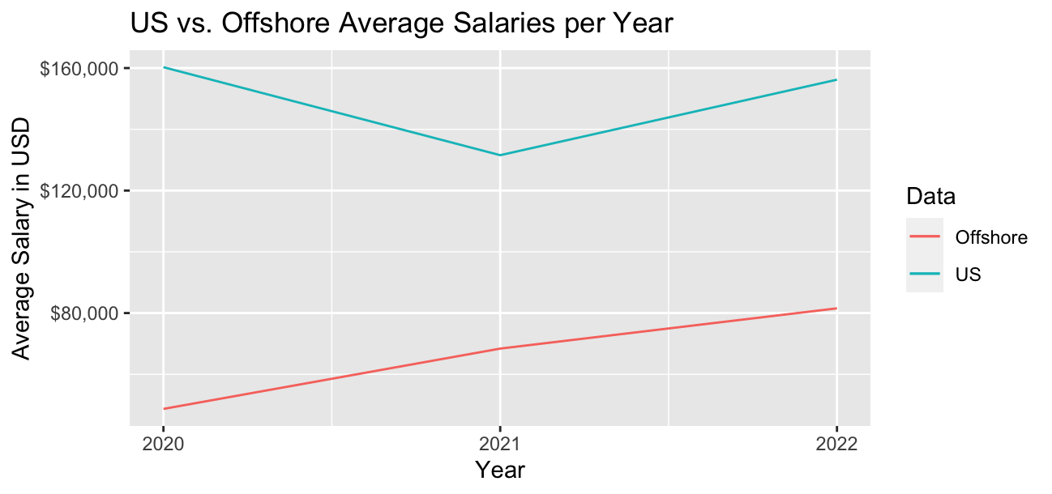
US vs. Offshore Average Salaries
Average salary percentage difference between US and Offshore by year:
329% higher in US in 2020
192% higher in US in 2021
191% higher in US in 2022
In 2020, US Data Scientists were getting paid more than triple than those Offshore and almost double in 2021 and 2022.

Slide 7
US vs. Offshore Salary Data
Over last 3 years:
Difference in average salary is $82,719
Difference in maximum salary is $228,772
Difference in minimum salary is $48,257
Salary Type | United States | Offshore
Average Salary | $153,517 | $70,798
Maximum Salary | $412,000 | $183,228
Minimum Salary | $68,428 | $20,171

Slide 8
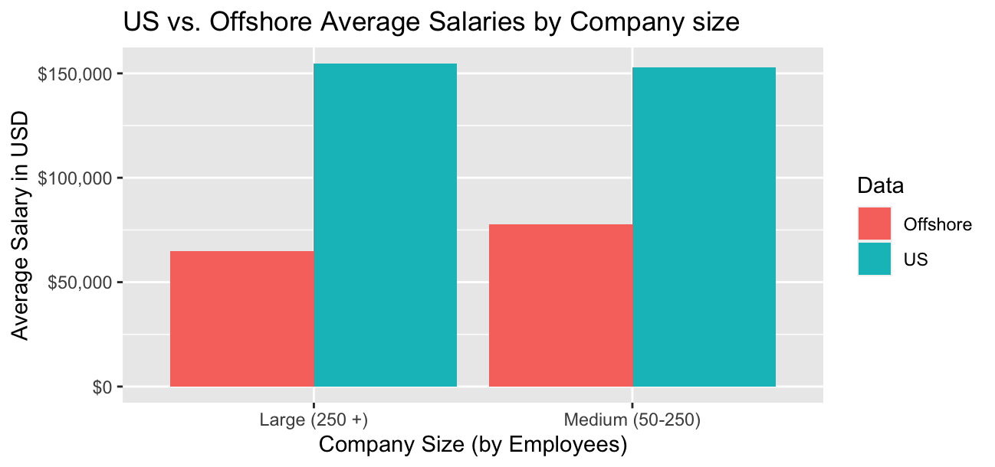
US vs. Offshore Salary Data by Company Size
US Average salary by company size:
Large-sized company was $154,729
Medium-sized company was $153,027
Offshore average salary by company size:
Large-sized company was $64,976
Medium-sized company was $77,784

Slide 9
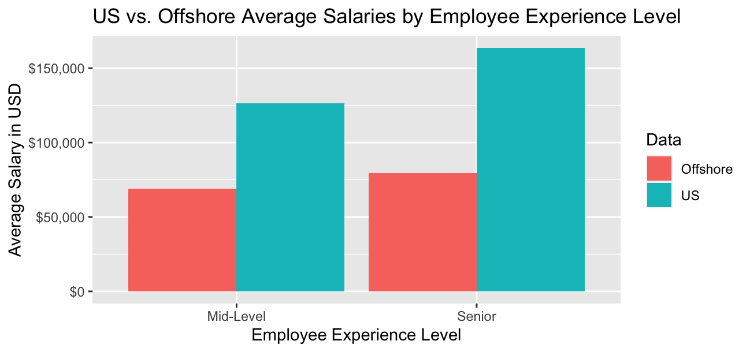
US vs. Offshore Salary Data by Experience Level
US average salary by experience:
Mid-level was $126,587
Senior-level was $164,679
Offshore average salary by experience:
Mid-level was $68,856
Senior-level was $79,538

Slide 10
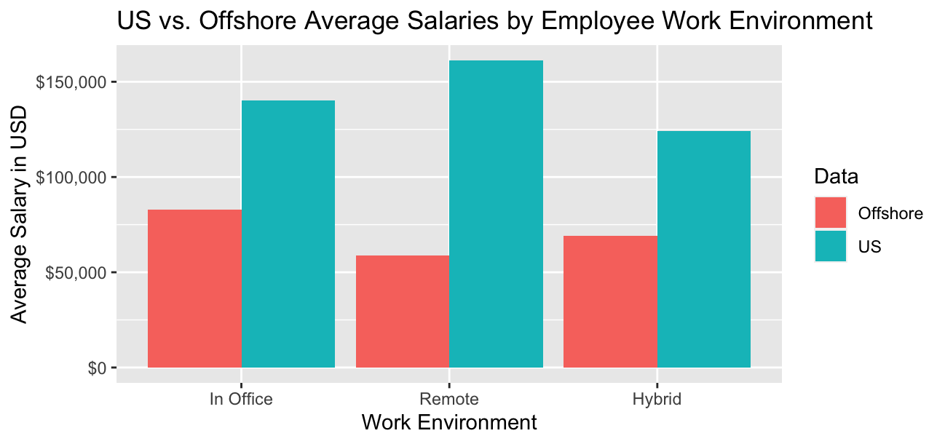
US vs. Offshore Salary Data by Work Environment
US average salary by work environment:
In office was $140,225
Fully remote was $161,234
Hybrid was $124,000
Offshore average salary by work environment:
In office was $83,024
Fully remote was $58,955
Hybrid was $69,154

Slide 11
US Salary Data Takeaway
The average salary between Medium and Large-sized companies was practically the same. In the US, it seems that Data Scientists working in companies sized 50-250 and those those working in companies with over 250 employees, on average are getting paid the same.
Those in the US working fully remote are getting paid on average $21,000 more than those not working remote. Hybrid workers are getting paid less than both fully remote and fully on-site employees.
The big difference in the average salaries is seen with the experience level. If you want someone with more experience, you will have to pay for it, as the difference for average salaries between Senior-level and Mid-level Data Scientists is $38,092. The average of Senior-level and Mid-level averages is $145,133. This may be a good reference point when hiring US candidates of Senior or Mid-level.

Slide 12
Offshore Salary Data Takeaway
The average salary between Medium and Large-sized companies was a little different than what we saw in the US (aside from difference in pay). Unlike in the US, the employees at Medium-sized companies on average were paid more than than those working at Large-sized companies. By about $13,000.
Opposite to those in the US, offshore Data Scientists working fully remote are getting paid less than those who work fully on-site. Plus, if hired for our company, Offshore employees will be remote anyways.
Seems that you can get similar type experience in both Medium and Large-sized companies Offshore and can pay them a fraction of what those in the US are making. However, when you have someone Offshore, they will not be able to be on-sight everyday. You pay them less, but they also will not be physically present everyday.

Slide 13
Recommendation = Hire Offshore Senior-Level Data Scientist
I recommend hiring an offshore Senior-level Data Scientist from a Medium-sized company. This will provide you with same level experience for a fraction of what it would cost to hire a Data Scientist working in the US. Senior-level Data Scientists have proven track record of climbing ranks and know what it takes to be a contributing member to a team. The Medium-sized company background will provide solid experience to bridge our company from a Small to a Medium-sized company (and hopefully larger) as we rapidly grow.
Since you are looking to expand the department to keep up with the rapid growth of the company, I would recommend using the money you will be saving hiring an offshore Data Scientist, to invest in someone else, such as a Head of Data Science, to assist and potentially lead that new hire.
Using average salaries over past 3 years and looking at 20% overall average income growth from 2021 to 2022 for both US and Offshore, we should be paying our Offshore Data Scientist approximately $94,400 per year. If we chose to go with a Data Scientist in the US, we should be paying them $183,000 per year. We can use that difference of $88,600 and invest into Head of Data Science position and use our money more efficiently.

Slide 14
Recommendation Conclusion
Hire Offshore Senior-level Data Scientist from Medium-sized company.
Pay them salary of approximately $94,400 per year.
If we hired US Senior-level Data Scientist from Medium-sized company, we would be paying approximately $183,000.
Take $88,600 in difference and allocate those savings towards investment in Offshore Head of Data Science to maximize efficient spending.
Let those two establish foundation for growing team!

