Slide 1
Ridge vs. Lasso Regression on Climate Data

Slide 2
DANIEL KHALIL
computer science

Slide 3
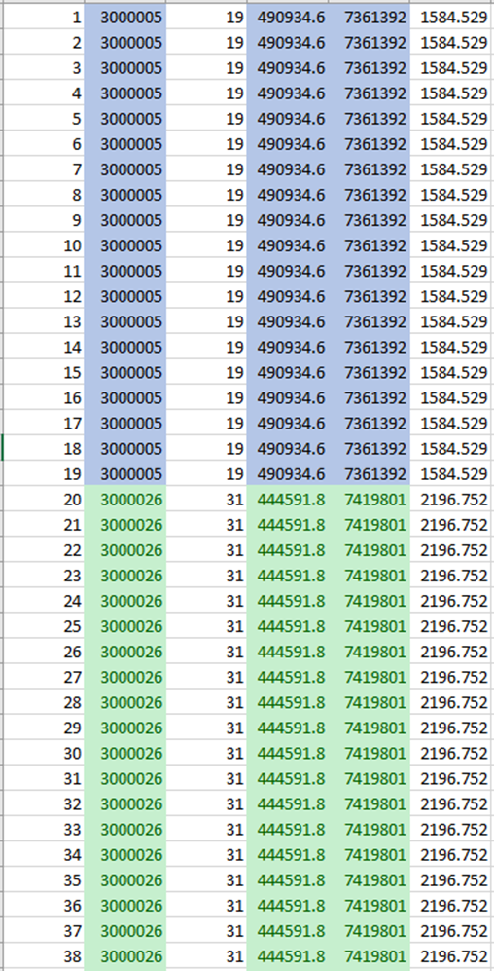
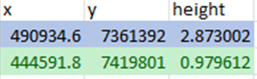
INTRODUCTION
Given time series of individual points with different heights per year
Approximate each coordinate in 2006 using ALPS
Dataset comprised of 2789 entries approximated from larger dataset

Slide 4
INTRODUCTION
Spatial approximation given 2789 coordinate, height pairs
Approximate F(X, Y) = H
  Using Lasso Regression
  Using Ridge Regression
Track differences in performance
Are either a viable regression model

Slide 5
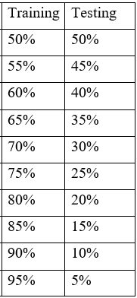
Methodology
Test Lasso and Ridge with:
  alpha = 1
  feature length = 2
Take the average MSE through multiple training splits

Slide 6
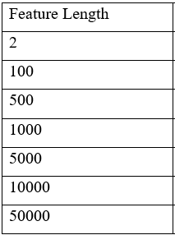
Methodology
Test Lasso and Ridge with added Features

Slide 7
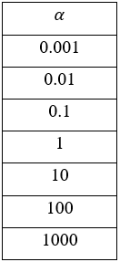
Methodology
Test Lasso and Ridge with added features
Test Lasso and Ridge with different alpha-values

Slide 8
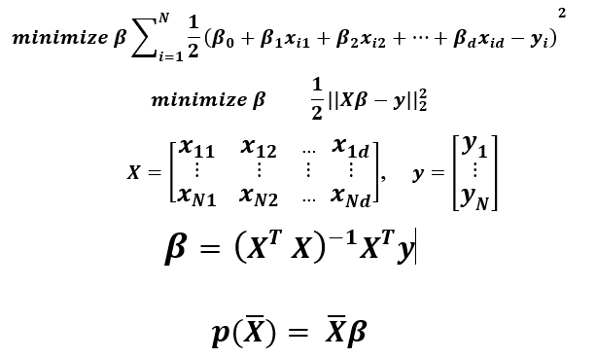
Connection to Linear Algebra
LINEAR
REGRESSION

Slide 9
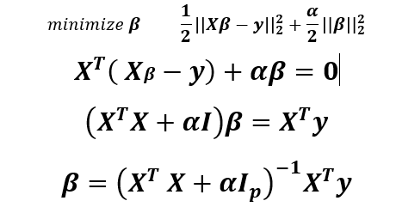
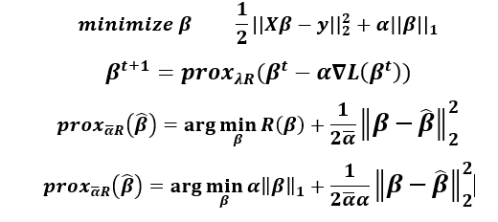
Connection to Linear Algebra
RIDGE REGRESSION
LASSO REGRESSION

Slide 10
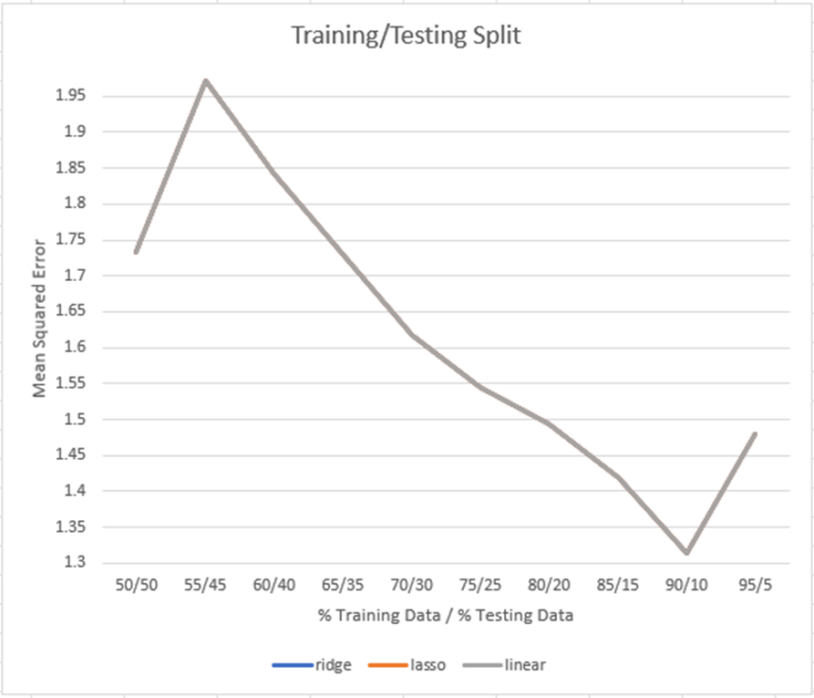
Results

Slide 11
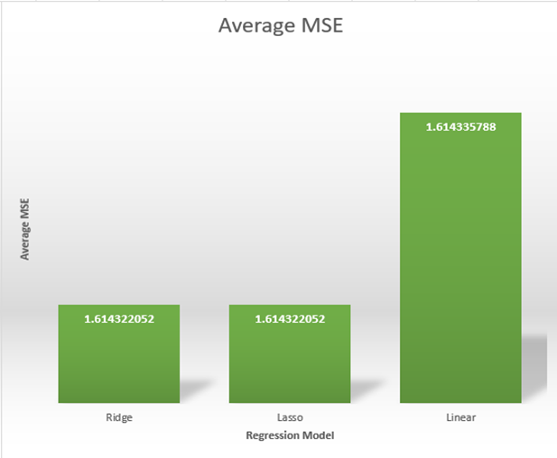
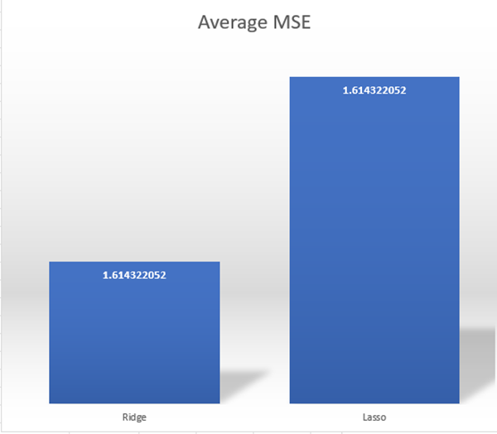
Results

Slide 12
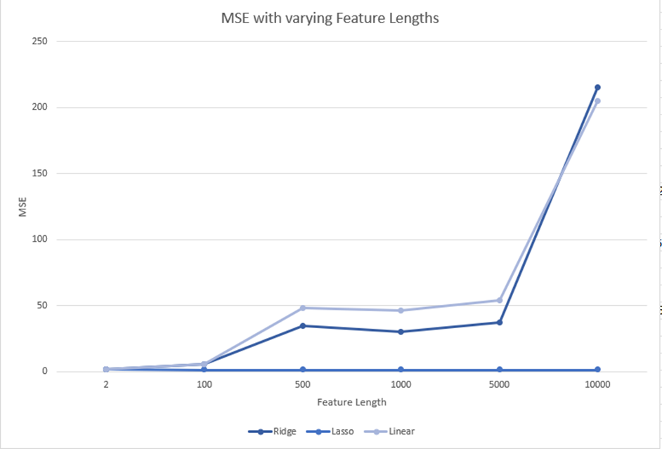
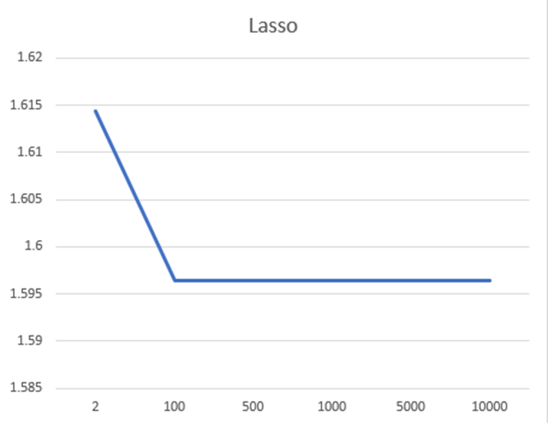
Results

Slide 13
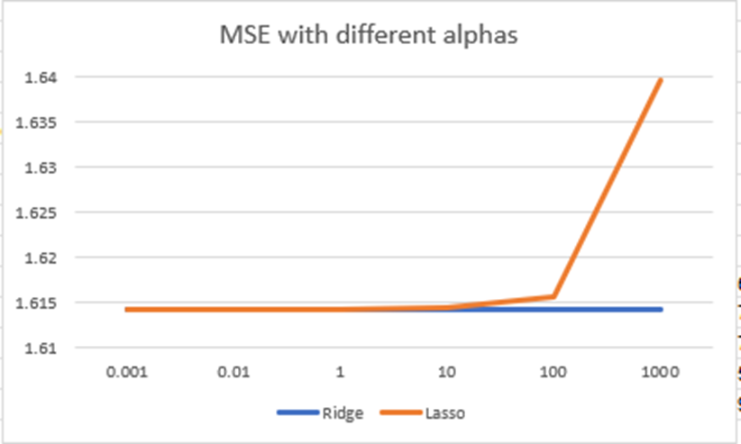
Results

Slide 14
Conclusion
Neither algorithm performs particularly well with this dataset
Overall, the best mean squared error received from both Lasso and Ridge Regression given a 95% training data 5% testing data split, was 1.479
Possibly some use in adding additional features to the dataset and using Lasso
No matter which regression algorithm is used, the resulting approximation will be mostly similar

Slide 15
References
[1] Shekhar, P., Csatho, B., Schenk, T., Roberts, C., & Patra, A. K. (2021). Alps: A unified framework for modeling time series of land ice changes. IEEE Transactions on Geoscience and Remote Sensing, 9(8), 6466–6481. https://doi.org/10.1109/tgrs.2020.3027190
[2] The problem of multicollinearity. (n.d.). Understanding Regression Analysis, 176–180. https://doi.org/10.1007/978-0-585-25657-3_37
[3] The problem of Multicollinearity | SpringerLink. (n.d.). Retrieved December 5, 2021, from https://link.springer.com/chapter/10.1007%2F978-0-585-25657-3_37.
[4] Sneiderman, R. (2020, November 6). From linear regression to ridge regression, the Lasso, and the elastic net. Medium. Retrieved December 5, 2021, from https://towardsdatascience.com/from-linear- regression-to-ridge-regression-the-lasso-and-the-elastic-net-4eaecaf5f7e6.
[5] Python: Implementation of polynomial regression. GeeksforGeeks. (2021, October 4). Retrieved December 5, 2021, from https://www.geeksforgeeks.org/python-implementation-of-polynomial- regression/.

