Slide 1
EGR101 SIM
- - - SPRINT 4 DEMO - - -
Emily Connearney, Luke Crump,
Vivian Dang, Daniel Khalil,
Keely Mashburn

Slide 2
Project Description
An application that allows virtual bot design with:
component configuration
wiring layout
3D simulation
Packaged with an Arduino IDE.

Slide 3
Project Use
Students couldn’t do hands-on due to COVID-19.
Cheaper alternative to buying an $85 kit.
Fully emulates EGR101.

Slide 4
Assumptions/Dependencies
Constraints
Students are familiar with the kit and its components ​
Students understand assigned task and what to do ​
Only the professor can add additional components/pieces to the kit ​
The application can run on different operating systems ​
​Project is constrained by the kit provided to the EGR 101 students ​
Cannot have functionality or components that the actual robot and kit does not have

Slide 5
Fall Semester
Wiring Interface
Simulation Functionality
Most Models Completed
Arduino Interface

Slide 6
Major Sub-Systems
​Design/Wiring Interface
Arduino IDE
Arduino Emulation

Slide 7
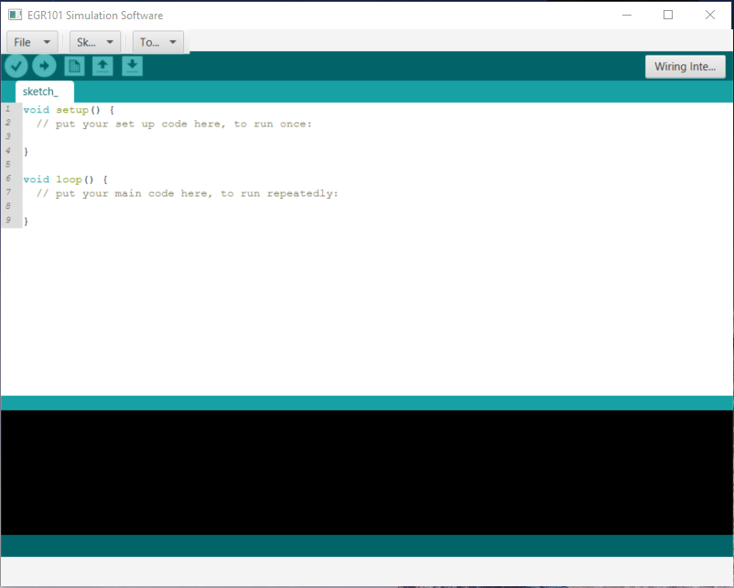
Arduino IDE
Progress

Slide 8
Bot Customization Menu
create new components
snap components onto bot
select added components

Slide 9
Bot Customization Menu
Mount preset functionality with:
4 different mount types
4 IR sensor array configurations

Slide 10
Bot Customization Menu
4 different wheel presets
Delete or modify position of added components

Slide 11
Models

Slide 12
Color Picker

Slide 13
Bugs
TCP/UDP
Fixed TCP bug by switching to UDP
Wiring
Wirecast isn’t touching pin
Bug Document

Slide 14
Semester Timeline
SPRINT 4
SPRINT 5
SPRINT 6
Bot customization functionality
Completed more models:
Mounts
Wheels
IR Sensor
Bot wiring functionality
Bot simulation updates components from customization
Improve the GUI
Bug fixes
Polishing

Slide 15
Lessons Learned
Start work earlier
Distribute more comprehensive tasks
Communicate more

Slide 16
THANK YOU!
Any questions?

