Slide 1
EGR101 SIM
- - - SPRINT 4 DEMO - - -
Emily Connearney, Luke Crump,
Vivian Dang, Daniel Khalil,
Keely Mashburn

Slide 2
Project Description
An application that allows virtual bot design with:
component configuration
wiring layout
3D simulation
Packaged with an Arduino IDE.

Slide 3
Project Use
Students couldn’t do hands-on due to COVID-19.
Cheaper alternative to buying an $85 kit.
Fully emulates EGR101.

Slide 4
Assumptions/Dependencies
Constraints
Students are familiar with the kit and its components ​
Students understand assigned task and what to do ​
Only the professor can add additional components/pieces to the kit ​
The application can run on different operating systems ​
​Project is constrained by the kit provided to the EGR 101 students ​
Cannot have functionality or components that the actual robot and kit does not have

Slide 5
Fall Semester
Wiring Interface
Simulation Functionality
Most Models Completed
Arduino Interface

Slide 6
Major Sub-Systems
​Design/Wiring Interface
Arduino IDE
Arduino Emulation

Slide 7
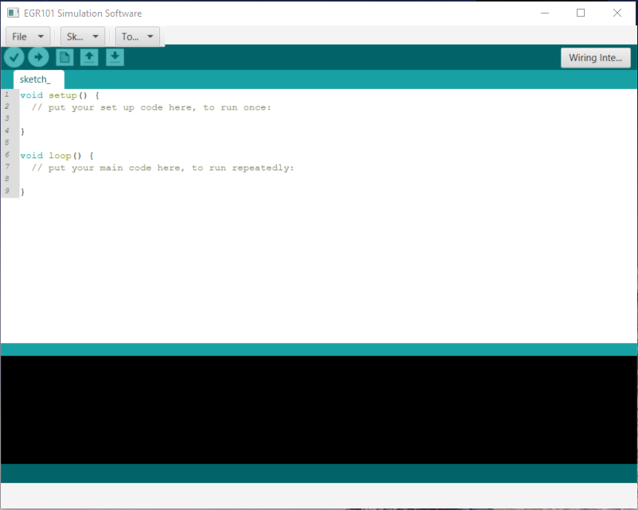
Arduino IDE Progress

Slide 8
Bot Customization Menu

Slide 9
Models

Slide 10
Color Picker

Slide 11
Bugs
TCP/UDP
Bug Document

Slide 12
Semester Timeline
SPRINT 4
SPRINT 5
SPRINT 6

Slide 13
Lessons Learned
Topics needed to be covered: 1. Where we left off last semester 2. What we have accomplished this sprint 3. What we plan on working on for the remaining sprints 4. Gifs and Demo or Gifs or Demo or neither 5. Roast session

Slide 14
THANK YOU!
Any questions?

