Slide 1
What is the model actually looking at?
Interpreting self-supervised 4D-STEM diffraction clustering
Making the DINO “grain map” explainable in physical terms — IMC & NaPHI
Daniel Khaykelson

Slide 2
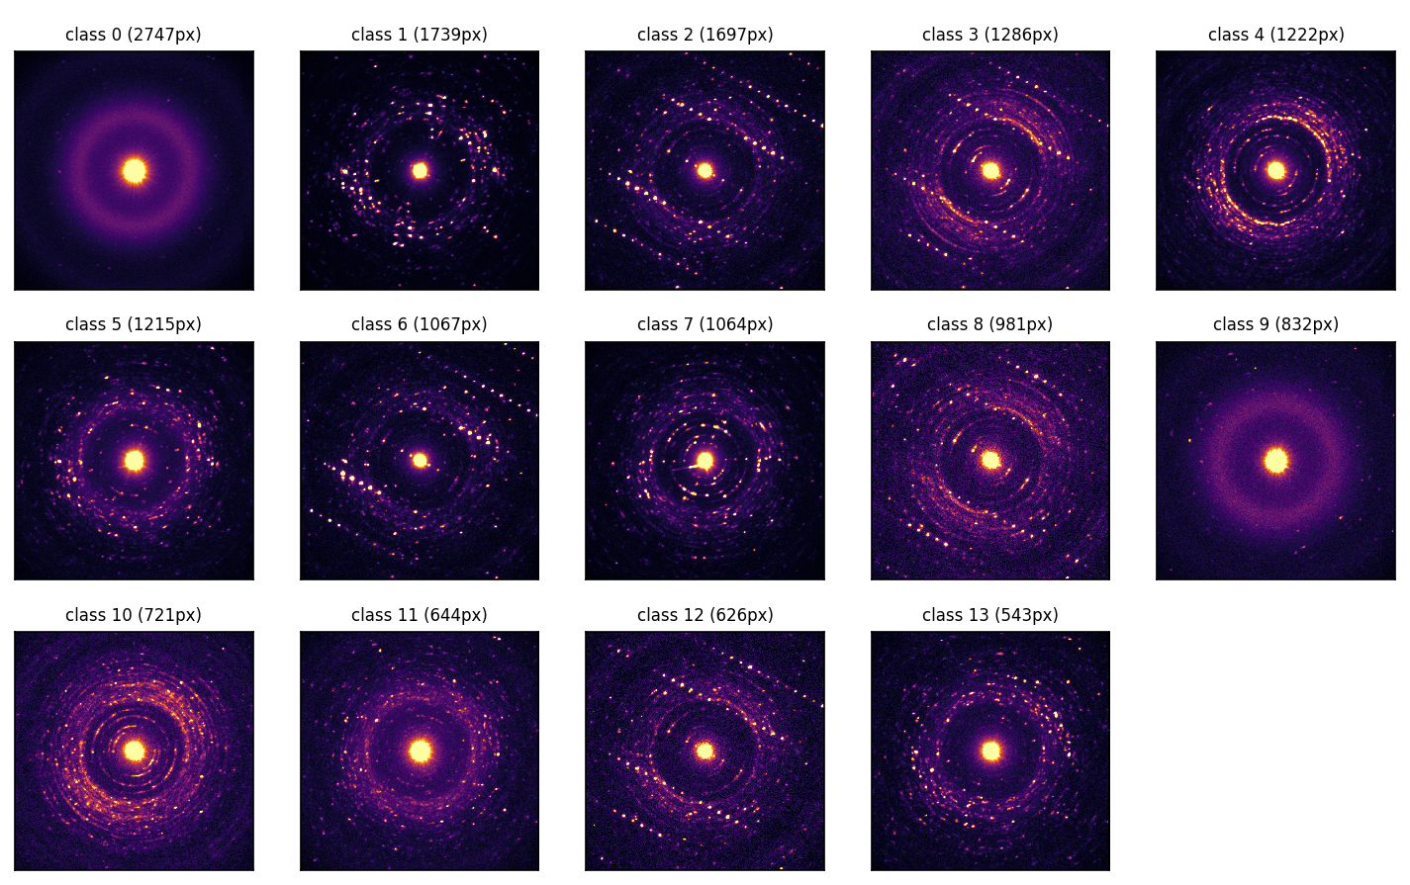
The setup — and the problem
What the model does
At every probe position it reads the diffraction pattern and sorts the position into one of 14 groups — with no labels and no chemistry input. The result is a “grain map.”
The problem
It works, but it is a black box: we do not know which physical property defines the groups — crystallinity? thickness? crystal orientation? something new?
Goal: explain the groups in physical terms a chemist can trust.
Each group's average diffraction pattern (IMC, 14 groups).

Slide 3
Four simple tests
Each is independent; together they triangulate what the model uses.
1
Probing
Can we predict a known physical property from the model's internal fingerprint? If yes, it pays attention to that property.
2
Ablation
Erase one ingredient of the diffraction pattern, re-run the model, and see whether the map survives.
3
Classical check
Could a standard 4D-STEM method (virtual detector, PCA, NMF) have drawn the same map — or is this map new?
4
Orientation check
Is it merely sorting by crystal orientation? (plus Grad-CAM: which part of the pattern it looks at.)

Slide 4
Test 1 · Probing — what is encoded?
In plain terms
If we can “read off” a property (say crystallinity) from the model's notes for each point, then the model is keeping track of it.
How it is measured
Fit a simple linear predictor from the model's 128-number fingerprint to each measured property. The score R² (0–1) says how predictable — i.e. how strongly encoded — that property is.
Properties tested: total scattered intensity, crystallinity, spottiness, and crystal orientation (ACOM).
R² ≈ 1
strongly encoded
R² ≈ 0
ignored by the model
Result preview: scattered intensity & crystallinity score high; orientation scores ~0.

Slide 5
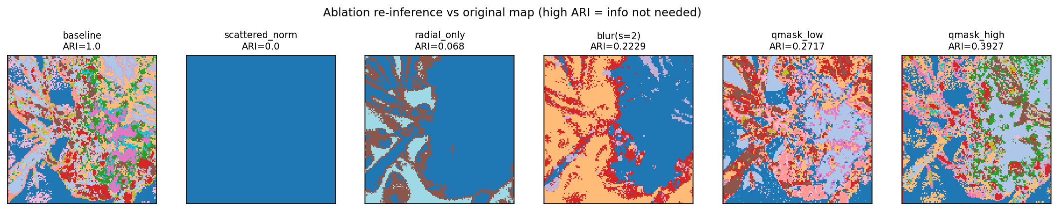
Test 2 · Ablation — what does it depend on?
In plain terms
Like covering part of a photo to see if you still recognise it.
How it is measured
Blank out one ingredient — overall brightness, fine angular detail, or inner vs. outer rings — re-run the model, and compare the new map to the original (agreement = ARI).
Map survives the edit → that ingredient was not needed. Map falls apart → the model depended on it.
Re-inference after each edit (IMC). Low agreement = the model relied on what was removed.
What we see:
• Remove overall brightness → map collapses (intensity matters).
• Average away the angles → collapses (needs the 2-D pattern, not just a 1-D profile).
• Inner (low-angle) rings matter far more than outer rings.

Slide 6
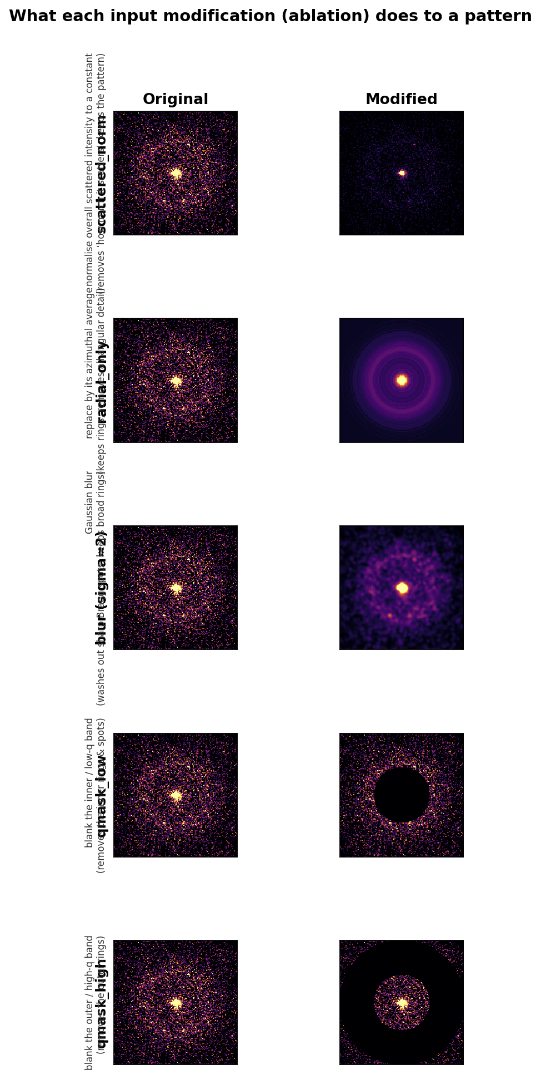
What each edit does — before vs. after
Same diffraction pattern, edited one way at a time:
• scattered-norm — rescales the overall brightness away (keeps the pattern, removes ‘how much it scatters’).
• radial-only — keeps the rings, erases all angular detail.
• blur — washes out the sharp Bragg spots.
• mask low-q / high-q — blanks the inner / outer rings.
We re-run the model on each edited version and check whether the map survives (Test 2). The edits that break the map reveal what the model relies on.

Slide 7
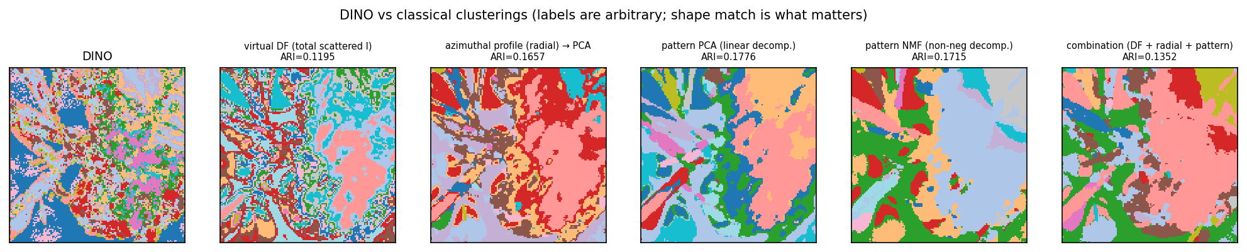
Test 3 · Could a classical method do the same?
In plain terms
Does the AI just redraw what an old-school analysis already shows, or something genuinely new?
How it is measured
Cluster classical features — virtual dark-field, azimuthal profile, PCA / NMF of the pattern — into the same number of groups, and measure agreement with the AI map (ARI / AMI).
IMC: DINO (far left) vs. classical clusterings. Colours are arbitrary; shape match is what counts.
Uniqueness is material-dependent
IMC: classical agreement ARI ≈ 0.15 → the AI map is distinctive (classical methods miss the fine grains).
NaPHI: ARI ≈ 0.5 → about half-classical.

Slide 8
How to read the two numbers
R²
How predictable a property is from the model's fingerprint.
0 = the model ignores it → 1 = fully encoded
ARI / AMI
How much two maps agree, correcting for chance.
0 = no better than random → 1 = identical maps

Slide 9
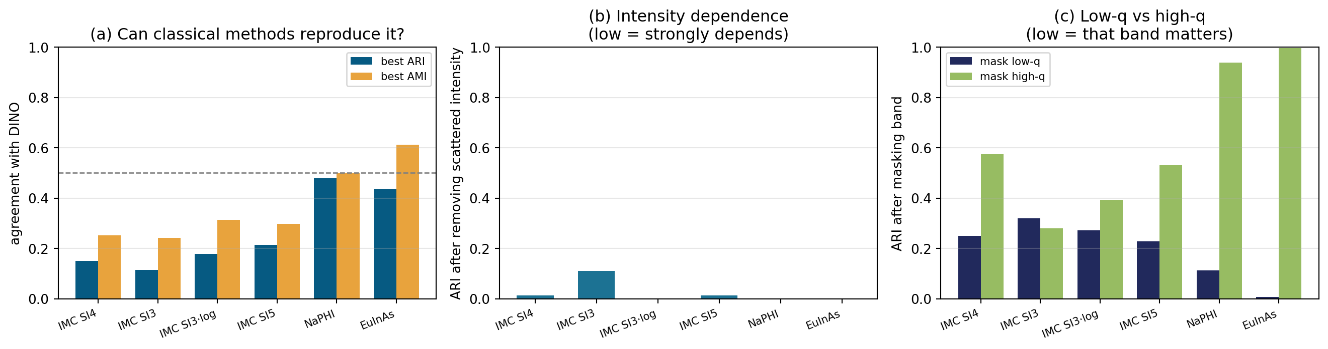
Across all samples
IMC SI3/SI4/SI5 · NaPHI (Na007b) · EuInAs. (a) classical agreement; (b) intensity dependence; (c) low-q vs high-q.
Same physical basis everywhere
Scattered intensity + low-q 2-D structure drive every sample; removing intensity or the low-q band breaks the map.
Distinctiveness varies by material
IMC: classical ARI ≈ 0.1–0.2 (distinctive). NaPHI & EuInAs: ≈ 0.5 (classical gets most of the way).
EuInAs alone also tracks crystal orientation (zone-axis AMI ≈ 0.3).

Slide 10
What it means
The model groups regions by how much, and what, they diffract at low angles — crystallinity, molecular packing, and thickness. A physically sensible axis, not an arbitrary black box.
For IMC it is genuinely distinctive (a standard virtual-detector / PCA map does not reproduce it); for NaPHI and EuInAs it stays closer to classical. The crystalline EuInAs additionally tracks crystal orientation (zone-axis), which the molecular films do not.
Caveat: “scattered intensity” blends crystallinity with sample thickness — a thickness map would separate the two.

