Slide 1
Label-free, bias-free classification of difficult 4D-STEM diffraction
A diffraction-tailored self-supervised model — validated against expert segmentation, and interpretable
IMC · NaPHI · EuInAs | no labels · no K · no n-components
Daniel Khaykelson

Slide 2
The problem
Difficult 4D-STEM — beam-sensitive, low-dose, many domains, diffuse scattering — needs a fast, unbiased first segmentation.
But every standard route asks the microscopist to commit upfront:
• k-means / HDBSCAN — choose K (or density)
• NMF / PCA — choose n-components
• supervised — provide labels (huge effort on hard data)
• SAM + orientation mapping — slow, and needs user feature parameters
Goal: a label-free, parameter-free first map — that we can also trust and explain physically.

Slide 3
The method — a model engineered for diffraction
Self-distillation (DINO) with design choices specific to NBED — not a borrowed vision model:
1
CNN (ResNet), truncated
right inductive bias + capacity for small, sparse, low-count patterns (ViT is data-hungry, overkill here)
2
Physics-chosen augmentations
azimuthal theta-roll -> in-plane-rotation invariance; flips / colour-jitter disabled (meaningless for diffraction)
3
Radial-gated SupCon + 1-D loss
grouping biased toward the physically meaningful radial / ring signature
4
Emergent K + optional semi-supervision
over-specify prototypes; the model uses what it needs. A few pairwise hints can steer it if wanted

Slide 4
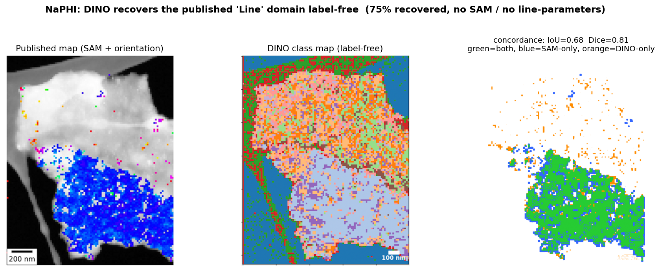
It gets the known answer — label-free
NaPHI: our class map vs our previously-published SAM+orientation map (same scan, aligned).
DINO reproduces the published 'Line' domain — IoU 0.68, Dice 0.81, ~75% recovered — with NO labels, NO SAM, and NO user line-parameters.
...and transfers to a new (tilted) acquisition of the same flake in milliseconds.

Slide 5
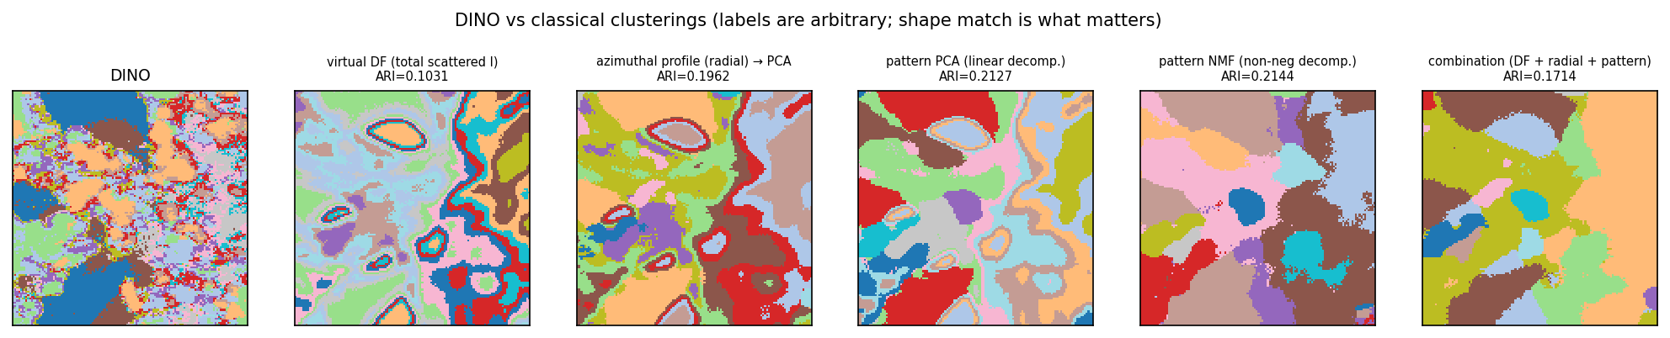
It cracks the hard case
IMC (low-dose molecular): DINO (far left) vs classical clusterings of the same data.
On the hard molecular films, classical methods (virtual-DF / radial / PCA / NMF) do NOT reproduce the DINO map (best agreement ARI ~ 0.11-0.21).
There is no external ground truth here — classical analysis simply cannot give a coherent map. Our method is the only route, and (next slide) we prove the map is physical, not noise.

Slide 6
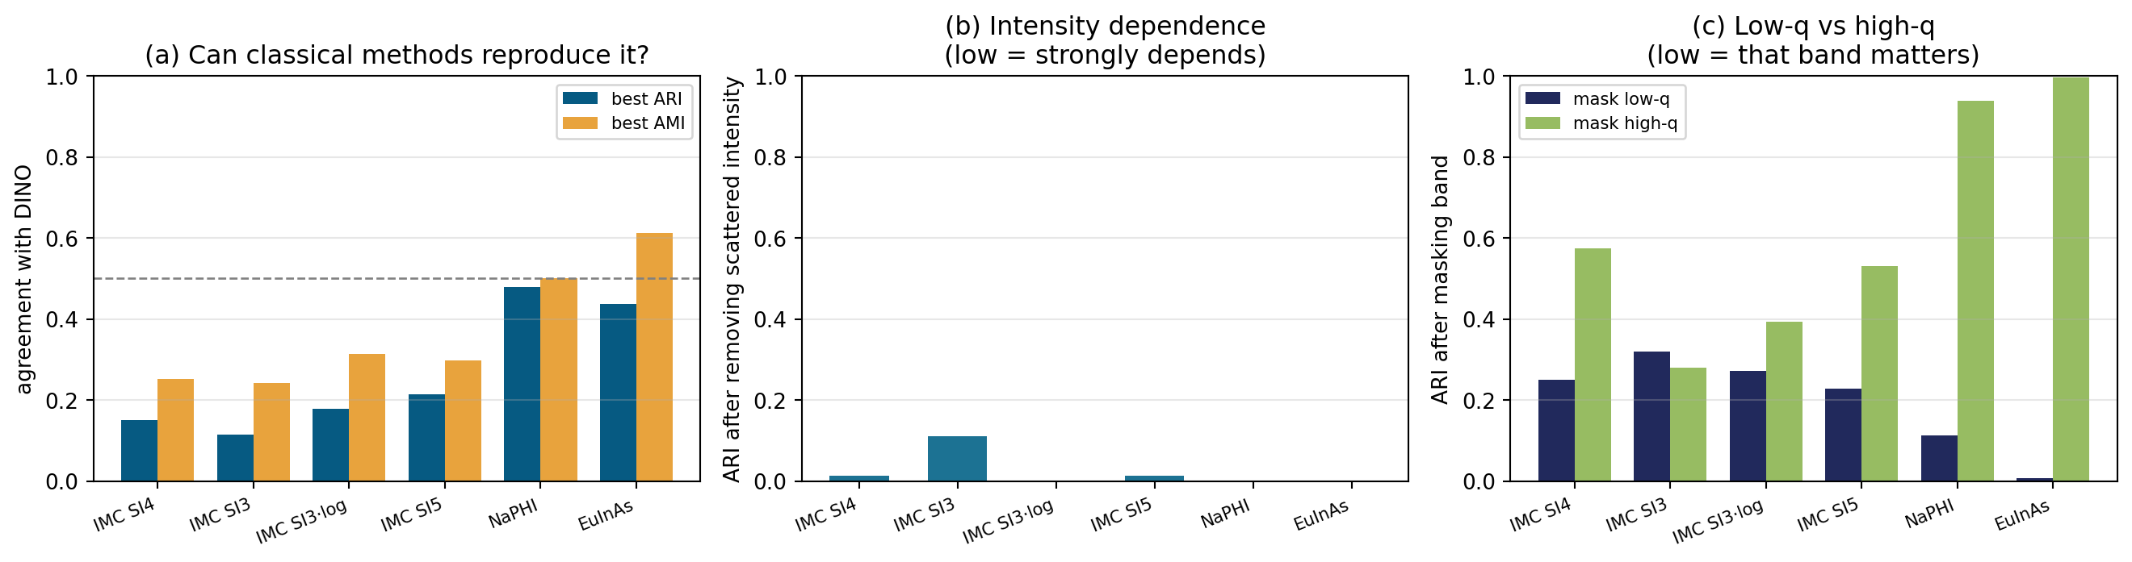
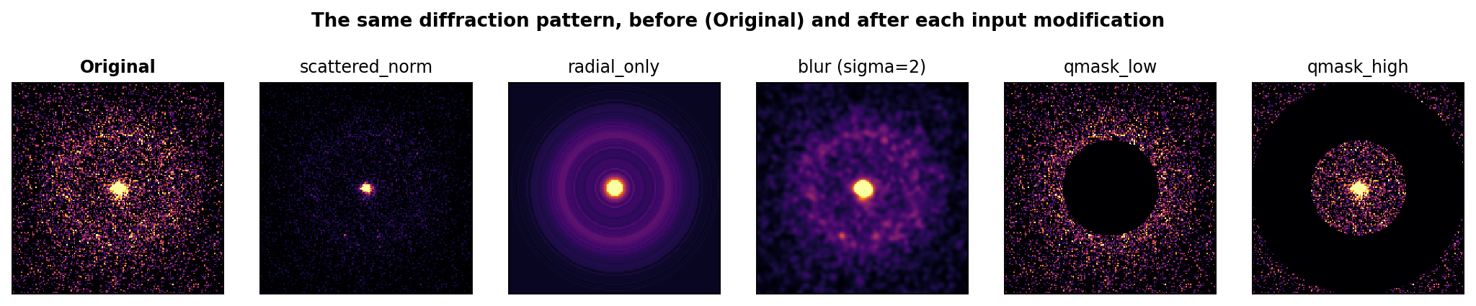
What the clusters mean (and when we add value)
(a) what's encoded (probe R2) (b) causal ablations (c) classical agreement. IMC SI3/SI4/SI5 - NaPHI - EuInAs
Built-in interpretability protocol
Clusters are driven by scattered intensity + low-q 2-D structure; rotation-invariant; NOT orientation (molecular).
Uniqueness is material-dependent (panel c).

Slide 7
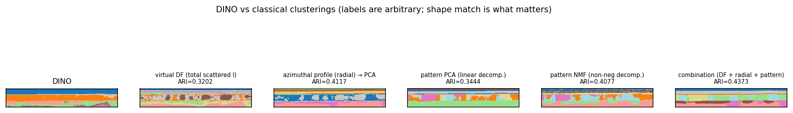
It generalises — crystalline, multi-phase, orientation
EuInAs (layered, 3-phase): DINO vs classical clusterings.
On the well-ordered EuInAs, classical methods get about halfway (ARI ~ 0.44) — DINO stays closer to classical here (it is most distinctive on the HARD molecular samples).
And 3-phase ACOM shows DINO additionally tracks crystal orientation here (zone-axis AMI ~ 0.30) — a genuine secondary axis the molecular films don't have.

Slide 8
What we deliver
1. A diffraction-tailored self-supervised classifier — label-free, no K, rotation-invariant, with optional semi-supervision.
2. Validation against our published expert segmentation (NaPHI), label-free and without SAM; ms transfer to new data.
3. A built-in interpretability protocol that proves the clusters are physical (scattered intensity + low-q structure) and quantifies when the model beats classical (hard molecular IMC) vs converges with it (ordered NaPHI / EuInAs).
Most valuable exactly where existing tools fail: low-dose, diffuse, molecular crystals.

