Slide 1

Deep Learning Community of Practice Meeting 5

Slide 2
Today’s Meeting
Upcoming Logistics
Previous Session(s)
Example in PyTorch
(Optional) Revisiting puzzle from last time
(Optional) In case you missed it: How does BatchNorm help?

Slide 3
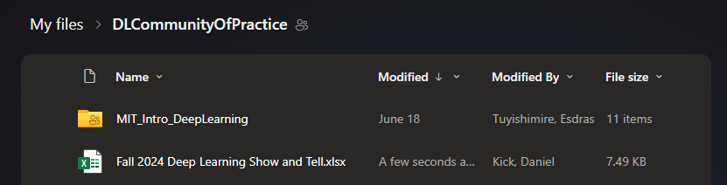
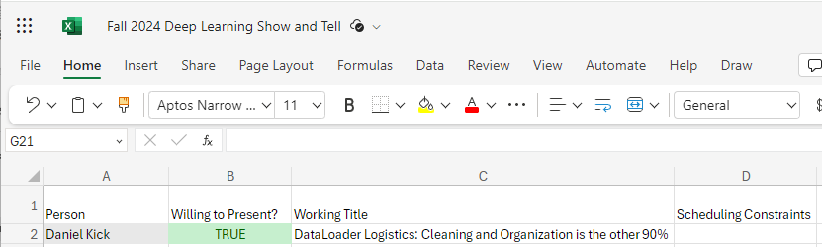
Logistics
S | M | T | W | R | F | S
 |  | 6 | 7 | 8 | 9 | 10
11 | 12 | 13 | 14 | 15 | 16 | 17
18 | 19 | 20 | 21 | 22 | 23 | 24
25 | 26 | 27 | 28 | 29 | 30 | 31
1 | 2 | 3 | 4 | 5 | 6 | 7
8 | 9 | 10 | 11 | 12 | 13 | 14
15 | 16 | 17 | 18 | 19 | 20 | 21
22 | 23 | 24 | 25 | 26 | 27 | 28
29 | 30
Semester begins soon
New Scheduling Poll
https://www.when2meet.com/?25825400-b3JmD
Proposed Plan:
Multiple videos for next two sessions:
Theory Video on Attention (26m) and optional background
Generatively Pretrained Transformer (1h56m)
Next meeting on the 20th
Theory video and start of GPT
Sign up for works in progress show an tell
Next Next (penprimary?) meeting TBD
Remainder of GPT

Slide 4
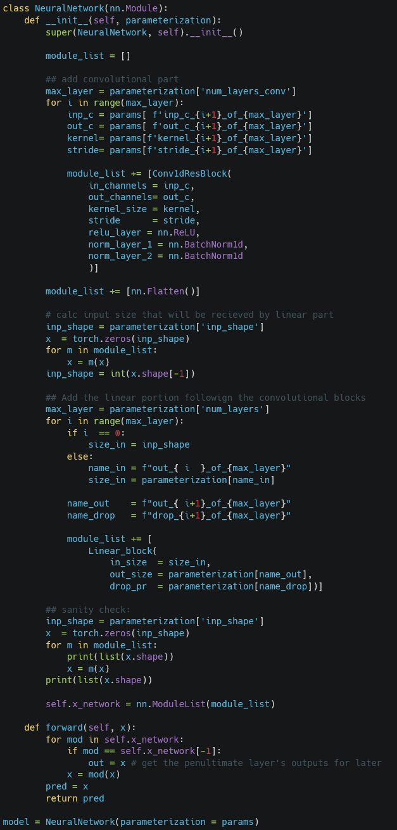
Previous Session: Option 1: Revisiting Backprop. and Wavenet Option 2: Only Wavenet

Slide 5
Theme for Previous Session:
Know how to dig in when you need
Okay if it doesn’t all click right now!
Backprop
Think about what level to abstract at
Be able to trace gradients back
be able to modifying them when you need
Wavenet
How do you reorganize code?
How do you abstract away complexity?
Notice where friction remains (e.g. hyperparameter tuning, validation)

Slide 6
Example:
Computational Graph
Graph as Weights
W=0, B=0 -> No connection
W=1, B=0 -> No operation (Identity)
A
B
ŷ
Forward Pass
Backward Pass
Node A
Node B
Node A
Node B
0
0
0
1
ŷ
0
1
ŷ

Slide 7
Example:
Computational Graph
Graph as Weights
W=0, B=0 -> No connection
W=1, B=0 -> No operation (Identity)
These gradients must be zeroed before stepping optimizer
A
B
ŷ
Forward Pass
Backward Pass
Node A
Node B
Node A
Node B
0
0
0
1
ŷ
0
1
ŷ

Slide 8
(Unoptimized) PyTorch Example

Slide 9
Things to look for
Wrapping code in classes and functions (and vestigial code)
PyTorch-isms that increase complexity short term for readability long term
Almost but not entirely identical behavior (`Sequential`)
Moving values between CPU <-> GPU
Not shown (echoing the lecture)
Manually checking dimensions before abstracting
Fixing bugs from data types (e.g. float vs float64)

Slide 10
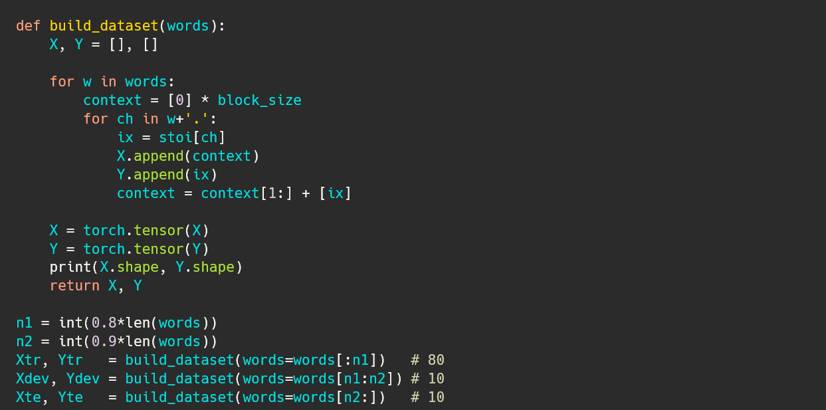
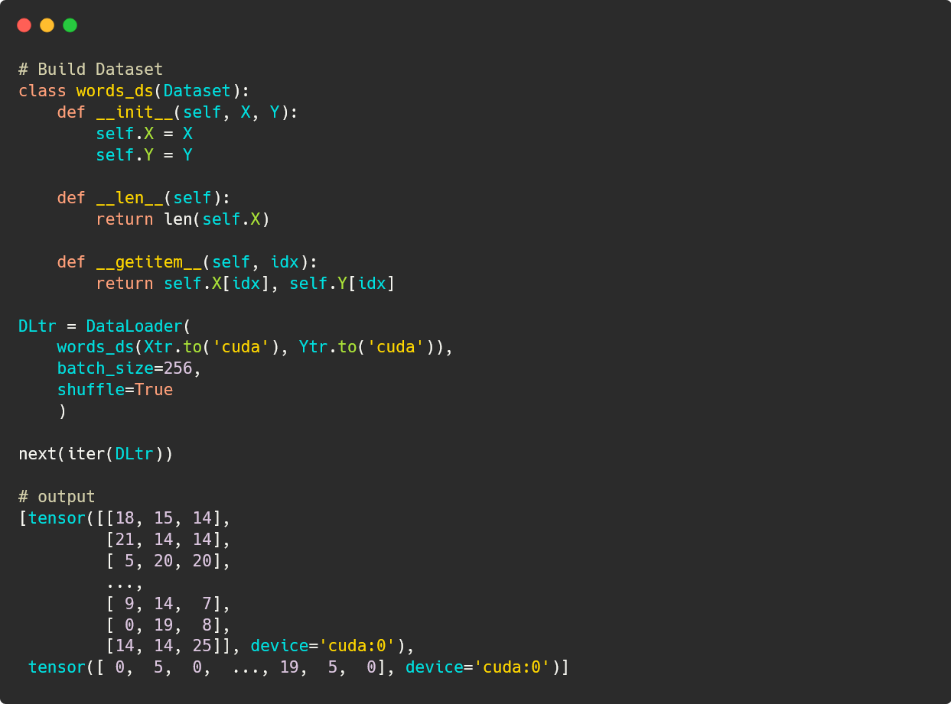
Data Setup
Same as seen in lecture

Slide 11
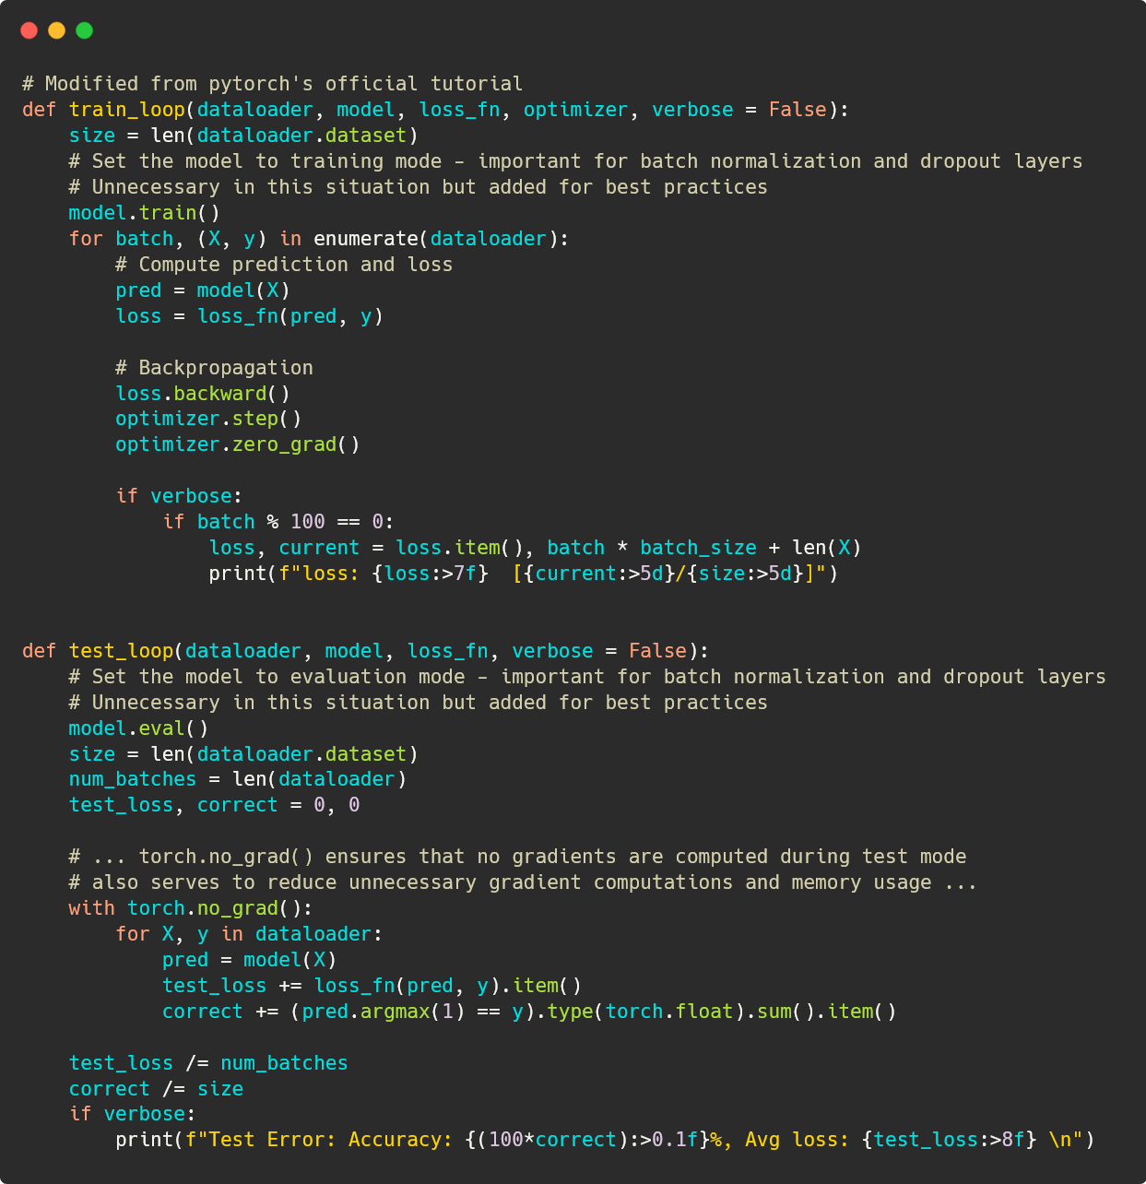
Data Setup 2
Dataset
__init__
__len__
How many items are there?
__getitem__
How do you get the i^{th} item?
Could be complex:
Read files (e.g. images)
Access databases
Dataloader
Adds logic for creating minibatches
.to(‘cuda’) manages where the data is

Slide 12
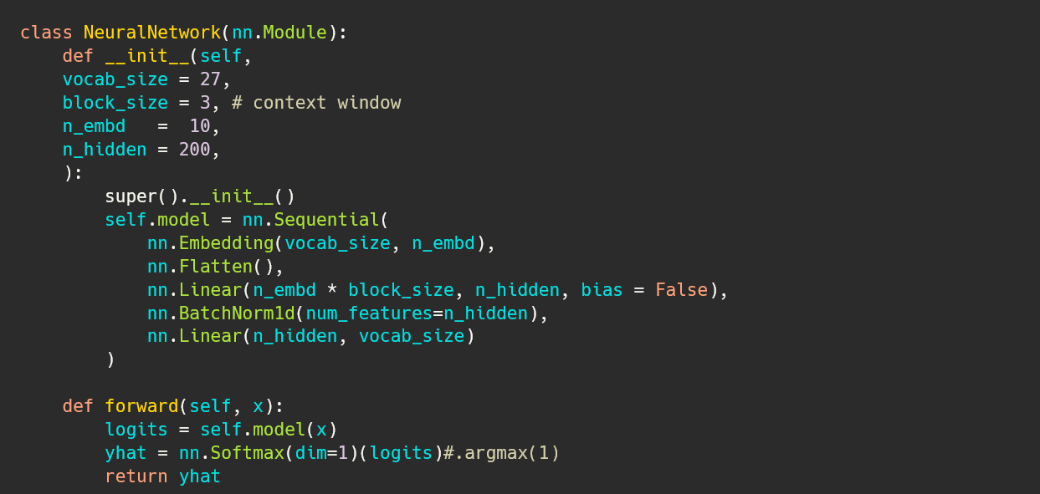
Run One Epoch
Note that gradient tracking only happens in the train_loop()

Slide 13
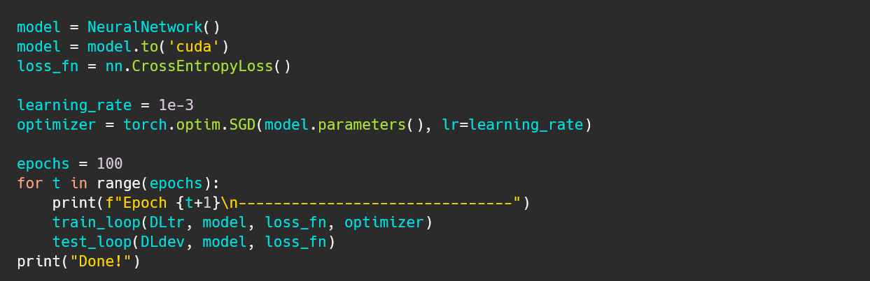
Define the Network
__init__
How should the model be initialized?
forward
How does the model run?
nn.Sequential runs each layer in order so we don’t have to call each in order
Returns distribution of yhat (the next token)
Vestigial from testing before abstraction.
argmax() returns the index of the highest probability

Slide 14
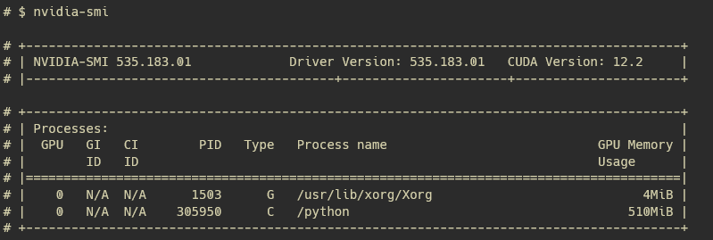
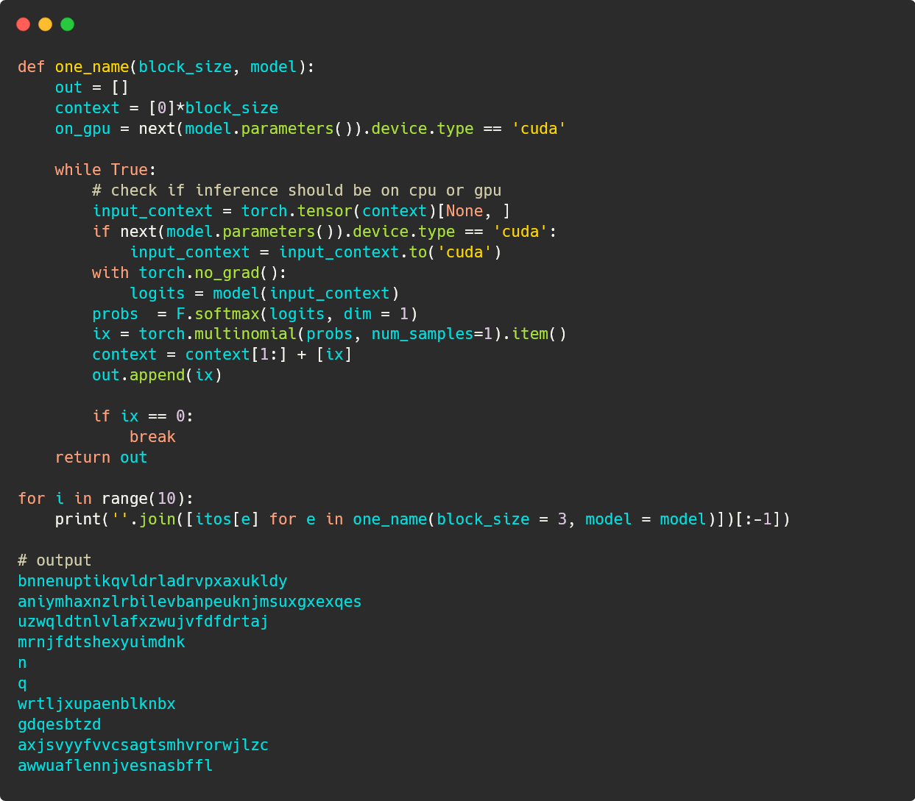
Train Model
Instantiate model
Send to gpu
Instantiate optimizer
(instead of manual optimization)
Call train_loop() once per epoch
Aside:
This model is small but not necessarily fast to train with this unoptimized code

Slide 15
Generating Samples
Mostly the same code
Extra logic for moving context onto gpu (if model is on gpu)
Poor performance, only trained 100 epochs

