Slide 1
A Lightning Quick Intro to Git
Washburn Lab
24.09.16

Slide 2
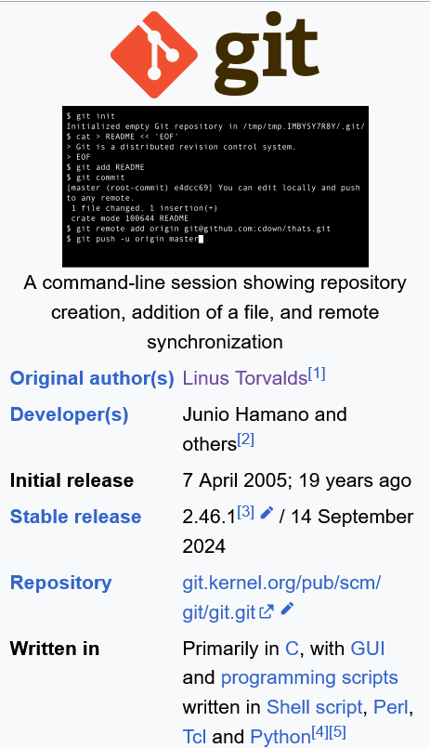
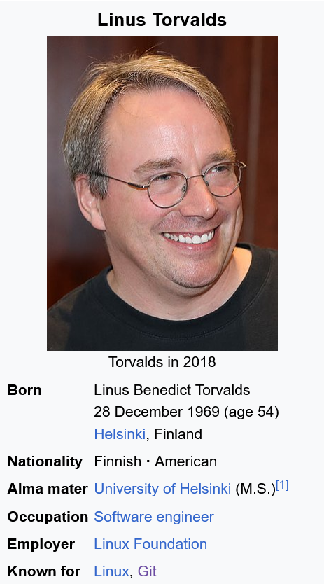
What is Git?
Version Control System (vcs)
Think “Track Changes”
Git is the de facto standard vcs
https://en.wikipedia.org/wiki/Git
https://en.wikipedia.org/wiki/Linus_Torvalds

Slide 3

Why?
Don’t do this.
Fewer files, organize early
nbdev
R Package
Cookiecutter Data Science
Python Project
Johnny.Decimal
Clarity
Who did what and when?
When did x stop working?
https://phdcomics.com/comics/archive.php?comicid=1531

Slide 4
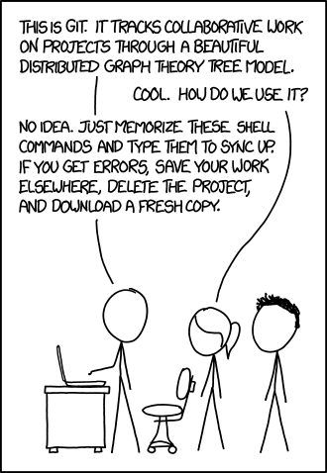
What is Git really?
We’re focused mostly on use
Encouraged to learn more
e.g. Missing Semester: Version Control
https://xkcd.com/1597/

Slide 5



Example
Alice
GitHub
Bob
Alice is helping Bob with an error
Bob commits the errant code and pushes it to GitHub.
Alice pulls the changes, fixes the error, and commits the fix.
Alice pushes the modified code.
Bob pulls the modified code.
☹
commit
☹
☹
push
pull
☹
☹
☹
commit
☺
☹
☹
push
☺
☺
☹
commit ≈ snapshot
push ≈ send
pull ≈ retrieve
☺
☺
☺
pull

Slide 6
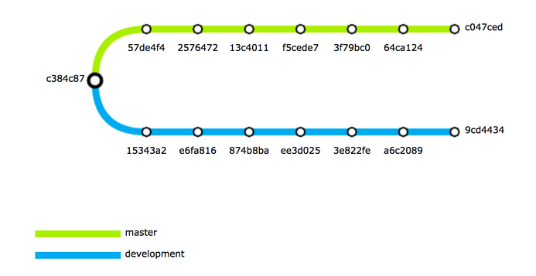
A few items to be aware of…
Repositories can be forked to create branches
https://pages.charlesreid1.com/git-subway-maps/

Slide 7
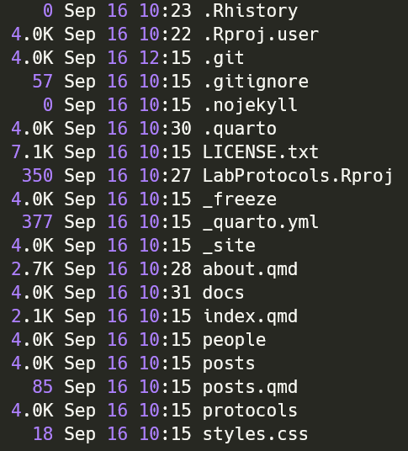
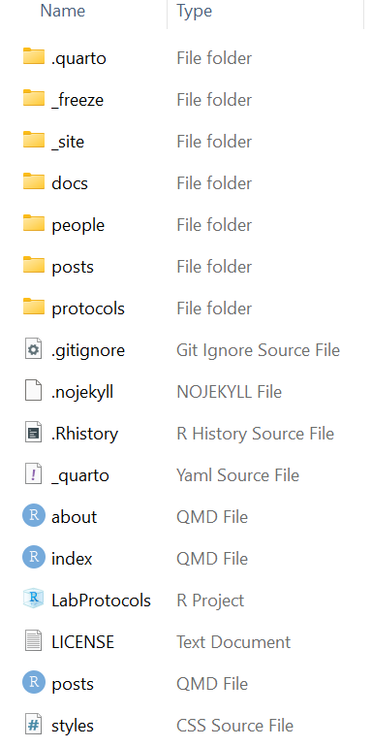
A few items to be aware of…
Repositories can be forked to create branches
The .gitignore file can be used to exempt things from tracking
Git uses hidden files. Some cloud storage providers fail to track these and may eat your repository.

Slide 8
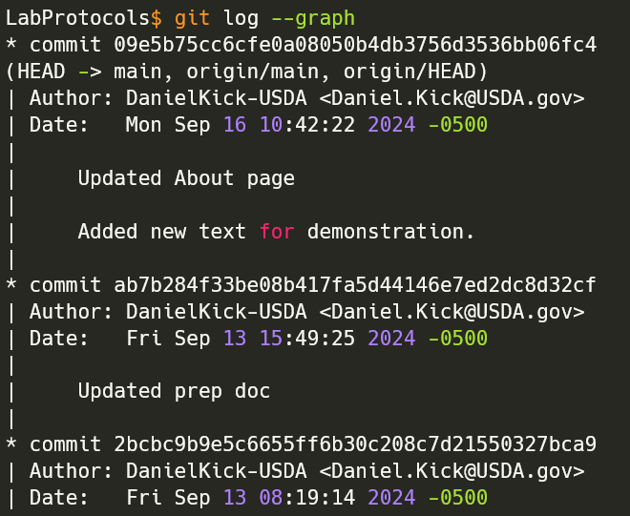
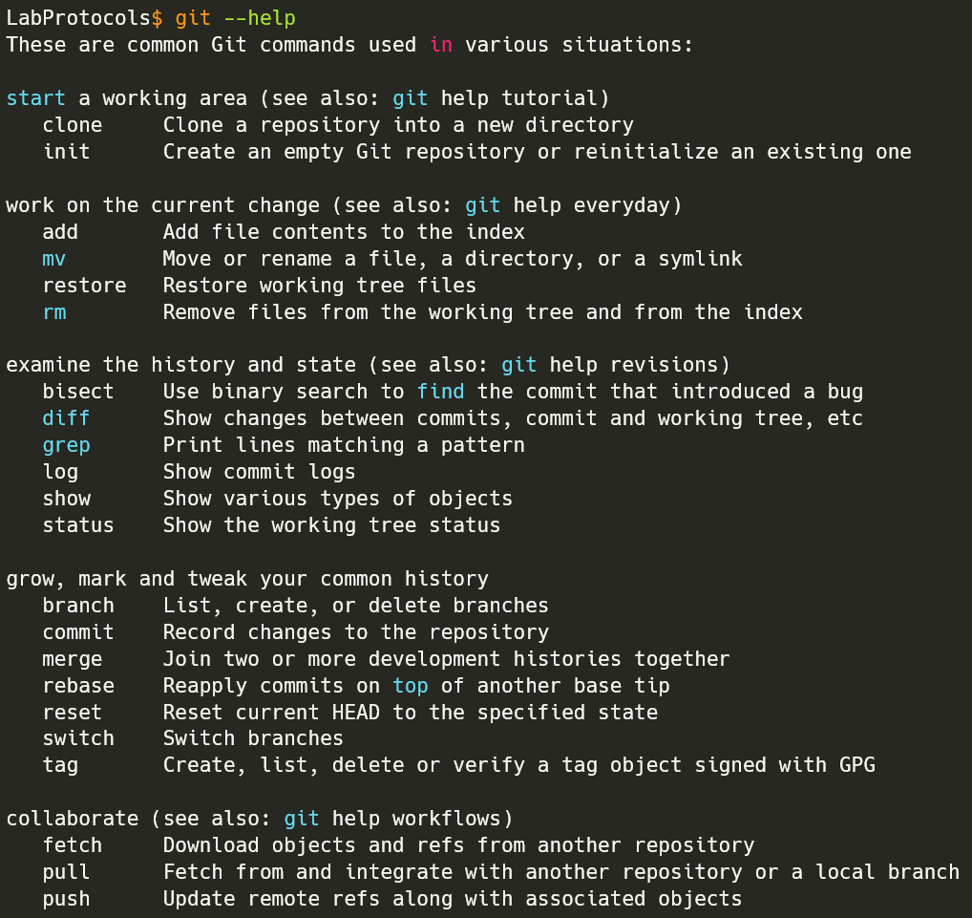
A few items to be aware of…
Repositories can be forked to create branches
The .gitignore file can be used to exempt things from tracking
Git uses hidden files. Some cloud storage providers fail to track these and may eat your repository.
Built for command line

Slide 9
Your Turn: Editing the Lab Website
Fork the LabProtocols repository to create a personal branch
Clone this branch of LabProtocols to a location that is not synced.
For faster building:
Delete LabProtocols/posts/*
Edit LabProtocols/about.qmd in RStudio or notepad
Optional: build the website
Commit only LabProtocols/about.qmd
Push your changes
Open GitHub and create a pull request to the official repository
Wait for pull request to LabProtocols to be accepted.
Optional: create a .gitignore

