Slide 1
Why Learn Python If You Already Know X?
(Or why we’re not using R)

Slide 2
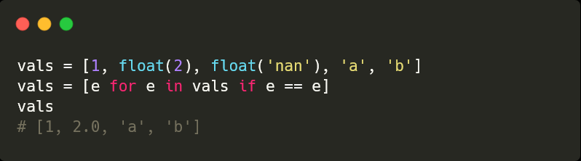
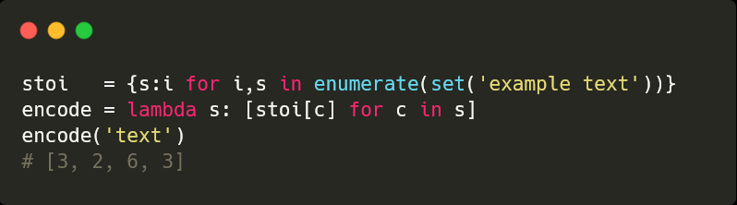
Reasons to Learn Python
It’s easier! It’s just executable pseudo code!
… is it?
It presents alternate approaches to articulating a solution

Slide 3



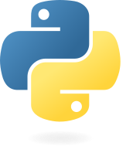
The Blub Paradox
It doesn’t even have
non-standard evaluation!
It doesn’t even have
dictionary comprehensions!
“programming languages are not merely technologies, but habits of mind as well”
Languages fall along a continuum [4] of abstractness, from the most powerful all the way down to machine languages … [consider a] hypothetical language called Blub. Blub falls right in the middle of the abstractness continuum.
As long as our hypothetical Blub programmer is looking down the power continuum, he knows he's looking down. Languages less powerful than Blub are obviously less powerful, because they're missing some feature he's used to. But when our hypothetical Blub programmer looks in the other direction, up the power continuum, he doesn't realize he's looking up. What he sees are merely weird languages. He probably considers them about equivalent in power to Blub, but with all this other hairy stuff thrown in as well. Blub is good enough for him, because he thinks in Blub. When we switch to the point of view of a programmer using any of the languages higher up the power continuum, however, we find that he in turn looks down upon Blub. How can you get anything done in Blub? It doesn't even have y.
https://paulgraham.com/avg.html

Slide 4
Translate language 1 -> 2
Idiomatic
It’ll give you a new way to think about problems
It’ll change how you think about the language you use most

