Slide 1

Deep Learning Community of Practice Meeting 3

Slide 2
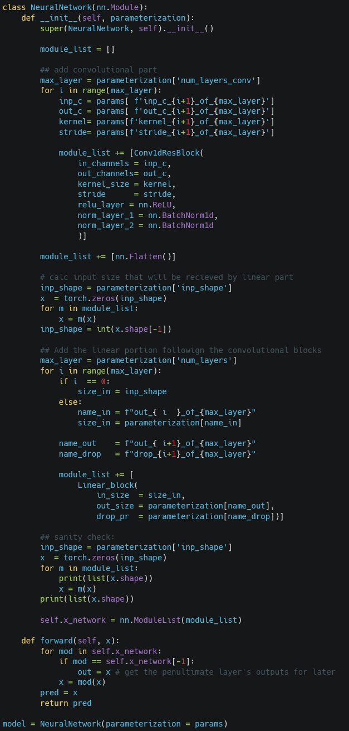
Considerations for Test/Train Splits

Slide 3
Defining a Holdout Set
Observations

Slide 4
Defining a Holdout Set
Site A
2014
Site B
Site C
Site A
2015
Site B
Site C
Observations

Slide 5
Defining a Holdout Set
Site A
2014
Site B
Site C
Site A
2015
Site B
Site C
Observations

Slide 6
Defining a Holdout Set
Site A
2014
Site B
Site C
Site A
2015
Site B
Testing Set
Site C
Observations

Slide 7
Defining a Holdout Set
Site A
2014
Site B
Site C
Site A
2015
Site B
Environments contribute to error equally
Testing Set
Site C
Observations

Slide 8
Key Questions:
Is there structure to your data you should account for in your sets?
Locations
Relatedness of individuals
Time
Is it possible for information from your testing set to “leak” into your training set?
E.g. Are values imputed or scaled based on all data?
How many splits do you need?
Test / train? Test / validate / train? Test/ validate 1 … validate # / train?

Slide 9
Hyperparameter Tuning in Practice

Slide 10
Hyperparameter Tuning
Define space to explore
Propose one or more options
Test one or more options
Propose one or more new options given results
Algorithms trade off
Parallelism vs Effectiveness

Slide 11
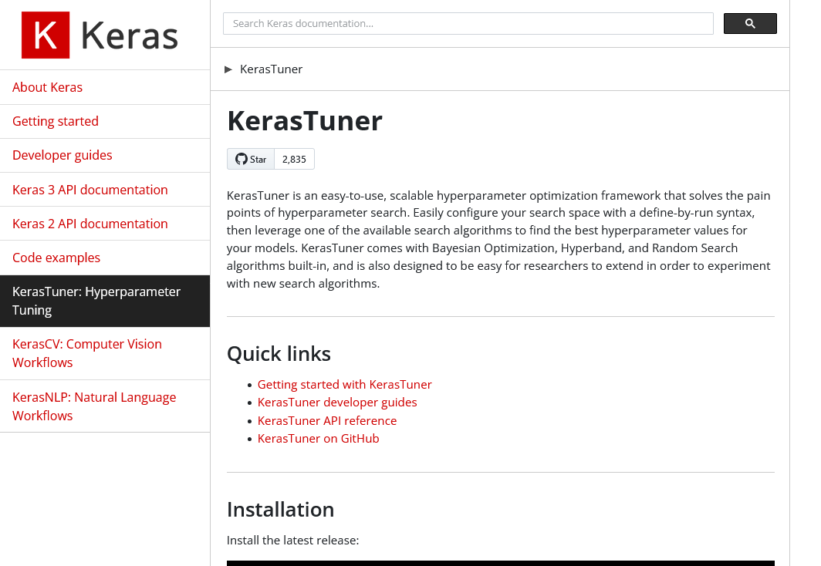
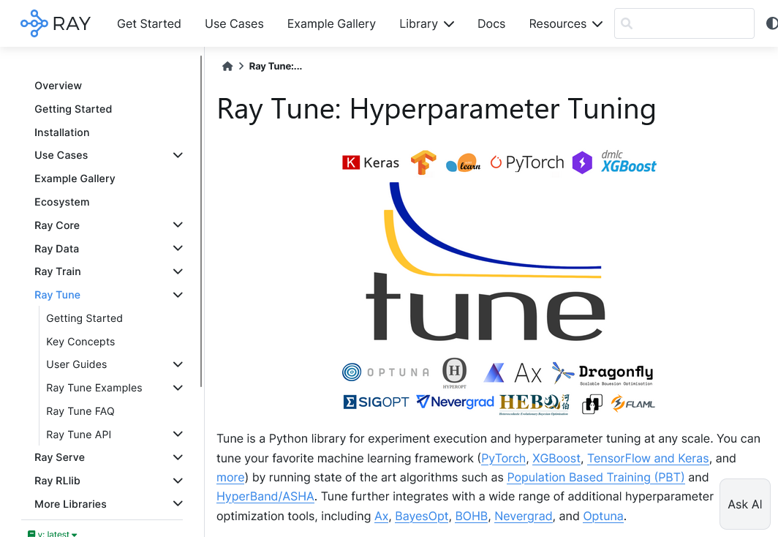
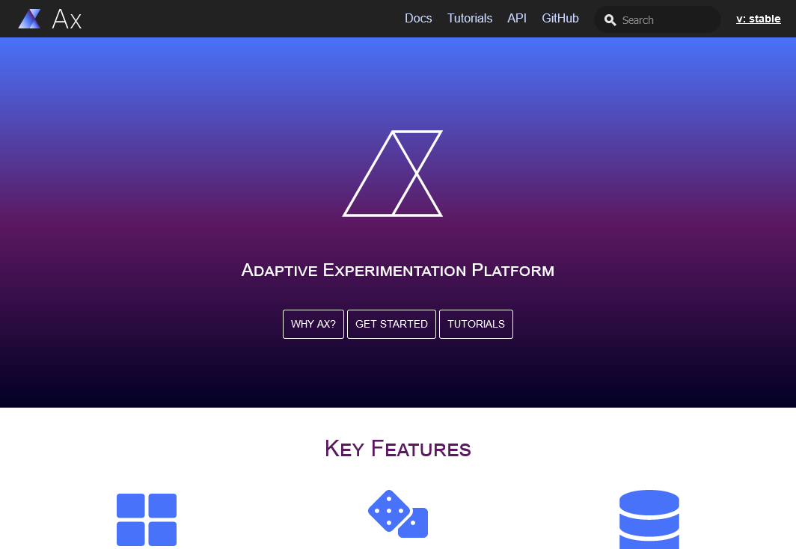
Common Hyperparameter Tuning Libraries

Slide 12
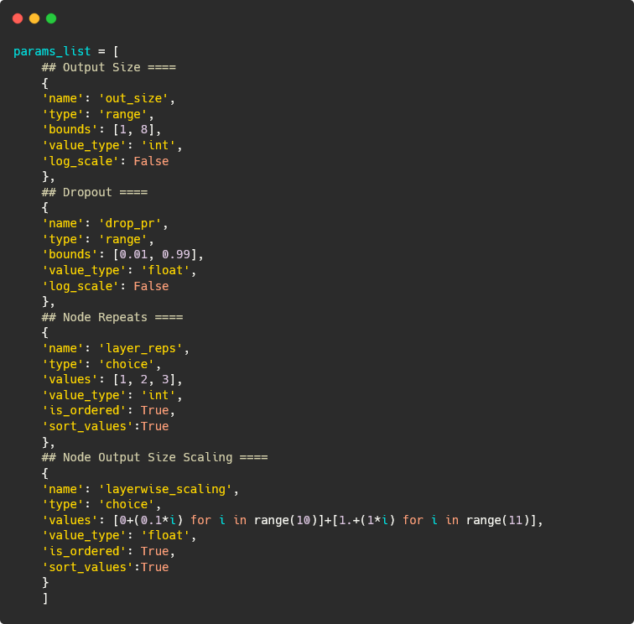
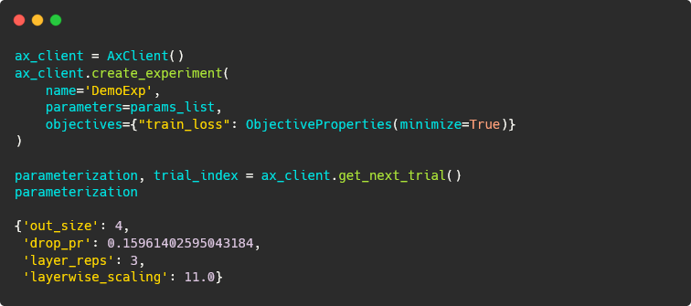
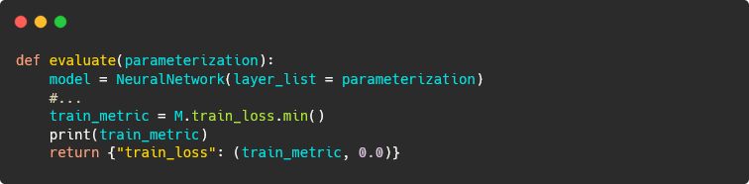
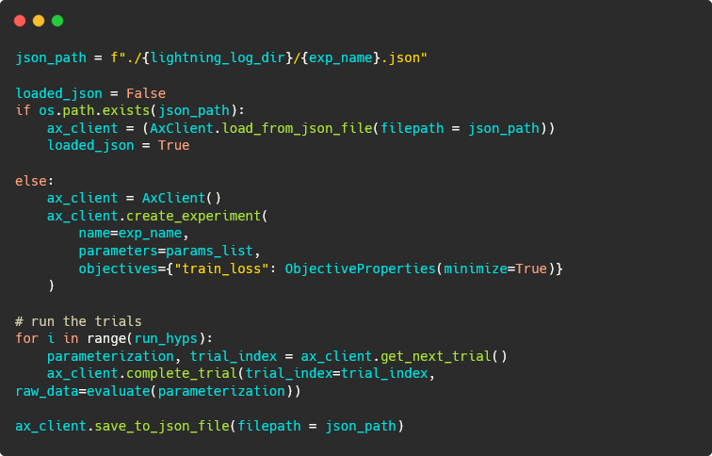
In Action: Ax
Define space to explore
Propose one or more options
Test one or more options
Propose one or more new options given results

Slide 13
In Action: Ax
Define space to explore
Propose one or more options
Test one or more options
Propose one or more new options given results

Slide 14
In Action: Ax
Define space to explore
Propose one or more options
Test one or more options
Propose one or more new options given results

Slide 15
In Action: Ax
Define space to explore
Propose one or more options
Test one or more options
Propose one or more new options given results

Slide 16
In Action: Ax
Define space to explore
Propose one or more options
Test one or more options
Propose one or more new options given results

