Slide 1
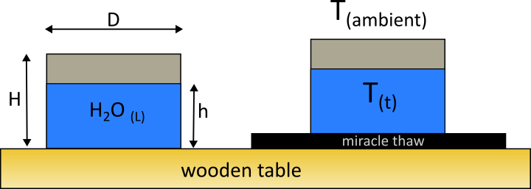
Miracle Thaw?
Prof. Sidebotham
The Cooper Union for the Advancement of Science and Art

Slide 2
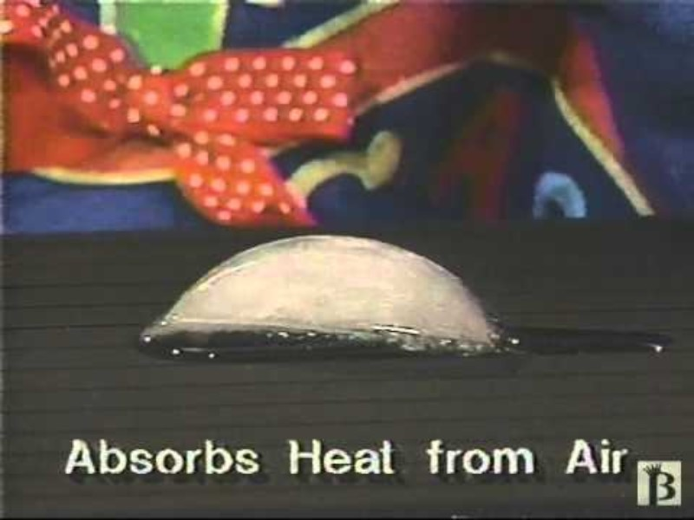

Slide 3
Prepare a Creative/Informative Title Slide

Slide 4
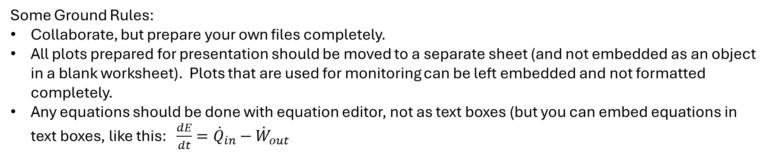
Acknowledgement slide
Some Ground Rules:
Collaborate, but prepare your own files completely.
All plots prepared for presentation should be moved to a separate sheet (and not embedded as an object in a blank worksheet). Plots that are used for monitoring can be left embedded and not formatted completely.
Any equations should be done with equation editor, not as text boxes (but you can embed equations in text boxes, like this: $\frac{dE}{dt}={\dot{Q}}_{in}−{\dot{W}}_{out}$

Slide 5
PROBLEM STATEMENT:
An experiment was conducted on the 1st day of class. Two aluminum cups were filled initially with hot water. One was placed on a wooden table, the other placed on a “Miracle Thaw” type device. The water temperature was measured as a function of time for the duration of the class period. The ultimate goal of this exercise is to determine and compare the over-all heat transfer coefficient (U) for both cases, in order to quantify the effectiveness of the miracle thaw.
A spreadsheet is provided with all the relevant raw data, and a template for data analysis. The analysis can be conducted either in that worksheet, and/or in a Jupyter notebook. However, prepare presentation-quality slides in this power point by taking appropriate snips of the excel and/or Jupyter files.
Define the system to be the combined H2O plus the aluminum cup. Use the entire surface area of this combination as the basis area for the over-all heat transfer coefficient determination.

Slide 6
Use as many slides as you need to “tell the story”. At a minimum there should be:
Well-formatted plot of raw data
Well-formatted plot(s) of dimensionless temperatures, showing time constant from curve fit.
Phenomenological theory/Derivation slide(s) to show how time constant relates to relevant geometric and thermal properties, and thereby leads to a semi-empirical measurement of the over-all heat transfer coefficient.

