Slide 1
Software development
- Breakout project
Level loading with an observer pattern
Switching between game states
Powering up the player with a strategy pattern
Testing the project
The development process
Daniel v. Düring Kjeldsen

Slide 2
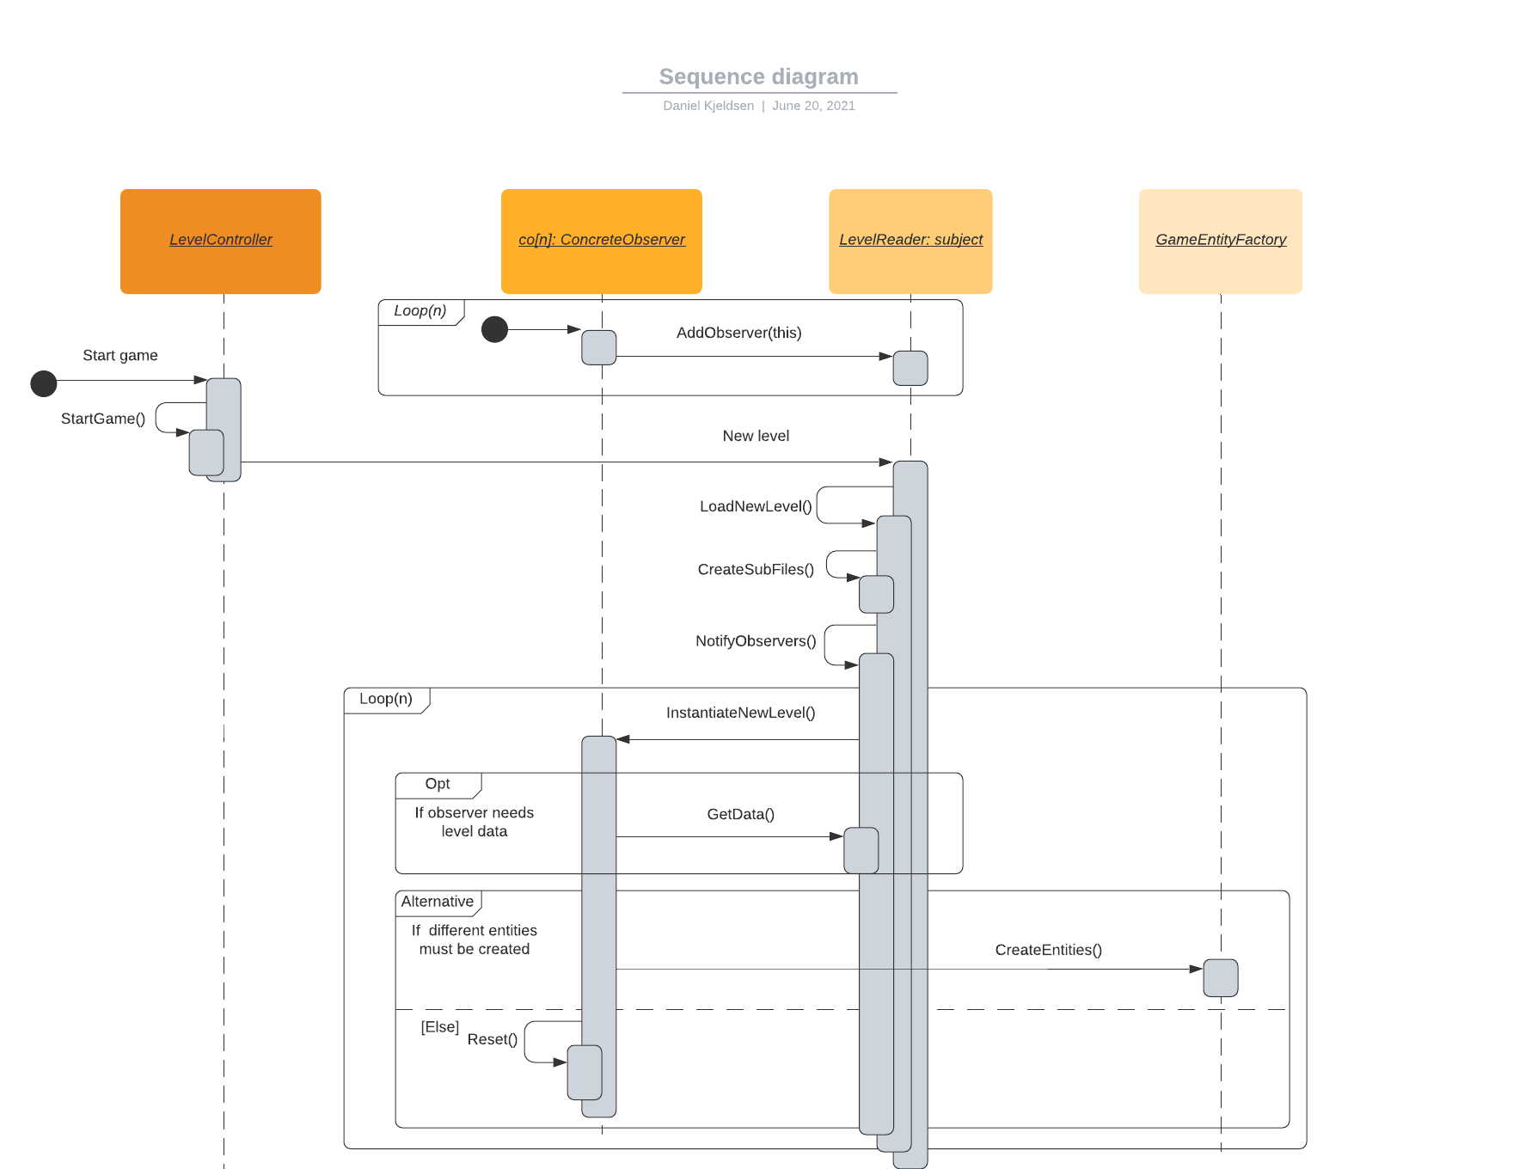

Level loading with an observer pattern
“This is also a great example of loose coupling and adhering to the open-closed principle, in that other game entities could be added with their own functionality without altering the [LevelReader].$"^{1}$
1: ”Breakout – Software Development 2021”: Greniman N., Folting D., Kjeldsen D.

Slide 3
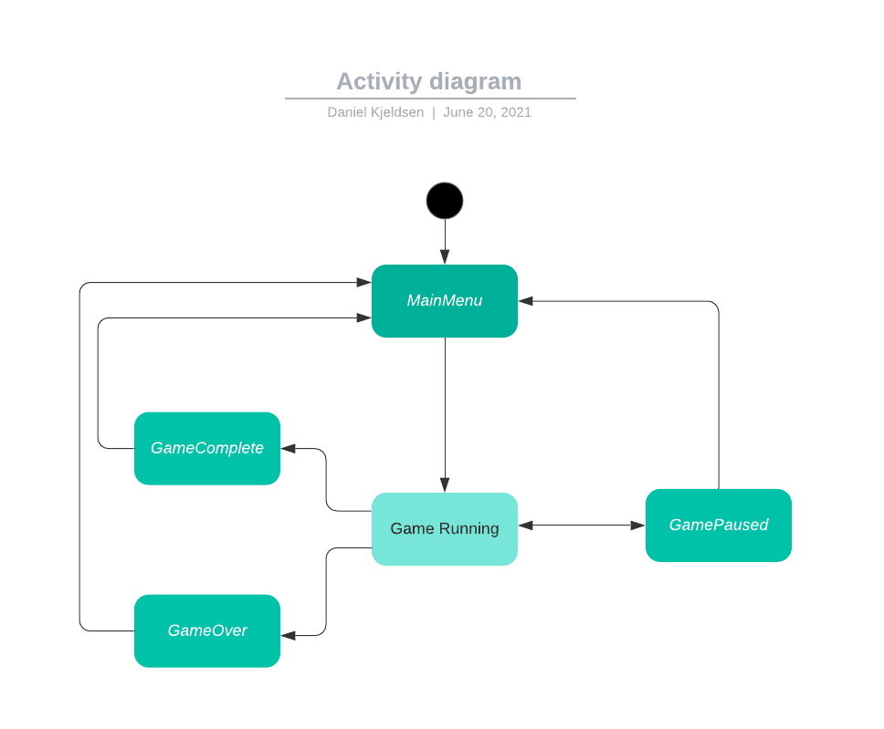
Switching between game states

Slide 4
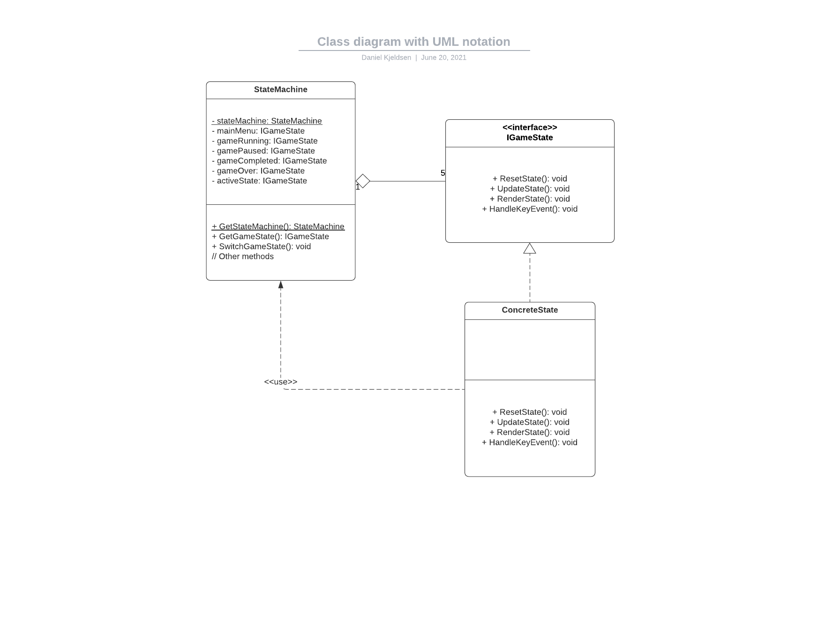
Switching between game states

Slide 5
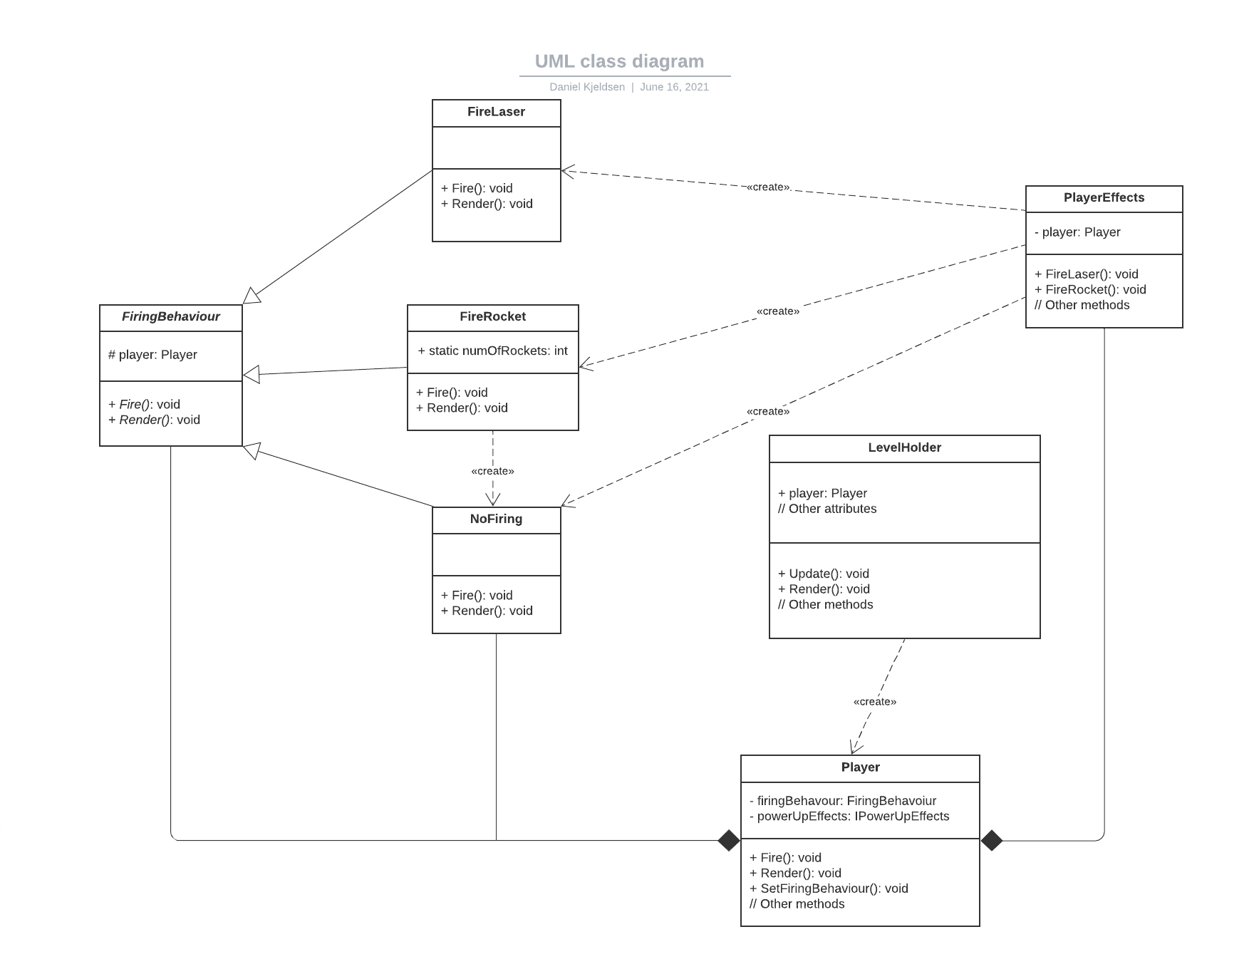
Powering up the player with a strategy pattern

Slide 6
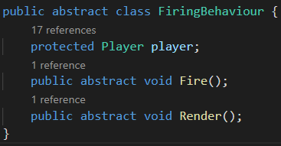

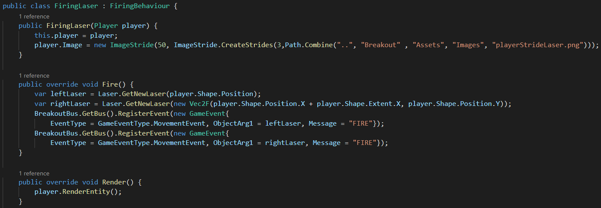
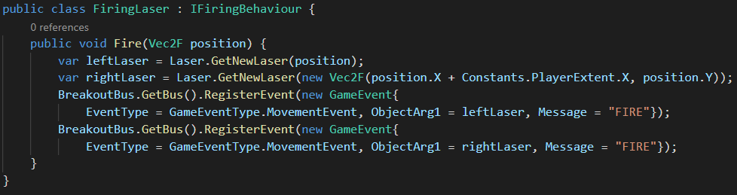
Powering up the player with a strategy pattern

Slide 7
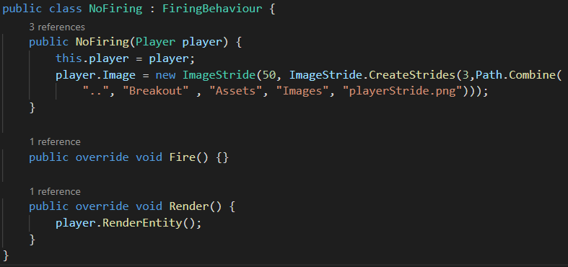
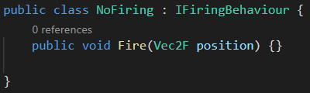
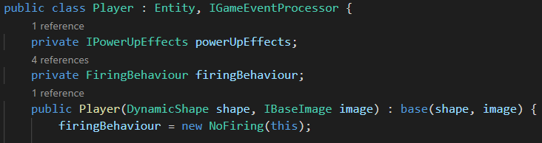
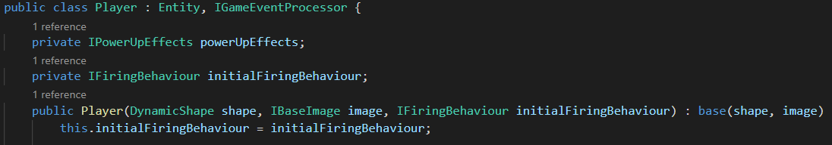
Powering up the player with a strategy pattern

Slide 8
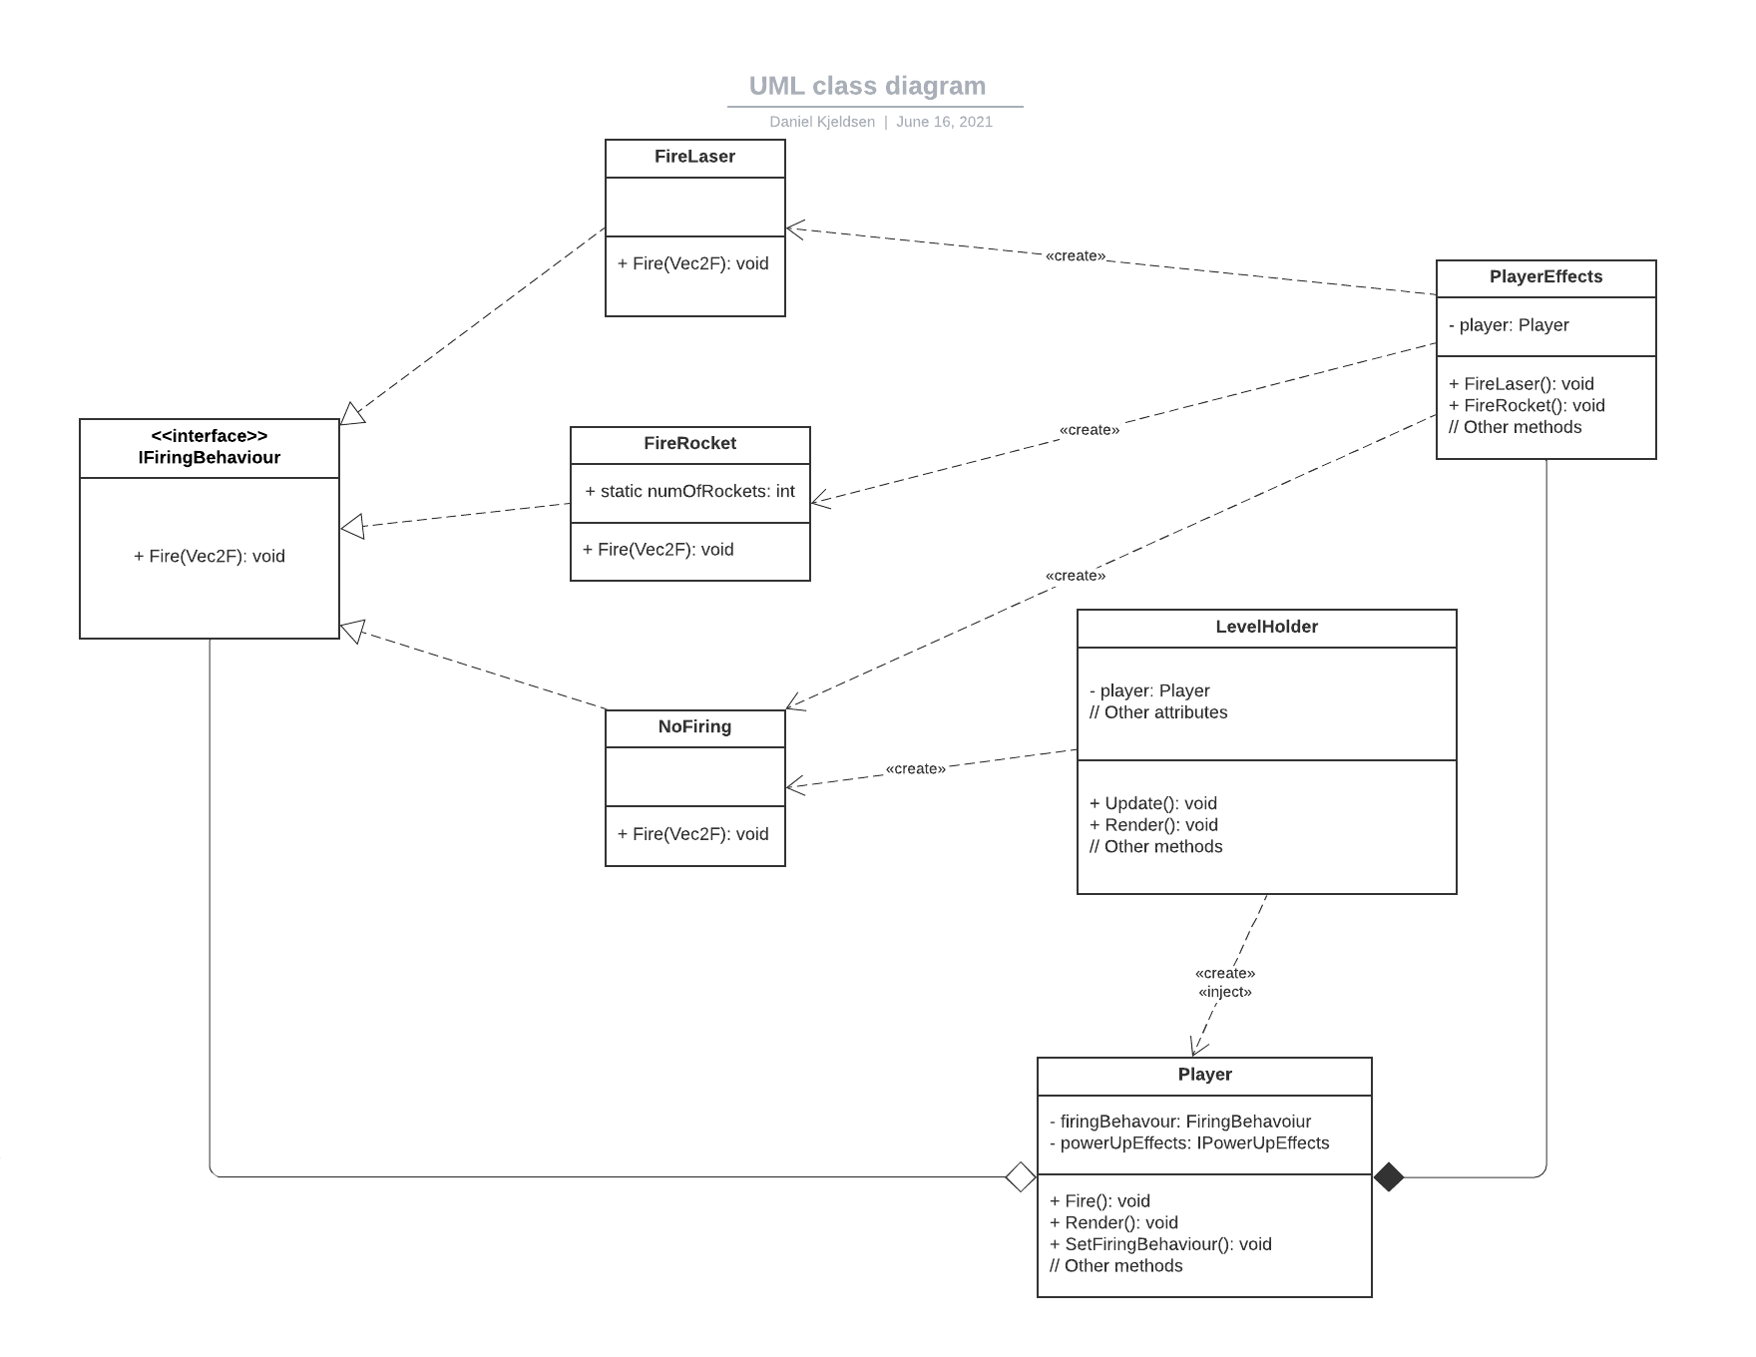
Powering up the player with a strategy pattern
Null
Object
Dependency
Injection
I

Slide 9
Testing the project
Manual
tests
Unit testing
White box -
statement and branch coverage
Black box –
equivalence partitioning
Acceptance
tests
Integration tests
Unit tests

Slide 10
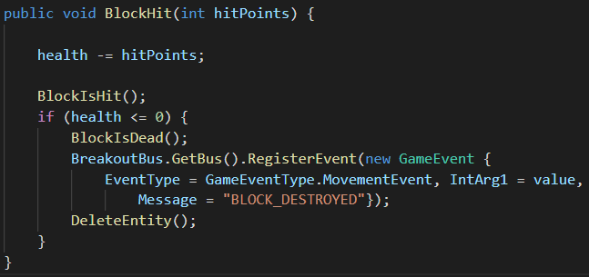

BlockHit(int hitPoints) must subtract hitpoints from health and check if block is destroyed.
Testing the project
Equivalence Partitioning
Test suite:
hitPoints = MinValue
hitPoints = -2
hitPoints = -1
hitPoints = 0
hitPoints = 1
hitPoints = 2
hitPoints = MaxValue

Slide 11

BlockHit(int hitPoints) must subtract hitpoints from health and check if block is destroyed.
Health must be decremented at each method call.
Testing the project
Equivalence Partitioning
Test suite:
hitPoints = MinValue
hitPoints = -2
hitPoints = -1
hitPoints = 0
hitPoints = 1
hitPoints = 2
hitPoints = MaxValue

Slide 12
The development process
Customer involvement
Incremental delivery
People not process
Embrace change
Maintain simplicity

Slide 13
The development process
Customer involvement
Incremental delivery
People not process
Embrace change
Maintain simplicity
Done ;)

Slide 14
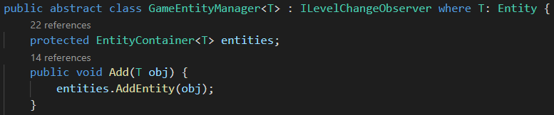
A Generic
Game entity manager
T

Slide 15
A Generic
Game entity manager
T
What is good?
- increases reusability
- reduced dependency (connascence of type instead of position)
However…
Liskov Substituion Principle is violated
- no covariance of return types
- no contravariance of the method arguments
GameEntityManager<Block> does not act as a subtype of GameEntityManager<Entity>, nor the other way around.

Slide 16


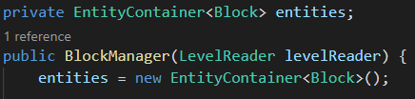
Fixing the Generic
Game entity manager
The problem:
A solution:
Interface where each concrete implementation contains a private instance of EntityContainer<T>
EntityContainer<T> is invariant
EntityContainer<T> must be removed from base!

Slide 17
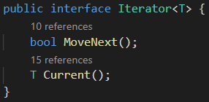
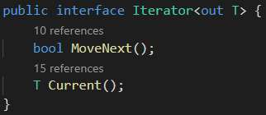
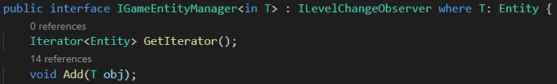
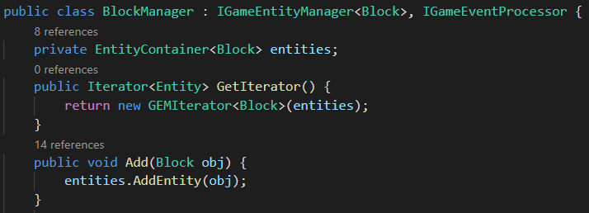
Covariance
Specify type in interface
Liskov Substitution Principle is now satisfied

Slide 18
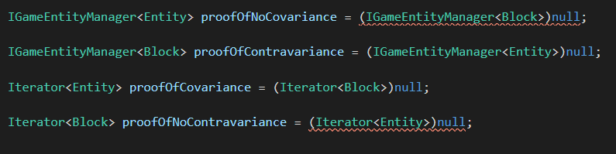
… and a proof

