Slide 1
Encrytping (Hashing)

Slide 2
Encrytpion Logic
Encrypting tools are needed to protect passwords so they cannot be hacked by any brute force, dictionary attack method or any other security social engineering methods. Most of the online users will be aware of encoding and decoding process. As hackers aggressively stay online in tracking the source of passwords, emails, URLs and other user information, it is indeed mandatory to encrypt your online details.

Slide 3
Let’s Apply It
Password Encryption/Decryption Program
The following program allows a user to encrypt and decrypt passwords containing upper/lower case characters, digits and special characters. This program utilizes the following programming features:
➤ for loop ➤ nested sequences (tuples)

Slide 4
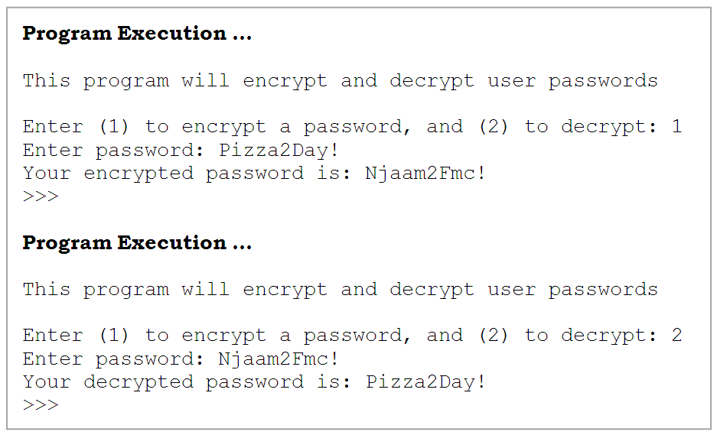

Slide 5
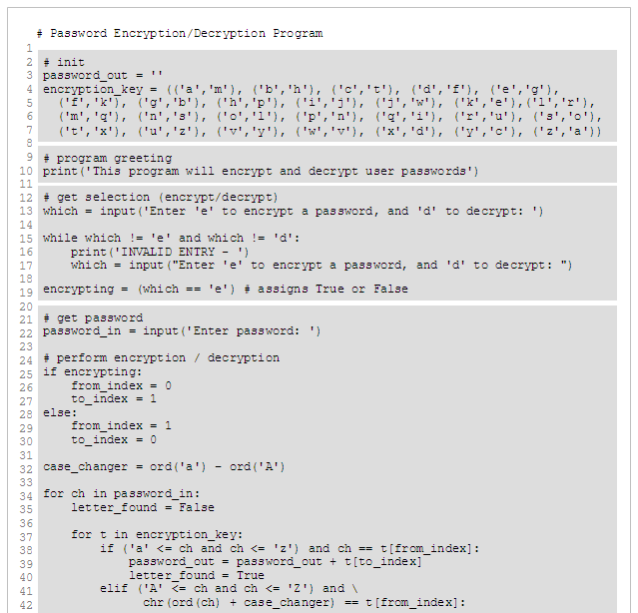
Lines 4-8 perform initialization. Variable password_out holds the encrypted/decrypted password, initialized to the empty string, with each next translated character appended to it.
Variable encryption_key holds the tuple (of tuples) used to encrypt/decrypt passwords:
encryption_key =
(('a', 'm'), ('b', 'h'), etc.
In lines 15-19, variable encrypting is set to either True or False, based on user response.
Lines 22-48 performs the encryption/decryption. Variable case_changer (line 32) is set to the difference between the encoding of the lower and upper case letters . The substitution occurs in the nested for loops in lines 34-48.

Slide 6
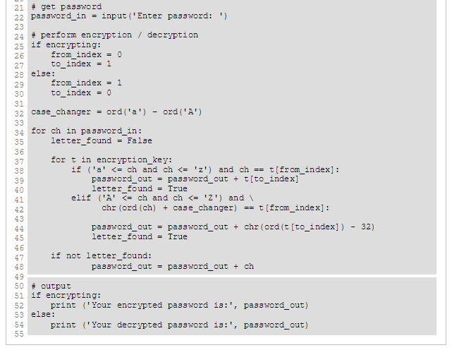
The substitution occurs in the nested for loops in lines 34-48.
The outer for loop iterates variable ch over each character in the entered password (to be encrypted or decrypted). The first step of the outer for loop is to initialize letter_found to False. This variable is used to determine if each given character is a (upper or lower case) letter. If a letter, it is replaced by its corresponding encoding character. If not, it must be a digit or special character, and thus appended as is (line 48).
The code on lines 38-40 and lines 41-45 is similar. The only difference is that since the letters in the encryption key are all lower case, any upper case letters in the password need to be converted to lower case before being compared to the letters in the key.

Slide 7
More!!
https://docs.python.org/2/library/hashlib.html
https://www.cyberciti.biz/python-tutorials/securely-hash-passwords-in-python/
https://passlib.readthedocs.io/en/stable/lib/passlib.hash.pbkdf2_digest.html

Slide 8
Some more!!
https://passlib.readthedocs.io/en/stable/modular_crypt_format.html#modular-crypt-format
https://en.wikipedia.org/wiki/Diffie–Hellman_key_exchange
https://en.wikipedia.org/wiki/Huffman_coding

Slide 9
Still more…
https://passlib.readthedocs.io/en/stable/modular_crypt_format.html#modular-crypt-format
https://en.wikipedia.org/wiki/Diffie–Hellman_key_exchange
https://en.wikipedia.org/wiki/Huffman_coding

Slide 10
And lastly…
https://www.tools4noobs.com/online_tools/encrypt/
http://insecure.org/

