Slide 1
Responses to reddit posts by Gender
An exploration into internet culture

Slide 2
Abstract
In this notebook, I attempt to explore the responses redditors have to different relationship issues: in particular to those of men vs women, cheating vs abuse, and the subjectivity and sentiment therein. The purpose of this is (1) to determine how people respond based on their implicit biases, (2) how redditors affect the culture on their website and (3) to provide recommendations to the administration on how to limit unwanted effects.
(1) Despite popular belief, no particular differences were found between comments in response to men or women. While this does not mean individuals cannot be biased, it appears that those biases cancel one another out.
(2) It is well-documented that redditors lack nuance in their approach to relationships -- they respond similarly to several different types of issue someone may have with their partner. One does not need to be a Data Scientist to encourage those experiencing relationship difficulties to confer with friends, seek out a therapist, or read the literature rather than to consult strangers on the internet.
(3) One possible recommendation would have been to do away with people announcing their gender/age in the post, however this does not appear to be necessary.

Slide 3
Obtaining the data
The top 2000 highest scoring posts of all time were obtained from r/relationships, r/relationship_advice, and r/AmITheAsshole.

Slide 4
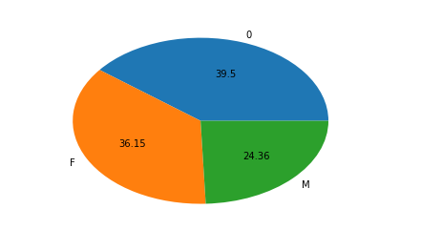
Scrubbing the Data
Regex was employed to determine if the poster was Male or Female. Some posters did not specify their gender. While the algorithm employed is not perfect, it only needs to be as smart as a person casually skimming the internet -- misinterpretations are acceptable.

Slide 5
Additional Scrubbing
Regex was also employed to determine if a comment mentioned cheating or abuse, but only ~10% did so, with some overlap.

Slide 6
Exploring the Data
The top 10 responses were scraped for each particular post, ranked in order by net upvotes. Deleted, stickied, and removed comments were ignored. Again, for some reason women had 1.5x as many responses as men, which is opposite the common belief that reddit is dominated by men. Perhaps people are more inclined to help women with their problems, and also excoriate them if they erred? For the sake of modelling, the extra F responses were removed.

Slide 7
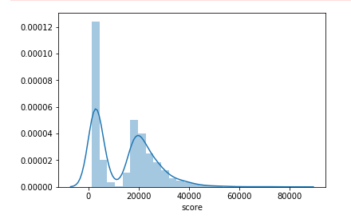
Score distribution
The scores are bi-modal: Most of them follow a distribution with a long left tail peaking at 20,000 points, with a huge spike at around 5,000 points

Slide 8

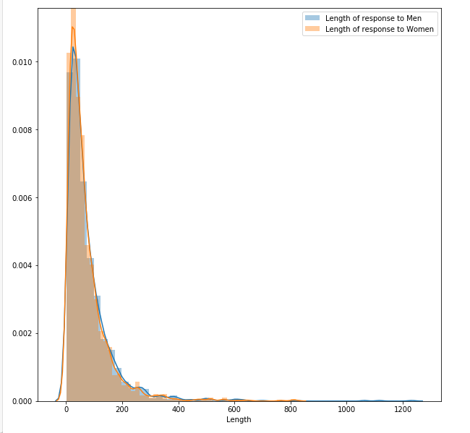
Response Lengths
Men get slightly longer responses than women -- which is the only statistically significant result in this analysis. Only ~5% of responses had fewer than 10 words.

Slide 9
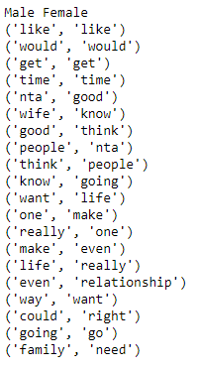
Most common words
Here are the top 20 most common words used in responses to men and women. Note significant levels of overlap, but also discrepancies.

Slide 10
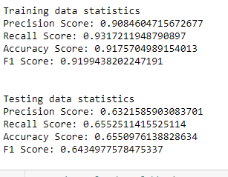
Modelling: Multinomial Naive Bayes
MNB provides terrible discrepancies between training and testing. A better model will be necessary. It is also based on a tf-idf algorithm, which is dated.

Slide 11

Robust algorithms
Even with Random Forests, SVMs and LogRegs built on Glove, the accuracy is never much greater than 50%, meaning that for all intents and purposes M and F responses are indistinguishable. Even though MNB provided better numbers, it wasn’t by much and it’s usage cannot be mathematically justified.

Slide 12
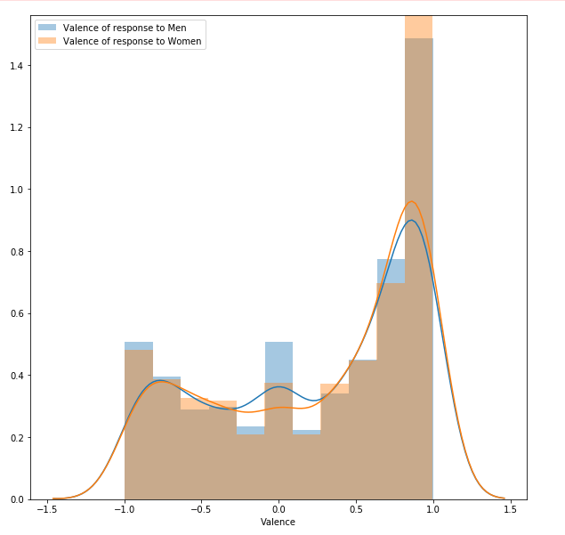
Interpretation of the data
Sentiment Analysis was finally used to check how responders actually reacted to those posts. p-value>>.05, meaning that the null hypothesis cannot be rejected: M and F responders had the same valence.

Slide 13
Simpsons Paradox
Simpsons paradox states that trends may flip correlation when one goes from viewing them in aggregate to viewing them separately. One must analyze groups before making any claims about general trends.

Slide 14
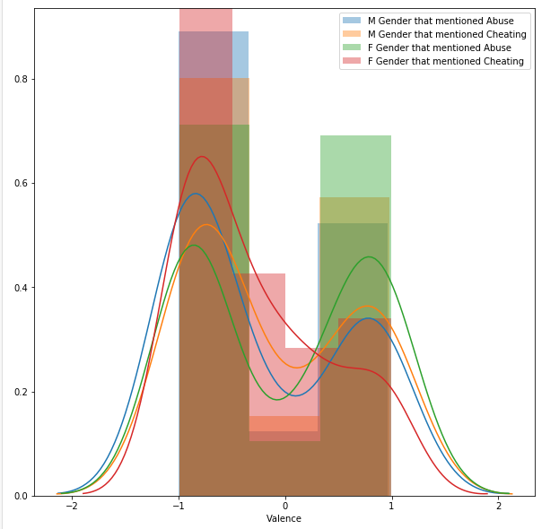
Cheating and Abuse
There was no particular difference in reaction to cheating and abuse -- which is ominous because such issues require nuance. As one can see, all the KDE plots look the same save F/Cheat, which is slightly less positive than the rest.

Slide 15

Future work
Although it seems like there is no distinction between how Reddit treats Men and Women, such a claim is inconclusive regarding advice to particular issues. Future work will be an exploration into lists of possible topics and whether the internet responds to them with any level of nuance, or if it repeats the same advice over and over.

