Slide 1
Scrum
Daniel Kułaga

Slide 2

Agenda
What the Scrum really is?
What does it mean Agile?
Scrum vs Waterfall
Benefits and drawbacks
Project management tools
Better solution for projects

Slide 3
Scrum – What is it ?
Scrum is an agile framework for developing, delivering and sustaining complex products in software development.

Slide 4
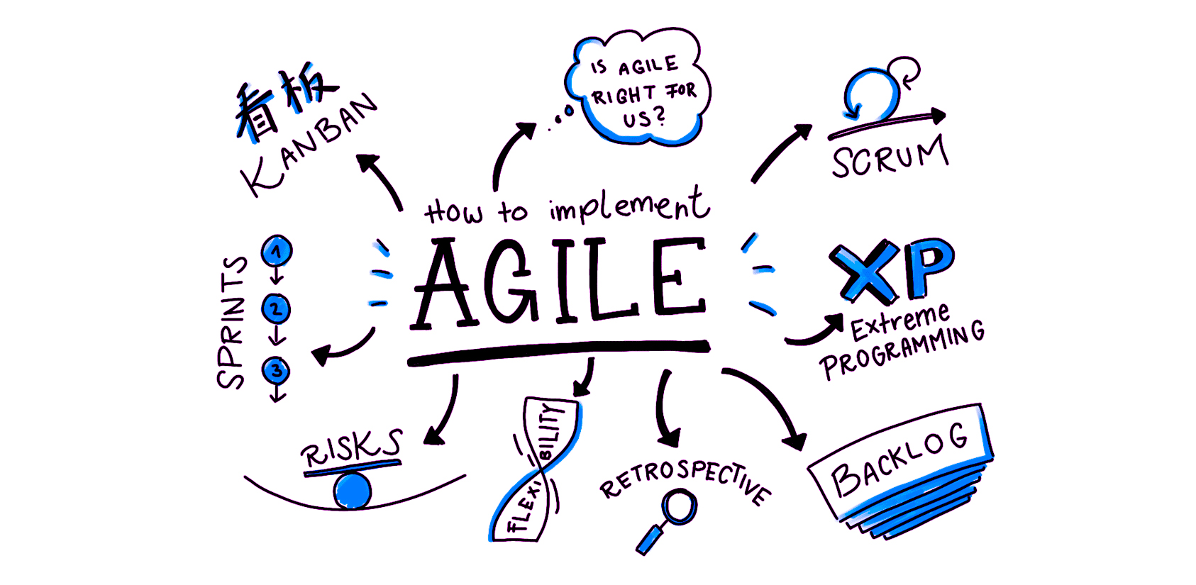
Agile

Slide 5
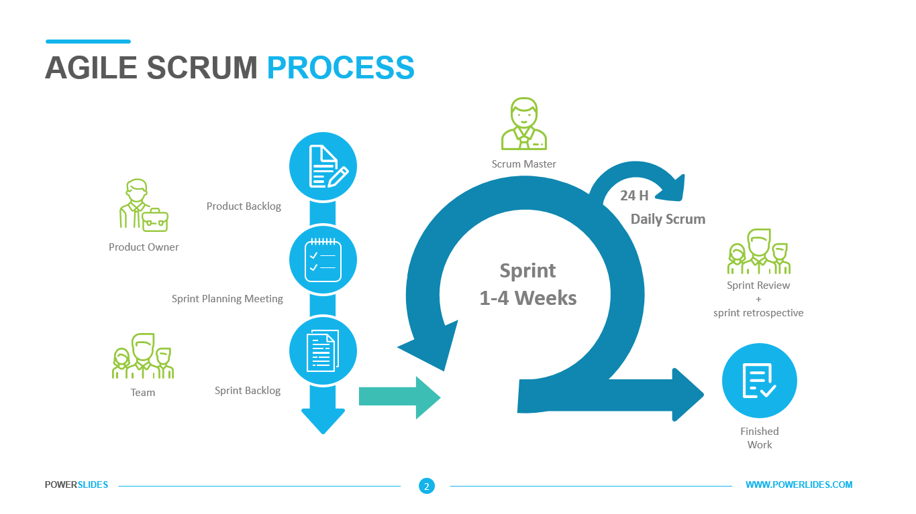
Scrum in action

Slide 6

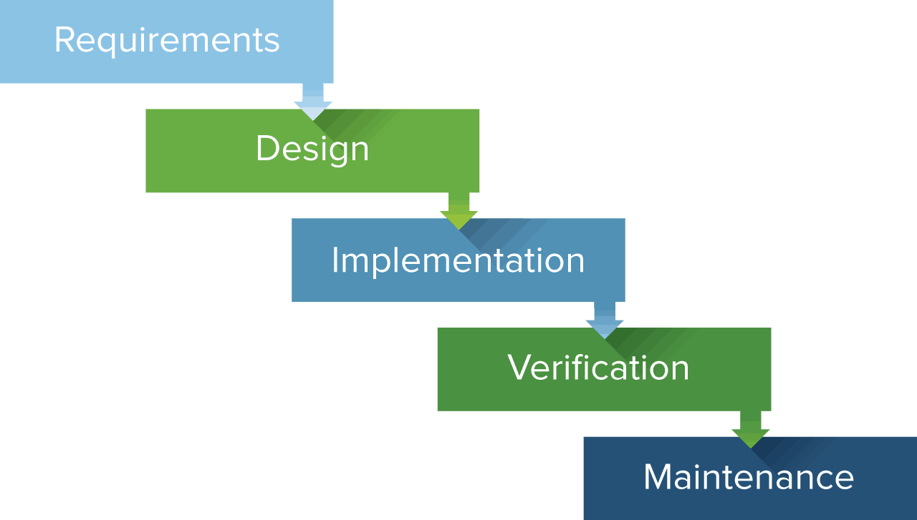
Waterfall

Slide 7
Scrum vs Waterfall
Scrum:
Better for long complex projects
Quick reaction for changes in requierments

Slide 8
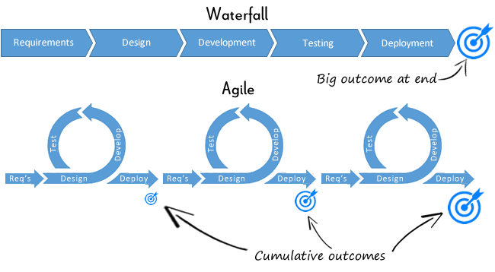
Scrum vs Waterfall

