Slide 1

THE IMPORTANCE OF SOFTWARE QUALITY
What is it for ?

Slide 2
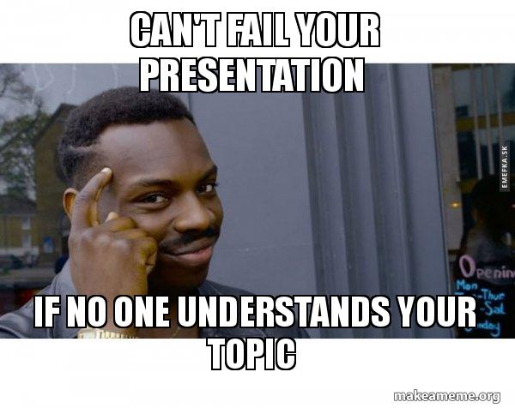
If you ask me why this topic ☺

Slide 3

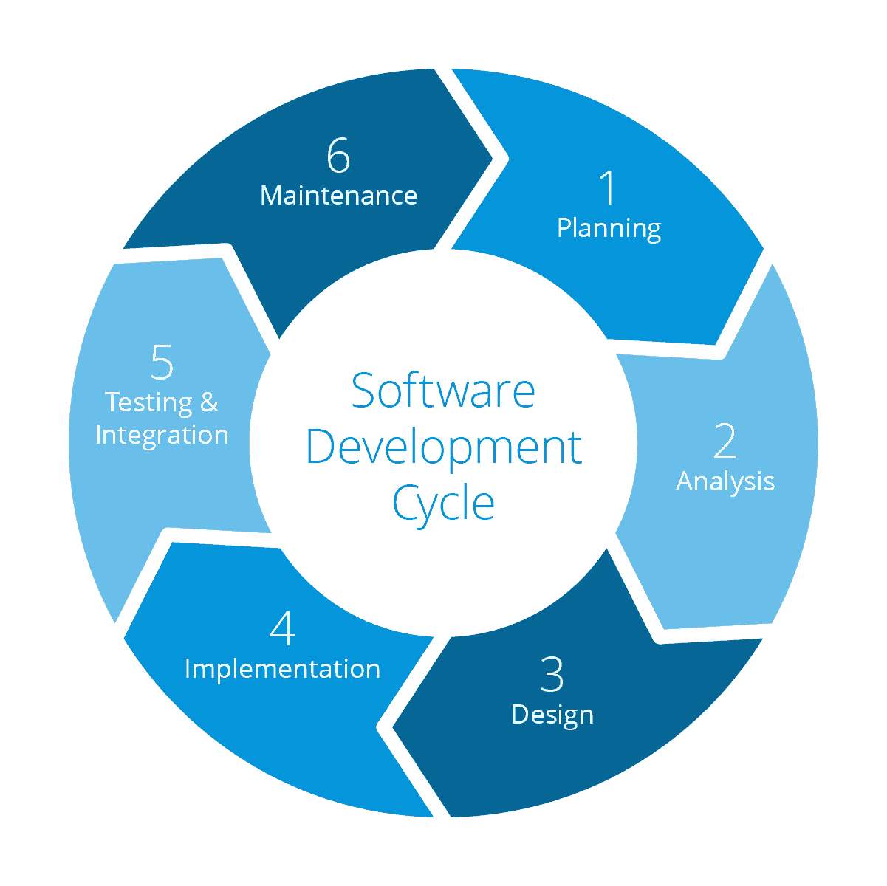
Software development process

Slide 4

What is software quality ?

Slide 5

What are the bugs?
A software bug is an error, flaw or fault in a computer program or system that causes it to produce an incorrect or unexpected result, or to behave in unintended ways.

Slide 6
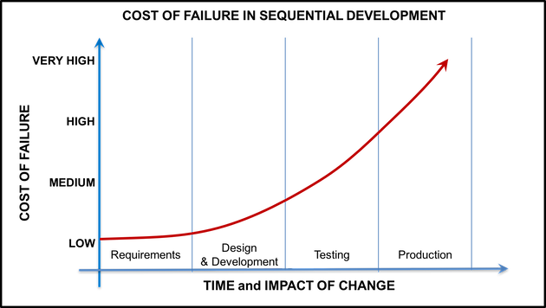
The sooner the better

Slide 7
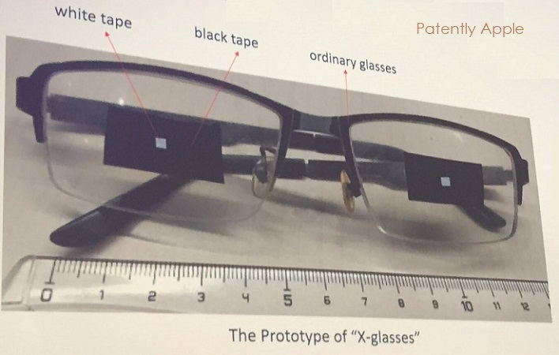
How to hack face id in the latest apple products?

Slide 8
THE Most popular bugs in websites
Browser Compatibility Problems
Responsive Website Mistakes
Links and Site Forms Aren’t Doing Anything
Slow Site Speed (ex sam.)
Website code has not been removed

Slide 9
Who will deal with it ?
SOFTWARE TESTERS
QA ENGINEERS
Technical Test Analyst
QA TEAM LEADS
Etc.
And finally: Developer

Slide 10
Who can be a tester ?
You understand priorities
You ask questions
You can create numbers of ideas
You can report negative things in a positive way
You are flexible to support whenever it’s required
You are a constant learner

Slide 11

THE BEST SOFTWARE TESTER IS USER

Slide 12

CERTIFIED TESTERS

Slide 13
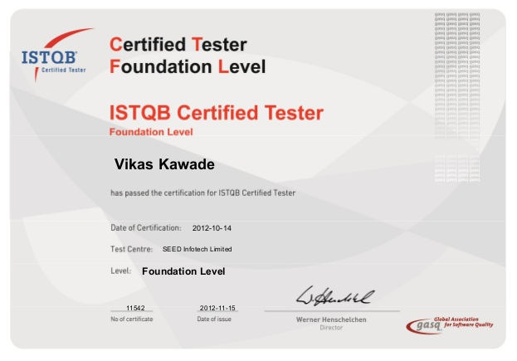

Slide 14

Users as a testers and not for free ☺

Slide 15
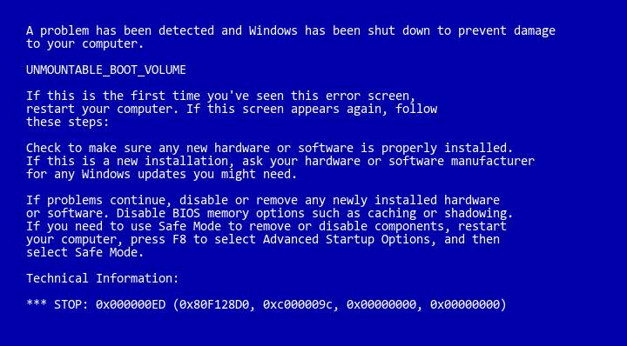
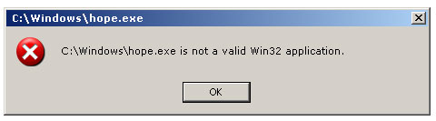
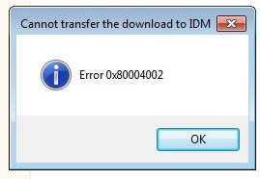
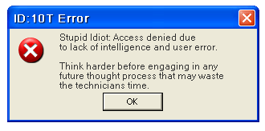
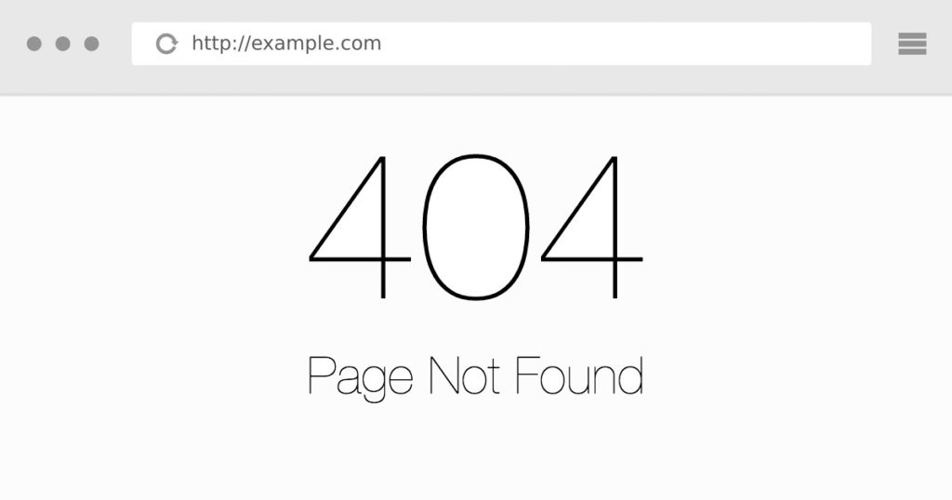
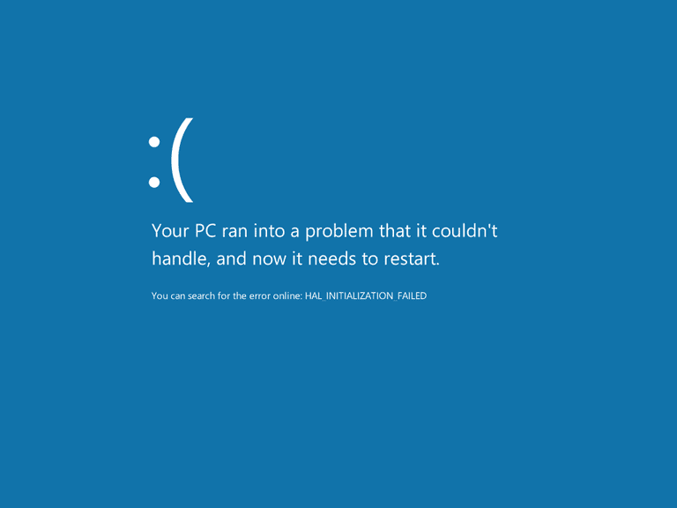
What would a world without testers look like?

Slide 16
Thanks for your attention ☺

