Slide 1


Predict Loan Approval
Nofar Selouk
Naama Elbaz
Daniel Kuznetsov

Slide 2
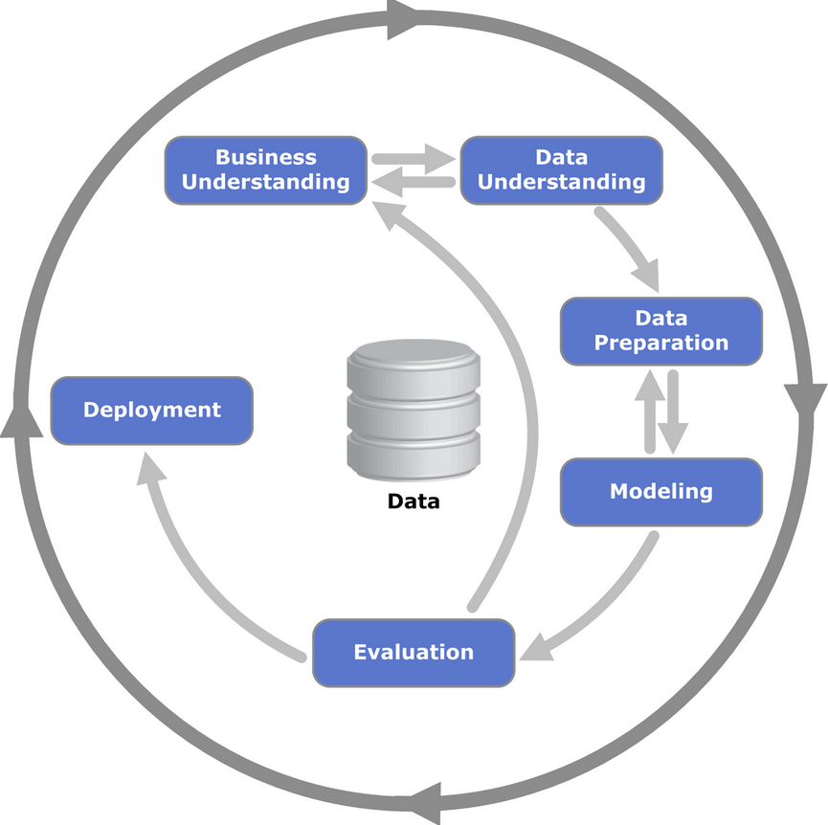
CRISP-DM Methodology-
What is CRISP-DM?
Cross-Industry Standard Process for Data Mining.
A widely used methodology for data mining projects.
Provides a structured approach to data mining.

Slide 3


Our problem – Predict Loan Approval
Relevance: Loan approval is a critical decision for financial institutions, predicting loan approval can streamline operations and improve efficiency
Impact: Accurate predictions can reduce default rates, leading to significant financial savings and increased profitability.
Customer Experience: A streamlined loan approval process enhances customer satisfaction by reducing wait times and improving transparency.
Competitive Advantage: Leveraging predictive analytics can provide a competitive edge in the financial services industry by enabling more informed and faster decision-making.

Slide 4


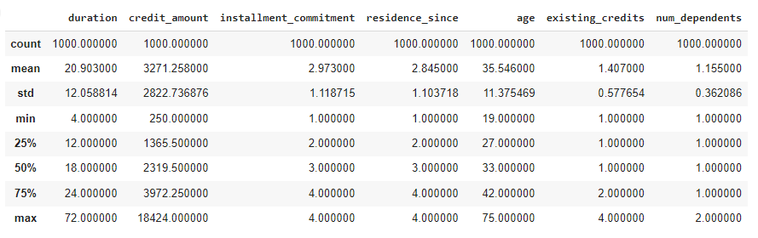
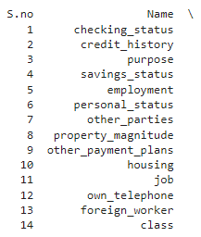
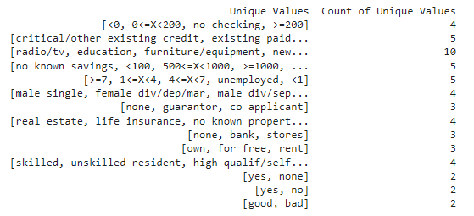
Dataset Overview -
Source of the dataset: credit_risk_customers from Kaggle.
The dataset consists of 20 features of the customers.

Slide 5
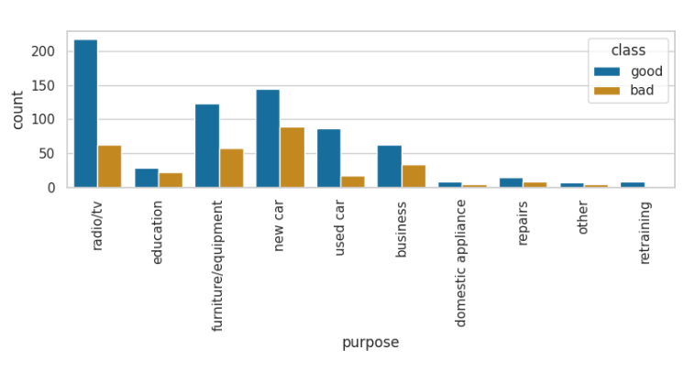
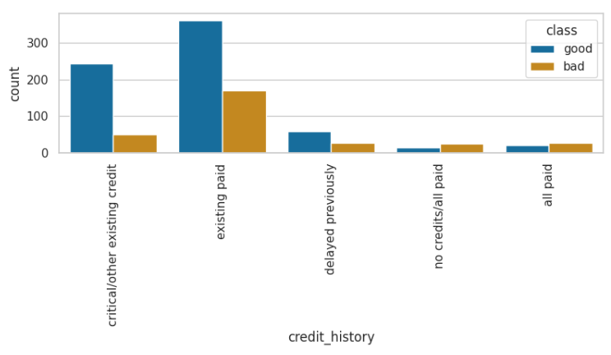
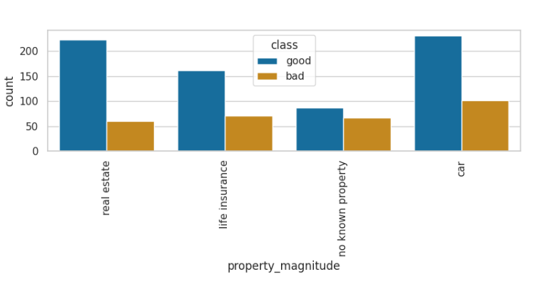
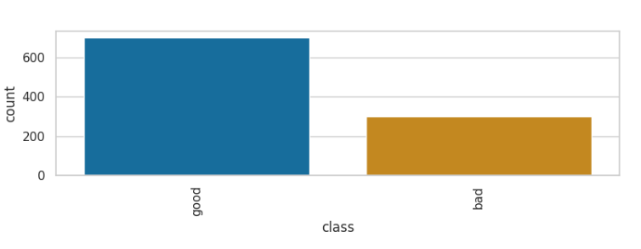
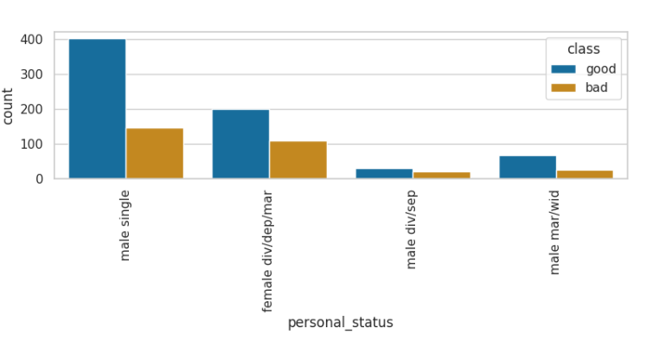
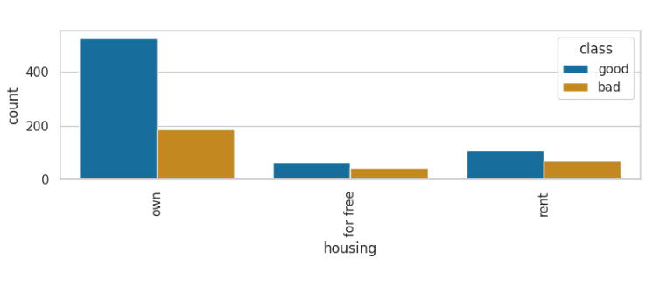
Some EDA -

Slide 6

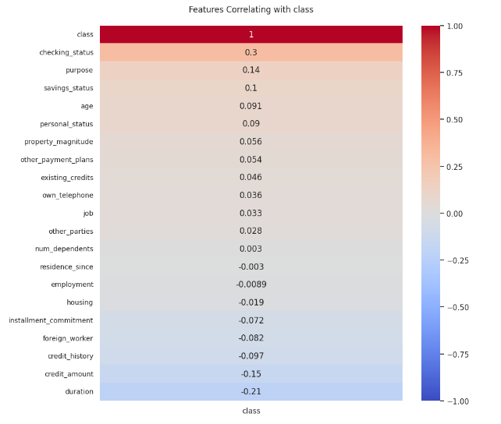
Correlation of features vs label
Understanding correlation of features vs label after encoding all the categorical variables.

Slide 7
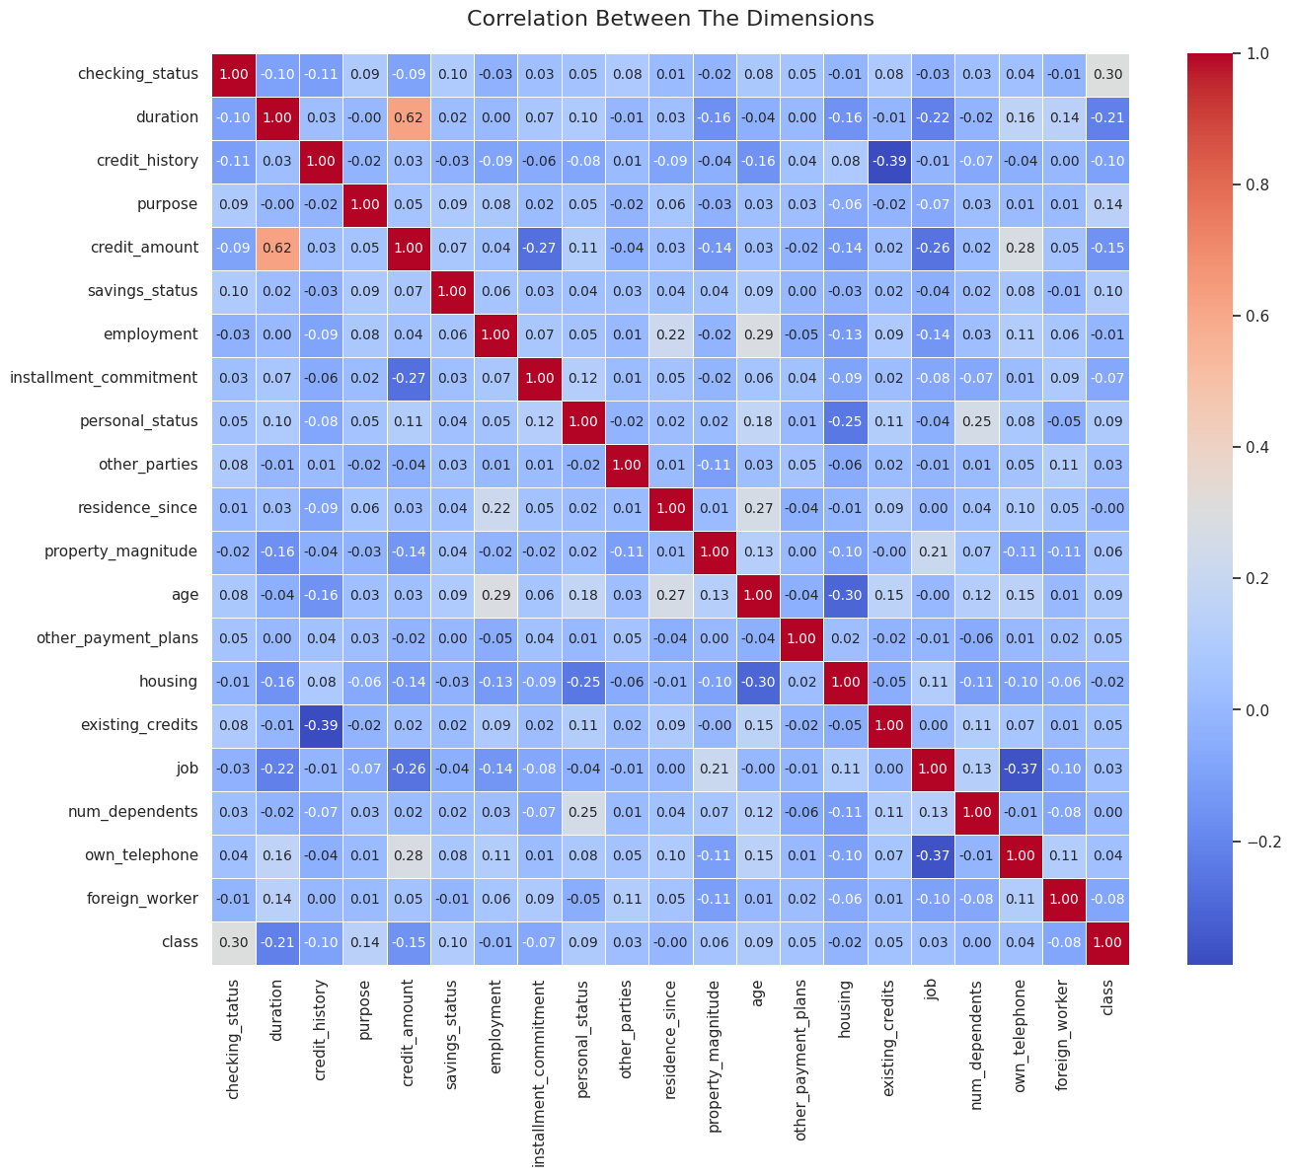
Correlation of features vs features
Understanding correlation of features vs features after label encoding
all the categorical variables

Slide 8
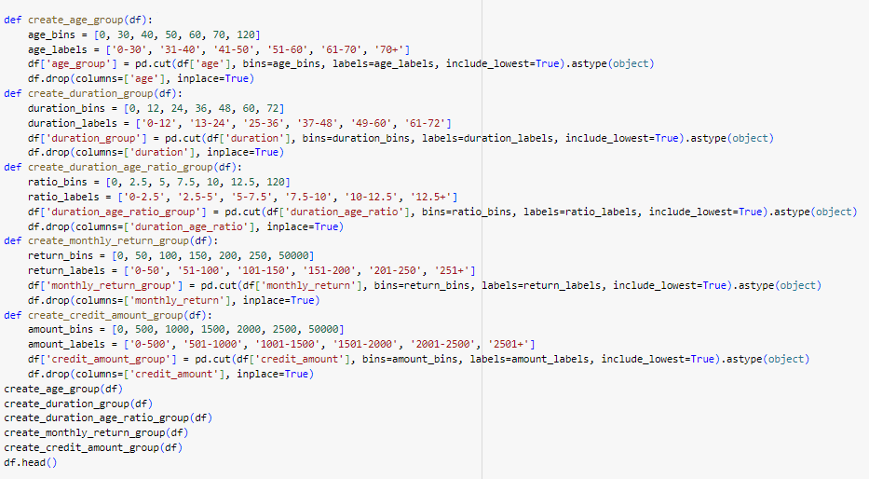
Pre Processing - Feature Engineering
Credit Amount Classification – classifies each credit_amout as either ‘high’ or ‘normal’ based on the mean and standard deviation of credit_amount for each purpose.
Monthly Return Calculation – calculates the monthly return by dividing the credit_amount by the duration.
Duration to Age Ratio - calculates the ratio of duration to age, scaled by 100.
Splitting personal_status - split into two new columns: sex and marriage, and remove the original column.
Notes:
Calculate mean and standard deviation of credit_amount by purpose: To create reference points for classifying credit amounts as 'high' or 'normal' based on their purpose.
Classify credit_amount as 'high' or 'normal' based on deviation from the mean: To categorize credit amounts relative to typical values for better risk assessment.
Calculate duration_age_ratio as percentage of duration over age:To normalize loan duration by borrower age for evaluating risk related to loan duration.
Split personal_status into sex and marriage, then drop personal_status: To separate and simplify the composite feature for clearer analysis. And create a feature that might give meaningful insights
Simplify categories in credit_history: To consolidate categories into smaller groups for better interpretability and analysis.
Group employment statuses into stable and unstable: To categorize employment duration into stable and unstable for simplified risk assessment.
Simplify job categories: To reduce the complexity of job categories for better clarity in analysis.
Simplify housing categories:To categorize housing status into ownership and non-ownership for easier analysis.
Simplify other_payment_plans categories: To group payment plans into existent and non-existent categories for better interpretability.
Simplify property_magnitude categories: To consolidate property types into broader categories for simplified analysis.

Slide 9
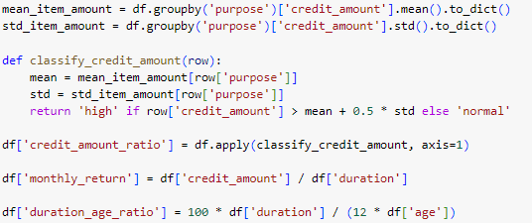

Pre Processing - Feature Engineering
Credit Amount based on mean by purpose – To categorize credit amounts relative to typical values for better risk assessment.
Monthly return as credit amount divided by duration - Important feature in loans, To assess the monthly financial burden of the credit amount on the borrower and ability to repay.
Calculate duration age ratio as percentage of duration over age - To normalize loan duration by borrower age for evaluating risk related to loan duration.
?
?
Credit
Credit by duration
Duration by age
Notes:
Calculate mean and standard deviation of credit_amount by purpose: To create reference points for classifying credit amounts as 'high' or 'normal' based on their purpose.
Classify credit_amount as 'high' or 'normal' based on deviation from the mean: To categorize credit amounts relative to typical values for better risk assessment.
Calculate duration_age_ratio as percentage of duration over age:To normalize loan duration by borrower age for evaluating risk related to loan duration.
Split personal_status into sex and marriage, then drop personal_status: To separate and simplify the composite feature for clearer analysis. And create a feature that might give meaningful insights
Simplify categories in credit_history: To consolidate categories into smaller groups for better interpretability and analysis.
Group employment statuses into stable and unstable: To categorize employment duration into stable and unstable for simplified risk assessment.
Simplify job categories: To reduce the complexity of job categories for better clarity in analysis.
Simplify housing categories:To categorize housing status into ownership and non-ownership for easier analysis.
Simplify other_payment_plans categories: To group payment plans into existent and non-existent categories for better interpretability.
Simplify property_magnitude categories: To consolidate property types into broader categories for simplified analysis.

Slide 10
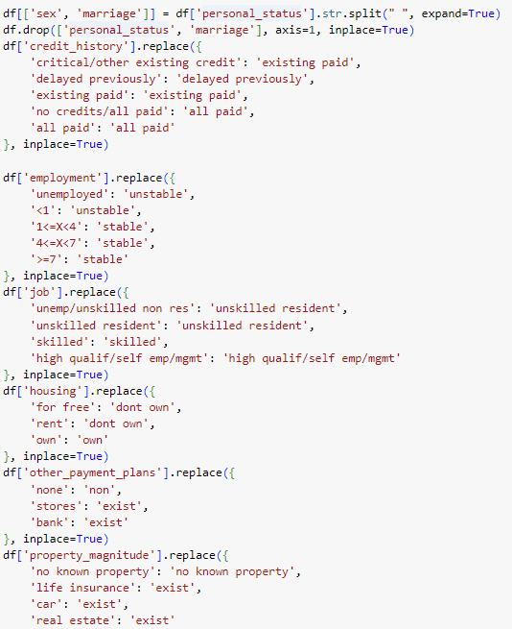
Pre Processing - Feature aggregating/engineering
Critical step for XAI and understanding of each feature impact on the model.
The dataset is not organized and preprocessing is a critical step.
Sex
Personal status?
Marriage
Paid
Credit history?
Delayed/not paid
Stable
Meaningful features
Employment?
Unstable
Skilled
Skilled job?
Management/High quality job
Properties?
Yes
No
Notes:
Calculate mean and standard deviation of credit_amount by purpose: To create reference points for classifying credit amounts as 'high' or 'normal' based on their purpose.
Classify credit_amount as 'high' or 'normal' based on deviation from the mean: To categorize credit amounts relative to typical values for better risk assessment.
Calculate duration_age_ratio as percentage of duration over age:To normalize loan duration by borrower age for evaluating risk related to loan duration.
Split personal_status into sex and marriage, then drop personal_status: To separate and simplify the composite feature for clearer analysis. And create a feature that might give meaningful insights
Simplify categories in credit_history: To consolidate categories into smaller groups for better interpretability and analysis.
Group employment statuses into stable and unstable: To categorize employment duration into stable and unstable for simplified risk assessment.
Simplify job categories: To reduce the complexity of job categories for better clarity in analysis.
Simplify housing categories:To categorize housing status into ownership and non-ownership for easier analysis.
Simplify other_payment_plans categories: To group payment plans into existent and non-existent categories for better interpretability.
Simplify property_magnitude categories: To consolidate property types into broader categories for simplified analysis.

Slide 11
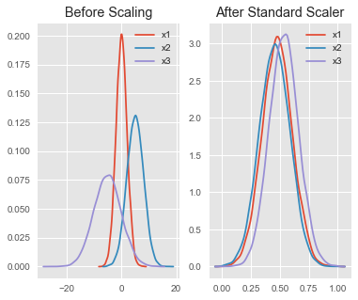


Pre Processing - Data Standardization
For all numerical entries the only way to preprocess them is to standardize them
We have implemented this using Standardscaler .
Standardizing the features ensures that they all contribute equally to the model by having the same scale. This is particularly important for algorithms like k-nearest neighbors (KNN) and support vector machines (SVM), which are sensitive to the scale of input data.

Slide 12
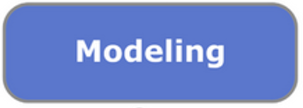
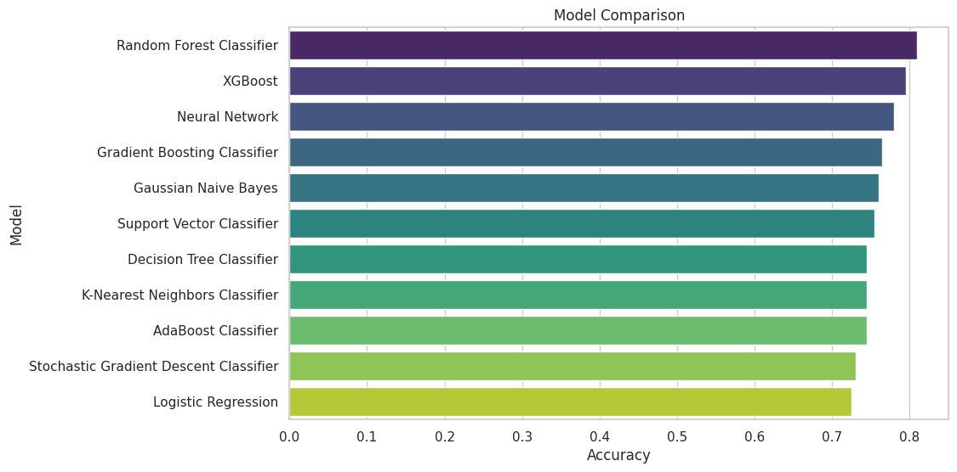
Modeling – Basic models comparison
We evaluate multiple machine learning models, including Random Forest, Decision Tree, Logistic Regression, Neural Network, XGBoost, and others. After splitting the data into training and test sets, we train each model, measure its accuracy, and record the training time. This is a basic model without any hyperparameter optimizing to get the baseline.

Slide 13
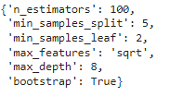
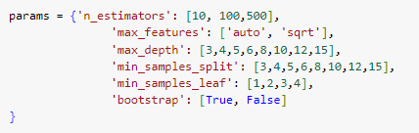
Modeling – Random forest improvements
Previous slide showed Random forest to preform the best, as a baseline we will continue to improve on this model by creating a gridsearch on different hyperparameters and testing the different evaluation methods on it.

Slide 14
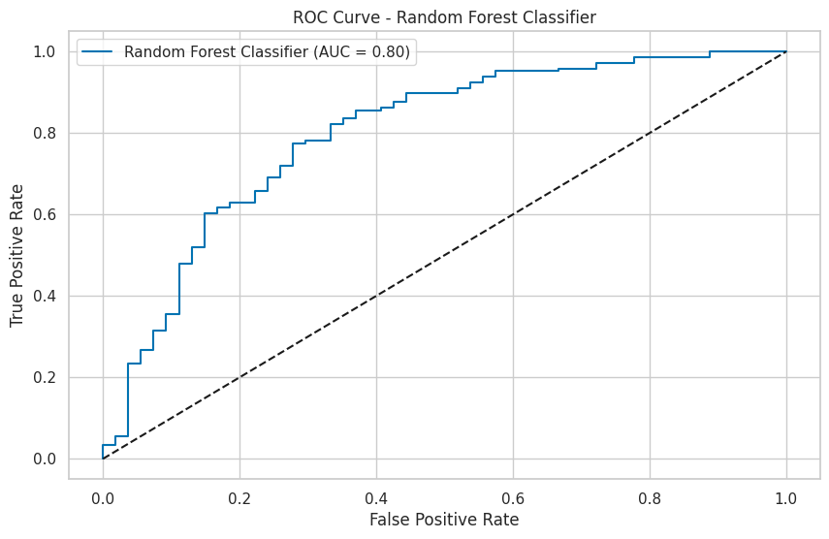
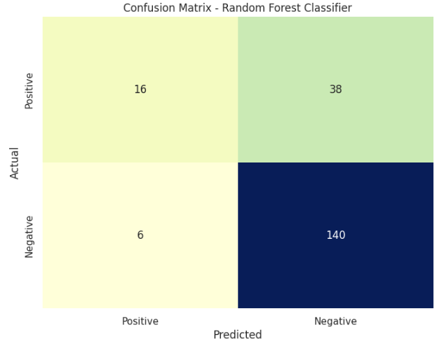
Modeling – Random forest results
Evaluation on Random Forest classifier results:

Slide 15
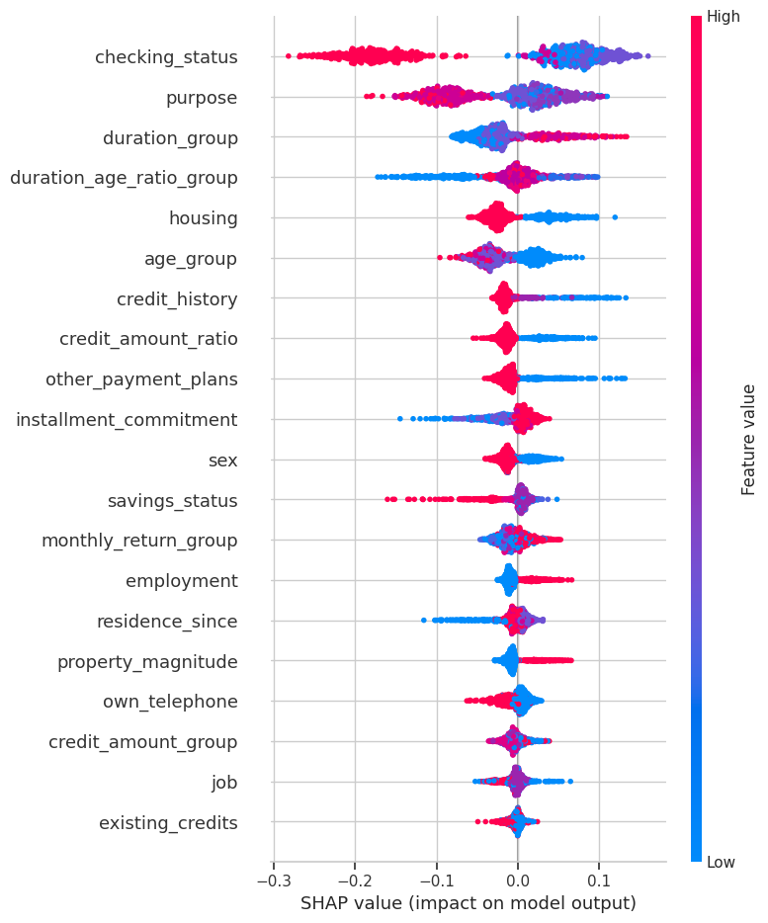
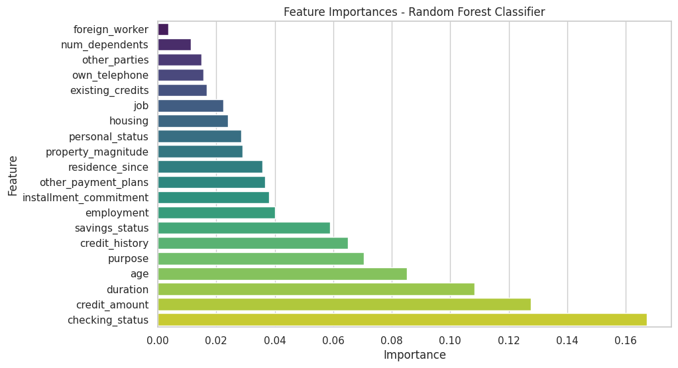
Modeling – Random forest Insights
And using XAI we gain insight into the features – which in CRISP-DM takes us back to data preparation.

Slide 16
Conclusions and next steps
We gained an insight into the importance of feature engineering and the impact of them on our model.
As part of our modeling step we evaluated the model and based on CRISP DM we went back to the feature engineering task.
The last step showed the importance of evaluation and we gained insights into the importance of our feature engineering.
Based on this we concluded we might create more features and analyse the impact of them on our model.
Next step:
Proceed with the evaluation phase on our models to decide on the most fitting one based on our baseline.
Continue developing more features that prove impact on the model ( while avoiding information leakage and overfitting)
Deploy a final model for the task which improves the baseline

Slide 17

Questions?

