Slide 1

Survey Data Analysis: Technology Trends & Compensation
Part 1

Slide 2

OUTLINE
Executive Summary
Introduction
Methodology
Programming Language Trends
Database Trends
Dashboards
Dashboard Insights
Overall Findings
Conclusion

Slide 3

EXECUTIVE SUMMARY
Top programming languages: Python, JavaScript most used
Future trends: high interest in Go, Rust
Database usage: SQL, MongoDB common; NoSQL demand increasing
Compensation and job satisfaction vary by age and experience
Dashboards provide detailed insights

Slide 4

INTRODUCTION
Purpose: Analyze survey data to identify trends in tech adoption, compensation, and job satisfaction
Audience: Developers, managers, recruiters, and analysts
Value: Guides skill development, hiring decisions, and career planning

Slide 5

METHODOLOGY
Data Source: Stack Overflow 2023 Developer Survey CSV
Key Steps:
Data cleaning and missing value handling
Age conversion from categories → numeric
Split multi-value columns (languages, databases)
Calculated medians, counts, and top 10 lists

Slide 6
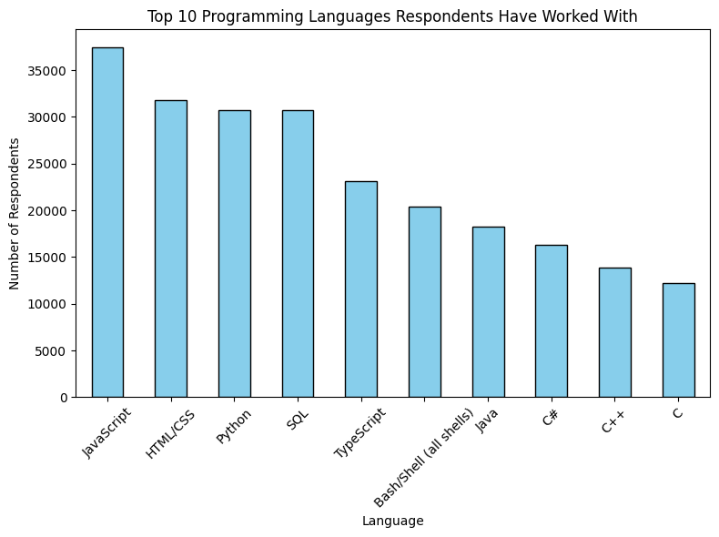
PROGRAMMING LANGUAGE TRENDS
Next Year

Slide 7
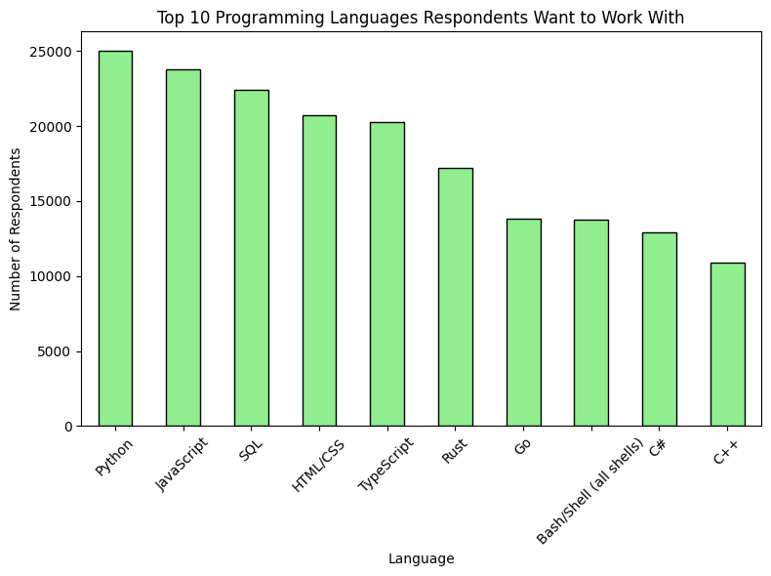
PROGRAMMING LANGUAGE TRENDS - FINDINGS & IMPLICATIONS
Python and JavaScript dominate current usage; Rust and Go are emerging in demand.
Implications
Implication 1
Implication 2
Implication 3

Slide 8
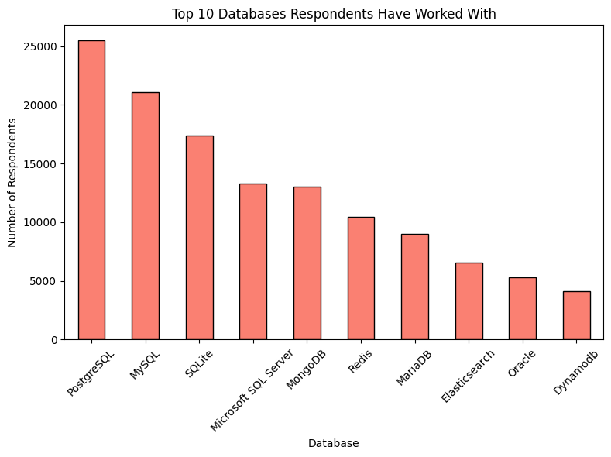
DATABASE TRENDS
Next Year

Slide 9
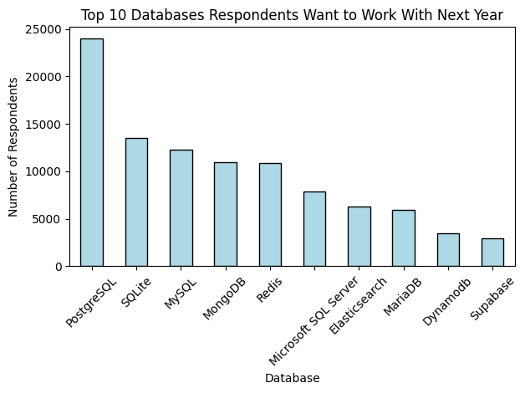
DATABASE TRENDS - FINDINGS & IMPLICATIONS
SQL dominates current use; NoSQL (MongoDB, DynamoDB) increasing in interest.

Slide 10
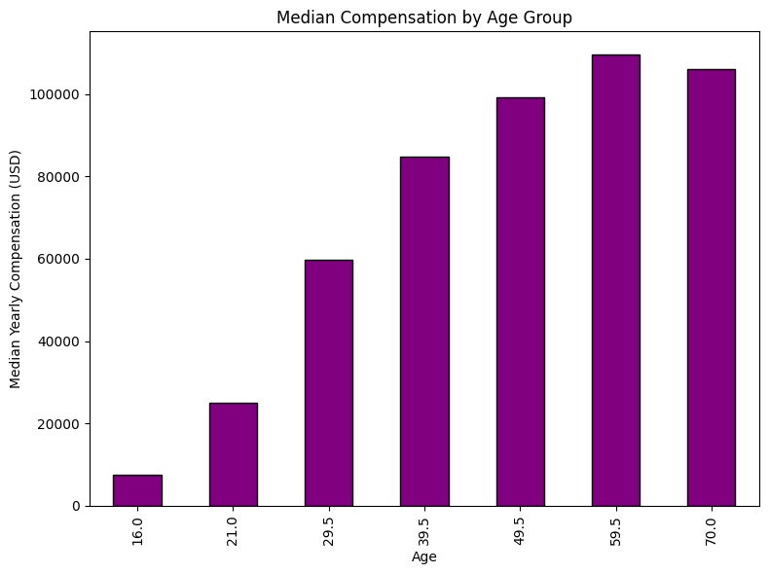
Compensation and Job Satisfaction

Slide 11
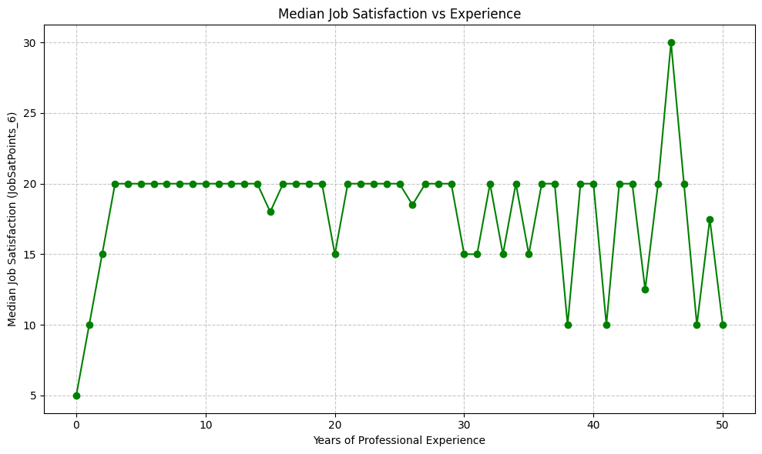
Compensation and Job Satisfaction

Slide 12
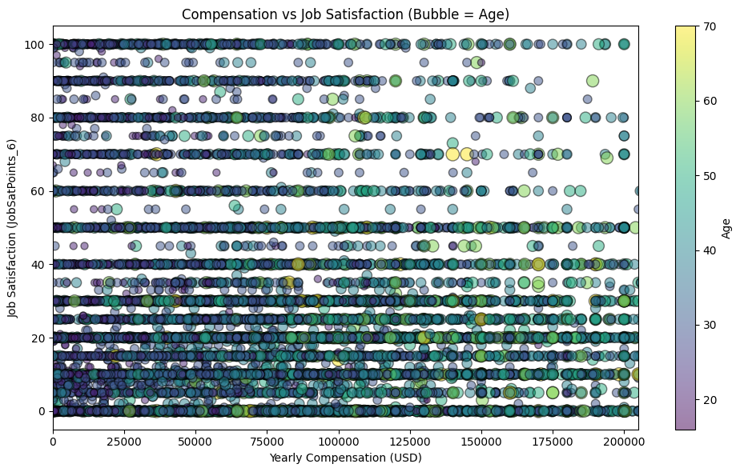
Bubble Plot: Compensation vs Job Satisfaction
Screenshot of dashboard tab 2 goes here

Slide 13

DISCUSSION

