Slide 1

Avani Choudhary, Alessandro D’Urso, Daniel Moran

Slide 2
Concept
Mobile application for those who love to cook
“Social media” type platform to create collaborative cookbooks
For anyone looking for recipes or wanting to share recipes
Intended for college students and young adults who need help in the kitchen
Can also be useful for family units looking to share family recipes

Slide 3
Functional Requirements
Sign-Up/Login for Account
Accounts will be essential to the User Experience
Cookbooks
List Cookbooks
Public/Private
View Cookbooks
See recipes in selected cookbook
Fundamental structure of the application

Slide 4
Functional Requirements (cont’d.)
Recipes
View, create, edit, and share
Explore
Users will be able to browse public-facing Cookbooks to enhance their own cooking abilities, or to contribute to a public book
Search functionality
Liked and Saved Recipes
Distinction between liked and saved
Messaging & Commenting
User interaction is what separates our platform

Slide 5
Functional Requirements (cont’d.)
The boring stuff:
Account & Settings Modification
The user must be able to edit their account and application settings
Examples
Notification Badges
Account Services
Password recovery
Account failure

Slide 6
Non Functional Requirements
Database input sanitization
To prevent errors and attacks
Message encryption
To prevent bad actors from from intercepting messages
Automatic password reset requests
Emails for password resets must be sent automatically

Slide 7
Non Functional Requirements (cont’d.)
Search result time
Results must be returned in less than 500 ms
Uptime
Application must be down no longer than 15 minutes each month
Cookbook storage
Database must be able to support dynamic storage resource allocation

Slide 8
System Constraints
Tool Constraints
Mobile Application Framework Constraint
Apache Cordova
Language Constraints
Backend Framework
HTML5, CSS3, JavaScript
Platform Constraints
Mobile Application Platform
Apache Cordova is platform independent

Slide 9
System Constraints (cont’d.)
Hardware Constraints
Storage Constraints
Set by Amazon Lightsail
User information will be stored in database
Computation Constraints
Set by Amazon Lightsail
Sufficient for this version of application

Slide 10
System Constraints (cont’d.)
Network Constraints
Access Database
Must have access to and query MySQL database for account, user and recipe information
Uploading
Users must be able to upload and share recipes
must be saved to MySQL database
Messaging
Must be able to send and receive messages, and share posted recipes

Slide 11
System Constraints (cont’d.)
Deployment Constraints
Amazon Lightsail Deployment
Will be deployed by Lightsail, which provides a free month of usage
Transition & Support Constraints
End of Life
Project will end at the termination of this course in May
Another team will have to take over and develop the application
Budget & Schedule Constraints
Time Constraints
Application must be completely designed by May 2021
Including a Requirements Document and Design Document
Budget Constraints
No funds available for this project, therefore there is no budget

Slide 12
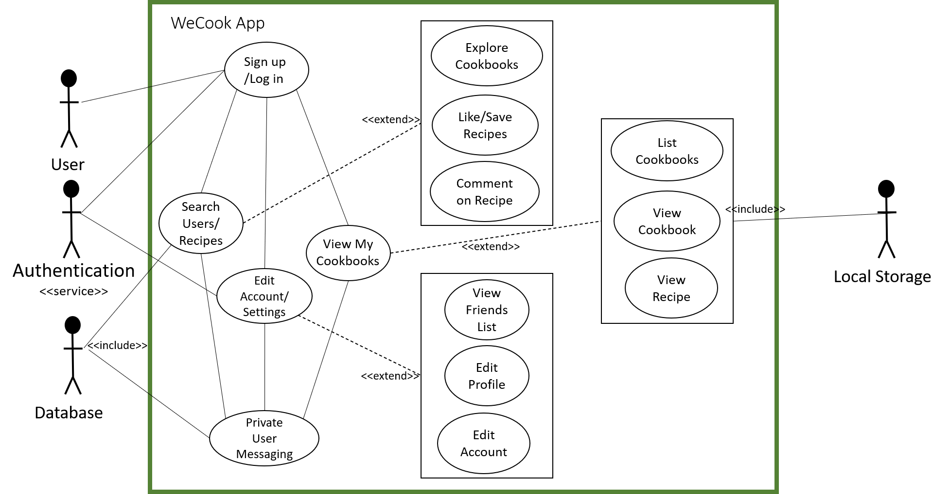
Use Cases and Use Case Diagram

Slide 13
Questions?

